Slide 1
Tuesday 21st April
Good Morning Primary 4!
French: Bonjour la class! Ca Va?
Quelle est la date aujourd’hui?
Aujourd’hui cest Mardi 21st Avril 2020
Now watch the months of the year song in French :
https://www.youtube.com/watch?v=7_u2SigckNQ

Slide 2
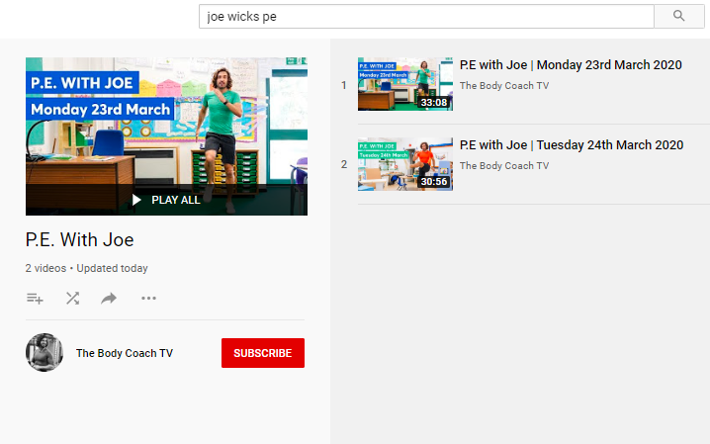
Health and Wellbeing
LI: We are learning to move our body well, exploring how to manage and control it, finding out how to use and share space.
P.E with Joe- Tuesday 21st April Video
(he is nearly as fun as Mr Martin, not quite, but nearly)
https://www.youtube.com/playlist?list=PLyCLoPd4VxBvQafyve889qVcPxYEjdSTl

Slide 3
Spelling slide 1 (Tom Fletcher & Roald Dahl groups)
LI: I can use strategies to help me spell common words
S.C. (what I need to do to be successful)
Find the ‘Range of Strategies’ help sheet in your work pack (it is on the following slide if you can’t find it!)
Today’s challenge is to use some of these strategies to help you spell your common words.
I will give you some examples in the following slides so that you know how to lay out the work in your jotters.

Slide 4
Spelling slide 2 (Tom Fletcher & Roald Dahl groups)
COMMON WORDS
triangle
rectangle
different
satisfied
juice
stopped
heard
their
Christmas
Easter
Season
birthday
centre
circle
square

Slide 5
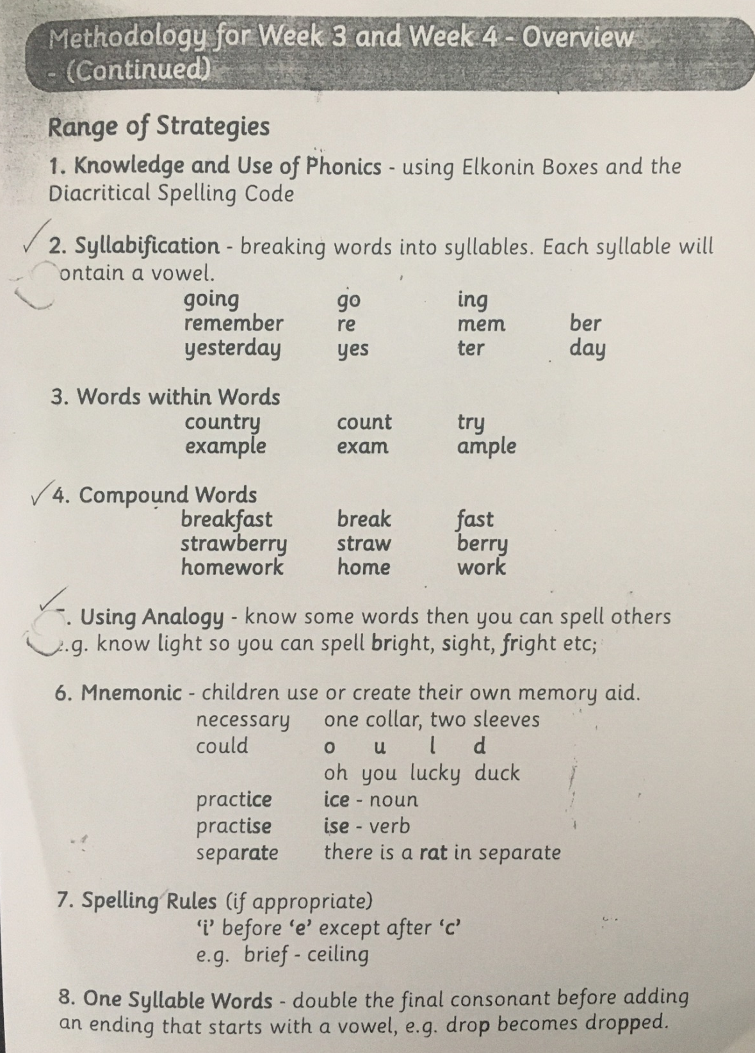

Slide 6
Spelling slide 4 (Tom Fletcher & Roald Dahl groups)
LI: I can use strategies to help me spell common words
EXAMPLES:
triangle = tri an gle (syllabification)
heard = hear d (words within words)
birthday = birth day (compound words)
Try and use as many different strategies as you can!

Slide 7
Spelling (David Walliams Group)
Practise a set of common words, using the strategy shown in the picture on this slide.
Remember, you use this strategy in class every morning.
Your common words are in your folder, which your parents collected from school before we closed.
Example of how to practise your common words!

Slide 8
Reading
L.I I am using different reading strategies to help me understand my book
Find your group’s reading task on Teams!
If you are struggling to access it, there is a different reading task on the next slide.

Slide 9
Reading
L.I I am using different reading strategies to help me understand my book
Personal reading – choose any book / magazine / article online that you enjoy and read it for 20 minutes or more.
Challenge – draw a picture of one of the character’s from your book. Having read about them, what do you think they will look like?

Slide 10
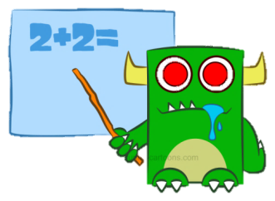
Numeracy Activities
LI: I am learning to estimate and measure lengths to the nearest centimetre
S.C. (what I need to do to be successful)
Task 1: READ Teejay p. 177
Task 2: complete Teejay p. 178
Finished?
- Find a ruler or measuring tape and measure some things around your house to practise!
Play some online maths games of your choice.

Slide 11
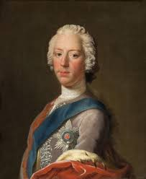
Topic: Great Scots! Bonnie Prince Charlie
“Hi, my name is Charles Edward Stuart but most people know me as Bonnie Prince Charlie. Why do you think they call me this?
I am angry because my father should have been the King of England and Scotland but he was robbed of this title! Now, I want it back!
Can you find out anything else about me by watching the YouTube clip below? I have written some questions for you to answer on the next slide. Listen to the clip carefully and listen several times if you don’t get the answers straight away!”
https://www.youtube.com/watch?v=-Vk4SW1CmtM

Slide 12
Topic: Great Scots! Bonnie Prince Charlie
Which King was sent away to France because he was a Catholic? Was it Charles I or James II?
What country was James II sent to? Was it France or Ireland?
What were the rebels who supported James II called? Clue = Jaco…
What year did Bonnie Prince Charlie come to Scotland? 1745 or 1545?
Was Charlie the son or the grandson of James II?
Who said they would support Charlie’s rebellion? The French or the Spanish?
Charlie’s rebellion was crushed by the British army near Inverness during the battle of what?

Slide 13
Feel free to leave comments / questions on Teams throughout the day and I will try my best to get back to you. Enjoy your day, Primary 4!

