Slide 1
Tuesday 21st of April
Good Morning Primary 3!
Bonjour la class! Ca Va?
Can you say todays date in French?
Aujourd’hui c’est (Tuesday) 21st (April) 2020
Watch ‘Quel temps fait il?” and see if you can describe todays weather.
Begin by saying - Aujourd’hui c’est……
https://www.youtube.com/watch?v=eBvJVOuBPXI

Slide 2
Literacy: Spelling
LI: We are learning to read and spell this weeks common words.
Sing ABC, abc and vowel song.
See home learning packs for common words and activities.
Introduce new common words
Identify single sounds and phoneme blends in the words.
Spell each word independently – look, say, cover, write, check

Slide 3
Literacy: Reading
We have signed up the infant department to this online reading resource.
To access, follow the link and enter the username and password below.
https://www.oxfordowl.co.uk/?sellanguage=en&mode=hub
Username – stantsps3
Password – primary3
Click the ‘My Class Login’ button and type the above username and password.
Go to ‘My Bookshelf’ and enter your child’s age and perhaps a genre that they may find interesting.
Click on a book and begin reading.
We encourage you to try and read a little bit every day.
*You could also read a book from your house if you would prefer*

Slide 4
Numeracy – Warm Up
LI: We are learning to identify odd and even numbers.
Can you read the following numbers aloud to an adult?
Can you work out what ones are odd and what ones are even?
*Extension Task* Can you put the numbers in order from smallest to biggest?
365
81
900
50
836
24
42
601

Slide 5
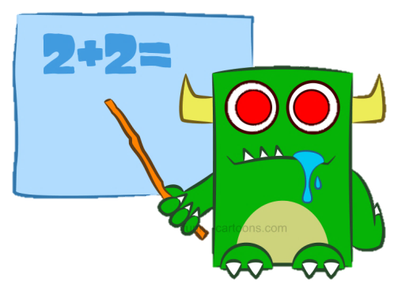
Numeracy Activities
LI: We are learning to count in 3s.
LOUD and quiet counting
Task
Count from 1-30
Whisper numbers which are not in the 3 times table
Shout (say loudly) numbers which are in the 3 times table
1 2 3 4 5 6 7 8 9 10
Challenge – Can you try it counting backwards?
3, 6, 9, 12, 15, 18, 21, 24, 27, 30

Slide 6
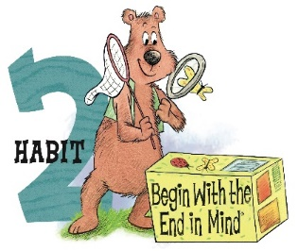
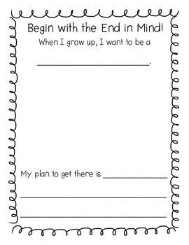
Health and Wellbeing Leader in Me
LI: We are learning to plan ahead and set goals for our futures.
Habit 2 – Begin with the end in mind
Think about what you would like to be when you grow up, how are you going to get there?
Activity – Can you please copy and complete this worksheet in the back of your jotter.

Slide 7
Enjoy the rest of your day Primary 3!

