Slide 1
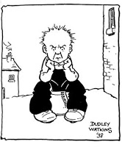
Tuesday 21-4-20
Good Morning Everyone!

Slide 2
Today’s Timetable
Morning Exercise
French
Morning Starter
Maths Lesson
Spelling
Literacy Task
Health and Well-being
Topic
Prayer

Slide 3
Daily Exercise
Try to do some form of exercise to start the day. This could be a walk or run with a family member or a work-out in the house. Check with your parents that it is ok for you to do this.
Why not try this 5min workout with the Body Coach :-
https://www.youtube.com/watch?v=pnKCGY9ZocA

Slide 4
A little bit of French to start the day
Click on the link below to sing along to the months of the year song in French?
https://www.youtube.com/watch?v=7_u2SigckNQ
Can you write today’s date in French?
Quelle est la date aujourd’hui?
C’est …………………….. [eg. C’est lundi vingt avril]
Can you also write today’s weather in French?
Quel temps fait-il?
Il pleut/ Il fait beau/ Il fait froid/ Il y a du vent/
Il fait mauvais/ Il y a des nuages/ Il y a du soleil

Slide 5
Morning Starter
Today, everyone’s morning starter is 15-20 minutes on
Times Tables Rockstars
If you normally do IDL Maths, please do this also for 15-20mins.

Slide 6
Maths Lesson
L.I. - We are revising how to divide any decimal number by a multiple of 10,100 or 1000.
S.C. – To be able to divide by 10,100 or 1000
- To be able to divide by a multiple of 10,
100 or 1000
- To be able to answer problem-solving
questions involving dividing by a multiple
of 10,100 or 1000.
Task :- Please see the attached sheet for your task.

Slide 7
Spelling
Today we’re looking again at the new spelling list.
Choose 5 different words from your spelling list and write each word out 3 times. You can do this using ‘dot writing’, ‘pyramid spelling’ or another spelling task of your choice. Remember to use the most suitable spelling strategy to spell each word eg. syllables, spelling rule, mnemonic etc.

Slide 8
Literacy Lesson
Today, your task is to listen to an interview with the author, Anne Fine. Click on the link:- https://www.bbc.co.uk/teach/school-radio/english-meet-the-authors-anne-fine/zfrnxyc
Extra task: Using a piece of A4 paper, create a short factfile/biography of Anne Fine.
If you have log-in details for IDL please continue to do 20 – 30mins Mon-Fri.

Slide 9
Health and Wellbeing
Today, we are going to learn about recognising our skills and achievements. This will help to prepare you for your next stage in your life and learning e.g. starting high school. We will look at areas for development in our next lesson.
Task : - Draw a picture of yourself. Around your picture write some of your strengths eg. hard-working, kind, good listener etc.
Under your picture write a short paragraph about
the skills and achievements you have gained both
at school and outwith school. This should be a
positive paragraph and should only include
strengths and achievements, not weaknesses.

Slide 10
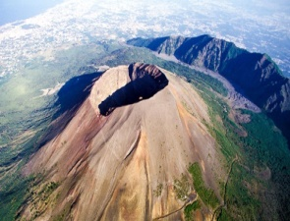
Types of volcanoes
We have covered just about everything in our Natural Disasters topic. However we didn’t get round to learning about the 3 different types of volcanoes. Watch the clip below to learn about them
https://www.youtube.com/watch?v=3Jxeh-yAXek
Task:- Divide an A4 piece of paper into 3 sections. Use each section to give a definition of each type of volcano and give an example of each eg. Mount St Helens is a stratovolcano. You can use pictures/diagrams to enhance your definition.

Slide 11
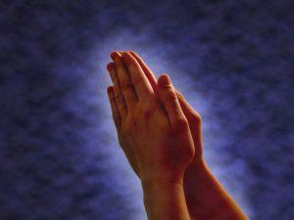
A prayer to end our day
Please take a few moments to say a prayer for all the doctors, nurses and care staff who are working very hard to save lives.

Slide 12
Well done!
Well done for working hard today!

