Slide 1

Tuesday 21st of April
Good Morning Primary 2/3!
French: Bonjour la class! Ca Va?
Quelle est la date aujourd’hui?
Aujourd’hui cest M____ 21st A____ 2020
Now practice counting to 20 in French with this song:
https://www.youtube.com/watch?v=UsEz58BblMY

Slide 2



Literacy
LI: We are learning to read and spell this weeks common words.
Sing ABC, abc songs.
Common words:
Stage 2 words- home, more, school, Mrs, five, time , life , line
Stage 3 words- walk, water, picture, once, until
  Write each word in your jotter 2 times- once normal, once in bubble writing

Slide 3

Reading
https://www.oxfordowl.co.uk/?sellanguage=en&mode=hub
username: stantsps
password:homelearning
Using your online reading book from yesterday can you complete the read to write task below in your jotter.
2 letter words | page | 3 letter words | page | 4 letter words | page | 5 or more letter words | page

Slide 4
Numeracy – Warm Up
LI: We are learning to count in multiples of 3
Choral counting: You will need to do this with an adult.
Adult: Clap 1,2
Child: Say 3
Adult: Clap 4,5
Child: Say 6
And so on, up to 30.
**If your child can do this with the clap and no words, you can reduce the claps to a silent action, like a finger point for each count. So the only sound should be your child saying every third number up to 30 whilst they watch your silent point for the numbers in between.
3 6 9 12 15 18 21 24 27 30

Slide 5
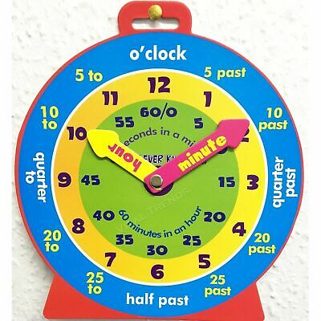
P2 Maths Activities
L.I – To tell the time on an analogue and digital clock using the terms half past, quarter past and o’clock.
Watch - https://www.bbc.co.uk/bitesize/clips/zbc2y9q
Time workbook – Complete this workbook
page found in your home
learning pack.
Play – https://teachingtime.co.uk/draggames/sthec1.html

Slide 6
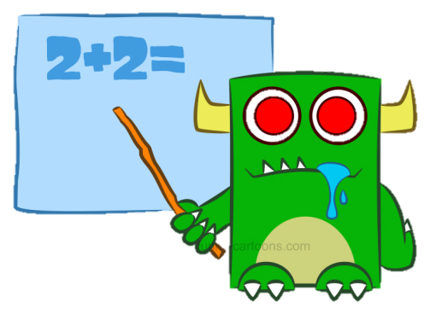
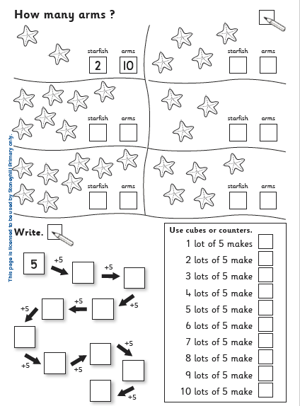
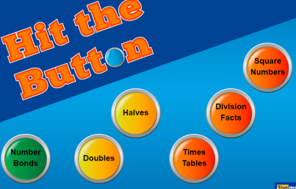
P3 Numeracy Activities
LI: To develop multiplication strategies.
Multiplication Workbook
Please do this worksheet in your booklet:
Topmarks– 5x table hit the button
https://www.topmarks.co.uk/maths-games/hit-the-button

Slide 7
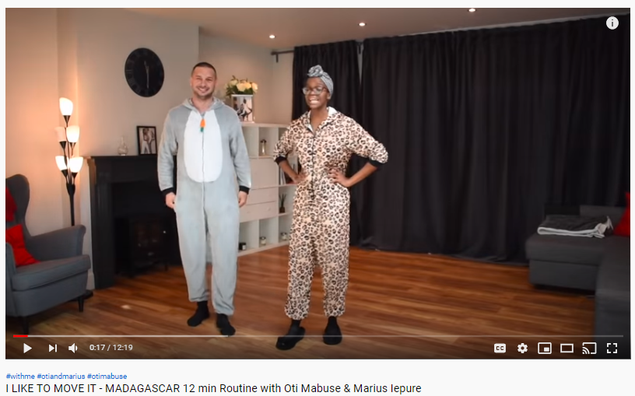
Health and Wellbeing
LI: To identify different features of dance and practise and perform steps and routines
Watch
Oti Mabuse- I like to move it- Madagascar
https://www.youtube.com/watch?v=aACgMV9_FmQ

Slide 8
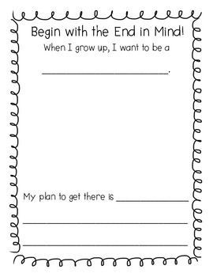
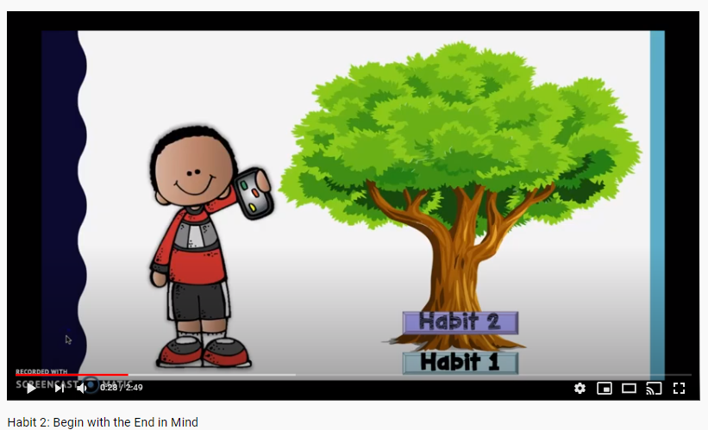
Leader in Me
LI: To plan ahead and set goals for myself.
“Begin with the end in mind”
Watch the video below
https://www.youtube.com/watch?v=8KHH-6vwl-I
Task-Using a page in your jotter, copy and complete this template opposite → →

Slide 9

I hope you have enjoyed your lessons today. It would be lovely to hear how you got on.
Enjoy the rest of your day Primary 2/3!

