Slide 1

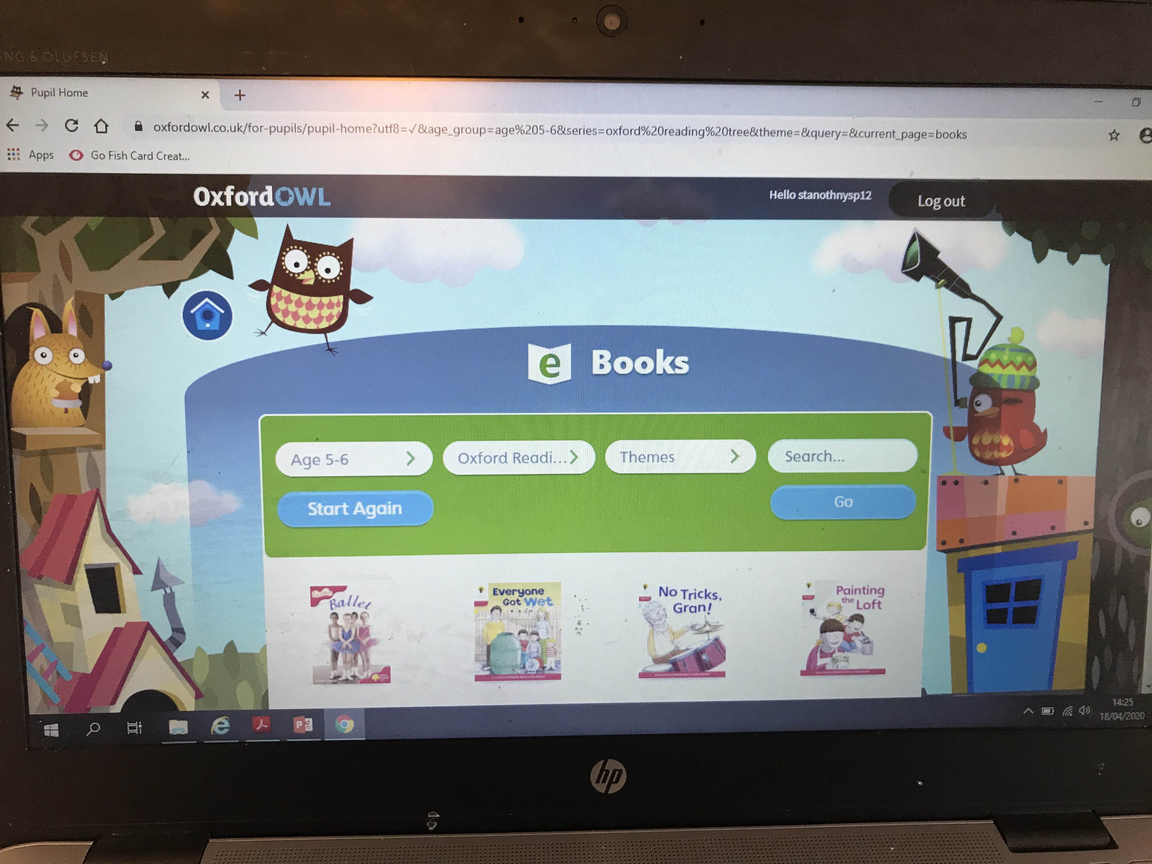
Reading
https://www.oxfordowl.co.uk/?sellanguage=en&mode=hub
We have signed up the infant department to this online reading
resource. To access, follow the above link and type in the username
and password below.
username: stanothnysp12
password: Homelearning*1
Your can log in using this username and password by clicking on the 'my class login' button on the oxford owl site
Go to free ‘ebook library’ and select your child's age or colour coded reading book band (this can be found on the back of one of your child's reading books). You can then select a reading book for your child to read aloud.
We would encourage you to try to read one book a week and revisit it each day.

