Slide 1
Monday 20th April
Good Morning Primary 4!
French: Bonjour la class! Ca Va?
Quelle est la date aujourd’hui?
Aujourd’hui cest Lundi 20th Avril 2020
Now watch the months of the year song in French :
https://www.youtube.com/watch?v=7_u2SigckNQ

Slide 2
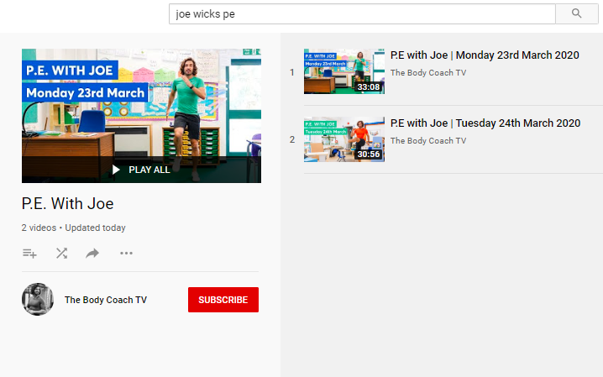
Health and Wellbeing
LI: We are learning to move our body well, exploring how to manage and control it, finding out how to use and share space.
P.E with Joe- Monday 20th April Video
(he is nearly as fun as Mr Martin, not quite, but nearly)
https://www.youtube.com/playlist?list=PLyCLoPd4VxBvQafyve889qVcPxYEjdSTl

Slide 3
Spelling (Tom Fletcher & Roald Dahl groups)
LI: I can recognise and spell common words
S.C. (what I need to do to be successful)
We are starting a new list of common words!
Your task is to look at the list of common words on the next slide and write them in your jotters using a fun spelling strategy.
Look at the spelling menu for ideas! You can find it in your work folder or see the following slides.

Slide 4
Spelling (Tom Fletcher & Roald Dahl groups)
LI: I can recognise and spell common words
triangle
rectangle
different
satisfied
juice
stopped
heard
their
Christmas
Easter
Season
birthday
centre
circle
square

Slide 5
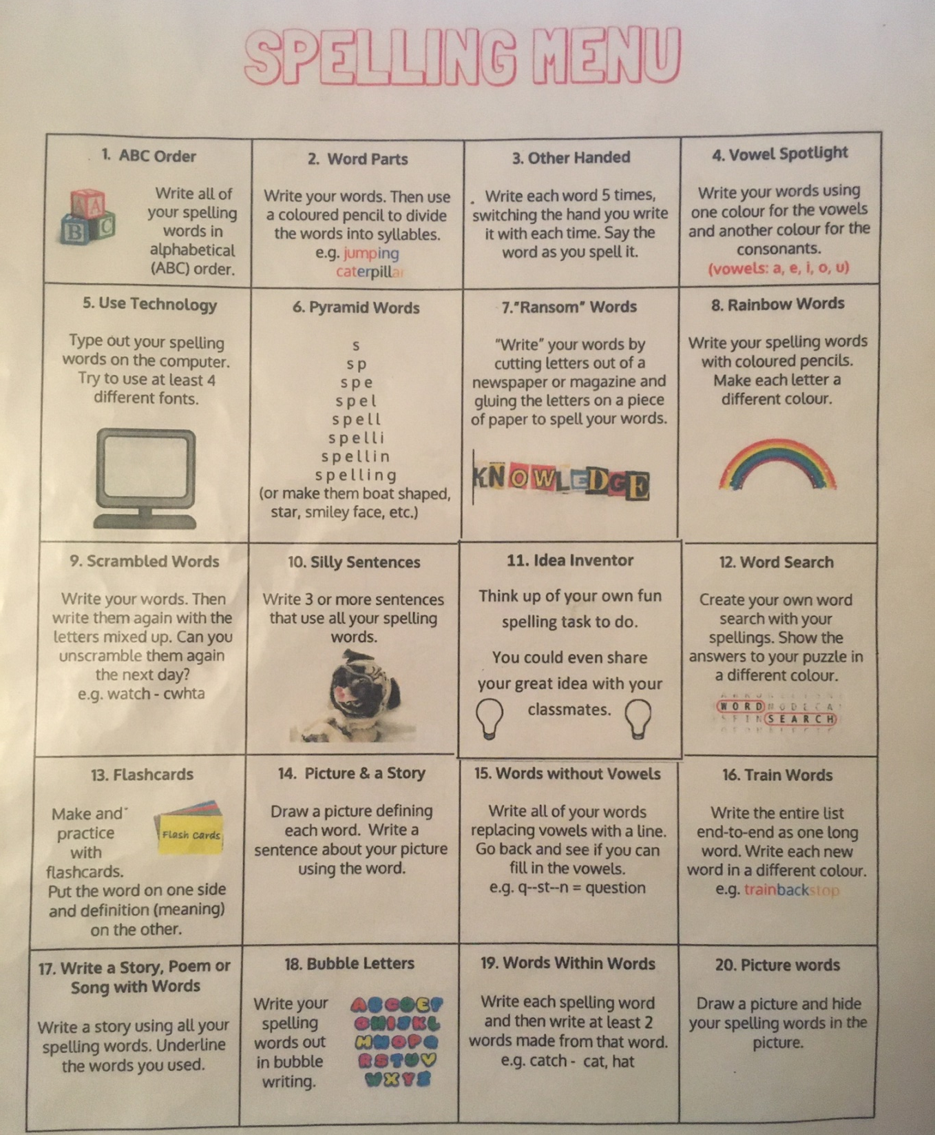

Slide 6
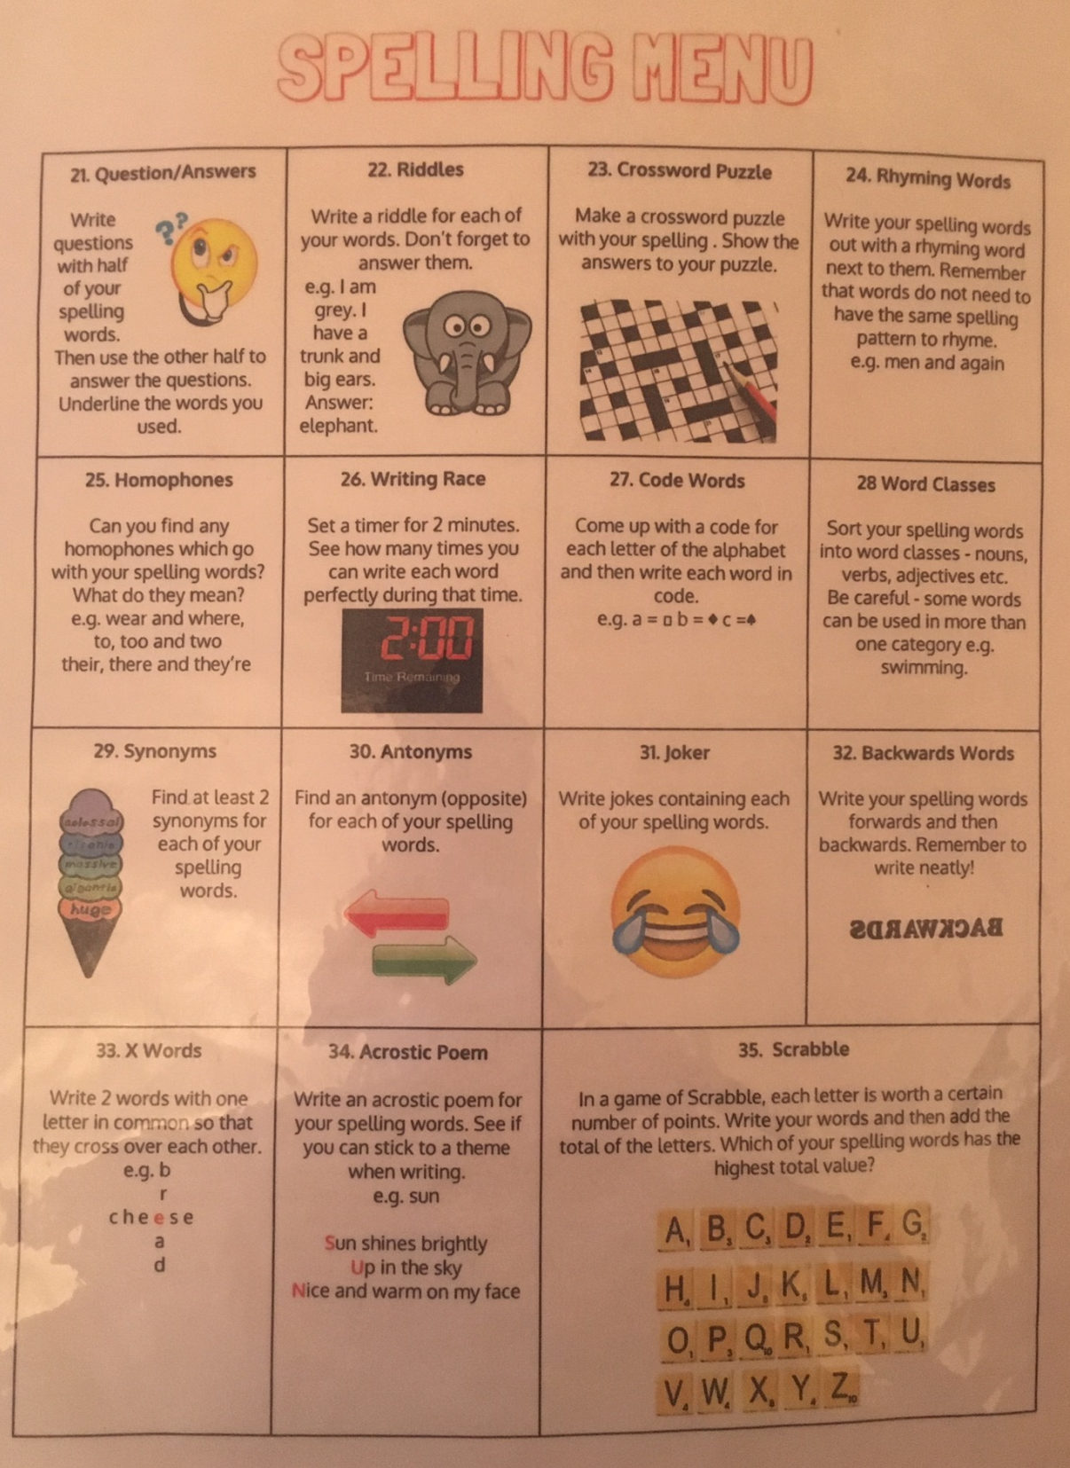

Slide 7
Spelling (David Walliams Group)
Practise a set of common words, using the strategy shown in the picture on this slide.
Remember, you use this strategy in class every morning.
Your common words are in your folder, which your parents collected from school before we closed.
Example of how to practise your common words!

Slide 8
Reading
L.I I am using different reading strategies to help me understand my book
Find your group’s reading task on Teams! (Roald Dahl group – see the Teams page / Blog for a link to ‘Epic Books’ – Mrs Moffat wrote this on the message board this morning. You will need to use this to access your reading material)
If you are struggling to access it, there is a different reading task on the next slide.

Slide 9
Reading
L.I I am using different reading strategies to help me understand my book
Personal reading – choose any book / magazine / article online that you enjoy and read it for 20 minutes or more.
Challenge – write a description of one of the characters? Include things like what they look like, their name, any other things you have found out about them.

Slide 10
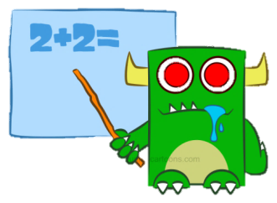
Numeracy Activities
LI: I am learning to estimate and measure lengths to the nearest centimetre
S.C. (what I need to do to be successful)
Task 1: Teejay activity – length:
pp. 175 – 176.
Remember – when we estimate a length, we are taking an educated guess.
Finished?
- Find a ruler or measuring tape and measure some things around your house to practise!
Play some online maths games of your choice.

Slide 11
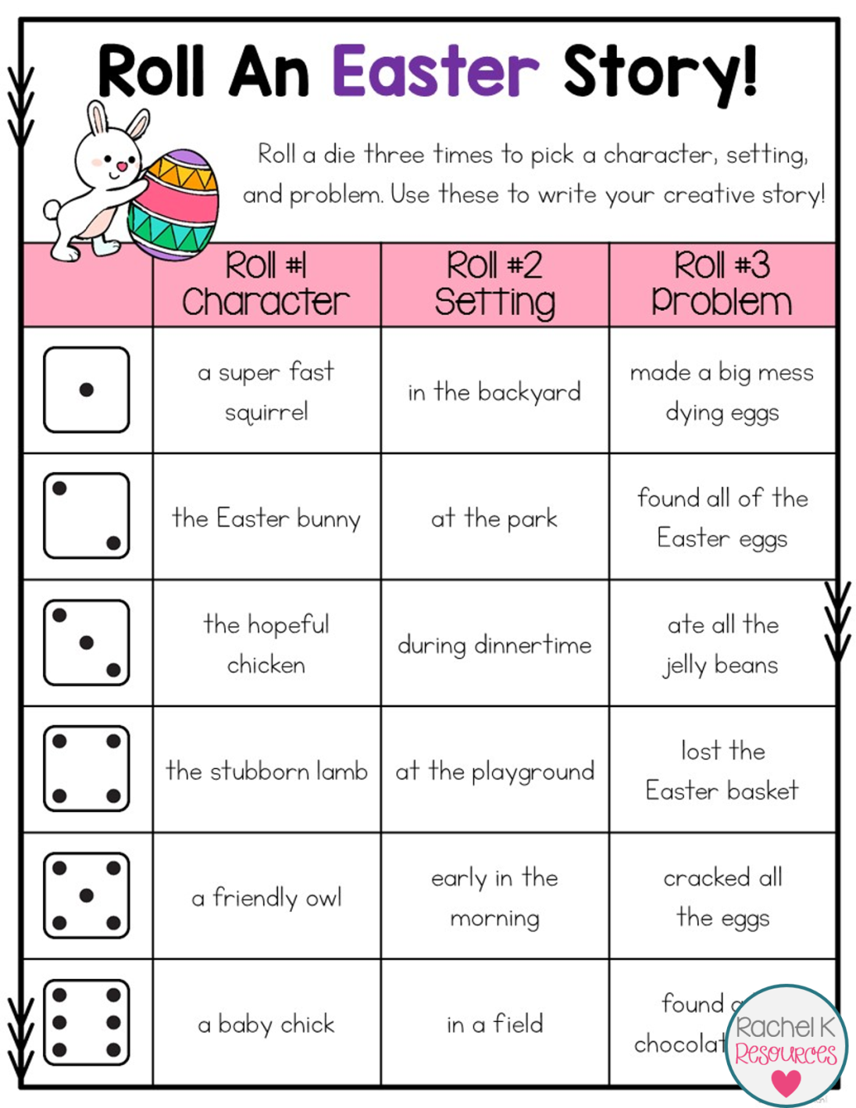
Story Writing
The link below will take you to a virtual dice. Let the dice decide the character, setting and problem in your story!
For example, if you roll a 3 then a 5 then a 1 your story will be about…
A hopeful chicken early in the morning who makes a big mess dying eggs!
Write a whole story and share it on Teams!
https://www.google.com/search?source=hp&ei=sq-cXs7bKPKJjLsPwrOBwAY&q=virtual+dice&oq=virtual+dice&gs_lcp=CgZwc3ktYWIQAzIFCAAQgwEyBQgAEIMBMgIIADICCAAyAggAMgIIADICCAAyAggAMgIIADICCABQjwhYzRhg-hloAHAAeACAAZcBiAHrDJIBBDAuMTKYAQCgAQGqAQdnd3Mtd2l6&sclient=psy-ab&ved=0ahUKEwjO_L-_pfXoAhXyBGMBHcJZAGgQ4dUDCAk&uact=5&safe=active&ssui=on

Slide 12
Feel free to leave comments / questions on Teams throughout the day and I will try my best to get back to you. Enjoy your day, Primary 4!

