Slide 1
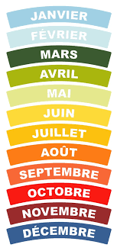
Monday 20th of April
Good Morning Primary 3!
French: Bonjour la class! Ca Va?
Can you say todays date in French?
Aujourd’hui c’est (Monday) 20th (April) 2020
Let’s refresh our memory and sing the French
months of the year song:
https://www.youtube.com/watch?v=7_u2SigckNQ
Notes:
Hello c

Slide 2
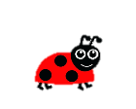
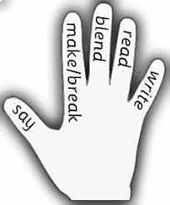
Literacy
LI: We are learning to recognise, read and make words containing the ‘ough’ phoneme.
Sing ABC, abc and vowel song.
Read the phoneme story and highlight the phoneme words.
Watch this video to get some examples of words with the ‘ough’ sound: https://www.youtube.com/watch?v=WGERKJYjkQI
Complete the phoneme word maker.

Slide 3
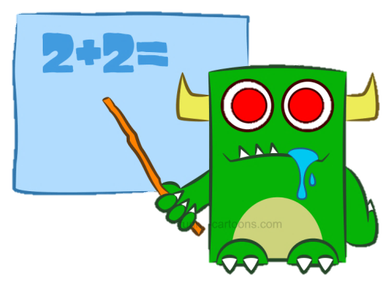
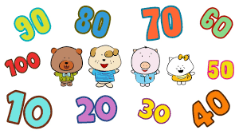
Numeracy – Warm Up
LI: We are learning to count forwards and backwards.
Choose 2 actions (for example – clap hands and snap fingers)
Count forwards and backwards in 5s to 50.
Count forwards and backwards in 10s to 100.
Count forwards and backwards in 100s to 1000.

Slide 4
Numeracy Activities
LI: We are revising our division strategies.
Since it has been a few weeks since we last looked at division, I have set a few questions for you to work out.
Remember to use your division strategies to help you work out the answers!
Share 25 pencils equally between 5 pupils.
30 divided by 3 equals ……
12 divided by 4 equals ……
Half of 16 equals ……
Share 27 grapes equally between 3 pupils

Slide 5
Health and Wellbeing
LI: We are learning to identify different features of dance and perform steps and routines.
Madagascar Dance Class with Oti Mabuse
https://www.youtube.com/watch?v=SLNk_sFY8rM
Miss McLean really enjoys taking part in Oti’s dance classes.
Why not try and get your family to join in with you! ☺

Slide 6
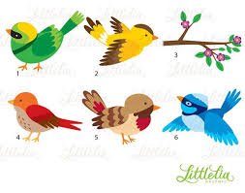
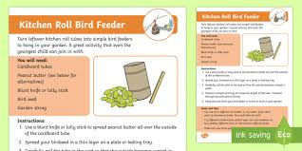
Topic
LI: We are learning to make our own bird feeders.
Before the Easter break, we spent some time spotting different types of birds in our gardens. Today, I thought it would be nice to make our own bird feeders for the birds in our gardens.
You might need an adult to help you!
Attached to this blog post are 3 sets of instructions to help you make your own bird feeders. You can choose what one to complete.
If you manage to make a bird feeder let me know in the comments or send a picture to our Twitter page!
If you cannot make the bird feeder you could read the instructions to an adult as reading practise. Look at the language used, do you recognise any words from when we wrote our own instructions in class?

Slide 7
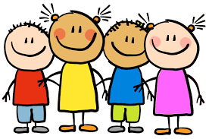
I hope you all had a great Easter holiday with your families! Enjoy the rest of your day Primary 3 ☺

