Slide 1
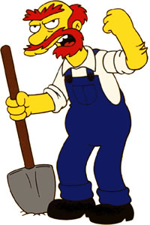
Monday 20-4-20
Good Morning Everyone!

Slide 2
Today’s Timetable
Morning Exercise
French
Morning Starter
Maths Lesson
Spelling
Literacy
R.E.
P.E.
Prayer

Slide 3
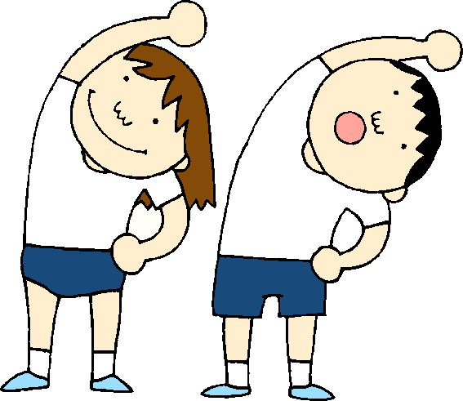
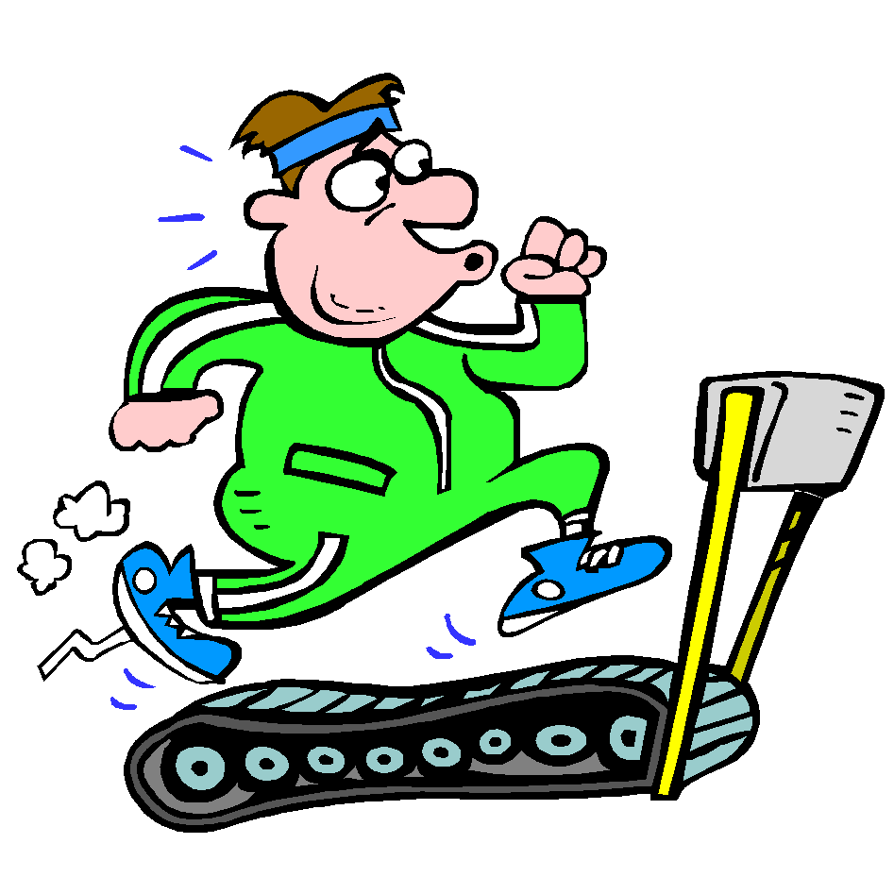
Daily Exercise
Try to do some form of exercise to start the day. This could be a walk or run with a family member or a workout in the house. Check with your parents that it is ok for you to do this.
Why not try the 8 minute workout https://www.youtube.com/watch?v=uqLNxJe4L2I
Or join the Body Coach live at 9am

Slide 4
A little bit of French to start the day
Click on the link below to sing along to the days of the week song in French?
https://www.youtube.com/watch?v=Lpwf5N0rfVE
Can you write today’s date in French?
Quelle est la date aujourd’hui?
C’est ……………………..
Can you also write today’s weather in French?
Quel temps fait-il?
Il pleut/ Il fait beau/ Il fait froid/ Il y a du vent/
Il fait mauvais/ Il y a des nuages/ Il y a du soleil

Slide 5
Morning Starter
Today, everyone’s morning starter is 15-20 minutes on
If you have log-in details for IDL Maths please continue to access this as normal.
SUMDOG

Slide 6
Maths Lesson
L.I. - We are revising how to multiply any decimal number by a multiple of 10,100 or 1000.
S.C. – To be able to multiply by 10,100 or 1000
- To be able to multiply by a multiple of 10,
100 or 1000
- To be able to answer problem-solving
questions involving multiplying by a multiple
of 10,100 or 1000.
Task :- Please see the attached sheet for your task.

Slide 7
Spelling
Today we’re looking at new spelling lists
Choose 5 words from your next spelling list and write each word out 3 times. You can do this using ‘dot writing’, ‘pyramid spelling’ or another spelling task of your choice. Remember to use the most suitable spelling strategy to spell each word eg. syllables, spelling rule, mnemonic etc.
Super spellers – as usual please choose an extra 5 words from the 250 Most Commonly Misspelt words list.

Slide 8
Literacy
Today, your task is to listen to an interview with the famous author, Michael Morpurgo. https://www.bbc.co.uk/teach/school-radio/english-meet-the-authors-michael-morpurgo/z6n78xs
Extra task: Using a piece of A4 paper, create a short factfile/biography of Michael Morpurgo.
If you have log-in details for IDL please continue to do 20 – 30mins Mon-Fri.

Slide 9
R.E.
In the aftermath of Jesus’ death, some of his disciples left Jerusalem for a town called Emmaus. They were sad at the loss of their beloved friend but also scared and frightened that they would also be put to death.
Task :- If you have a bible at home, read
Luke 24:13-35 and watch this clip:-
https://www.youtube.com/watch?v=dmmTWQn95xQ
Task:- Create a storyboard/comic strip of the events on the Road to Emmaus.

Slide 10
P.E.
Click on the following link for today’s P.E. session
https://www.youtube.com/watch?v=cABsHbhqv7Q
Alternatively, join family members for a walk, run or cycle.

Slide 11
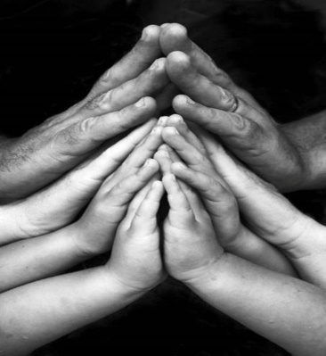
A prayer to end our day
Take a few moments to say a short prayer. You might like to dedicate your prayer to someone in your family who is unwell or who just needs your prayers.

Slide 12
Well done!
Well done for working hard today!

