Slide 1

Monday 20th of April
Welcome Back Primary 2/3!
I hope you and your families all had a fun, relaxing and safe Easter break and that you are looking forward to lots more learning activities whilst we remain at home!

Slide 2

Monday 20th of April
French: Bonjour la class! Ca Va?
Quelle est la date aujourd’hui?
Aujourd’hui cest Lundi 20th Avril 2020
Listen to the French Days of the Week Song and sing along:
https://www.youtube.com/watch?v=RL_5PvOMRdw

Slide 3


Literacy
Stage 2 Phonics: Consolidation Week
LI: We are learning to recognise, read and make words containing the o-e & i-e phonemes.
Sing ABC, abc with Mr Mac . https://www.youtube.com/watch?v=Emb2yvwAHtc
Play Forest Phonics Game for the two sounds above. https://www.ictgames.com/mobilePage/forestPhonics/index.html
In your jotter choose 2 o-e words and 2 i-e words, and write a sentence for each. (4 sentences)
Eg. The coke was so fizzy in my mouth.
On the windy day I went out to fly my kite.

Slide 4
Literacy
Stage 3 Phonics:
LI: We are learning to recognise, read and make words containing the ough phoneme.
Sing ABC, abc with Mr Mac . https://www.youtube.com/watch?v=Emb2yvwAHtc
Read the ough phoneme story and highlight the phoneme words.
Complete the phoneme word maker- Cut up all the letter boxes and use them to make the words listed at the bottom of the sheet.

Slide 5
Literacy: Reading
We have signed up the infant department to this online reading resource.
To access, follow the link below and type in the username and password.
https://www.oxfordowl.co.uk/?sellanguage=en&mode=hub
.
Username: stantsps
Password: homelearning
Your can log in using this username and password by clicking on the 'my class login' button on the oxford owl site
Go to free ‘ebook library’ and select your child's age or colour coded reading book band (this can be found on the back of one of your child's reading books). You can then select a reading book for your child to read aloud.
We would encourage you to try to read one book a week and revisit it each day.

Slide 6
Numeracy – Warm Up
LI: We are learning to count in multiples of 3
Choral counting: You will need to do this with an adult.
Adult: Say 1, 2
Child: Say 3
Adult: Say 4, 5
Child: Say 6
And so on, up to 30.
**As your child gets better at this, you can replace saying the number with claps. (eg clap, clap, 3, clap, clap, 6, clap, clap, 9)
3 6 9 12 15 18 21 24 27 30

Slide 7
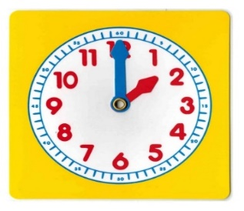
P2 Maths Activities
LI: To tell the time on an analogue and digital clock using the terms half past, quarter past and o’clock.
Warm up - https://www.youtube.com/watch?v=5xrobx7ivgi
Time workbook – Complete ‘What time is it?’ p1&2 in the time workbook found in your home learning pack.
Play – BBC Bitesize: How to tell the time game
https://www.bbc.co.uk/bitesize/topics/zm4k7ty/articles/zbjbbdm

Slide 8
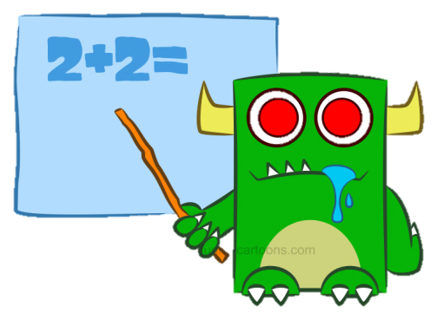
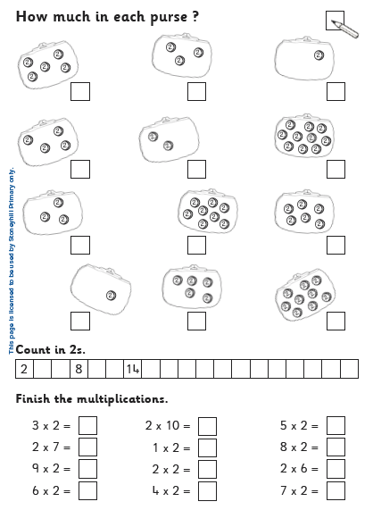
P3 Numeracy Activities
LI: To develop multiplication strategies
Multiplication Workbook
Please do the next page of your booklet- Coin Purses counting in 2’s
It should be the page that is pictured opposite.
Tomorrow we will look at multiples of 5.
IXL Maths: Multiplication Arrays
https://uk.ixl.com/math/year-2/write-multiplication-sentences-for-arrays

Slide 9
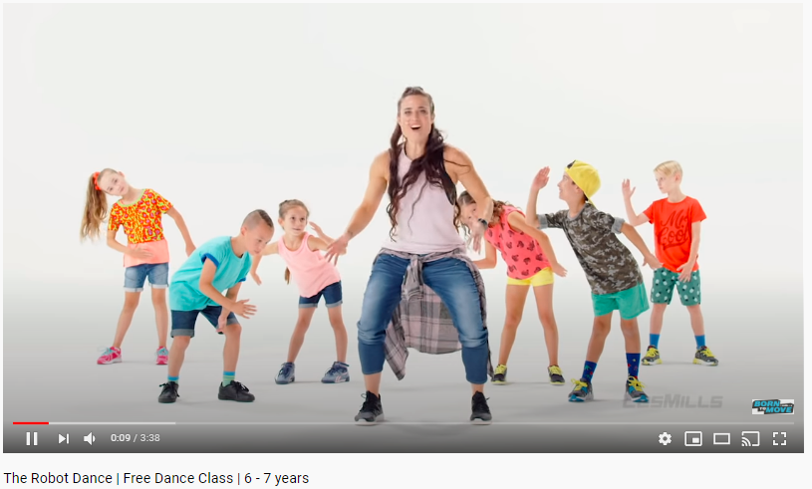
Health and Wellbeing
LI: To identify different features of dance and practise and perform steps and routines
Watch
The Robot Dance on Youtube
https://www.youtube.com/watch?v=B-ulfVFtFBs

Slide 10
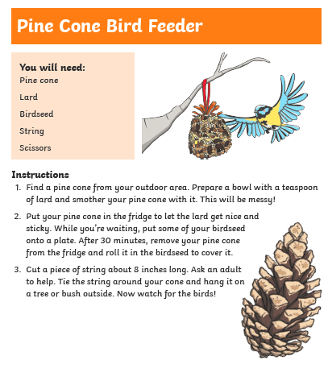
Topic- Spring
LI: To make a birdfeeder
Attached to today’s Blog post are three make your own birdfeeder instructions.
A pine cone one
Toilet roll one
Yoghurt pot one
You can choose which one you would like to make. If you do not have the things you need to make it today, that’s fine. Remember there is no pressure to do everything suggested. You can always make it another day or invent your own way to make a bird feeder using what you do have at home.

Slide 11

Enjoy the rest of your day Primary 2/3!

