Slide 1
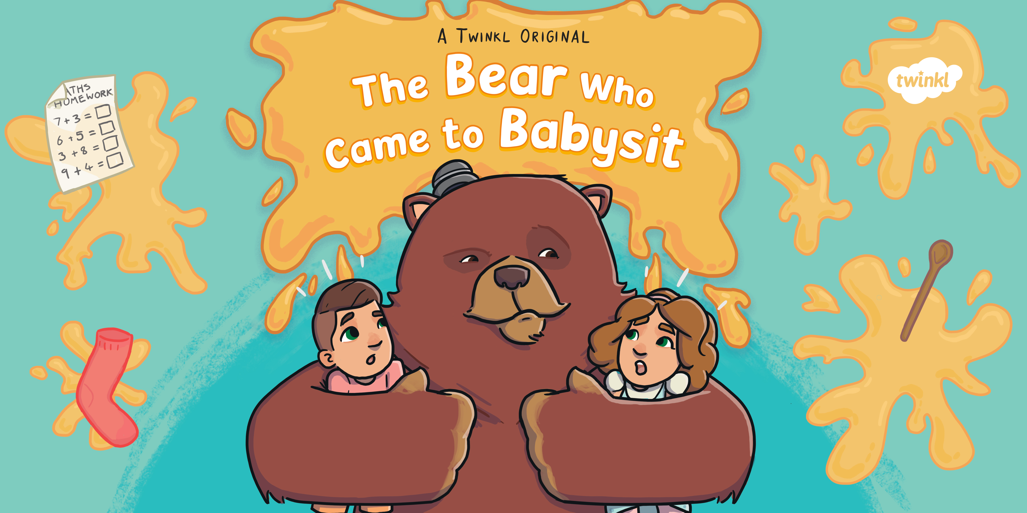

Slide 2
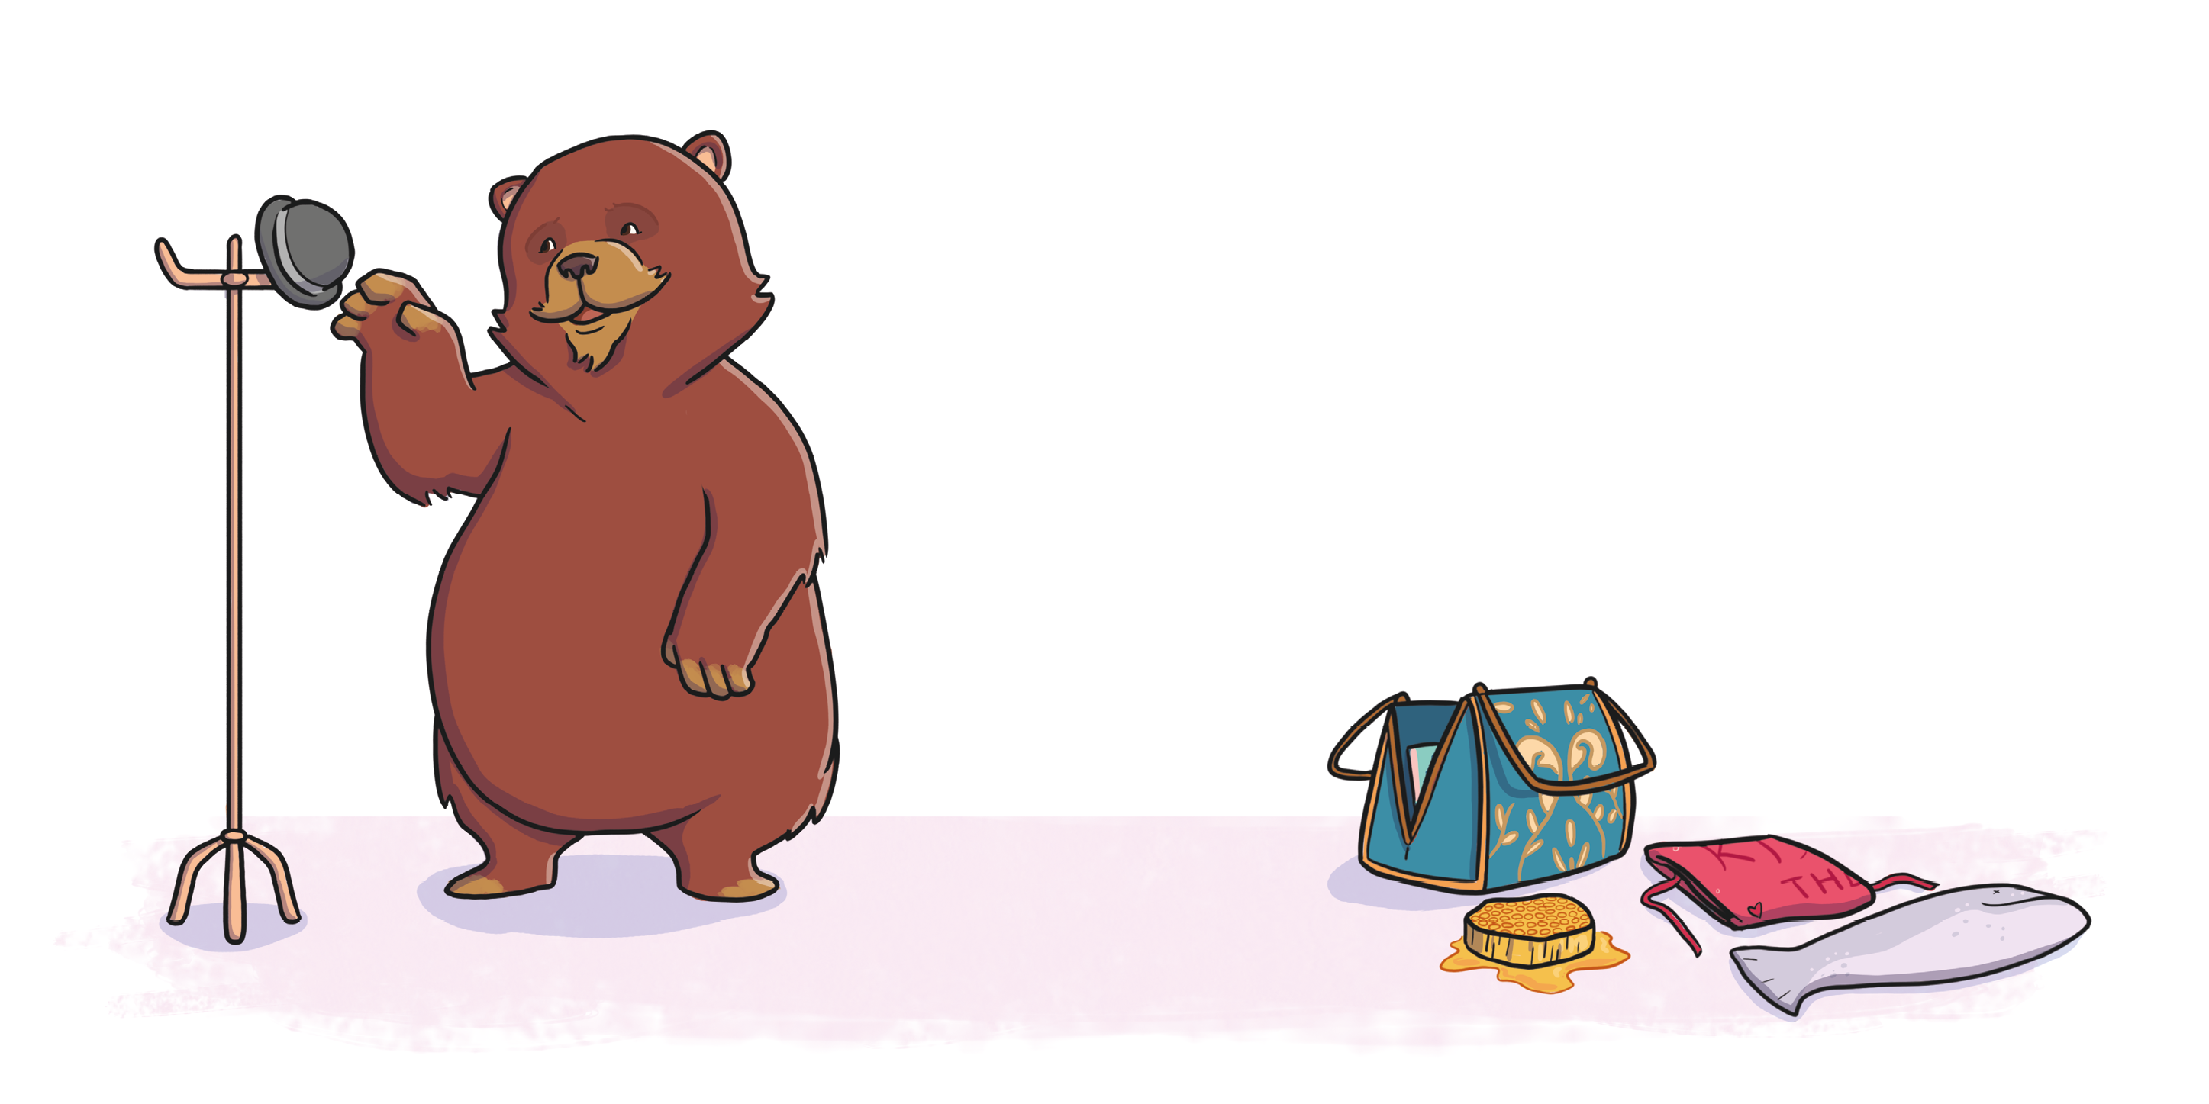

Slide 3
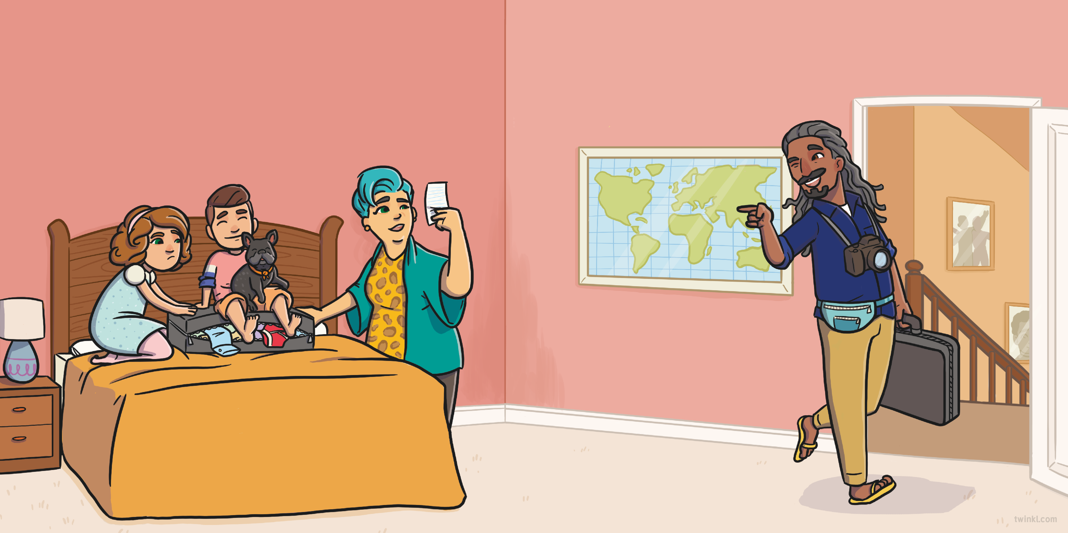
Arno and Bibi were helping Mum and Mike to pack for their honeymoon.
Mum checked her list. “Clothes, toothbrush, tickets… We just need the babysitter to arrive,” she said.
“We’ve found you the perfect one,” said Mike with a wink.
“You’re going to have a great time! You’ll bear-ly notice we’re gone.”
But little did the children know, the babysitter was...

Slide 4
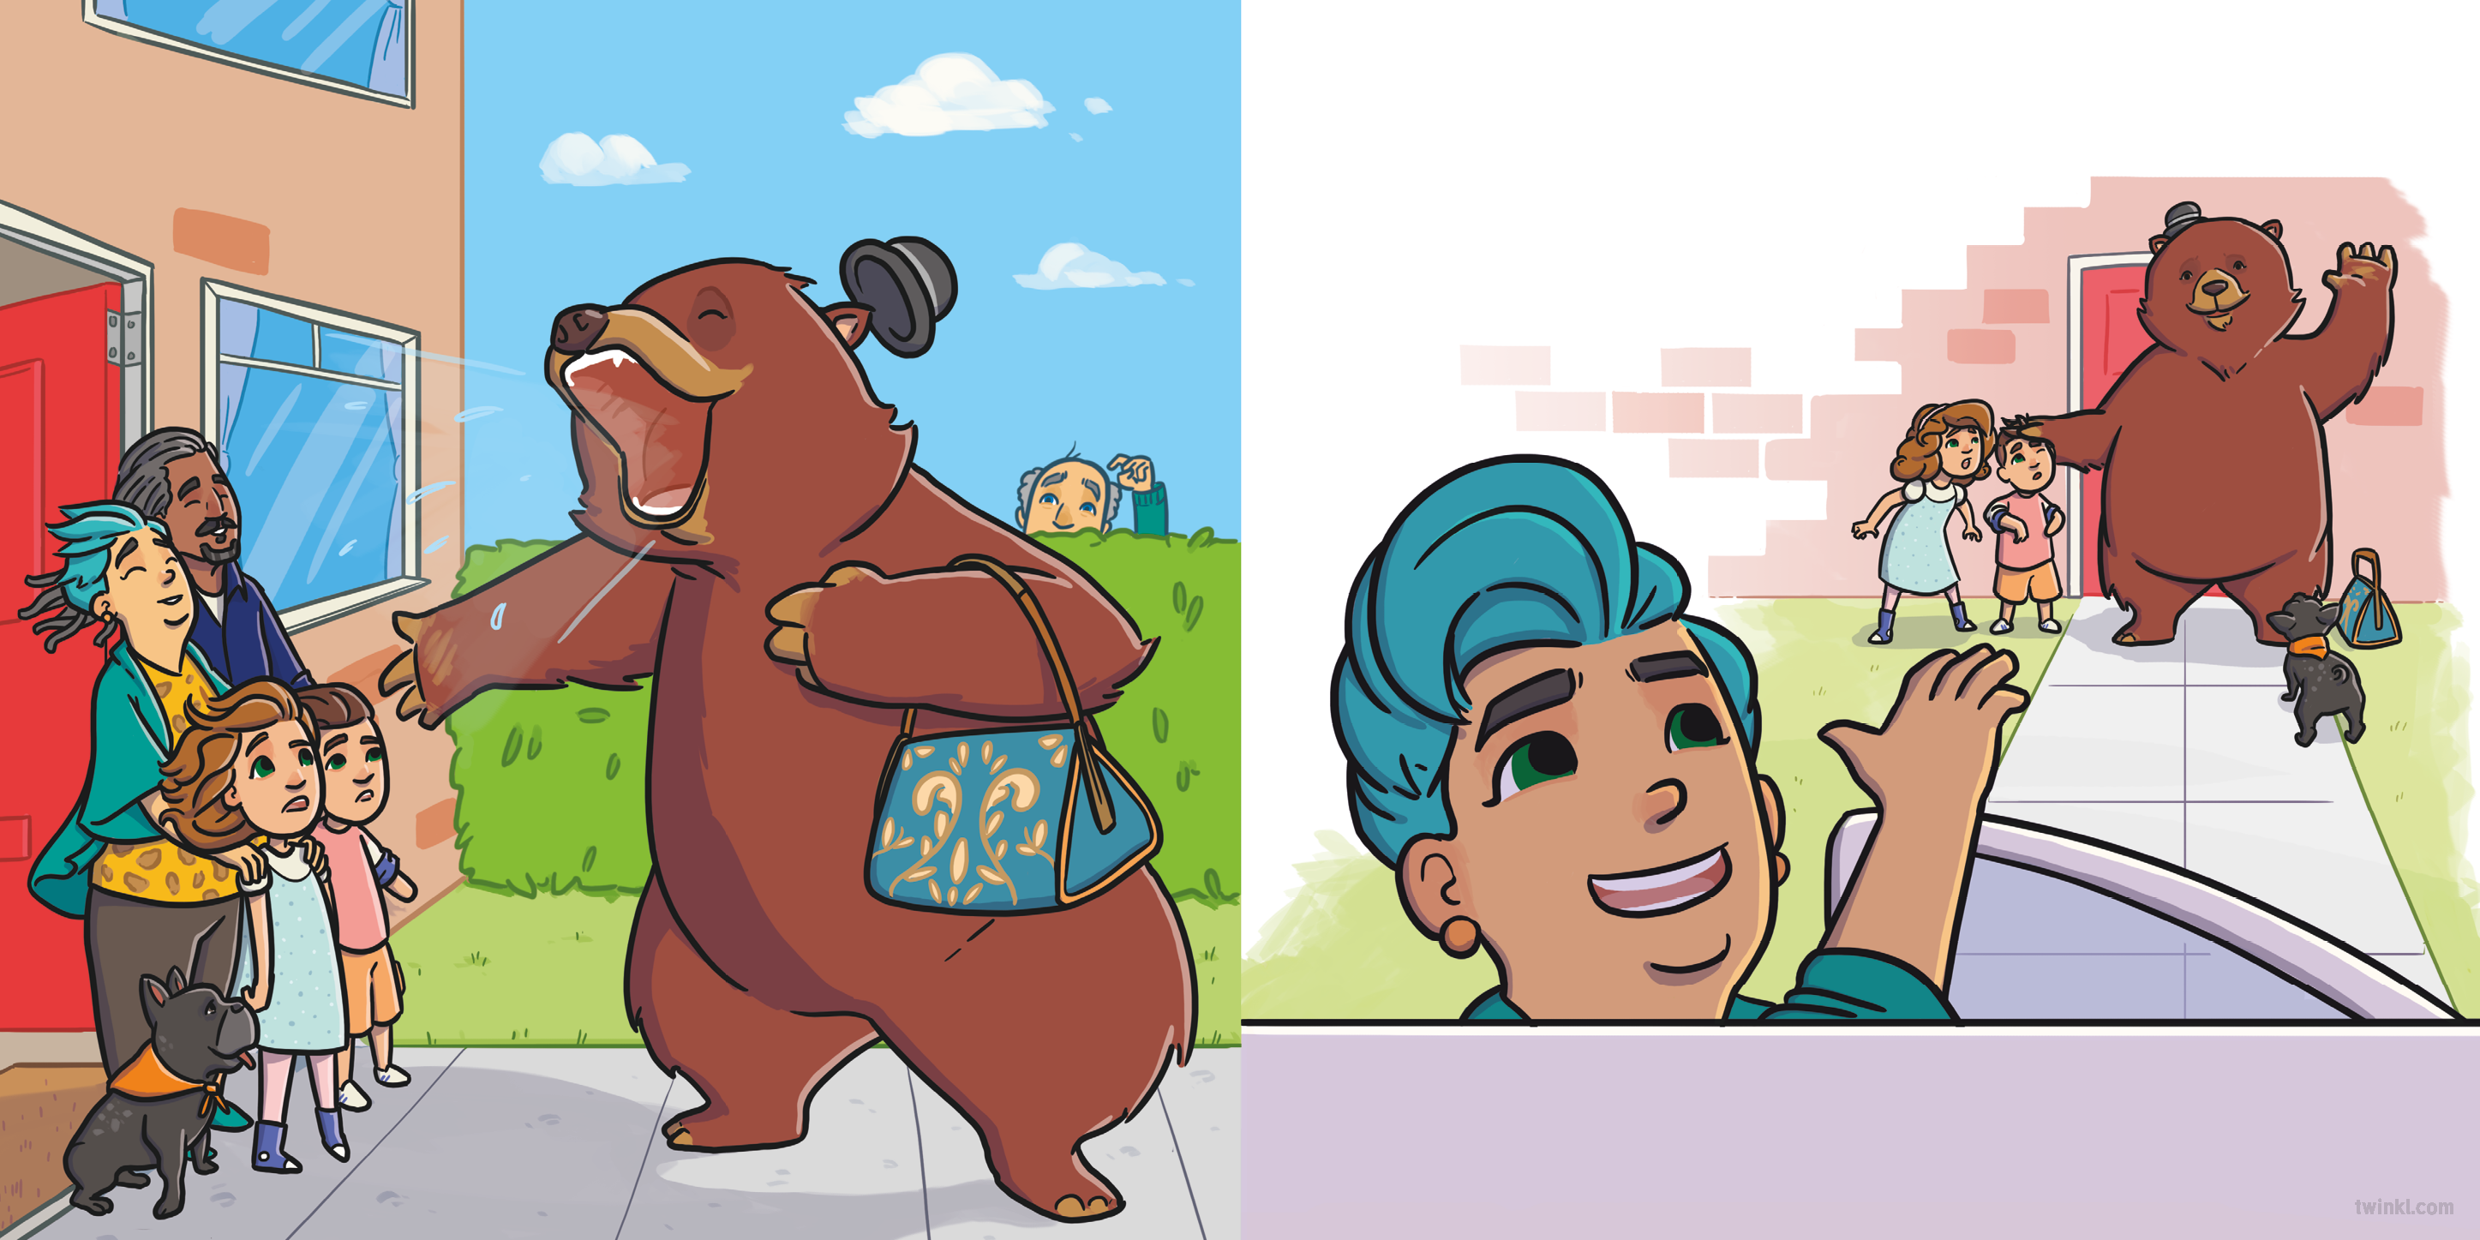

…a great,
“Be on your best behaviour,” said Mum. “We’ll be back in a few days!”
“ ” growled the bear.
big
BEAR!
The children stood speechless, staring at their new babysitter.

Slide 5
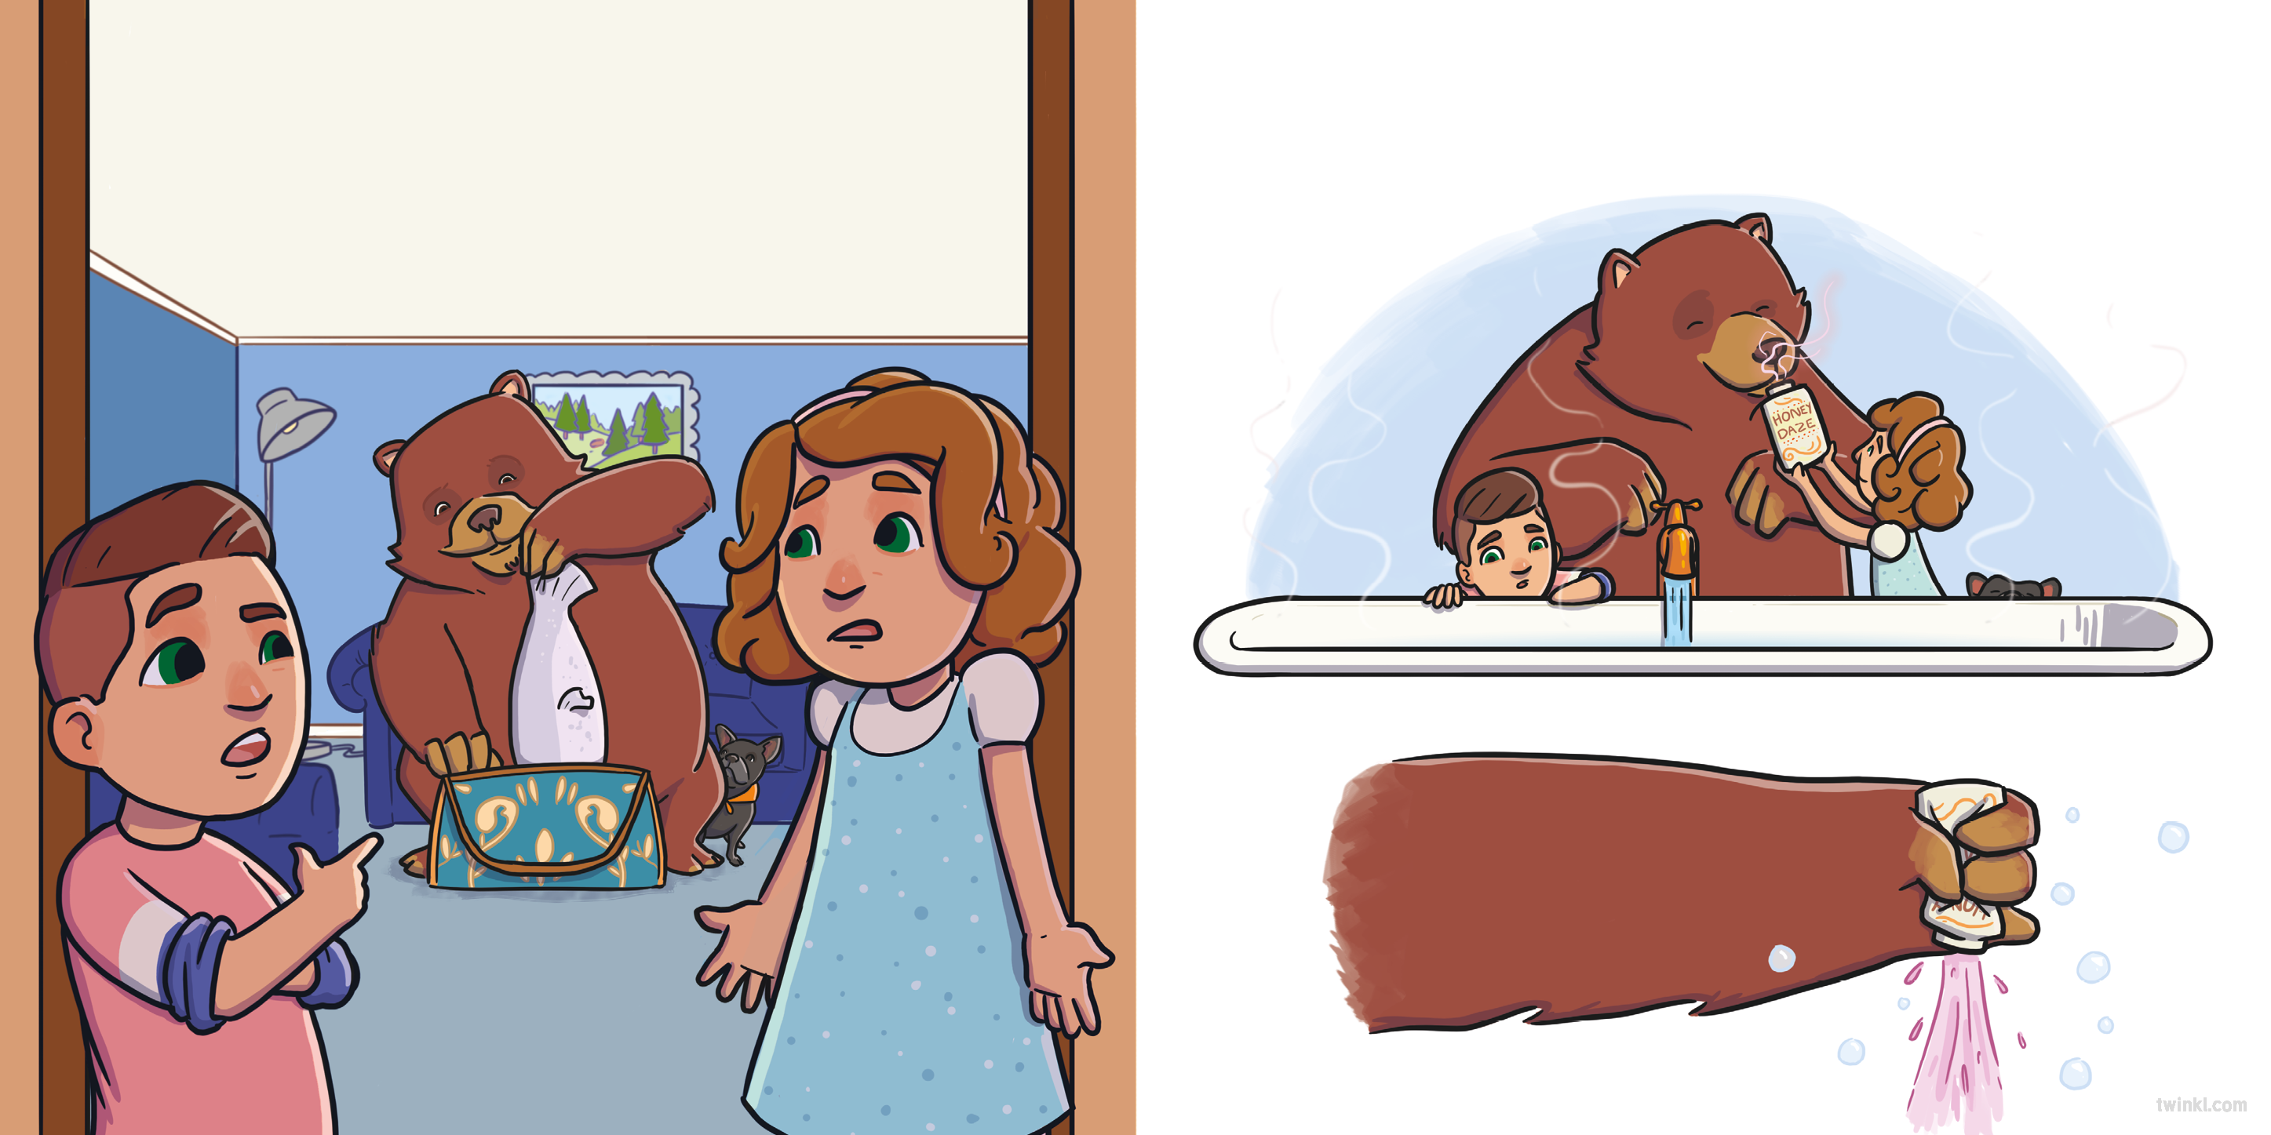
Arno turned to his sister. “Is this really happening?” he asked.
That night, the bear ran a bath. “Don’t forget the bubbles!” said Bibi, handing the bear the bottle.
“Whoever heard of a bear babysitter?” shrugged Bibi.
The bear squeezed it very hard!
“ ” growled the bear.

Slide 6
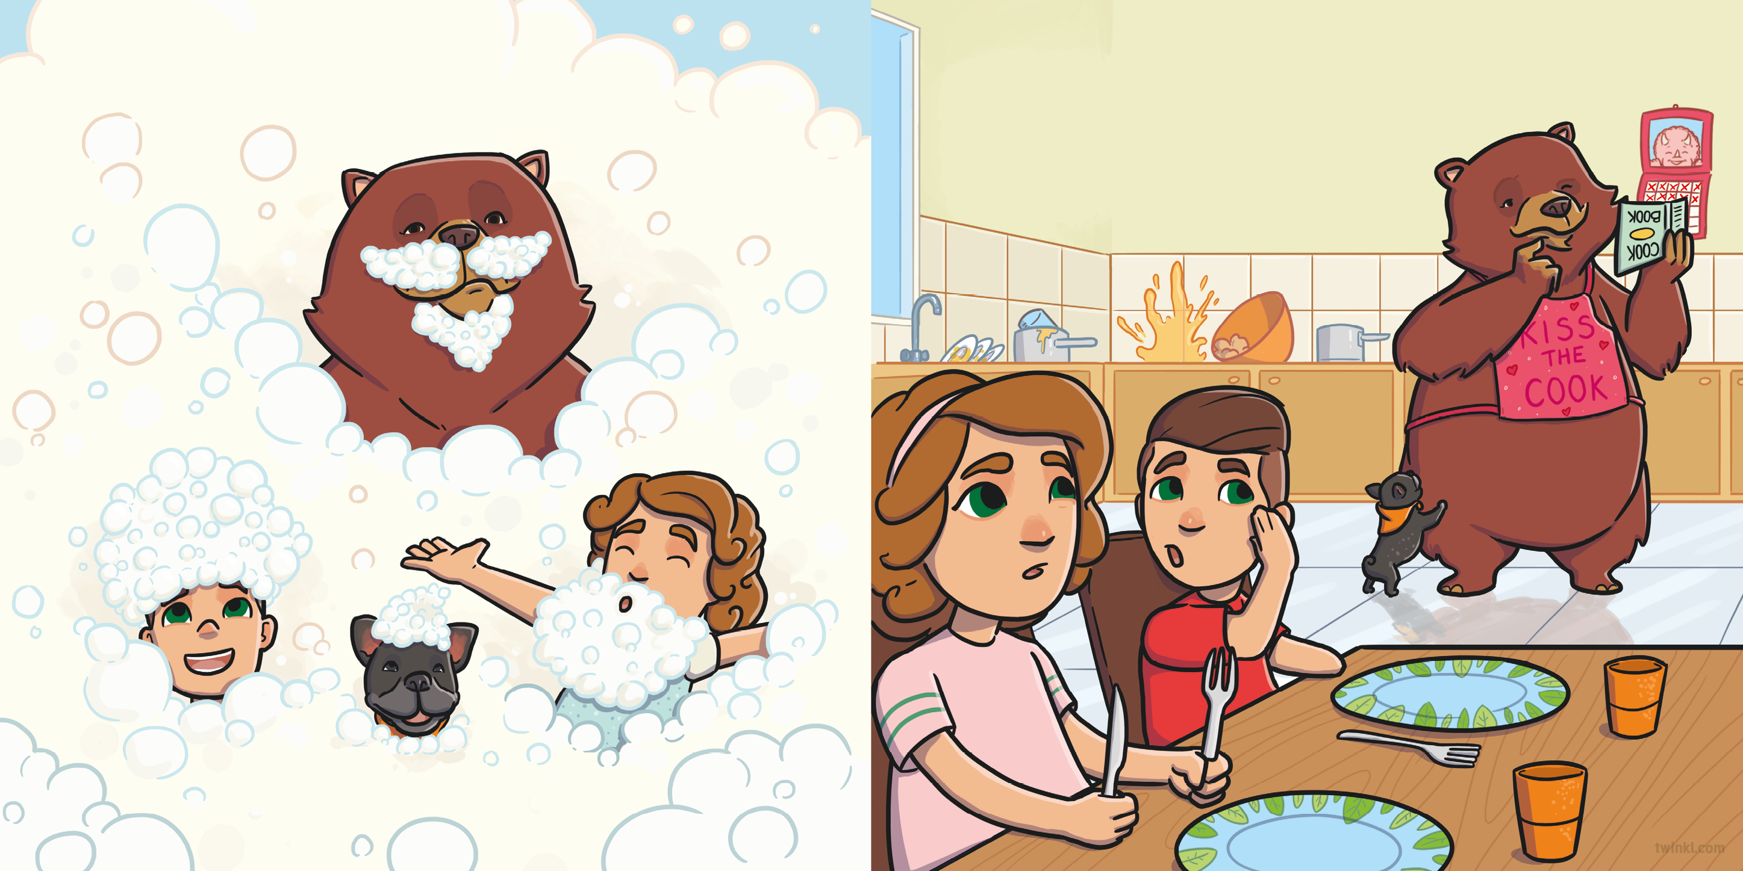
“This is fun!” giggled the children.
The next morning, Bibi and Arno sat down at the table.
“I wonder what’s for breakfast,” said Arno.
“ ” growled the bear.

Slide 7
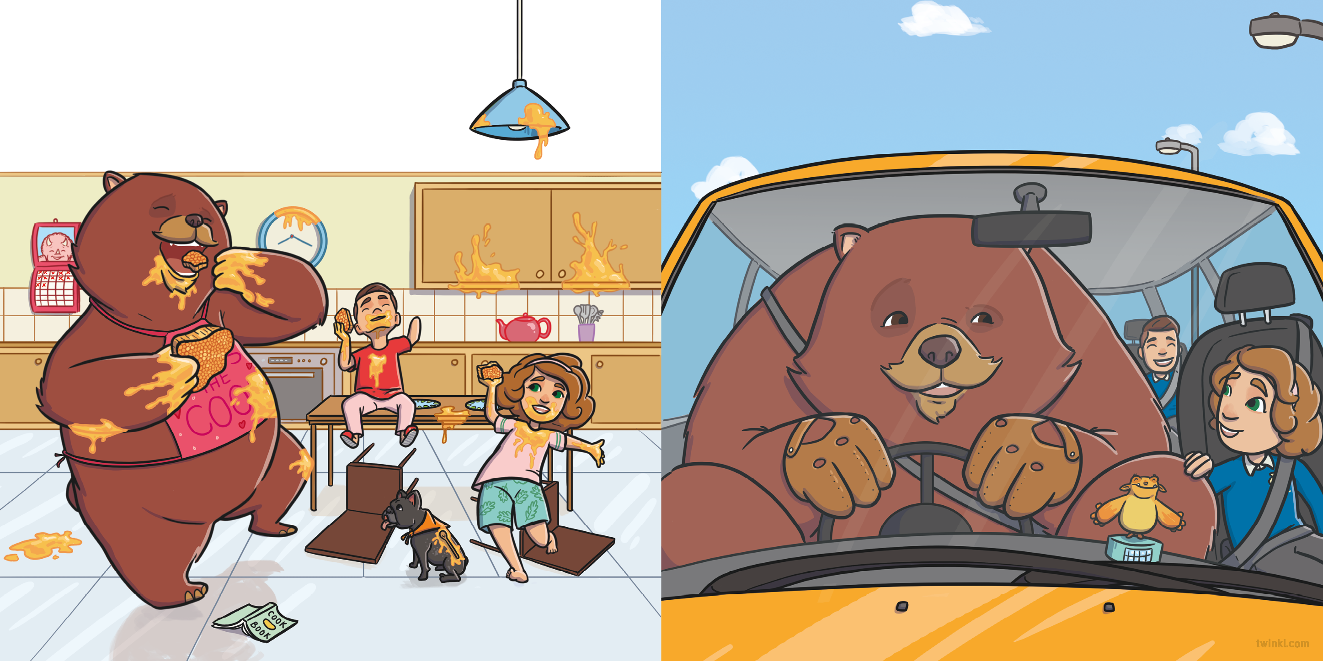
The bear gave them each some extremely sticky honey.
After breakfast, it was time to go to school. Arno and Bibi hopped into the car and buckled their seatbelts
as the bear squeezed into the driver’s seat.
“This is delicious!” chuckled the children.
“ ” growled the bear.

Slide 8
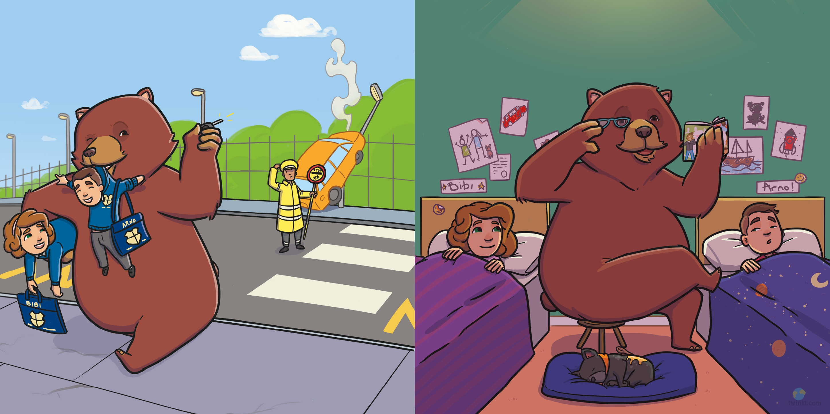
Screech! went the brakes.
“Wheeeeee!” said the children.
That night, the bear tucked the children into bed. They snuggled up to listen to a bedtime story.
“ ” growled the bear.

Slide 9
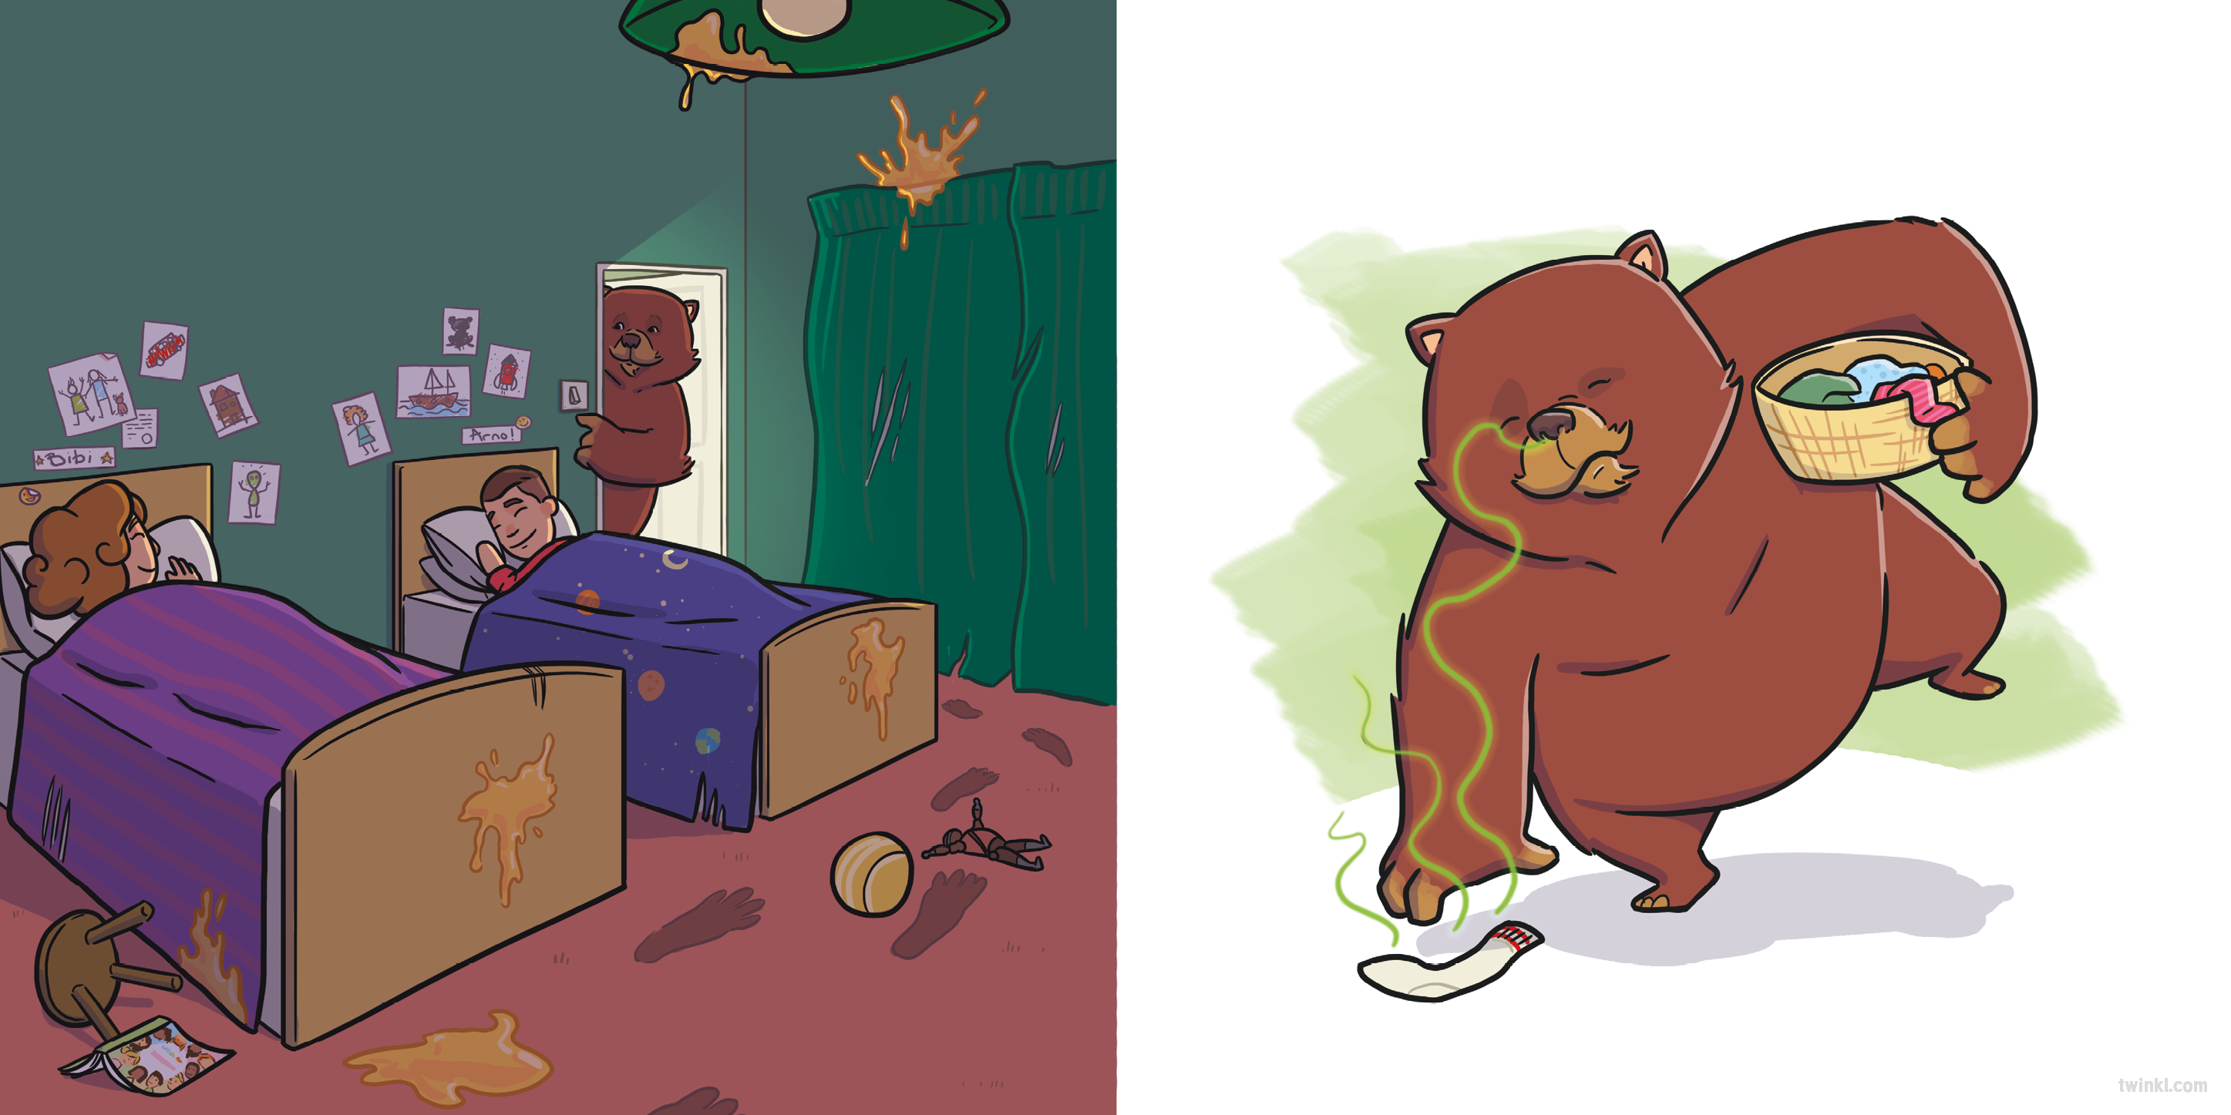

“Goodnight,” whispered Arno.
“Goodnight,” whispered Bibi.
The next day was Saturday so the children slept late. Meanwhile, the bear did some laundry...
“ ” growled the bear.

Slide 10
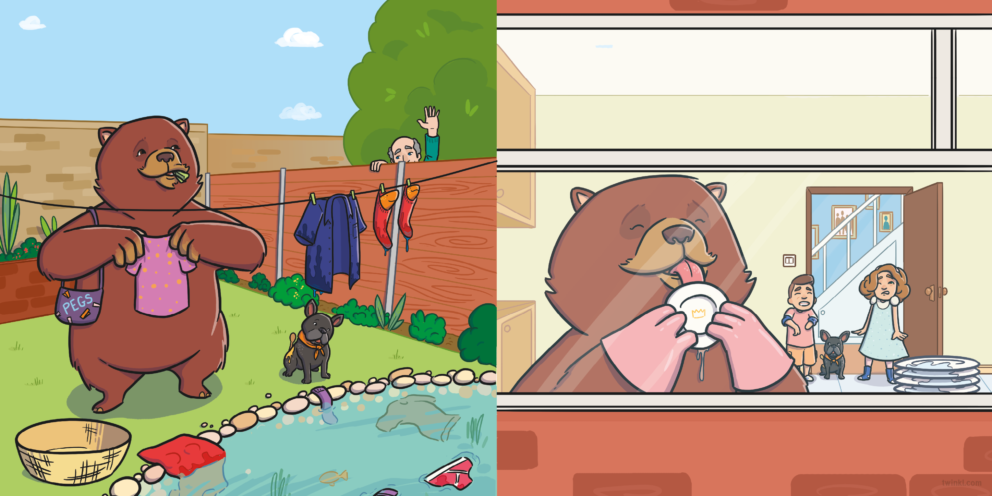
...then hung it on the line.
When the children finally woke up, the bear was busy washing the dishes.
“Good morning!” called the neighbour.
“Good morning, Bear!” shouted Bibi as they both raced downstairs. “How did you slee–”
“ ” growled the bear.
“Yuck!” said the children. This was not how Mum and Mike usually did the dishes.

Slide 11
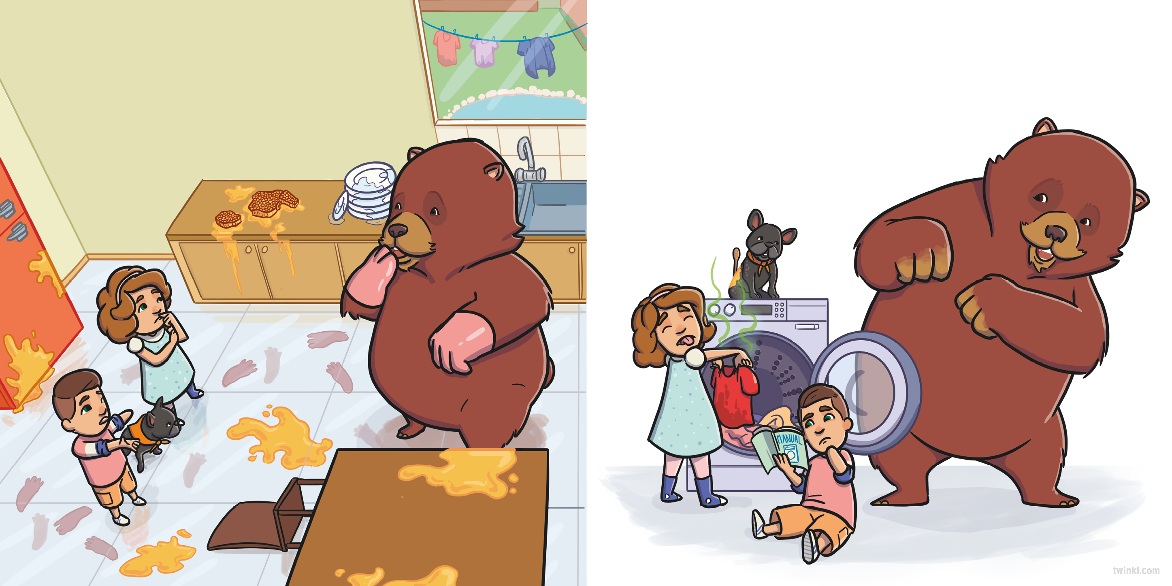
In fact, the bear hadn’t done anything the way that Mum and Mike usually did.
They rushed to gather the clothes from the line and placed them in the washing machine.
“They won’t let you babysit again if they see all this mess!” cried Arno.
“ ”
growled the bear.

Slide 12
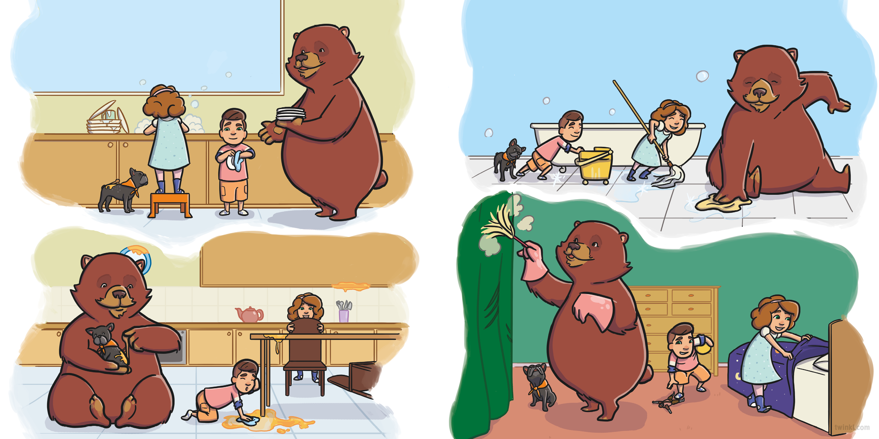
They whizzed around the kitchen until the dishes were spotless…
They sped through the upstairs rooms, mopping up the bathroom...
and the sticky breakfast mess was all cleaned up.
and tidying the bedroom.

Slide 13
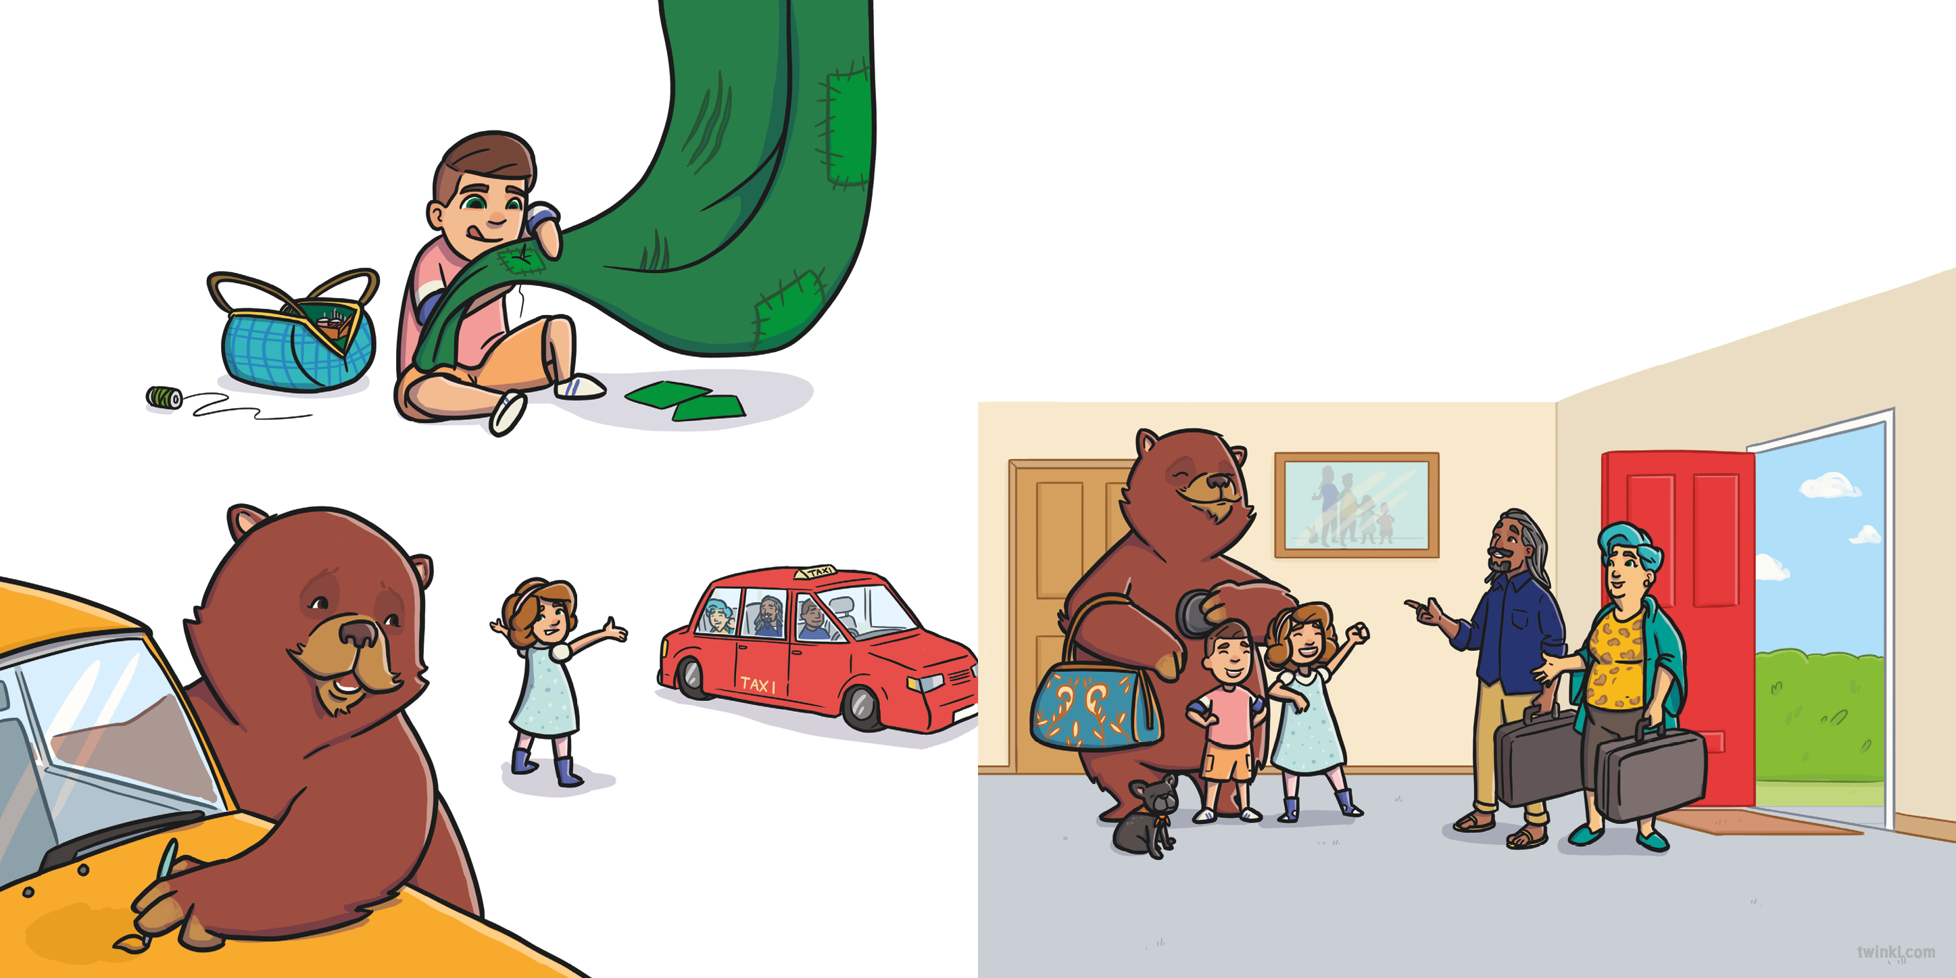
Arno hastily patched up the curtains...
“Well, you both look happy!” said Mike.
“And the house looks very tidy!” said Mum. “Have you all had fun?”
“YES!” shouted the children.
while Bibi and the bear hurriedly painted the car...
finishing just as Mum and Mike arrived home!
“ ” growled the bear.

Slide 14
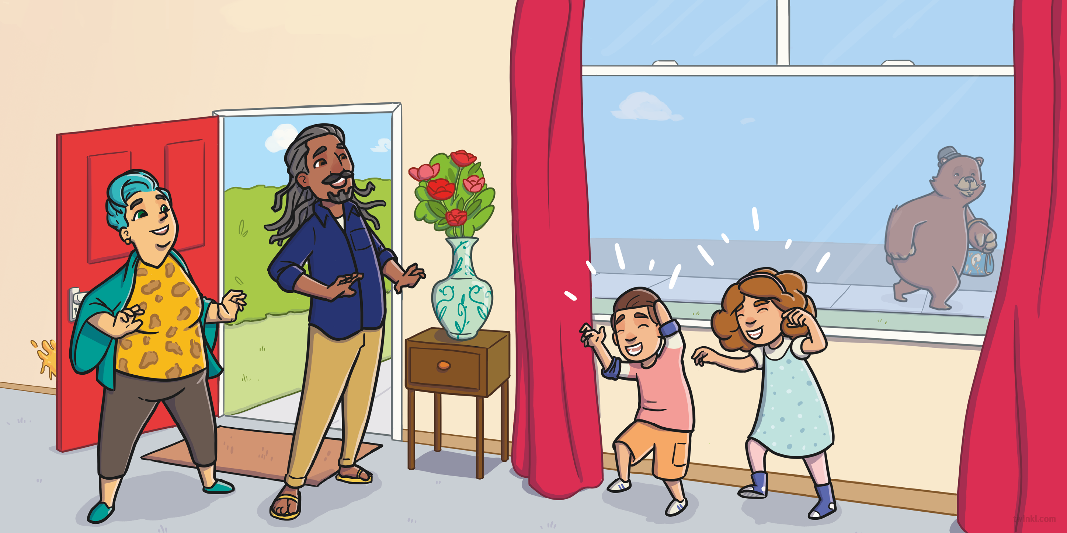
After the bear had gone, Mum asked the children, “Would you like your new friend to babysit again one day?”
“ ” growled the children.

Slide 15
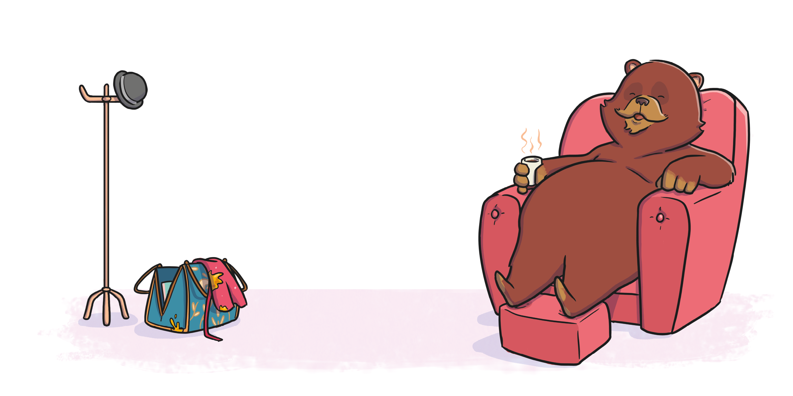

Slide 16
