Slide 1

Friday 3rd of March
Good Morning Primary 3!
Bonjour la class! Ca Va?
Aujourd’hui c’est Vendredi 3rd Avril 2020
Now watch the counting to 20 in French song. Maybe ask some family members to join in, remember to show them your cool moves!
https://www.youtube.com/watch?v=UsEz58BblMY

Slide 2
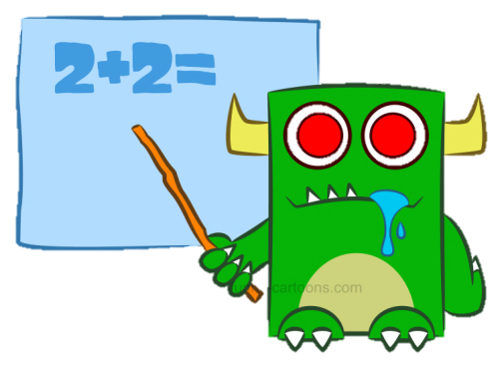

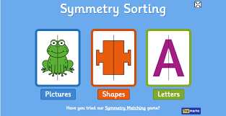
Maths
LI: To create a symmetrical design.
Primary 3, at the beginning of the year we learned all about symmetry. Let’s see how much you remember.
Here’s a little game that might help jog your memory –
https://www.topmarks.co.uk/symmetry/symmetry-matching
Activity:
Draw an outline of a butterfly in your jotter
Design your butterfly, making sure it has a symmetrical pattern.
Finally, colour in your butterfly (remember to make it symmetrical).

Slide 3
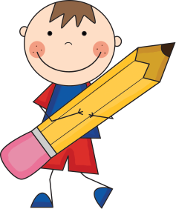

Literacy
LI: We are learning to write sentences using our common words.
Sing ABC, abc and vowel songs.
Recap ‘oe’ sound, common words.
Dictation
Choose a sentence from the pack
Read aloud the sentence to your child first, for them to listen to in full.
Then re-read the sentence slowly, word by word, allowing the child to write down each word on their own.
Please encourage your child to:
Have a go
Think about what sounds they hear in each word, can they chunk the word to make it easier to spell correctly.
Remember their core writing targets – full stops, capital letters and finger spaces.

Slide 4
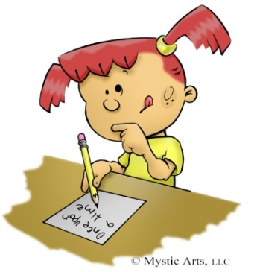
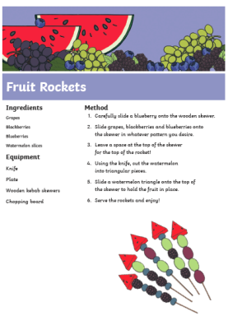

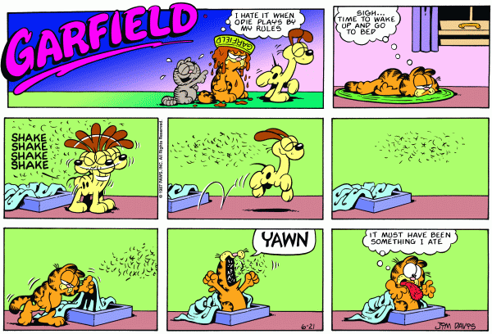


Free Writing Friday
LI: To create a text of my own choice.
On Fridays, we set aside a 15 minute timed session to do our “Free Writing” and during this time we select what type of writing we would like to do. It can be absolutely anything….. stories, poems, songs, recipes, fact files, comic strips, labelled diagrams…the list is endless.
Then at the end of the time, we share what we have created with each other.

Slide 5
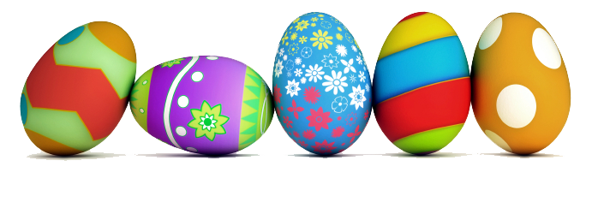
I am a lucky teacher to have such hard working pupils like you!
Stay safe and look after one another!
See you on Monday 20th April 2020 for more online tasks!
Have a lovely Easter Holiday P3!

