Slide 1
SPRINGFIELD PRIMARY SCHOOL
VIRTUAL SPORTS DAY JUNE 2020
RESULTS

Slide 2
Overview
Before we get to the results, I want to say a massive well done to each and everyone of you who took part in our Virtual Sports Week!
You demonstrated great resilience and determination to produce fantastic sporting results despite the different type of Sports Day we had this year.
It made me so proud to see everyone work together with the common goal of scoring points for their school house!

Slide 3
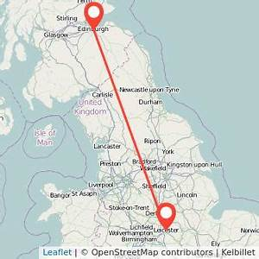
Sports week success!!!
180
1,800
391km
Pupils participating
Individual challenges completed
Travelled in house distance challenge
(Edinburgh to Leicester!!!)

Slide 4
Recognition
A special mention to the highest point scorer in each class:
P1a – Holly Lane
P1b – Donald Konczak
P2a – Alice Rainnie
P2b – Phoebe Meakin
P3a – Rory Maas & Emily Murrell
P3b – Abbie Outram
P4a – Euan McFadden
P4b – Esmie Hay
P5 – Cori Outram
P5/6 – Finlay Couper
P6 – Jemima Philpott
P7a – Imogen Casely
P7b – Lola Hay

Slide 5
House Distance Challenge Results
As a school you travelled 391km altogether and with a fantastic distance of 123km – HOPETOUN were the champions of the challenge!

Slide 6
Parents Results
Thank you to all the parents that participated in our Sports Challenges.
The 2020 Parent champions are:
Special mention for our distance champions Martin Maginnis and Gina Vereker who both completed >15km each!!!!
Mark
Schofield
1st
406pts
Denise Schofield
2nd
390pts
Richard Vereker
3rd
386pts

Slide 7
And the winner of our 2020 Virtual Sports Week is…
Well done Springfield Primary, thank you all for taking part and have a great Summer!!!!!
1st
Hopetoun

