Slide 1
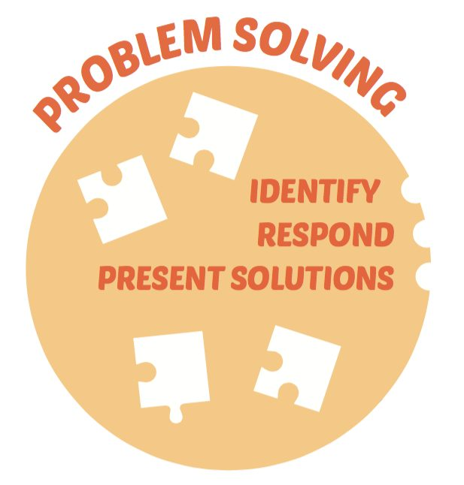
Problem Solving Parental Event
Helping your child develop problem solving strategies

Slide 2
Everyone CAN be good at solving numeracy problems
Pupils
Parents
Staff
Everything we do in school should help our children to develop skills for learning, life and work. Problem Solving is a life skill. Numeracy is about being able to understand and use numbers in a range of situations, for example when solving problems or making decisions in situations involving numbers.
With increased experience of problem solving, pupils should be able to develop their thinking skills, develop characteristics such as persistence and “willingness to have a go” and acquire a toolkit of strategies. They should gain increasing confidence in approaching unfamiliar situations and this should help them in everyday situations out-with the classroom.

Slide 3
Problem Solving Strategies

Slide 4
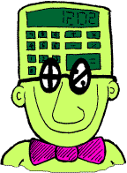
My learning in numeracy and mathematics problem solving enables me to:
develop a secure understanding of the concepts, principles and processes of mathematics and apply these in different contexts, including the world of work
engage with more abstract mathematical concepts and develop important new kinds of thinking
understand the application of mathematics, its impact on our society past and present, and its potential for the future
develop essential numeracy skills which will allow me to participate fully in society
interpret numerical information appropriately and use it to draw conclusions, assess risk, and make reasoned evaluations and informed decisions
apply skills and understanding creatively and logically to solve problems, within a variety of contexts
appreciate how the imaginative and effective use of technologies can enhance the development of skills and concepts.

Slide 5
EARLY LEVEL
Play board games
Completing a jigsaw
Laying the table
Pairing up the socks
Telling the time
Paying for items
Counting pocket money,
Packing a school bag,
Constructing a model – using Lego or other construction material
Counting down the days to a special event.
Knowing their birthday.
Notes:
Play counting games board games jigsaw, laying the table, pairing up the socks, telling the time, paying for items, counting pocket money, packing your school bag, constructing a model – Lego or other
Making dens
Counting down the days to a special event, knowing their birthdays and sequencing of family birthdays, days of the week

Slide 6
FIRST LEVEL
Sequencing of family birthdays, days of the week and months of the year.
Making dens – indoor and outdoors planning and gathering resources.
Playing board games which require using a strategy (Connect 4, Chess)
Working out simple durations in everyday life. How long until school starts? How long is the train ride to Edinburgh?
Online games or apps.
Solving problems using household items e.g. doubling up a recipe
Preparing a meal.

Slide 7
SECOND LEVEL
Helping out with the weekly shop
Planning their week – homework tasks, after school clubs, screen time
Using a diary or a calendar.
Playing age appropriate board games (e.g. chess, Battleships)
Online games
Planning a holiday
Making models
Baking or changing a recipe (prepare for 8 instead of 4)
Writing number problems for others
Notes:
How long questions.. Durations, cooking and baking, helping weekly shop, planning their week, using diary or a calendar, researching things that buys, setting up and managing a company, playing chess or strategic games ( battleships) planning a holiday, online games, planning and making models, using households items for measurements , planning ahead, pupils writing problems for others – shows understanding

Slide 8
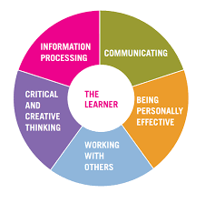
Skills for Learning, Life and Work
At all levels:
Let children work things out themselves - don’t always be there to give the answer. Praise their independence.
Ask “What if …?”. This extends thinking and promotes reasoning, a key skill in problem solving.
Involving your child in discussions about everyday number problems.
e.g. I need 80p for the bus fare, but I can only find 35p.
How much more do I still need to find?
We have to be at swimming lessons by 5pm, do we have time to do the shopping before then?
Encouraging perseverance and celebrating the effort they have gone to ‘stick with it’.

Slide 9
Useful links
Youcubed
A fantastic site, run by Stanford University’s Professor Jo Boaler. A well organised site, filled with resources for teachers, parents and pupils, on how to raise children’s confidence in maths and numeracy.
www.youcubed.org
Nrich
A site set up by Cambridge University to provide a resource filled with high quality puzzles, investigations and advice about problems solving in maths and numeracy. This site is used widely in classrooms across the cluster.
www.nrich.maths.org
Making Maths Count
Report published by Scottish Government earlier this year, with focus on development of positive public attitude to maths, providing high quality learning and teaching in schools and preparing a for employment.
http://www.gov.scot/Resource/0050/00505348.pdf
Parentzone Scotland
This site gives parents ideas on how to help children to apply their learning to daily life.
https://education.gov.scot/parentzone/learning-at-home/supporting-numeracy

Slide 10
