Slide 1
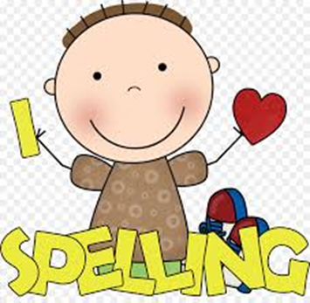
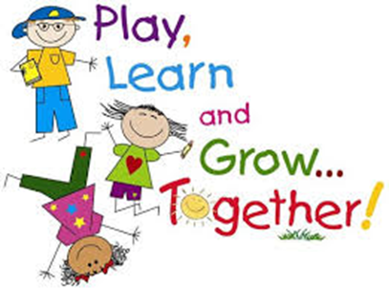
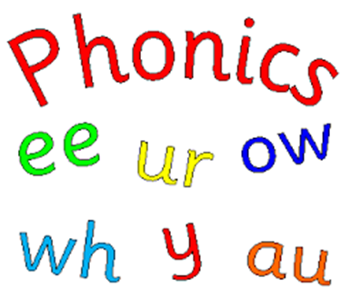
Welcome to Springfield Primary School
“BIG SPELL”

Slide 2
Why is correct spelling important?
Allows you to communicate your thoughts and ideas clearly.
Incorrect spelling makes your work difficult to read and understand.
When you take the time to check your work and spelling you give a good impression.
Some people think its not important as computers will check spelling and correct their mistakes.

Slide 3
Why is correct spelling important?
In reality you do need to be able to spell and spot mistakes.
The computer spell checker does not check for meaning, only for spelling:-
“The spell chequer on my pea sea finds awl the mist aches eye kin not sea.”

Slide 4
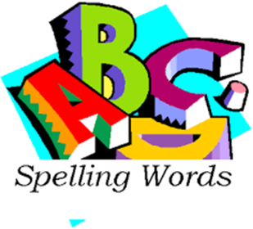
Developmental stages of spelling
Its generally accepted that spelling is a developmental process in which there are three main stages:-
Emergent
Phonetic spelling
Independent spelling (Applying rules)

Slide 5
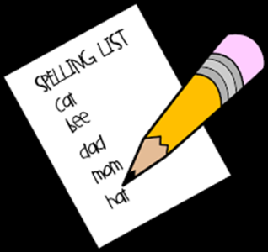
Spelling programme
A progressive and systematic and whole- school approach.
Teaching and learning of high frequency words.
Interactive teaching of spelling rules, new vocabulary and commonly used words.
Words with unusual spelling patters (“tricky words”.
Class word banks for topic-specific words.
Use of dictionaries and thesauri.

Slide 6
Spelling programme - Springfield
Springfield progressive phonics programme covering all sounds, patterns, tricky words and “cvc” words.
Spelling Lists (Standard word spelling programme)
Supplemented by appropriate spelling resources, strategies and activities.
High frequency/commonly used words – Fry’s Lists
Weekly spelling test.

Slide 7
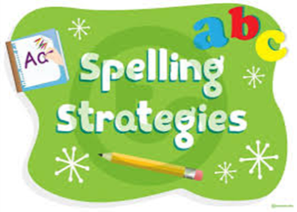
Spelling strategies – some examples
Look, say cover, write, check.
Mnemonics
Because (Big elephants can always understand small elephants).
Alphabetical order.
Words within words
Apartment (art, part, men)
Homophones – same sound but different spelling/meaning.
see/sea, made/maid.

Slide 8
Spelling rules – some examples
The alphabet is made up of vowels and consonants.
a,e,i,o,u. (Angry elephant in orange underpants).
“I” before “e” except after “c”.
Plurals – ends in a consonant plus y, change “y” to “i” and add “es” e.g. party - parties
All, well, full – Drop an “l” when adding to another word.
Always, wonderful, welcome.

Slide 9
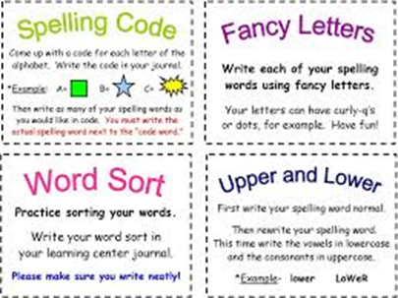
Spelling Activities – some examples

Slide 10
Big Spell Event
You are welcome to visit your children's classes and take part in the Big Spell.
Try out some of the games with the children.
Have lots of fun!
Thank you for coming along today.

