Slide 1
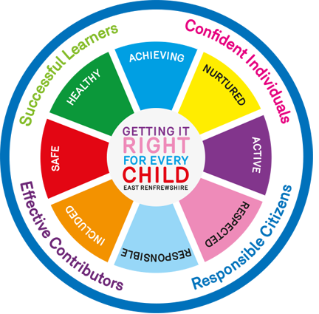
Tracking and Monitoring Our Children’s Health and Wellbeing
Springfield Primary School and Bonnytoun Nursery

Slide 2
Health and Wellbeing: the responsibility of all
Everyone within Springfield and Bonnytoun’s learning community, whatever their contact with our children may be, shares the responsibility for creating a positive ethos and climate of respect and trust – one in which everyone can make a positive contribution to the wellbeing of every child.

Slide 3
Health and Wellbeing: the responsibility of all
Our role as practitioners:
Establishing open, positive, supportive relationships across the school community, where children will feel that they are listened to
Creating an environment where children feel secure in their ability to discuss sensitive aspects of their lives
Promoting a climate in which children feel safe
Modelling behaviour which promotes health and wellbeing and encouraging it in others
Using learning and teaching methodologies which promote effective learning
Being sensitive and responsive to the wellbeing of each child

Slide 4
Tracking and Monitoring
How we track and monitor children’s health and wellbeing:
Ongoing reflection by the child (Termly self-reporting)
Ongoing observations
Protected time for 1-1 dialogue (Bubble Time)
Using information gathered through existing whole school approaches (Profiling, learners reflections, pastoral notes)
Information from parents/carers
Information from other partners or outside agencies

Slide 5
Self-Reporting
Children’s ongoing reflection on their health and wellbeing using wellbeing indicators
Safe, Healthy, Active, Nurtured, Achieving, Respected, Responsible, Included
Carried out on a termly basis
Nursery to P3 using smiley face form
P4 to P7 using online questionnaire
Follow-up conversations with class teacher and SMT where appropriate

Slide 6
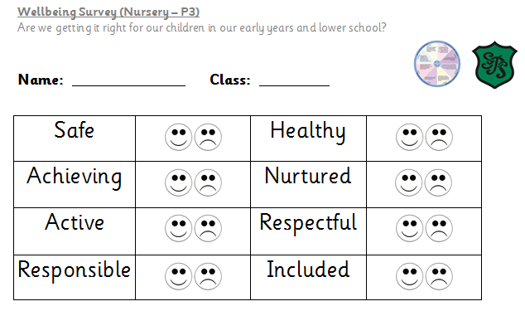
Self-Reporting from Nursery – P3

Slide 7
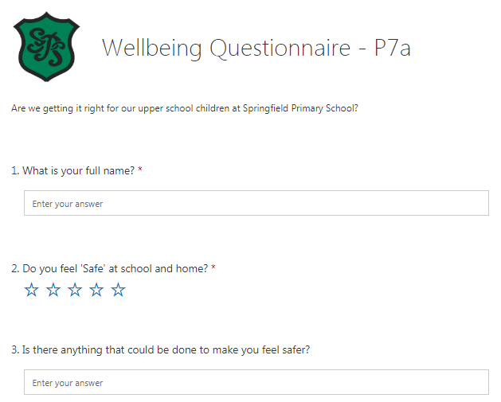
Self-Reporting from P4 – P7

Slide 8
The Incredible 5 Point Scale
New whole school approach
Enabling children to understand social interactions and manage their feelings and emotional responses
Children move name/picture from 1-5 on the scale in their classroom according to how they are feeling
1 may indicates the child is happy, content or settled where
5 may indicate the child is upset, panicked or angry

Slide 9
The Incredible 5 Point Scale
Introduced by all class teachers
Children have completed individual 5 point scales to refer to
What does 1-5 look like and feel like to you?
Self-regulation strategies or ‘Chill Skills’
Strategies could include reading a book, speaking to an adult or a stress ball
Chill Skills tray in each classroom

Slide 10
Bubble Time
Protected time for 1-1 dialogue
No interruptions, teacher will indicate this to class
Used when a child moves their name/picture to a 4 or 5 on the scale
May also be used when a child consistently moves their name over a 2 week period

Slide 11
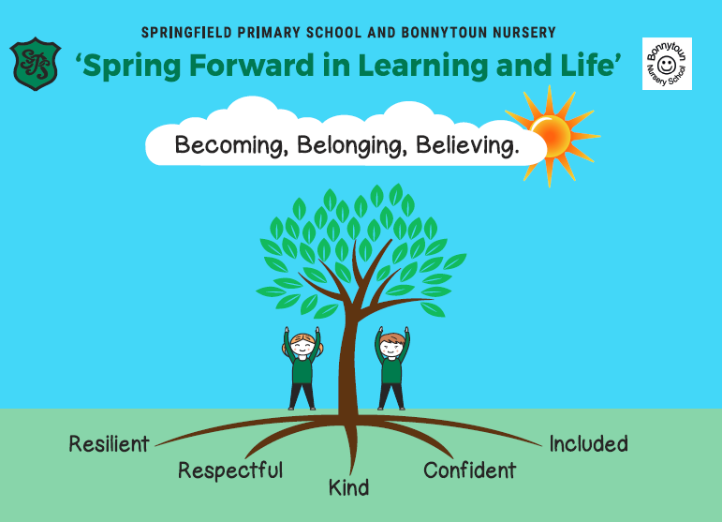
Tracking Wider Achievement – Values Hall of Fame
Explained to all children in class
Sent home this week in bags
Children can enter hall of fame by completing all activities linked to values
Once completed they may sign the graffiti wall
Class teachers will regularly check-in and praise pupil progress

Slide 12
