Slide 1
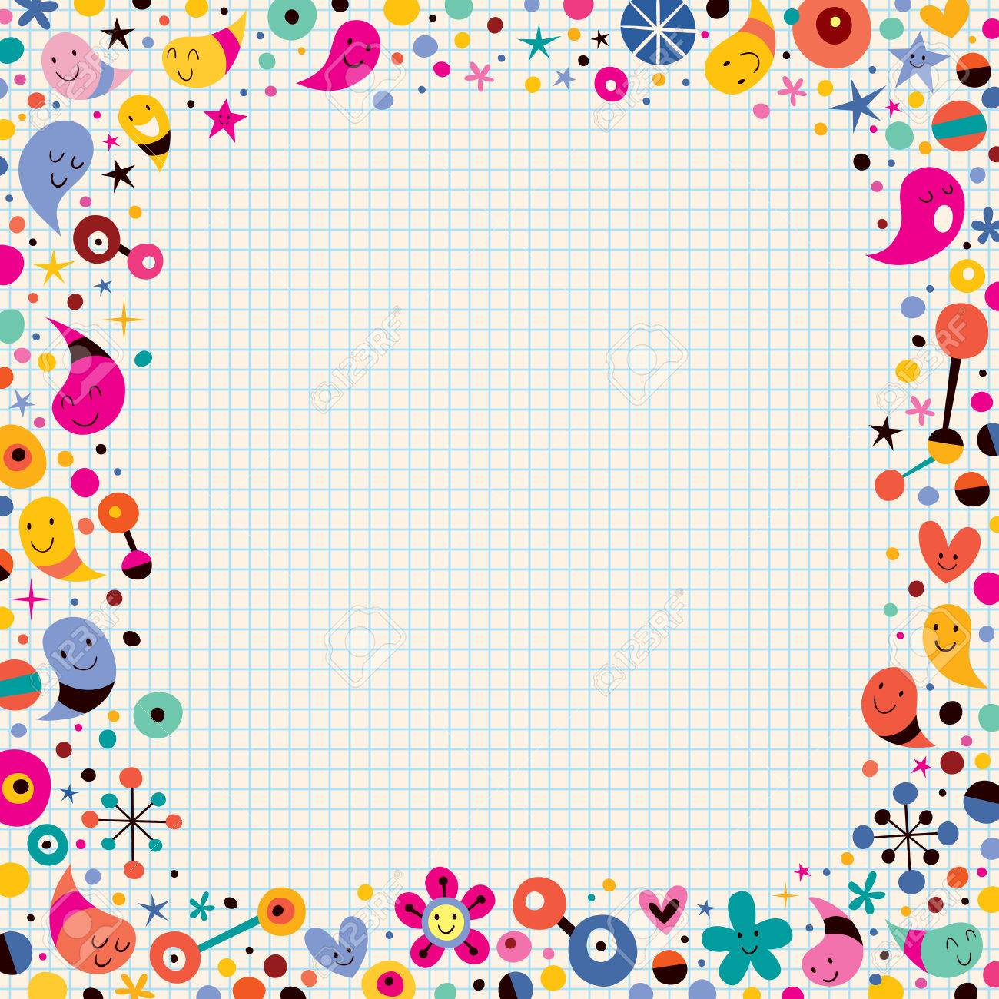
Today’s Word
CELEBRATE

