Slide 1
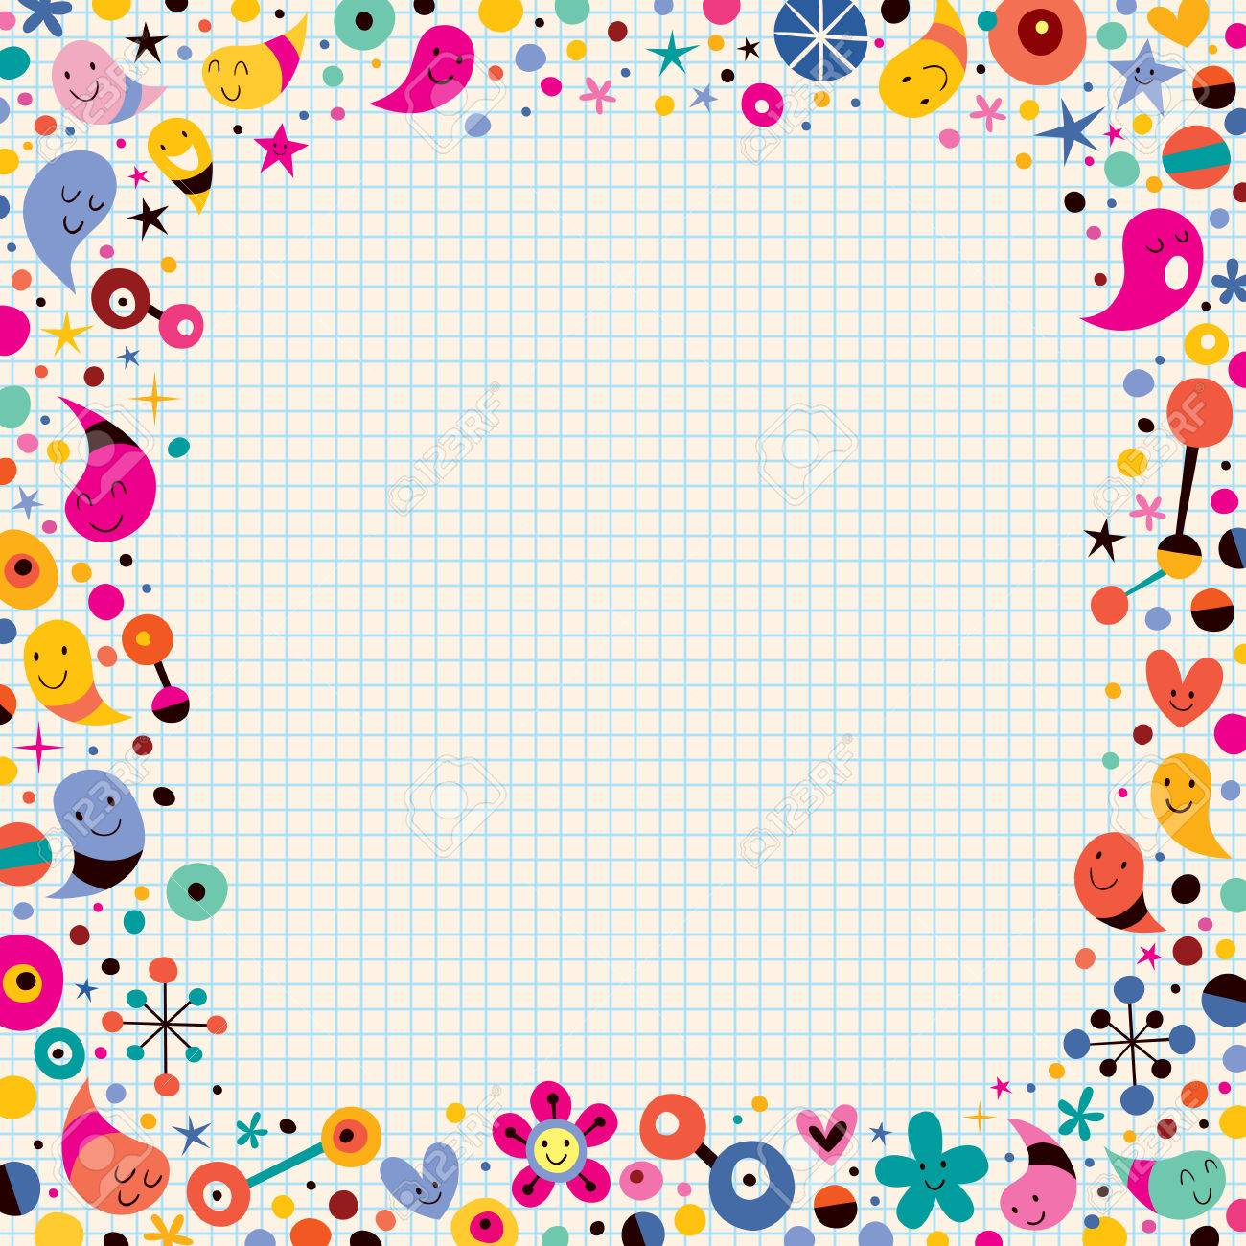
Today’s Word
Guitar

