Slide 1
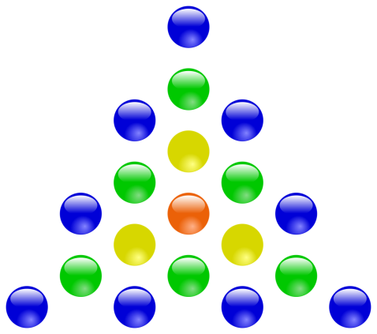
Simpson Nursery Class
Parent/Carer Biscuits & Blether
December 2020
Counting Principles and Maths Through Stories

Slide 2
Intentions for Session
To develop a knowledge and understanding of the counting principles and how they support our children’s knowledge and understanding of number.
To support you in helping your child to further develop knowledge of number or maths through stories.

Slide 3
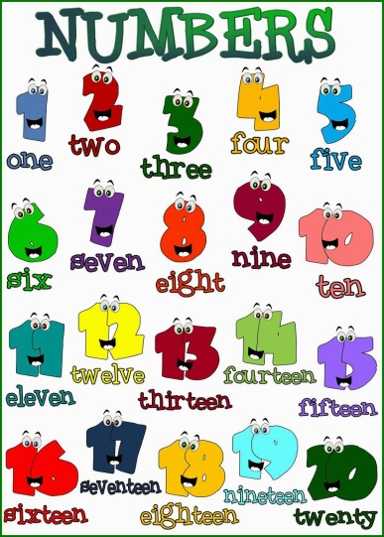
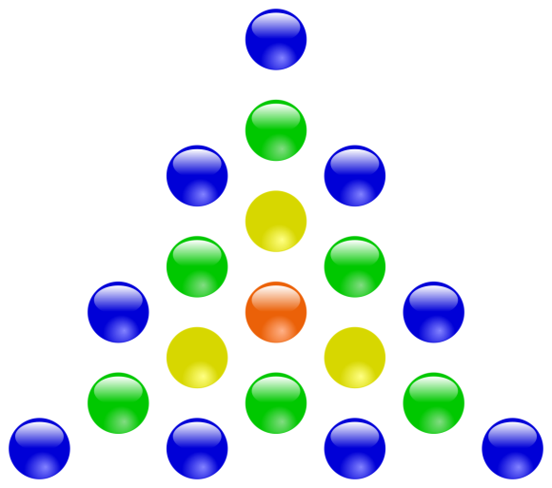
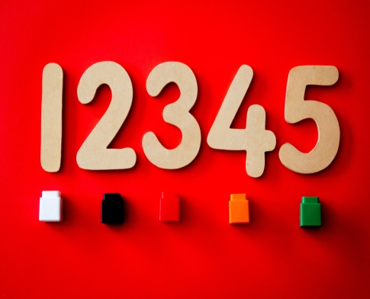
Possible Counting Mistakes
Unable to correspond their pointing to individual objects.​
Unable to correspond the sound with the pointing action.​
Miss an object or miss a number name​
Count an object more than once or apply the same name twice ​
Confusing the order of names. ​
Lose track of what has been counted & what remains to be counted. ​
Don't stop the verbal sequence at the last object, keep on because of the rhythm. ​
Don't realise the last number is how many in the set. ​
Choose to miss some objects because they don't think they should be included in the count because of their colour, shape, position etc.​
Notes:
Lynda
There common mistakes that children make when counting such as:
Hopefully today we will give you an idea of the 5 principles which will support your child at home

Slide 4
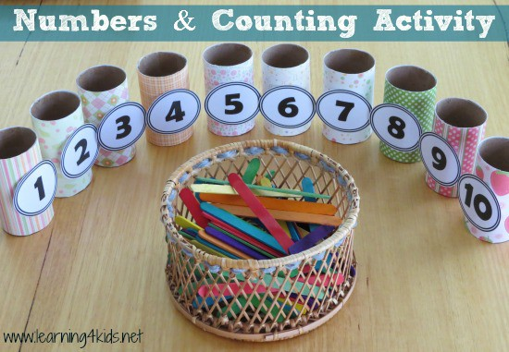
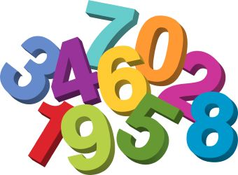
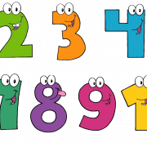
Counting Principles
Stable Order Principle​
The 1:1 Counting Principle​
The Cardinality Principle​
The Abstraction Principle​
The Order-Irrelevance
https://www.youtube.com/watch?v=SG0jzpZtfgs​
Notes:
Carol

Slide 5
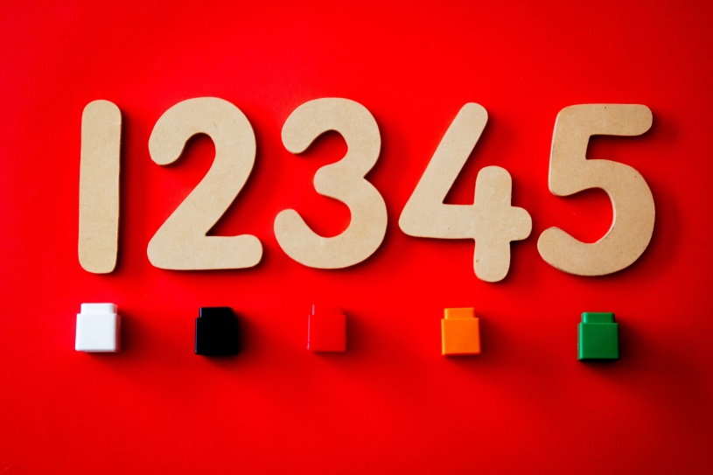
Stable Order Principle
The number names are in a fixed order and must always be used in this fixed order (1, 2, 3, 4, 5, 6 …)
Must use the number names in the same order every time.
Notes:
Lynda
Activities to support
Share ideas within groups first
Singing rhyme
Hide and Seek
Number Tennis
Making Mistakes
Activities to support
Share ideas within groups first
Singing rhyme
Hide and Seek
Number Tennis
Making Mistakes
Activities to support:
Songs: 1,2, 3, 4,5 once I caught a fish
Counting stairs, houses, teddies, toys
Matching games
Hide and seek
Number tennis

Slide 6
One to One Principle
Every object to be counted is associated with EXACTLY one of the number names — not more than one and not less than one.
1 2 3 4 5 6
There is one number tag/name for each object
Notes:
Carol
Activities to support the one-to-one principle
Moving items when counting
Matching items with pictures
Instrument e.g. drum – record one mark for each sound

Slide 7
Cardinal Principle
1 2 3 4 5 6
There are … 1, 2 ,3 , 4, 5, 6 dots. Yes, there are 6 dots altogether
Notes:
The purpose of counting is to find “how many” and this is given by the last number stated.
Fully grasping the cardinal principle depends on understanding the previous two principles (one-to-one & stable order)
There are three phases in the development of cardinality (Fuson & Hall, 1983).
1. Reciting the last number with no clear idea that it relates to quantity, but because they realise it is the response the adult expects.
2. Understanding that the last number of the count relates to the quantity.
3. Understanding the progressive nature of cardinality i.e. if they are stopped in the middle of a count they can say how many they have counted so far, then carry on.
It is necessary for the child to grasp the cardinal principle before they can:
• Understand that the next number in the sequence represents a larger quantity.
• Use the strategy of “counting on”.
• Use counting to determine and compare the equivalence of sets.
Activities to support
Share ideas in group
Creating sets of groups e.g. show me a set of 4
Get every teddy a chair
Can you set the table for 6 children
Stop them in the middle of a count … how many have you counted?

Slide 8
Abstract Principle
Notes:
Lynda
We can count any specified set of "objects", real or imagined, similar or disparate (different).
Different types of collections can be counted - not just collections of the same type.
The arrangement of the objects to be counted does not affect how many there are.
Some children will only count red counters because red is their favourite colour.
Activities to support
Share ideas in groups
Matching set of different items with the same quantity
Counting non-tangible things eg sounds, actions, questions people ask, steps
Counting pennies in a jar – temporal patterns
5 different toys – how many toys altogether?
We can count any specified set of "objects", real or imagined, similar or disparate (different).
Different types of collections can be counted - not just collections of the same type.
The arrangement of the objects to be counted does not affect how many there are.
Some children will only count red counters because red is their favourite colour.
Activities to support
Share ideas in groups
Matching set of different items with the same quantity
Counting non-tangible things eg sounds, actions, questions people ask, steps
Counting pennies in a jar – temporal patterns
5 different toys – how many toys altogether?

Slide 9
Order Irrelevance
2 1 6 5 4 3
Notes:
Carol
The order in which the objects in a set are counted does not affect the number in the set (e.g. counting a string of objects can start at the beginning, although it may be unwise for other reasons)
It doesn’t matter in which order the objects in a collection are counted. Can start in the middle of a row – doesn’t always have to be counted left to right.
Students who can count quite well will have difficulty with this until counting is well established. For example, put 5 objects of different colours in a row, with the yellow one in the middle.
• Ask children to count all the objects, starting with the yellow object as '1'. • For a greater challenge, ask the children to count all the objects, making the yellow one '5'.
Activities to support
Counting items left to right/right to left
Top-to-bottom, bottom to top
Mixed up

Slide 10
Maths Through Stories
Notes:
Lynda
Fantastic ways to show how mathematical concepts in story books can be used to develop numeracy skills.
In addition
1. Used to generate mathematical problems and context for mathematical problem solving
2. Used for introducing new mathematical topics and skills 7
3. Used to generate discussions about mathematics
4. Used in collaboration with role play and games
5. Used in collaboration with hands-on investigative activities
6. Used for formative assessment
7. Used for reviewing / recapping mathematical topics and skills
8. Used to consolidate knowledge at the end of the lesson
9. Used in collaboration with manipulatives
10. Used to integrate mathematics indoor and outdoor learning

Slide 11
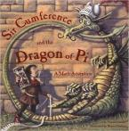
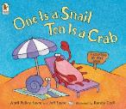
Maths Through Stories
Picture books with a narrative/story that is explicitly linked to mathematical concept(s)
Picture books with a narrative/story that is implicitly linked to mathematical concept(s)
Picture books that are explicitly linked to mathematical concept(s), but without any narrative/story
Notes:
Lynda – Examples of what we are doing in nursery

Slide 12
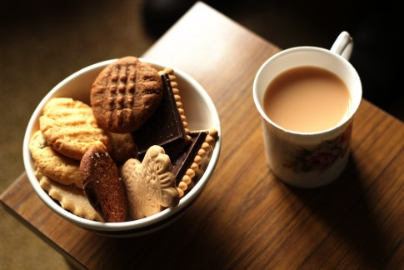
Thanks for Joining our first online Biscuits and Blether!
Any questions?

