Slide 1
Home Learning
Here are some home learning tasks for you to complete. You could use paper and bring this into school tomorrow or you could complete online and upload directly to Teams.
Have a lovely day and stay cozy!
Miss Hall :)

Slide 2
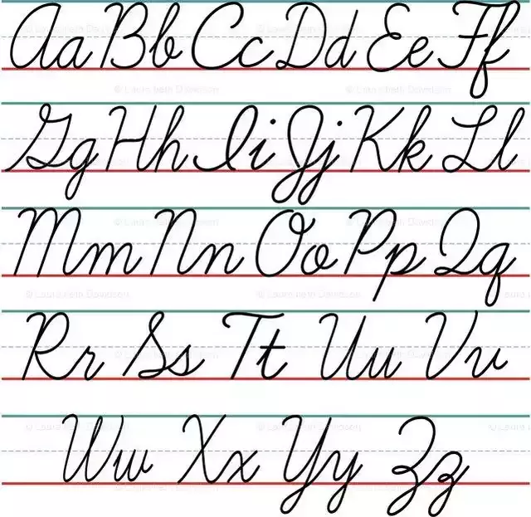
22.1.24 Smart Start
Using cursive handwriting, copy out your Scots poem.
You could also practice reading your poem to your toys or pets.

Slide 3
armies babies buggies centuries dictionaries factories injuries secretaries | disable disagree disclose disown unable undo unlucky | cats rocks dogs bats chains bees
Spelling
Copy words x3
Silly Sentences
Doorway textype practice
*If you have your IDL login at home, please complete 2 lessons.

Slide 4
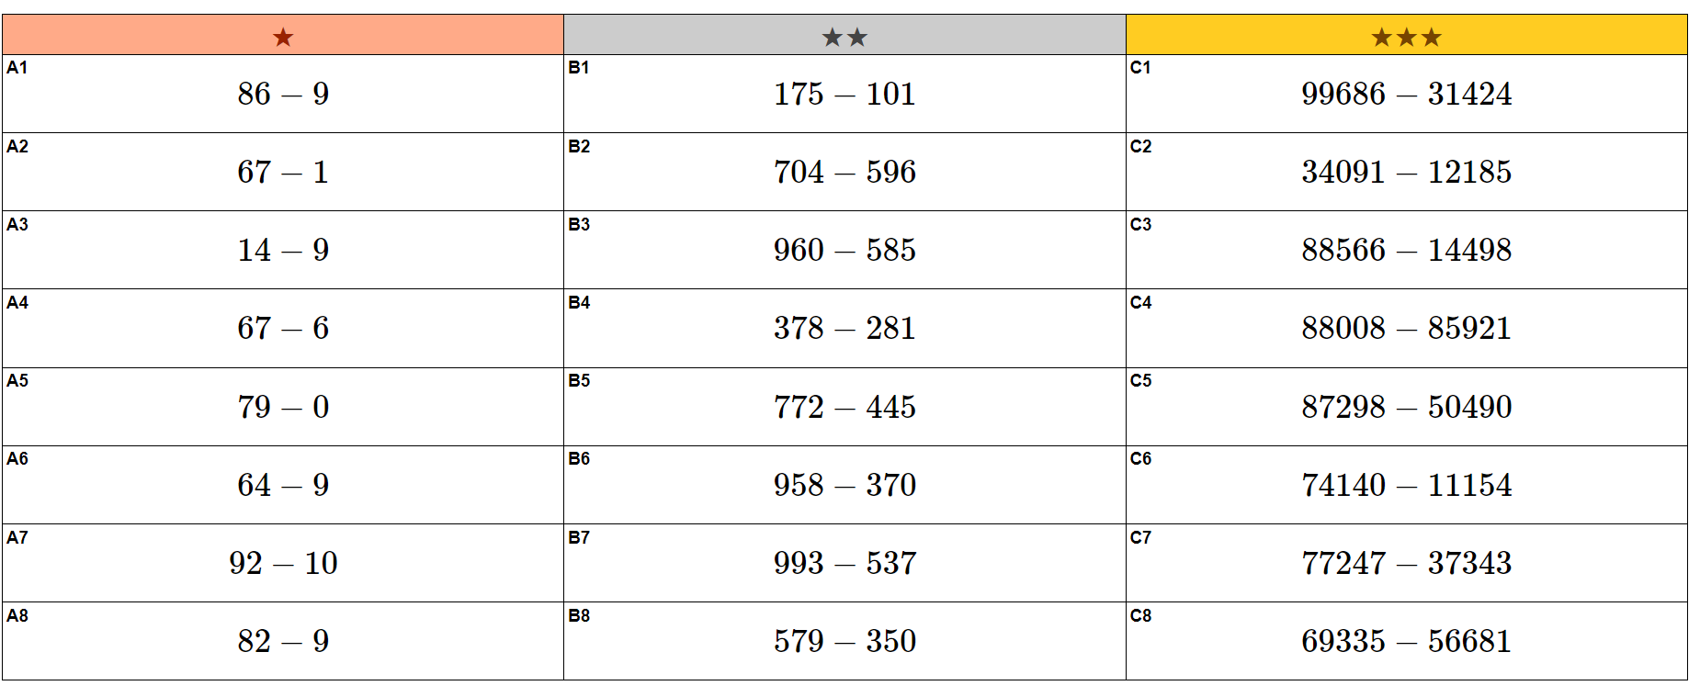
Challenge yourself to practice some subtraction sums using your chosen strategy.

Slide 5
Sumdog
Login to Sumdog and complete today’s subtraction challenge!
https://www.sumdog.com/user/sign_in

Slide 6
Scottish Landmarks
https://www.youtube.com/watch?v=G6TPowZU-QQ
Follow the step by step video to draw a well-known Scottish landmark.

Slide 7
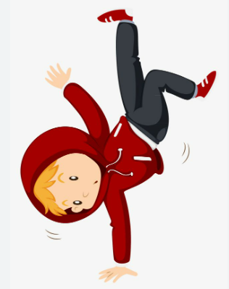
Dance workout
https://www.youtube.com/watch?v=m-ZudUKDFrg

