Slide 1
Welcome to P6
We are going to tell you about routines, nursery buddies, trips, topics and more that you do in P6

Slide 2
EXPECTATIONS
1.We always listen with respect.
2. Listen when the teacher is talking.
3.Do not disrespect the teachers or you will get relocated.
4. Learn about your class charter to help you to remember your expectations.
5. Always do the things that you have been told to do if reasonable.
6.always keep the younger ones safe.

Slide 3
Maths in P6
Algebra
Fractions
Measurement
Coordinates in four quadrants
3d and 2d shapes
Decimals
Percentages
Equations
Mrs comrie’s maths group

Slide 4
Languages
Writing: We wrote diaries, Comics, poems, character descriptions, newspapers and letters.
Reading: We use reciprocal reading roles in groups.
French: We learn French bingo, French writing and a French conversation.

Slide 5
HWB
In p6 a baby comes for Roots of EmpaTHY
We learn how to eat healthily
We do pe with mrs cougan and JJ
safe ways to get to school
A visitor comes in to teach you about the dangers of smoking

Slide 6
Technology
We learned how to use scratch.
Scratch is a website where you can make a simple game and other things like that.
We also learned to make sure certain websites are reliable enough.

Slide 7
Topics
Scottish Inventors-For this topic we made and assembly about the inventions and how they help us today. WE also did some dragons den pitches.
The Jacobite's-For this topic we went on a trip to a place where the Jacobite's once had a camp.
Rivers-we needed to make a power point about the water cycle and the different stages.
The solar system-For this topic we made posters about life in a spaceship (as an astronaut) and we made posters about all the planets in our solar system.
Micheal murpurgo-he was a famous author and we made powerpoints about an animal because a lot of his books had animals

Slide 8
P6 Trips
Sport trips
Basketball Trip; we ate some food and watched it. it was really interesting and inspiring because they did cool tricks.
skiing; we went to hillend in edinburgh for three days of the week and we learned how to do a snowplough, fall safely and to use a draglift.
Triathlon; we went to deans and we did three different things –swimming, running and cycling.
Topic and Learning Trips
EUROQUIZ; A GROUP OF 4 P6s WENT TO HOWDEN PARK CENTRE to take part in the EuroQuiz
Jacobites; We visited the water of leith visitor centre as part of our jacobites topic

Slide 9
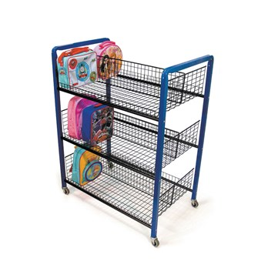
Routines In P6
P6 lunch days are Tuesday.
Quiet Zone: Tuesday P6 & P7, Wednesday P6, Thursday P6 & P7.
We have wet play time classes.
Our Grass day is Thursday.
Our kick pitch day is Tuesday.
We do blue bags on Tuesday.
We do the lunch trollies every day after break time and bring them back before the day ends.

Slide 10
Responsible roles - play ground box and trolleys
Each week we choose 2 new people for each trolley.
We also have to take the trolleys to the hall and after lunch we take them back to each class.
We also choose 2 new people for playground box each week.
Every break and lunch we have to take out the playground box before break and lunch and we take it back in after break and lunch.

Slide 11
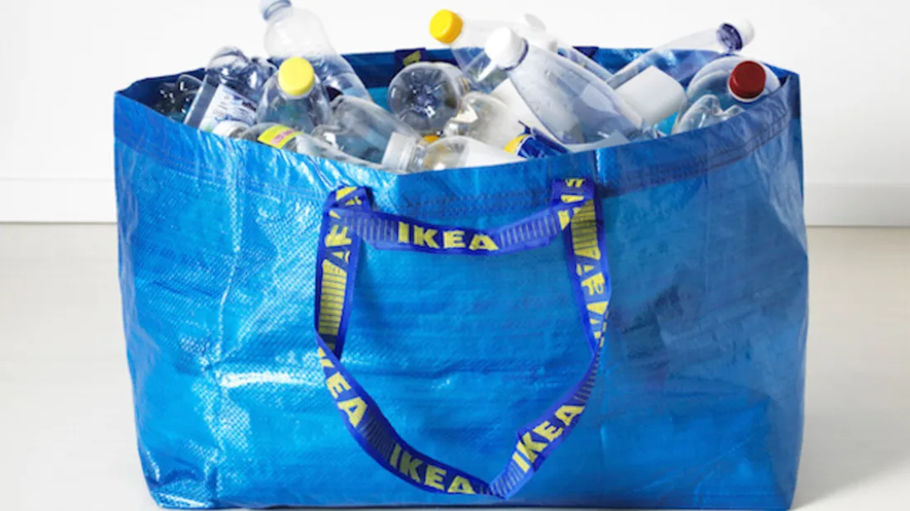
Responsible roles - Indoor break/lunch and Blue bags!
We choose 4 new people for blue bags every term.
Make sure you don’t give the same class 2 blue bags.
Make sure that if you drop paper you pick it up and if you make a mess around the bins pick it up.
For wet break and lunch there are some people in the corridors and the rest in classes
When its wet break and lunch you need to make sure everyone is sitting down.
Make sure to tell the class to tidy up a couple of minutes before the end of break or lunch.

Slide 12
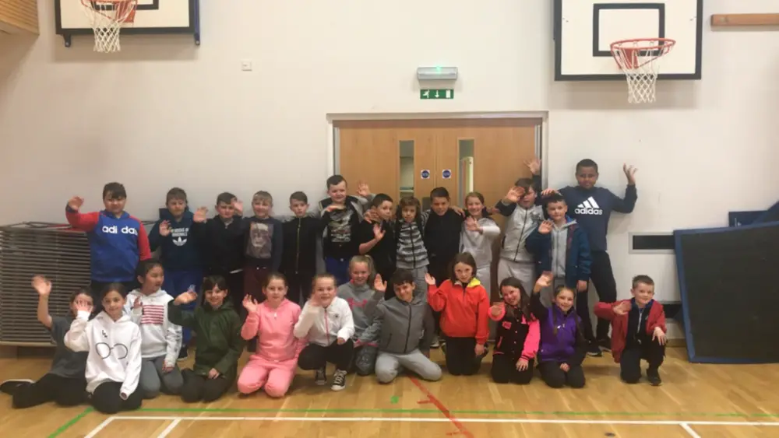
Magic moments
Roots of empathy where we learn how to care for babies
Half way through the year we got to go skiing and we did some other trips
we had nursery buddies

Slide 13
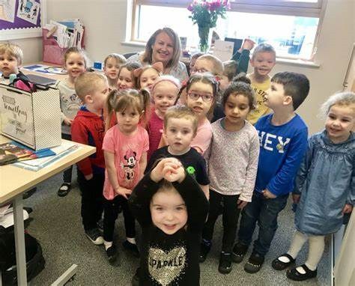
Nursery buddies
Expectations
what the teachers expect
Make sure you are interacting with the nursery kids.
Respect the nursery adults.
If the nursery adults ask you to do something you do it straight away.
Our nursery times were on a Tuesday and a Wednesday but yours might be different.
in the nursery you will get the chance to communicate and play with them.
make sure they are having fun.
make sure you are not being rough whilst you are playing with them.
It is lots of fun you will enjoy going because we enjoyed going.

