Slide 1
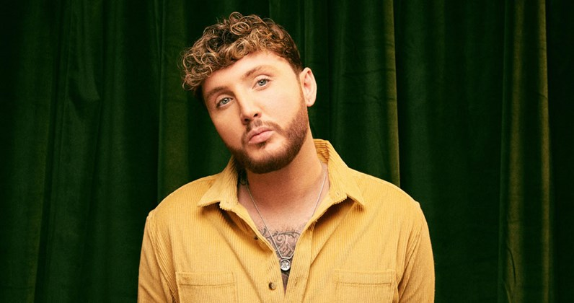
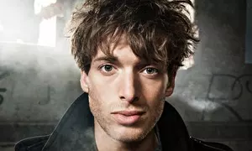
Welcome to our PowerPoint about Scottish singers/musicians. We hope you enjoy☺

Slide 2
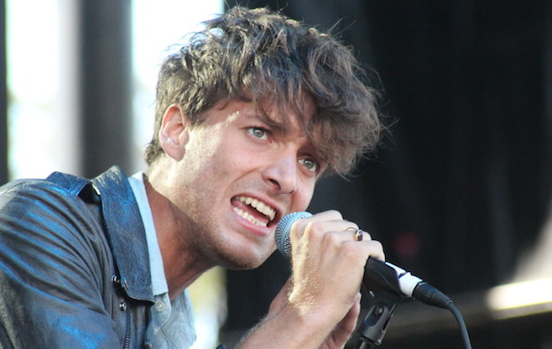
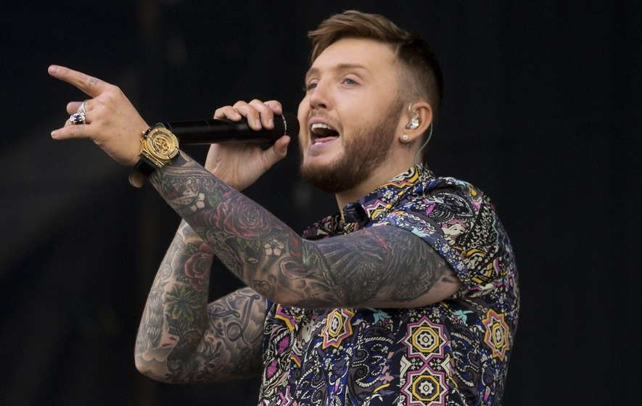
There's a lot of different singers and musicians, but we’re just going to be focusing on two. The two singers we’re focusing on are James Arthur and Paulo Nutini☺

Slide 3
All about James Arthur
His full name is James Andrew Arthur.
He was born on the 2nd of March 1988 which makes him 30 years old.
He was born in Middlesborough, United Kingdom.
James lives in Saltburn-by-the-Sea,with his mother and sisters.
His mother is Shirley Ashworth and father Neil Arthur.
James’s parents split up when he was 2 years old, they both settled with new partners.
Arthur has been writing and recording songs since he was 15 years old.
He has 5 siblings - 1 brother called Neil Arthur, 2 sisters called Sian and Charlotte Arthur and 2 half sisters Jasmin and Neve Rafferty.

Slide 4
All about Paulo Nutini
1.His full name is Paulo Giovannio Nutini.
2. He was born on the 9th of January 1987 which makes him 32 years old.
He was born in Paisley, Scotland.
3.He has a loving, caring girlfriend called Amber Anderson.
4.He has a younger sister and father Alfrodo Nutini and mother Linda Nutini.
5.He has a gorgeous fluffy dog.
6. His top five songs are: Iron sky, New shoes, Last request, Scream (funk my life up), Pencil full of lead and Candy.

Slide 5
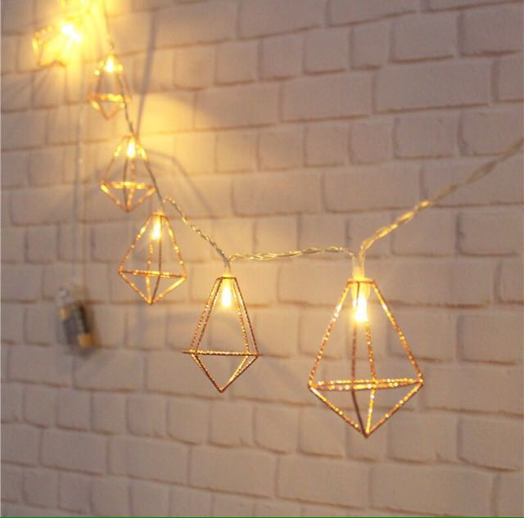
Extra facts about James Arthur
James does not have a dog but he loves to save them.
James has been homeless and has also been in foster care for most of his life, then reunited with his mother and sisters.
James Arthur has confirmed he's still with his ex-girlfriend Jessica Grist, after keeping his relationship under wraps for the past few months.
One of James’s hobbies is to play guitar and often uses it in music.
He has no children.
The genre of music James plays is Pop R&B soul hip hop rock.

Slide 6
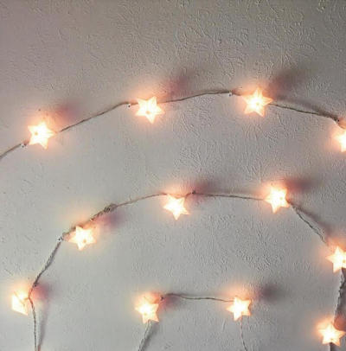
Here are a few pictures of James Arthur and his girlfriend

Slide 7
Extra facts about Paulo Nutini
The type of music Paulo plays is Pop rock, blue
-eyed soul, folk, blues and soul rock.
One of Paulo’s hobbies is to play the guitar and he often uses it in his songs.
He is both a song writer and singer.

Slide 8
Thanks for watching

