Slide 1
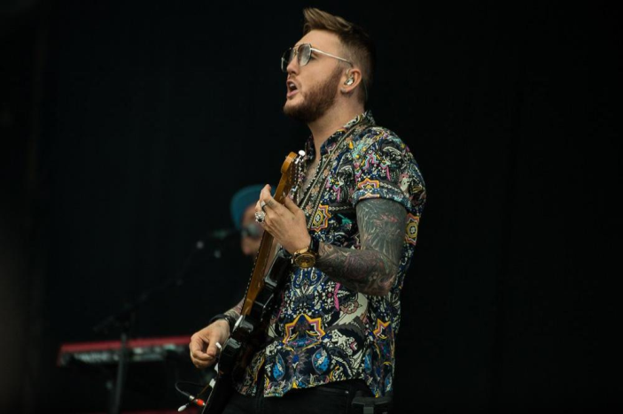
Calvin Harris & James Arthur☺

Slide 2
Calvin’s real name is Adam Richard Wiles.

Slide 3
Calvin Harris was born on the 17th of January in 1984 in Dumfries and that makes him 34 years old .

Slide 4
James Arthur was born on the 2nd of march 1988 in Middlesbrough and that makes him 30 years old

Slide 5
Song genres
James Arthur
Calvin Harris
James is mostly known for his pop music but does other music genres such as classical & contemporary R&B
Calvin is mostly known for his dance/electronic music but does music within most genres, such as pop,rock and hip hop,rap

Slide 6
Instruments James Arthur plays the guitar. Calvin Harris plays a Custom Gibson SG guitar, keyboard etc.

Slide 7
James Arthur has 5 siblings, 4 sisters and 1 brother. The sisters’ names are Neve, Sian, Charlotte and Jasmin, his brothers name is Neil. Calvin Harris has a brother and a sister - Sophie and Edward Wiles.

Slide 8
Calvin’s & James's parents
Mother’s name is Pamela Wiles
Father’s name is David Wiles

Slide 9
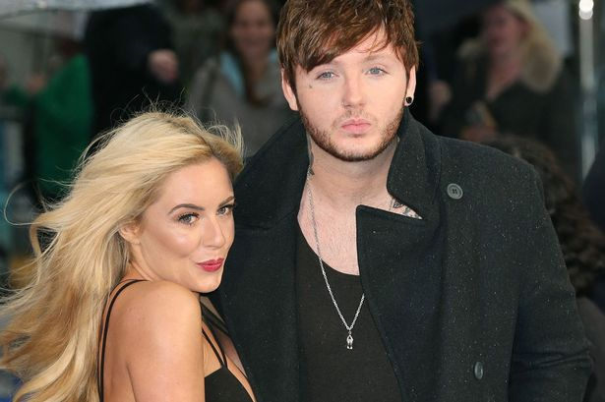
James Arthur has a Girlfriend James Arthur has a girlfriend named Jessica Grist she is 28 years of age named Jessica grist she is 28 years of age

Slide 10
Calvin Harris is currently single but has been out with a few music stars in the past such as Rita Ora, Ellie Goulding, Taylor Swift and more.

Slide 11
Calvin as you know already was born in Dumfries Scotland but is currently living his dream life in California.

Slide 12
James Arthur as you know was born in Middlesbrough England and is still living in England today.

Slide 13
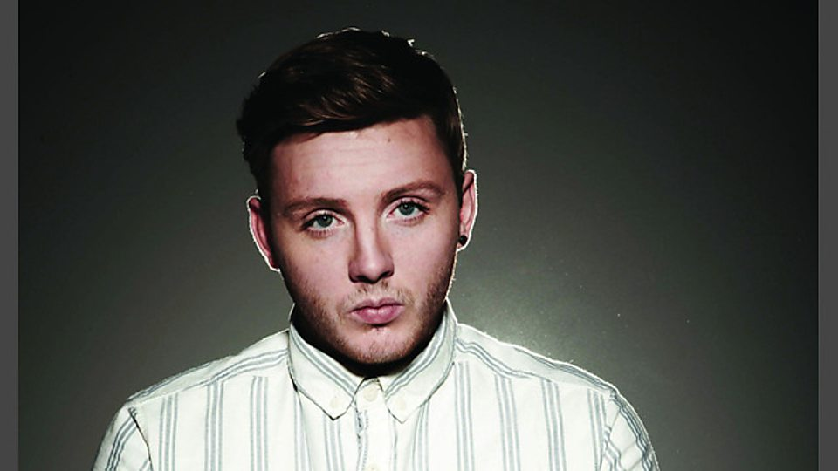
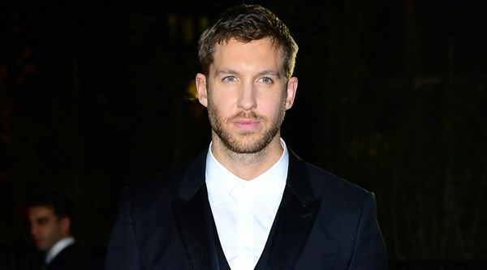
Thanks for listening to our PowerPoint about James Arthur & Calvin Harris ☺

