Slide 1
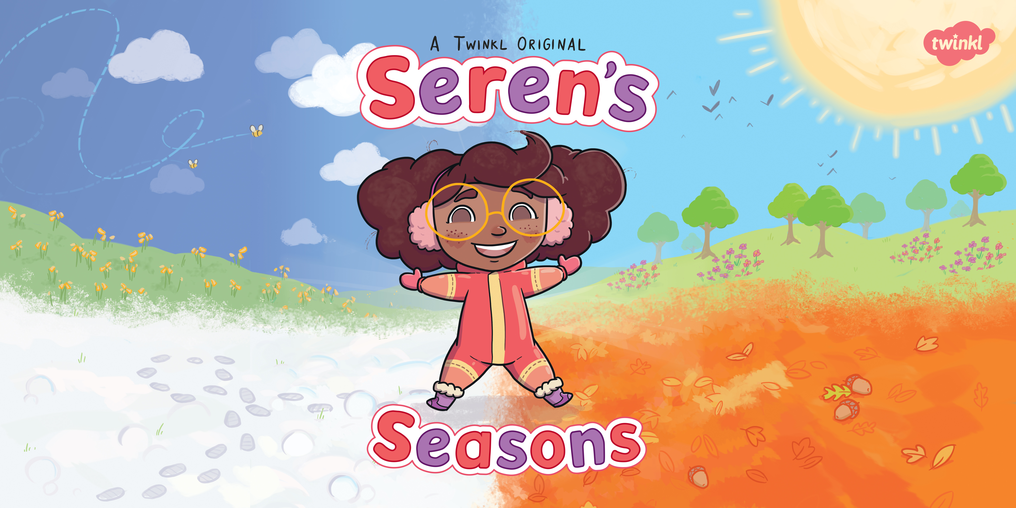

Slide 2
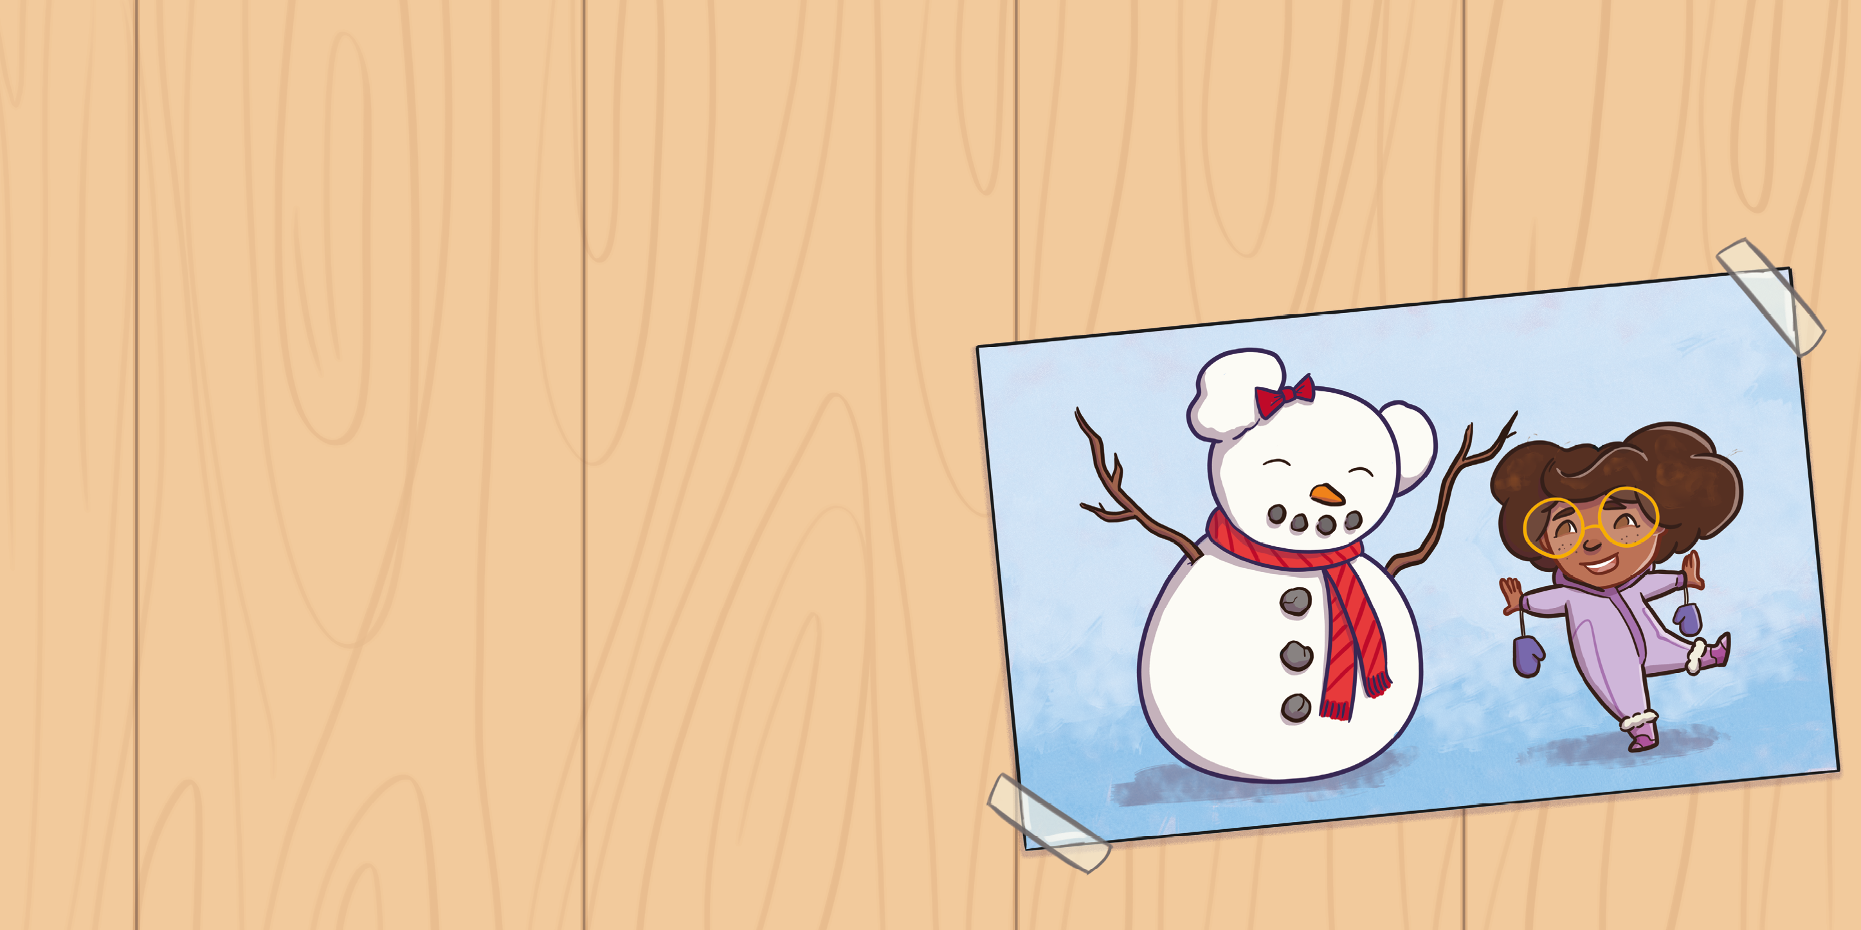

Slide 3
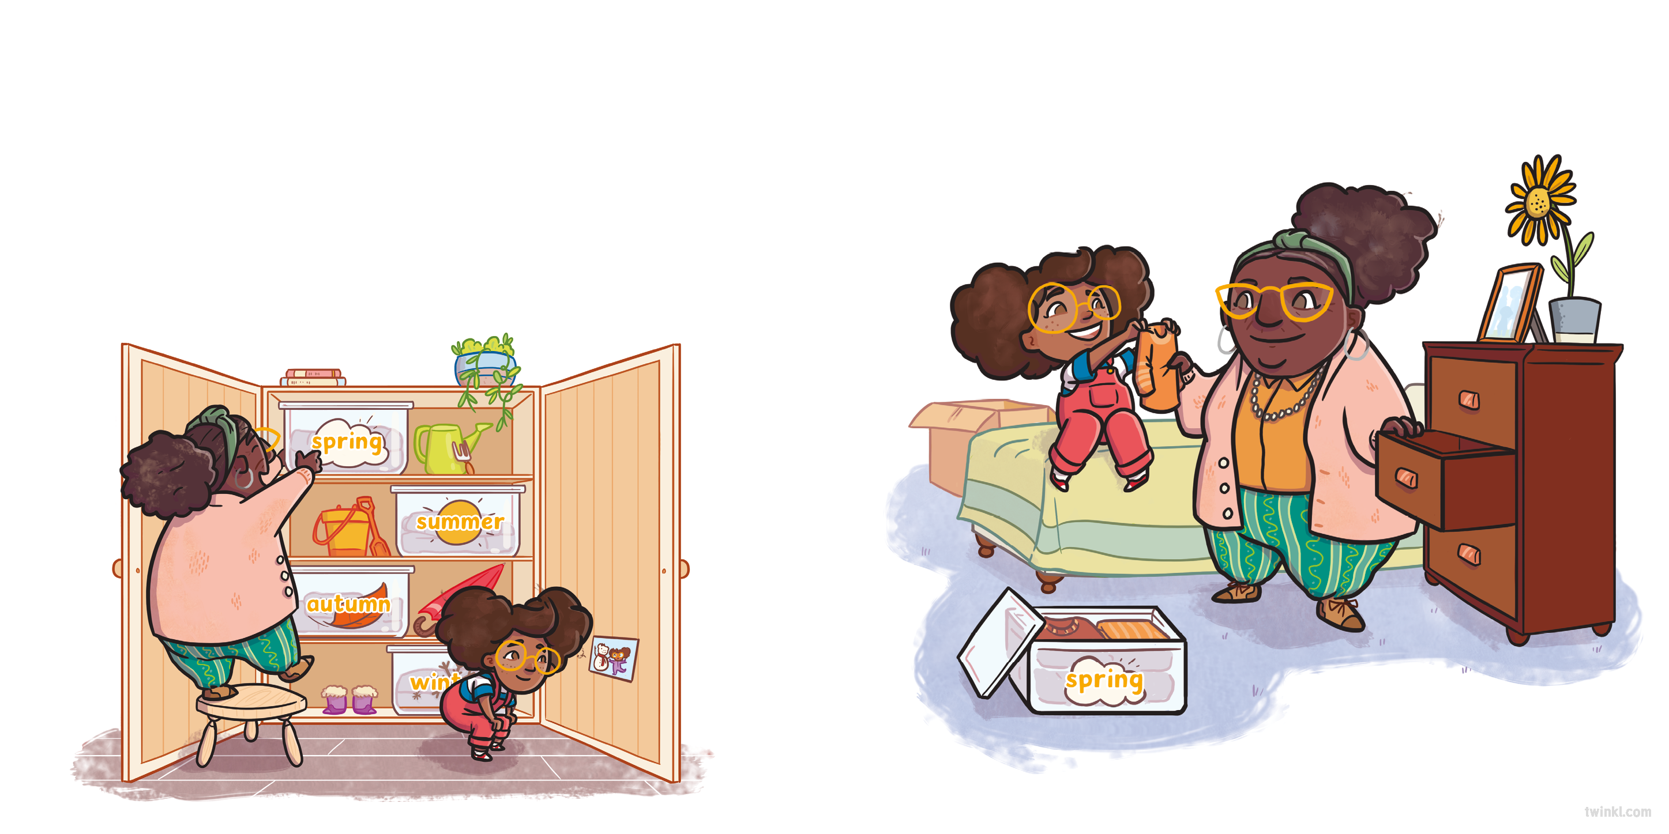
Nain had a big cupboard full of Seren’s clothes.
Seren put the spring clothes into her drawers, leaving her snow boots in the cupboard.
“Will it snow soon?” asked Seren. “Shall we take out my snow boots?”
“It doesn’t usually snow in spring,” said Nain.

Slide 4
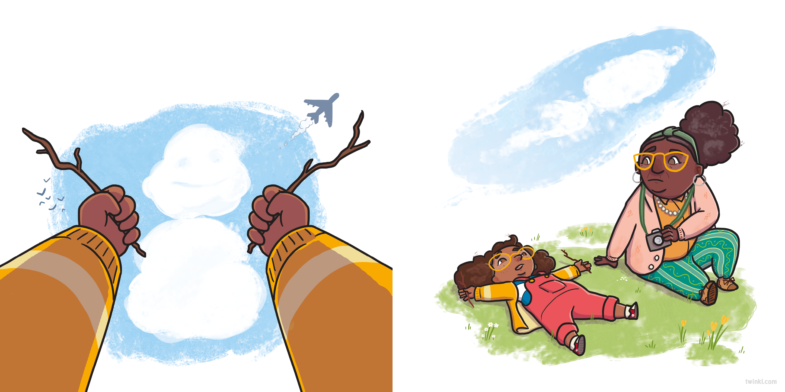
Spring brought lots of different weather. When it was cloudy, Seren lay on the dewy grass, spotting the shapes in the sky.

Slide 5
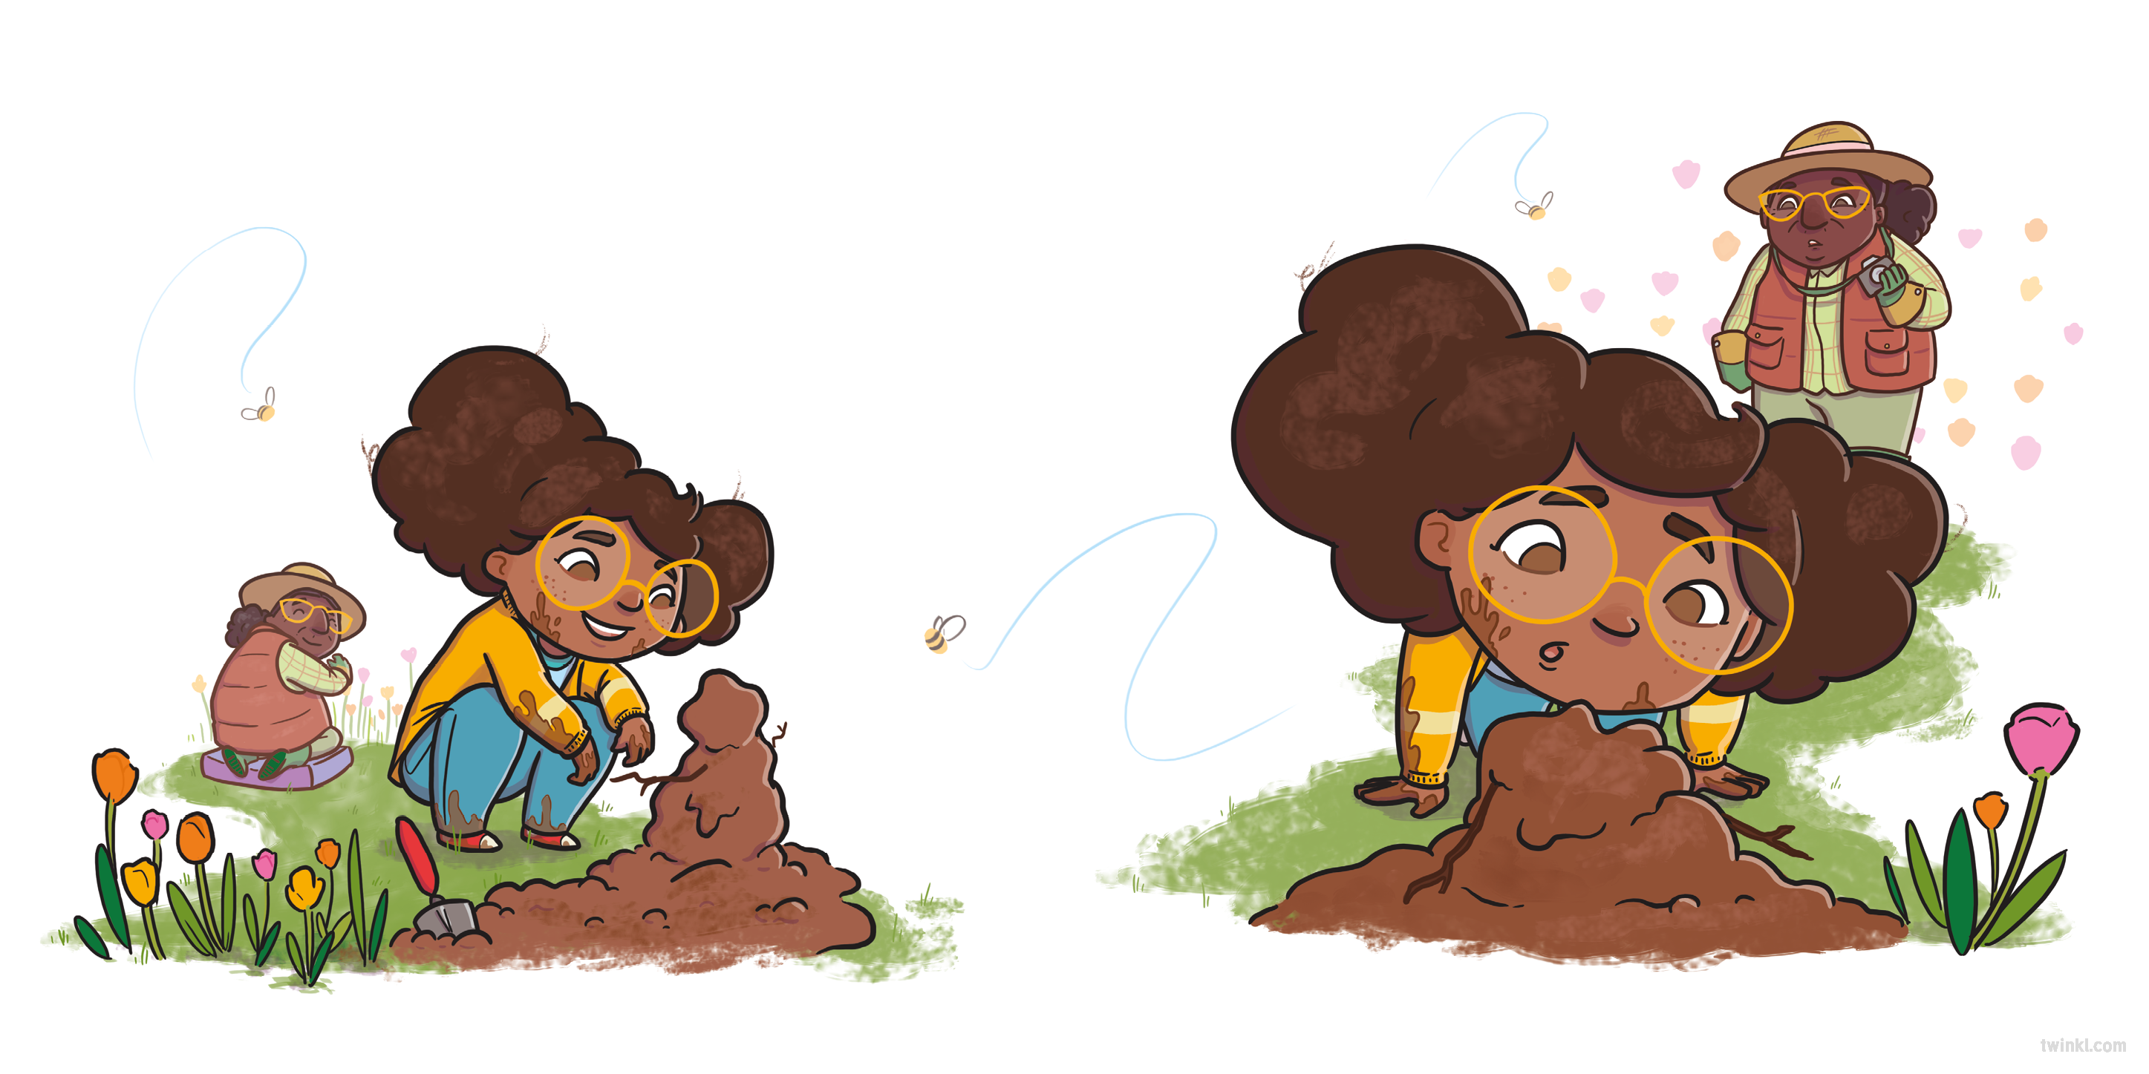
When there was a cool breeze, Seren could smell all the beautiful flowers that had started to bloom.

Slide 6
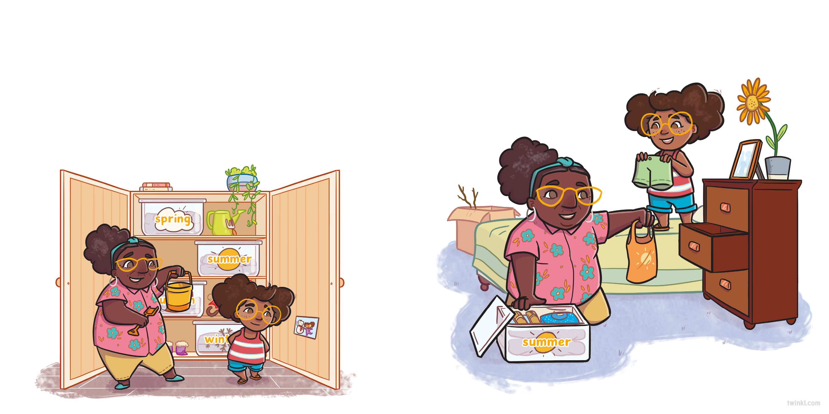
As the weather became warmer, Nain opened the cupboard again.
Seren asked, “Will it snow soon? Shall we take out my snow boots?”
Seren put the summer clothes into her drawers, leaving her snow boots in the cupboard.
“It doesn’t usually snow in summer,” said Nain.

Slide 7
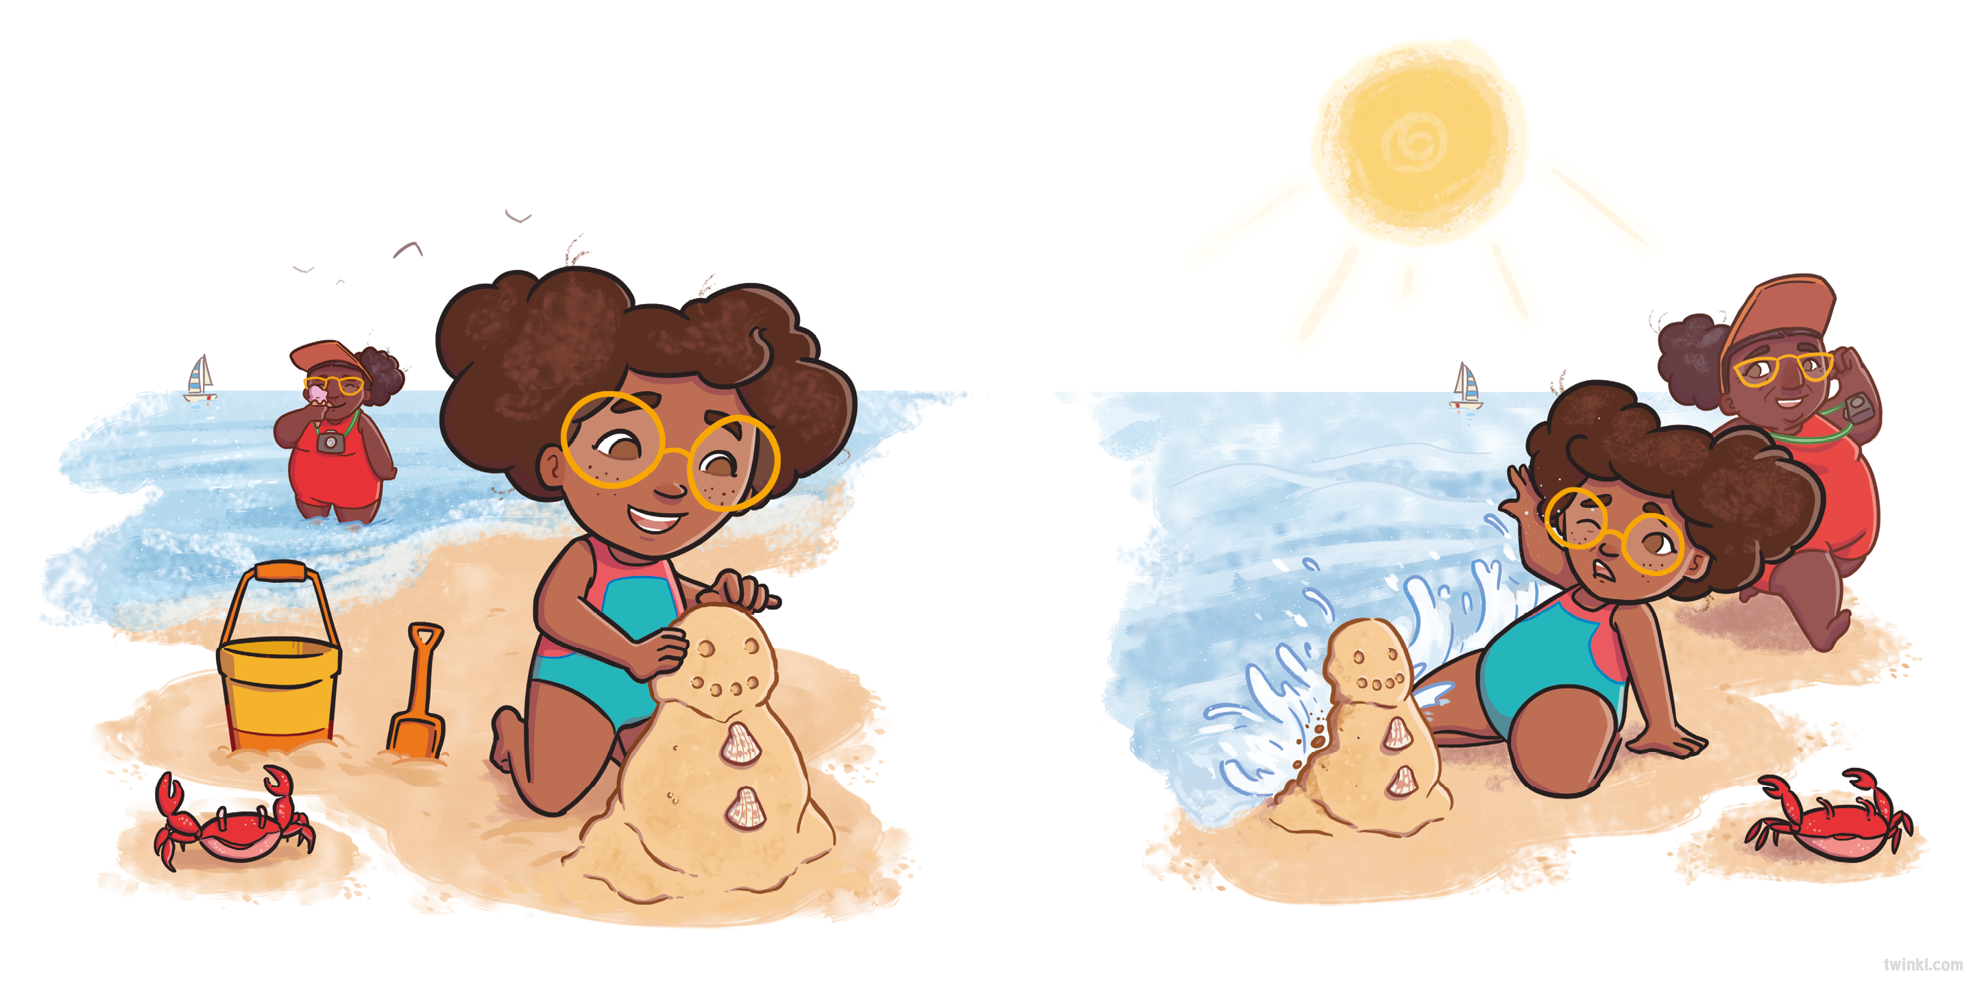
Summer brought lots of different weather. When it was sunny, Seren went to the beach.

Slide 8
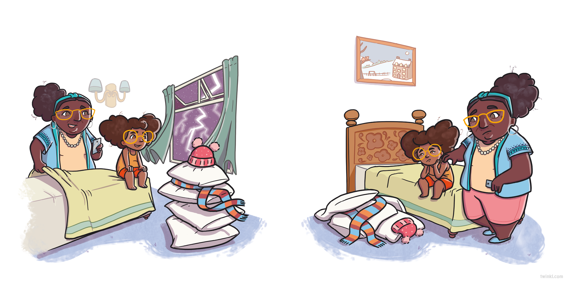
When lightning and thunder filled the sky, Seren watched from her room.

Slide 9
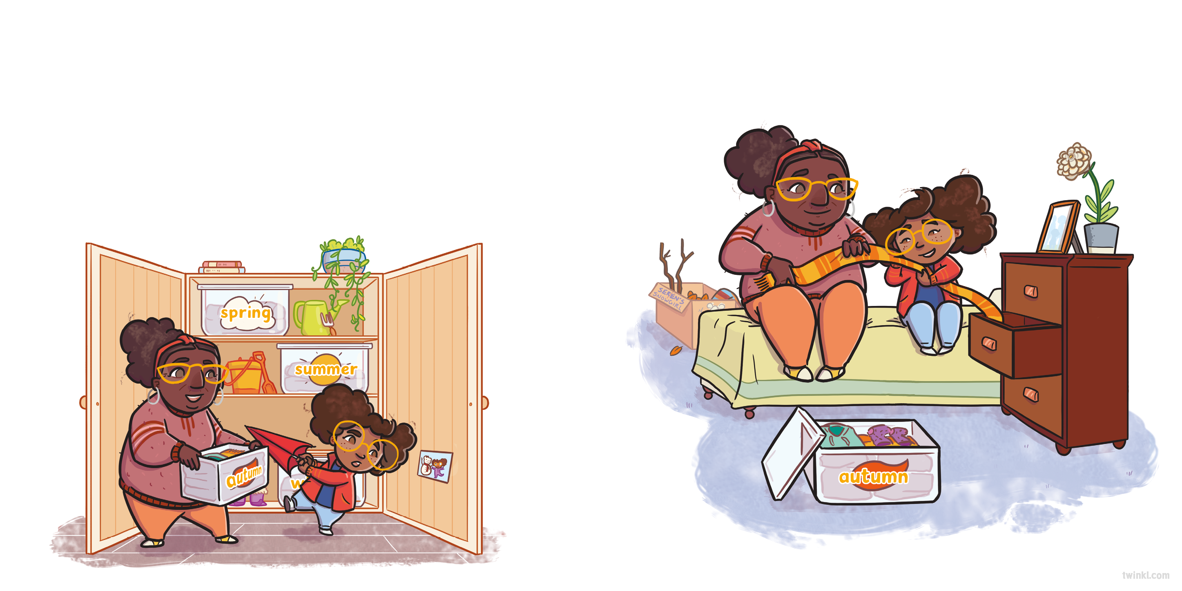
As the days grew colder, Nain opened the cupboard to fetch some warmer clothes.
Seren put the autumn clothes into her drawers, leaving her snow boots in the cupboard.
“Will it snow soon?” Seren asked, again. “Shall we take out my snow boots?”
“It doesn’t usually snow in autumn,” said Nain.

Slide 10
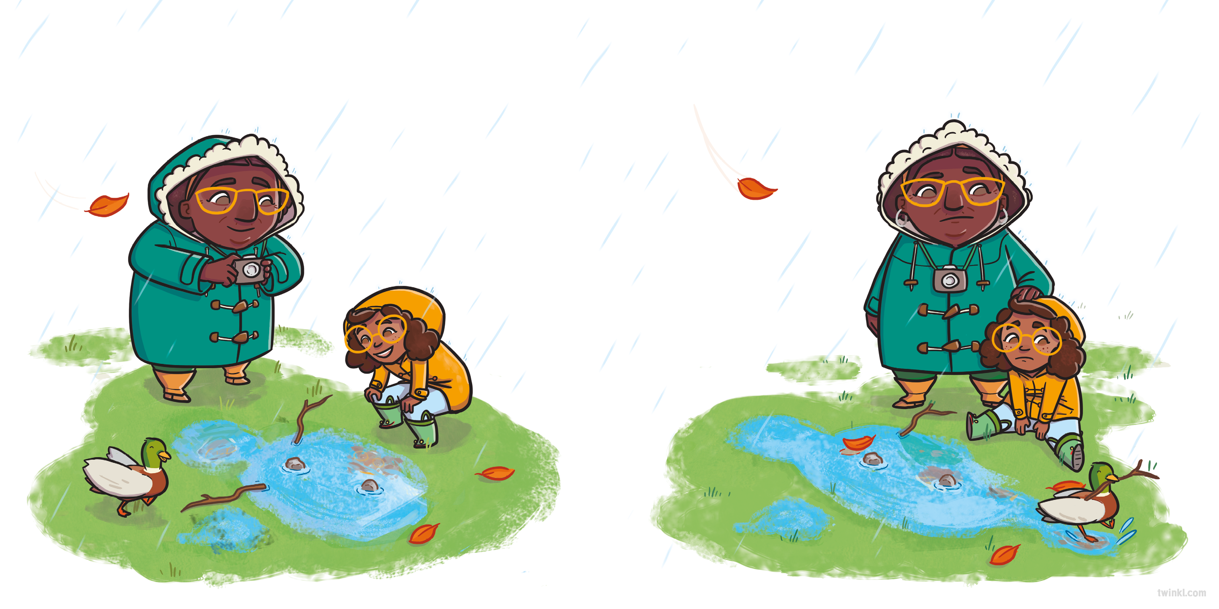
Autumn brought lots of different weather. When it rained, Seren splashed in the puddles in her wellies.

Slide 11
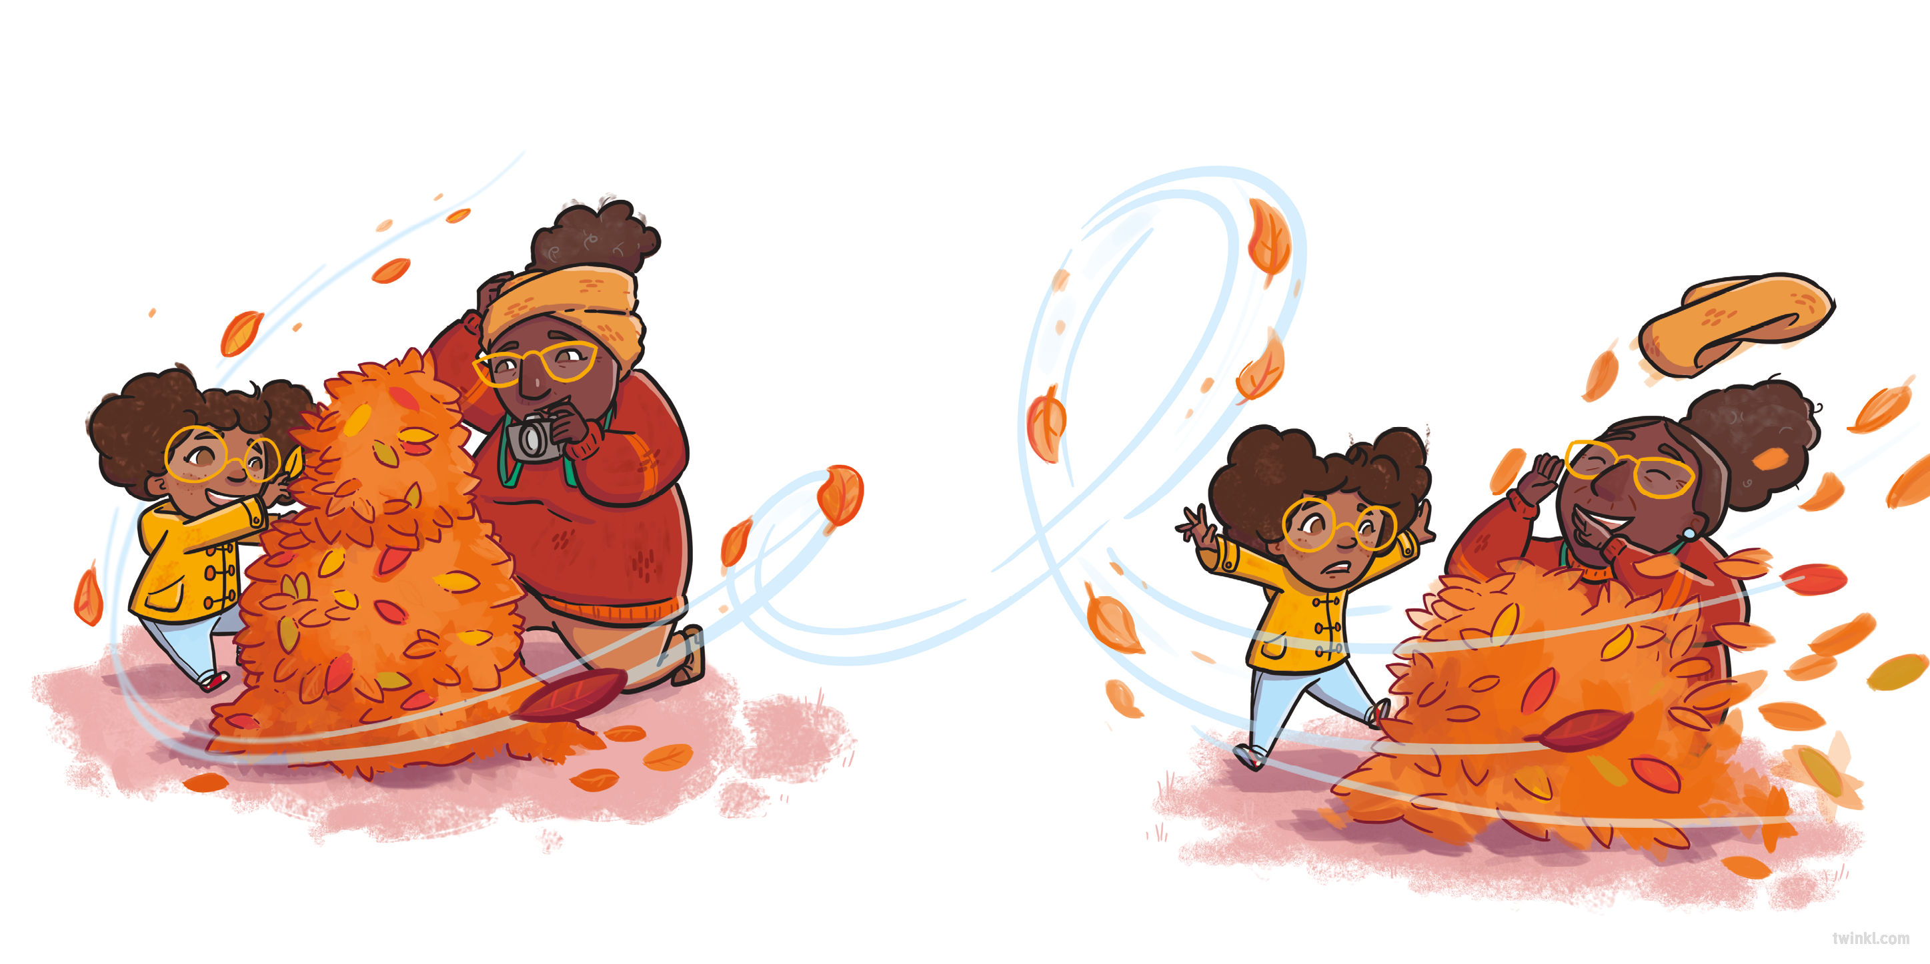
When it was windy, Seren watched the colourful leaves swirling around.

Slide 12
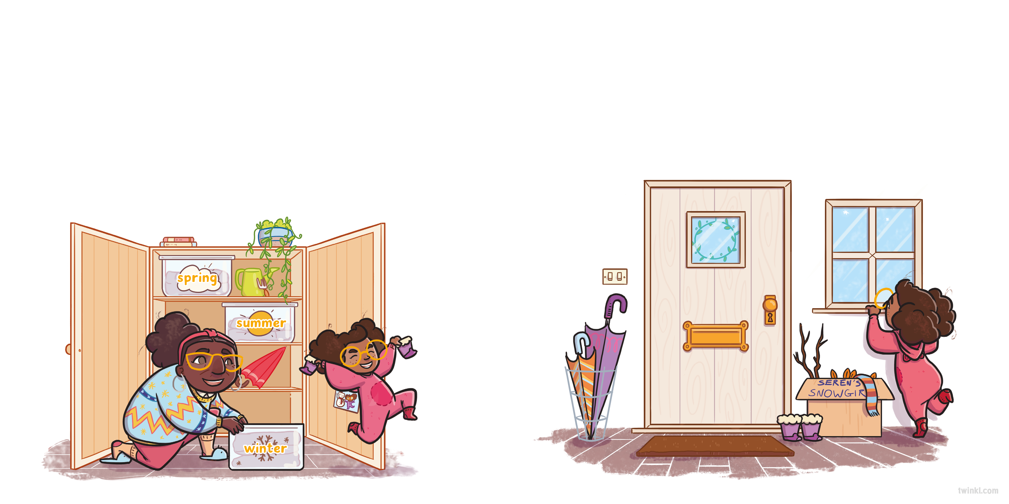
As the nights became longer, Nain opened the cupboard again.
Seren grinned as she put her snow boots near the door.
Winter brought lots of different weather but one day...
“Will it snow soon?” Seren asked. “Shall we take out my snow boots?”
“Well, it is winter,” said Nain. “It could snow any day now!”

Slide 13
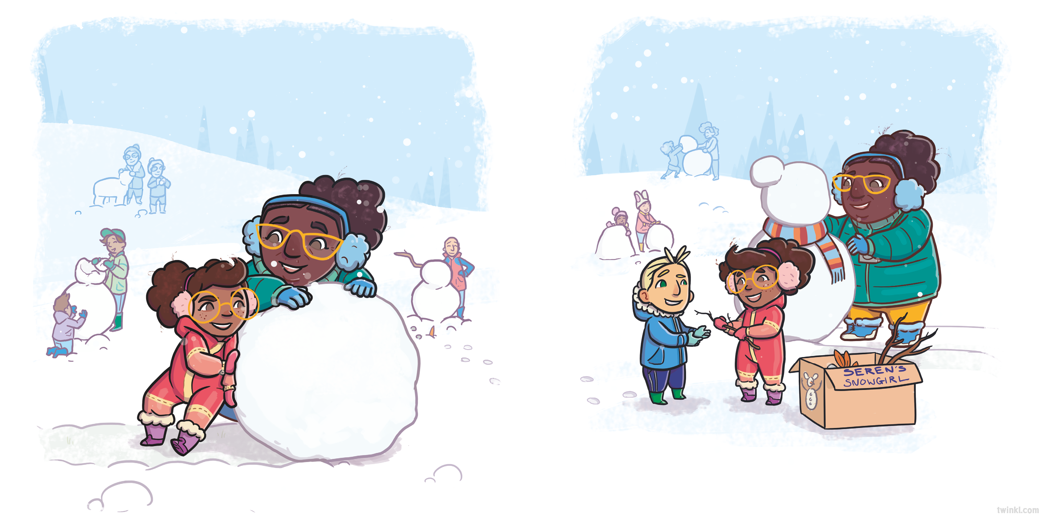
...it snowed!
Finally, Seren had everything she needed to build the perfect snowgirl.

Slide 14
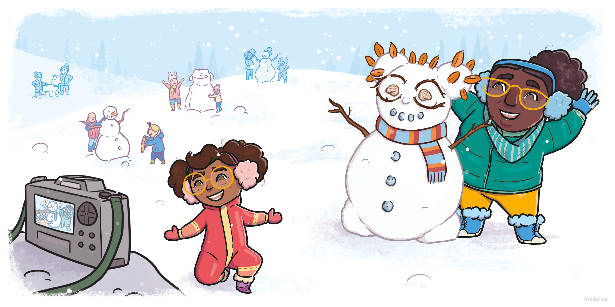

Slide 15
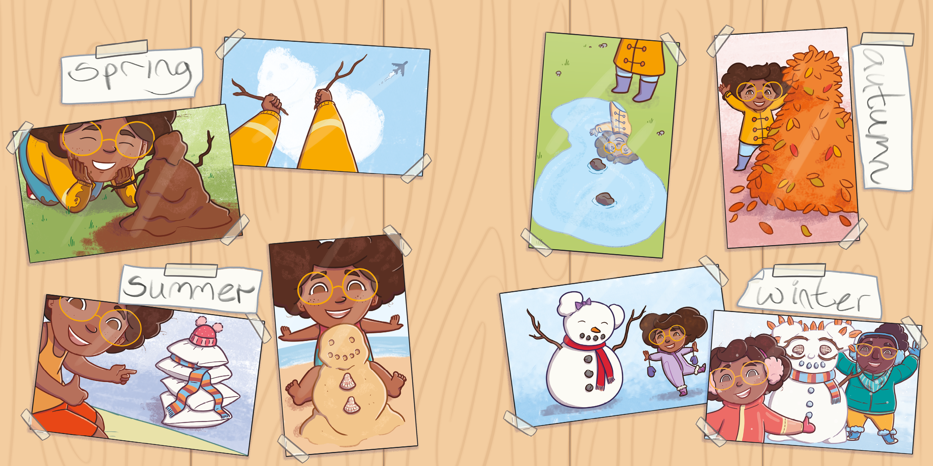

Slide 16
