Slide 1
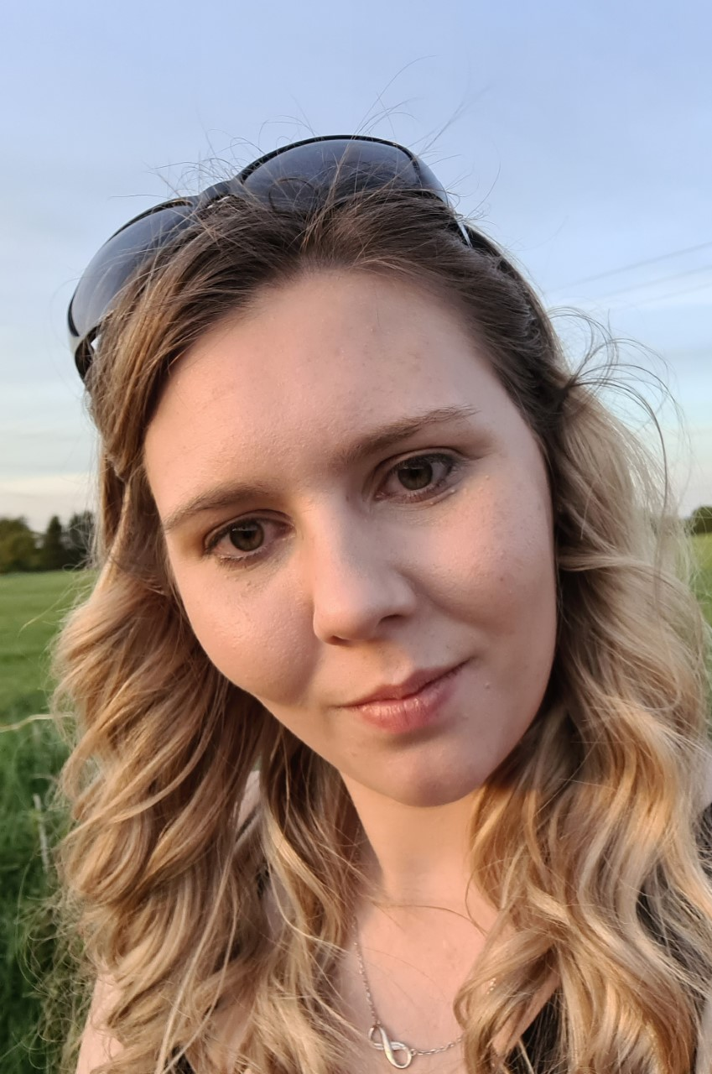
ALL ABOUT ME…
MY NAME IS MISS TALLIS
I AM AN AVANCED PUPIL SUPPORT WORKER WHO WILL BE WORKING IN YOUR SCHOOL
I AM REALLY LOOKING FORWARD TO GETTING TO KNOW YOU
MY FAVOURITE THINGS ARE…
My family
Chocolate
Dogs
Listening to music
Going on woodland walks
Disney
Marvel
Fancy pens

Slide 2
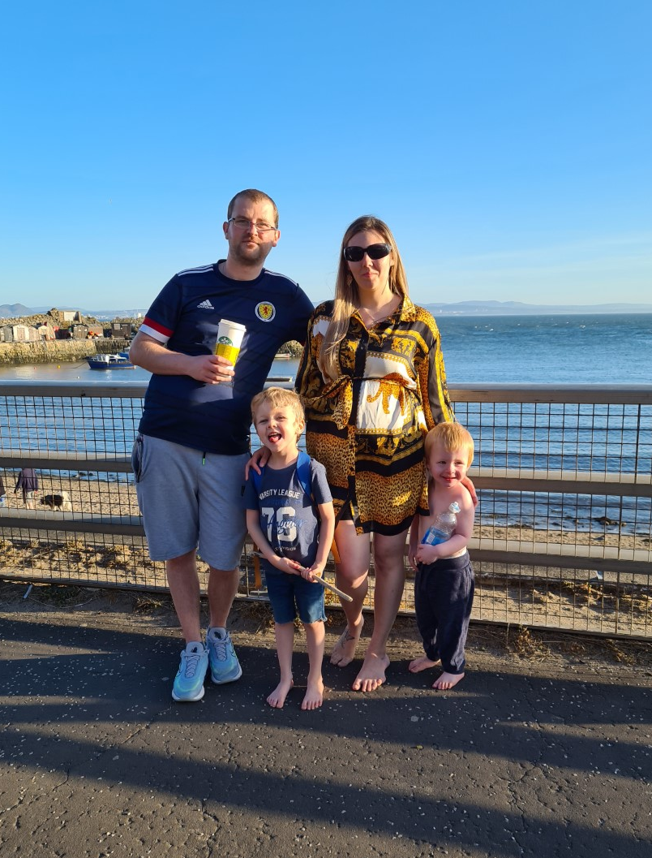
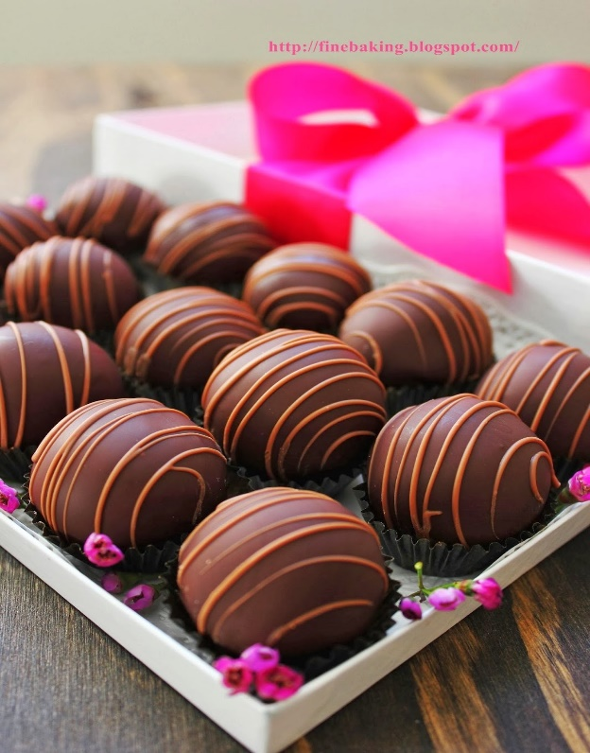
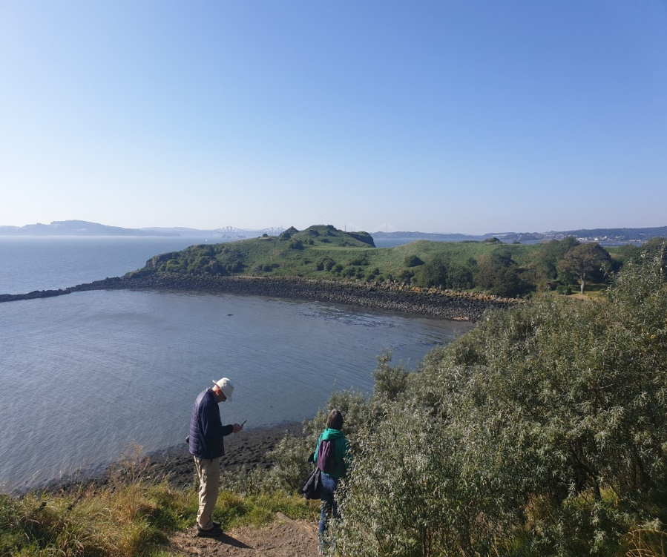
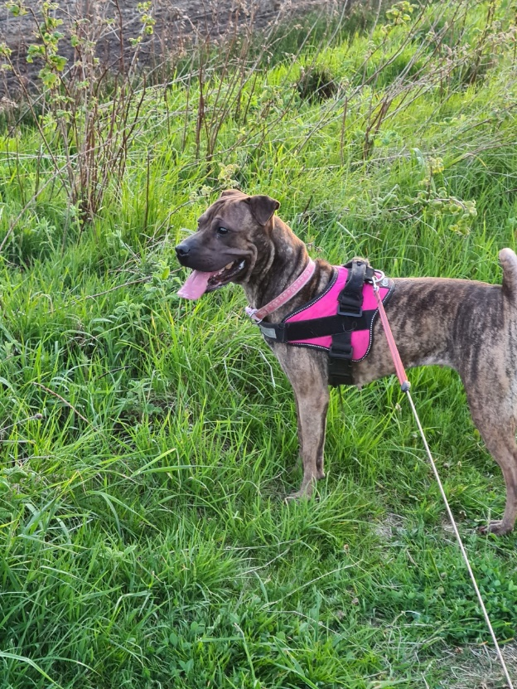
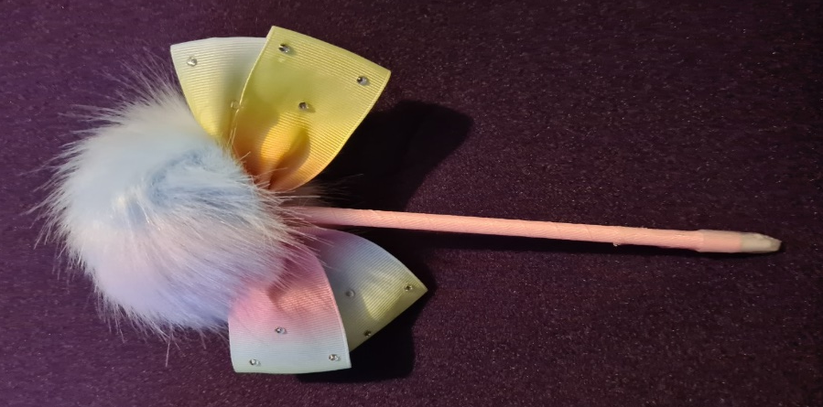
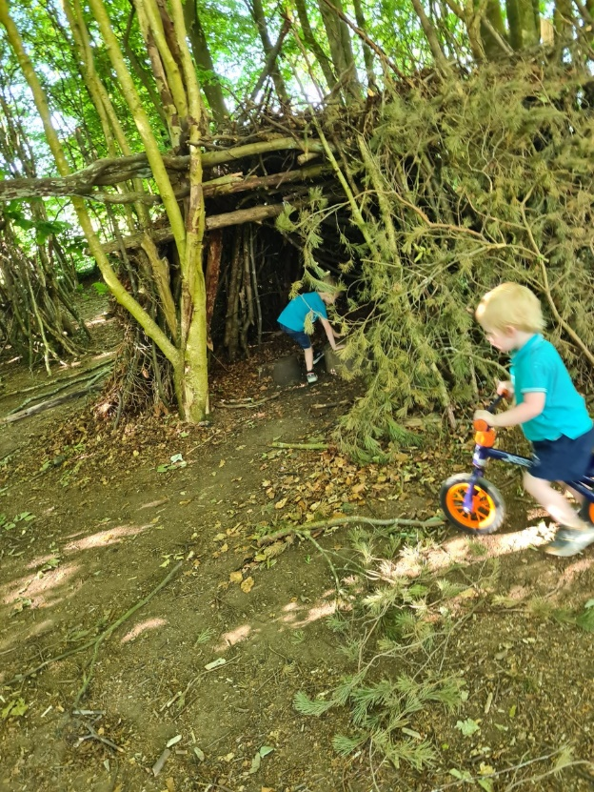
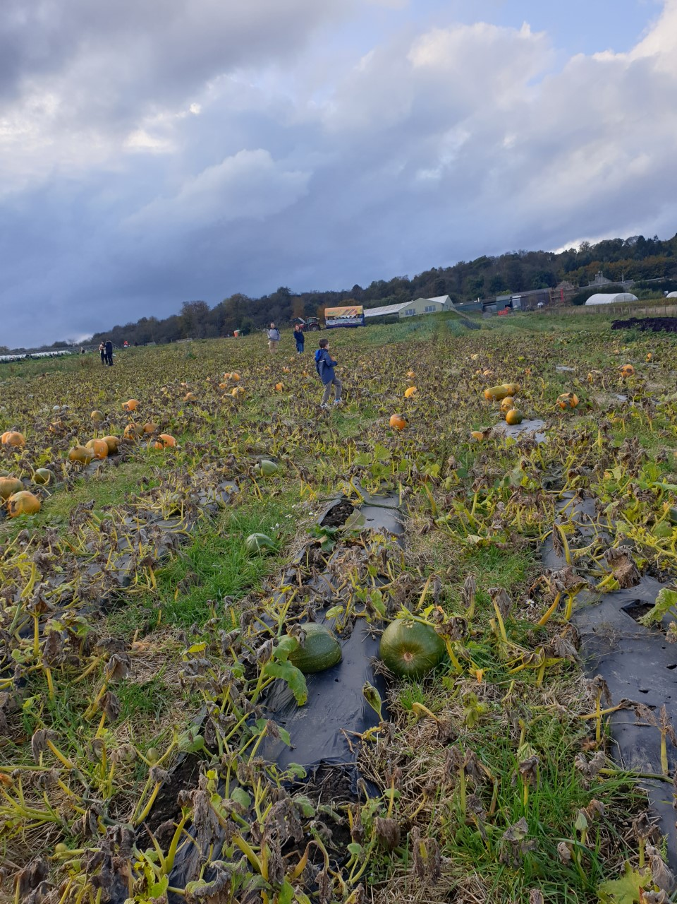
MISS TALLIS FAVOURITE THINGS

