Slide 2
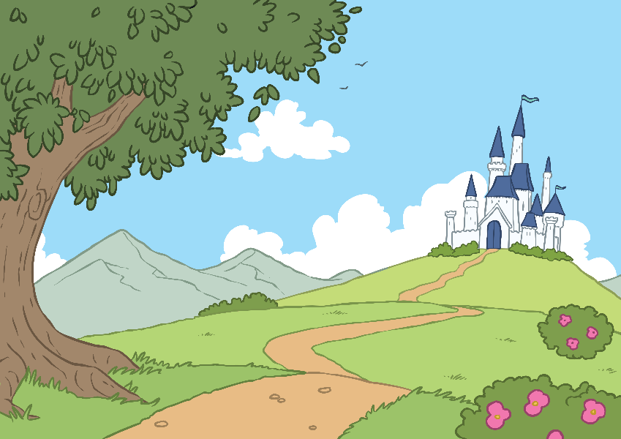
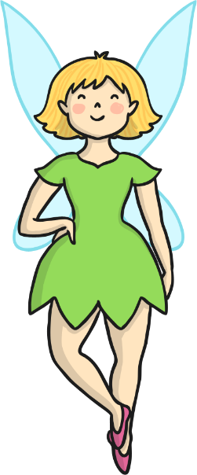
Disney
You have probably heard of the word Disney before. Disney films, Disney World, Disneyland. But did you know that Disney is actually the name of the person who started all these things?
This person is Walt Disney and we are going to learn all about him and how he ended up making so many famous films and places.

Slide 3
Walt Disney
Walt’s full name was Walter Elias Disney, but people called him Walt
for short.
Talk About It
Do people ever shorten your name? If so, what do they call you?
He was born in Chicago in the United States of America in 1901, that’s over one hundred years ago.

Slide 4
Walt’s Early Years
Walt had three older brothers, Herbert, Raymond and Roy. Two years after Walt was born, a little sister named Ruth joined the family. Throughout his life, Walt was particularly close to Roy.
As a child, Walt’s family moved towns several times because Walt’s dad sometimes found it difficult to get a job.
Talk About It
How do you think Walt felt moving towns? Do you think he missed his old friends? Have you ever moved to a new place? What was it like?

Slide 5
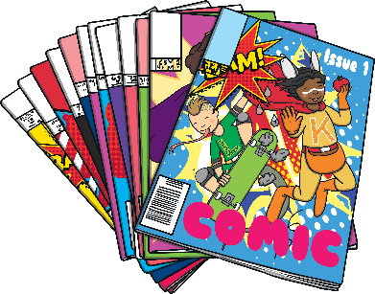
Walt’s Early Years
From an early age, Walt loved drawing. He copied pictures from newspapers and comics.
When Walt’s family lived in Missouri, they lived near a trainline. Walt became really interested in trains.
To help earn money for their family, Walt and Roy did a newspaper round. They used to get up at 4.30 in the morning, deliver the papers and then go to school. After school, the boys would deliver more newspapers. They even did this in the middle of winter when there was lots of snow and it was freezing cold. Walt was very tired and sometimes fell asleep in school.

Slide 6
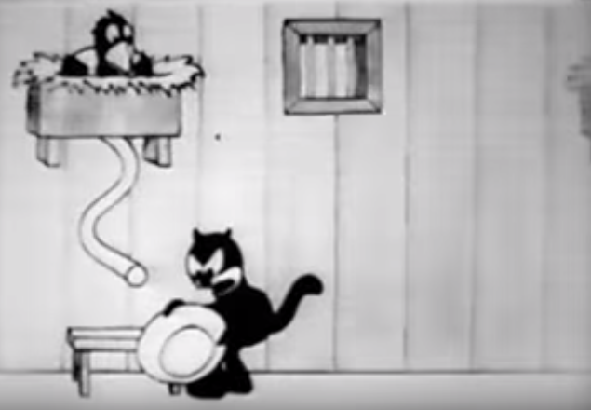
Illustrating
As a grown up, Walt still loved drawing. He got a job drawing pictures for adverts in newspapers and magazine.
With some friends, Walt started a company making short films. Walt had the idea of putting a real life girl in a film with cartoon characters. The film was based on the story of Alice’s Adventures in Wonderland. It wasn’t like the Disney films you watch today – it was only twelve minutes long, it was in black and white and it had no sound!
Sadly, the company didn’t make enough money and stopped making films. This wouldn’t be the last time Walt suffered a set back.

Slide 7
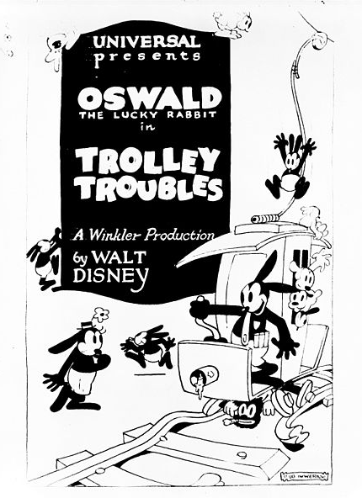
Oswald the Lucky Rabbit
Walt moved to Hollywood where he got a job drawing pictures for a film studio. His brother Roy was already in Hollywood. Walt invented a character named Oswald the Lucky Rabbit who appeared in lots of films.
When Walt left the company, he was shocked to find out that it would be against the law for him to use Oswald in any more films. The film company owned Oswald. Walt felt very sad.

Slide 8
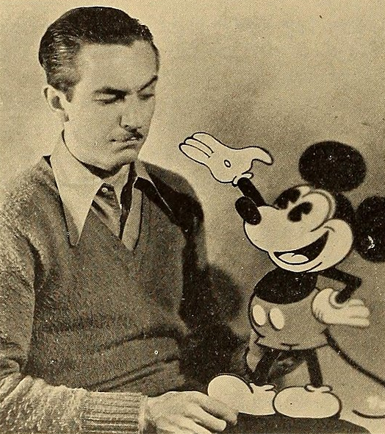
Mortimer…. No, Mickey!
Feeling sad and worried about the future, Walt was on a very long train journey across America.
An idea popped into his head… well actually it was a mouse! Walt started to draw and by the end of the journey, he had created a brand new character.
When he arrived home, he showed his wife Lilian the new character who he had named Mortimer. Lilian loved the mouse, but didn’t like his name. She suggested Mickey.
And that is how Mickey Mouse was born!

Slide 9
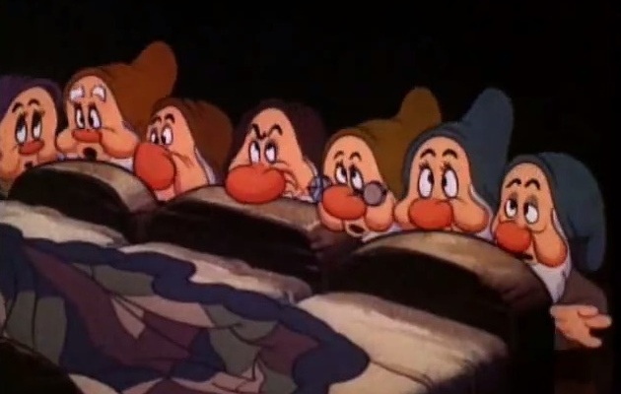
Making Films
Walt and Roy started another company and started to make short films. Mickey was joined by Minnie Mouse, Donald Duck and Goofy. Their films became more popular and they won a special film award called an Oscar.
Walt loved trying new things so set himself a new challenge. He decided to create a full-length, colour film with words and songs. In 1937, his film Snow White was released. This was followed by Pinocchio and Fantasia in 1940.

Slide 10
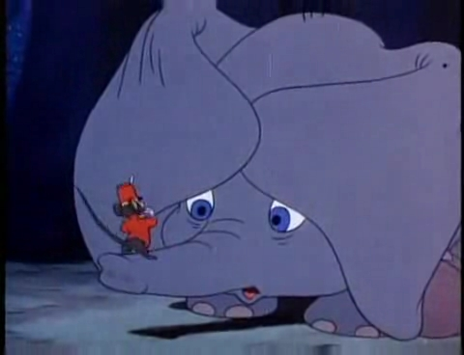
Walt’s Other Films
Walt’s films grew in popularity and his company known then as Walt Disney Pictures, made many films. Here are some of the most well known, although there are lots more:
1941 – Dumbo
1950 – Cinderella
1951 – Alice in Wonderland
1953 – Peter Pan
1955 – Lady and the Tramp
1959 – Sleeping Beauty
1961 – 101 Dalmatians
1964 – Mary Poppins

Slide 11
Walt Disney’s Disneyland
It may seem hard to believe but a long time ago, not many people had televisions! Over 60 years ago during the 1950s, television became very popular.
Walt realised this and decided to make his own television show. Every week, Walt presented a show telling stories and introducing different characters from his films.
Talk About It
If you were going to make your own television show what would it be about?

Slide 12
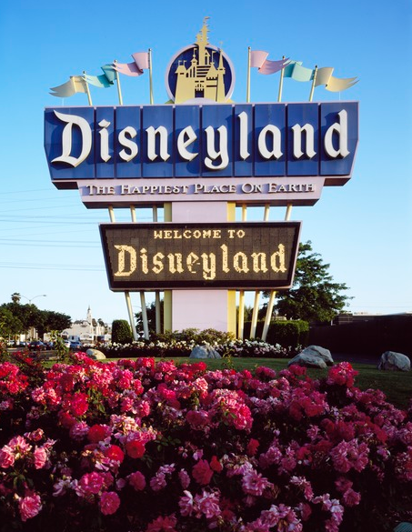
Disneyland
Walt and Lilian had two daughters, Diane and Sharon. Walt said Saturdays were ‘Daddy’s day’ and he was always looking for fun places to take his little girls.
An idea began to come into his head to build a place where parents and children could have fun together.
In 1955, Walt’s idea became real when the theme park Disneyland was opened.

Slide 13
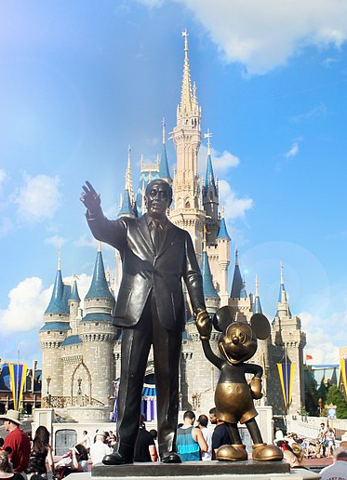
Walt Disney World
Walt continued to make films and had started plans on a new theme park, called Disney World, in Florida.
Sadly before Disney World opened, in 1966 Walt died.
Roy took over the plans to build the park and renamed it Walt Disney World in memory of his brother.
This special statue of Walt and Mickey was put in the Magic Kingdom in Walt Disney World. It reminds people of what Walt once said: ‘I only hope that we never lose sight of one thing — that it was all started by a mouse.’
Walt, Mickey, and the Castle by Jake Toczek is licensed under CC BY 3.0

Slide 14
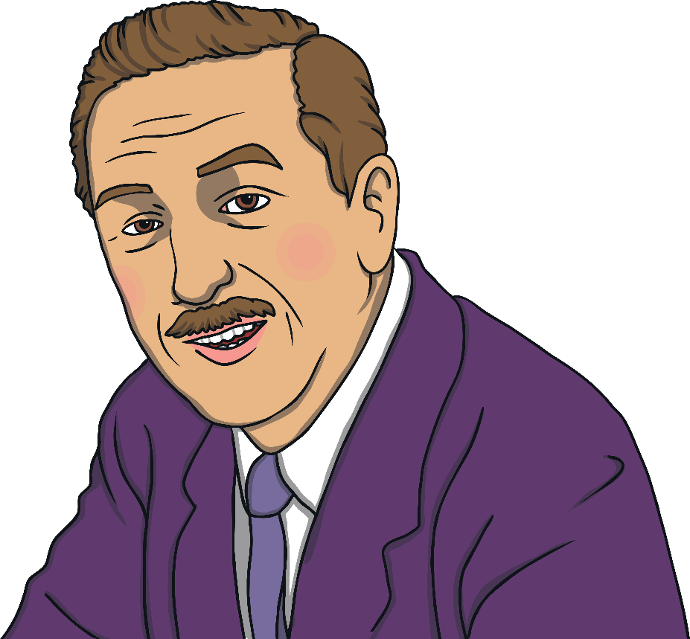
Walt’s Words
During his life, Walt said many things that have been remembered.
‘All our dreams can come true, if we have the courage to pursue them.’
‘Why worry? If you’ve done the very best you can, then worrying won’t make it any better.’
‘If you can dream, you can
do it.’

