Slide 2
A long, long time ago …
Before there were supermarkets and shops to go and buy food, people had to find it for themselves.
A long time ago people in the Stone Age, had to hunt and gather food. They moved around a lot.
These people were called Hunter-Gatherers.
They hunted animals for meat.
They looked for berries, fruits and plants.
They caught fish using nets.
Talk about it.
If you were a hunter-gatherer, what plants might you use that grow near where you live?

Slide 3
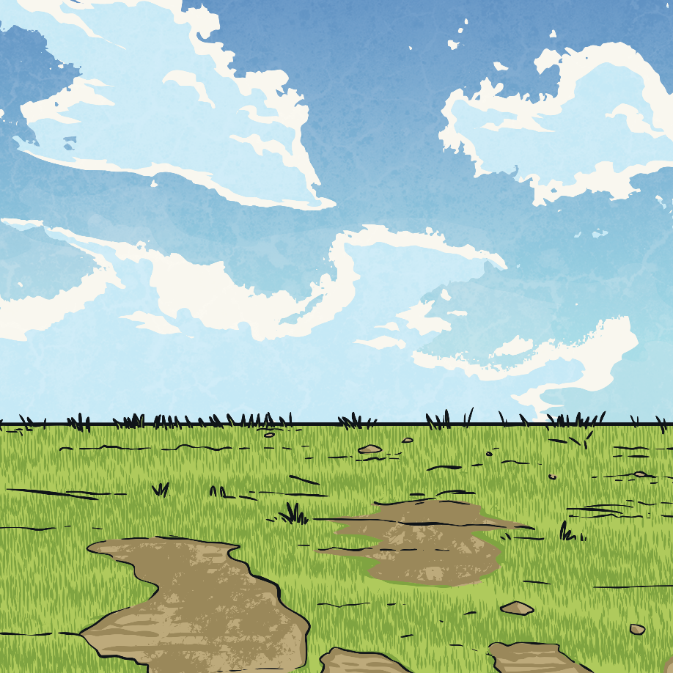
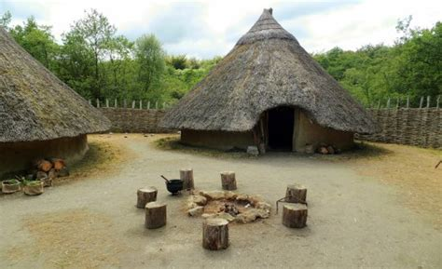
The Start of Farming
Around 4000 years ago some people stopped being moving so much.
They stopped being hunter-gatherers.
They started using the land to keep animals and grow their own food.
This was the start of Farming.

Slide 4
Farming
Farms were made by clearing away the trees.
The trees were used to build houses for the people.
The land around the houses were used as farms.
This was still the stone age because they used lots of stone for tools.

Slide 5
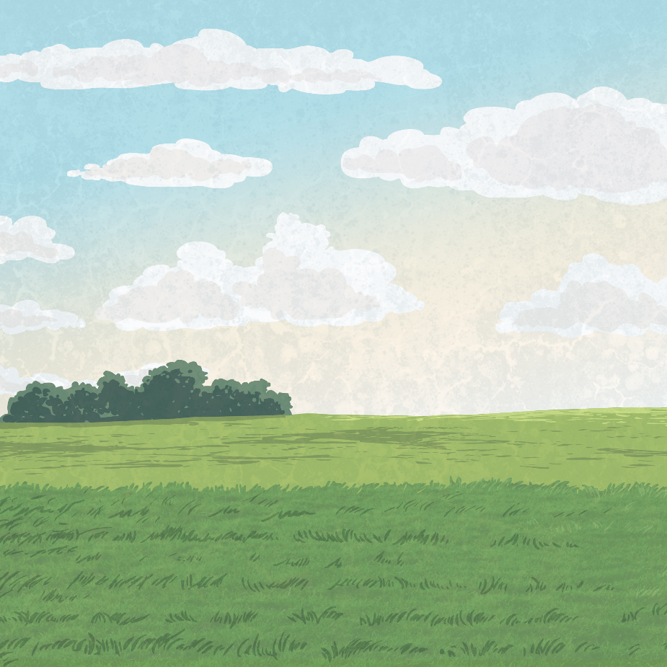
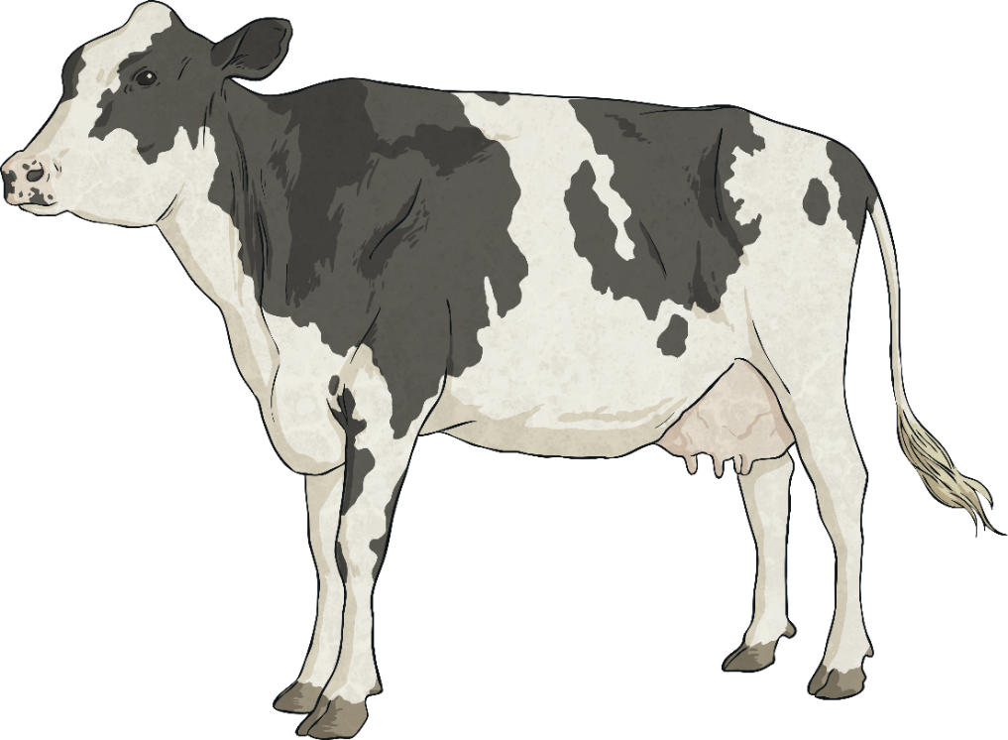
Animals
Stone Age farmers kept animals.
These animals included cows, sheep, goats and pigs.
Talk about it.
What could farmers get from each animal?
The farmers could get:
meat, milk and leather from cows;
meat, milk and wool from sheep and goats;
meat from pigs.

Slide 6
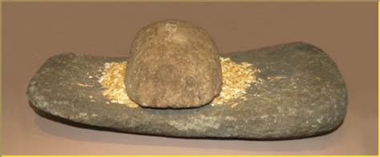
Crops
Farmers grew a variety of crops.
Wheat and barley were used to make flour.
The flour was used to make bread and porridge.
A plant called flax was turned into material.
The material was used to make clothes.
Other farmers grew beans and peas.

Slide 7
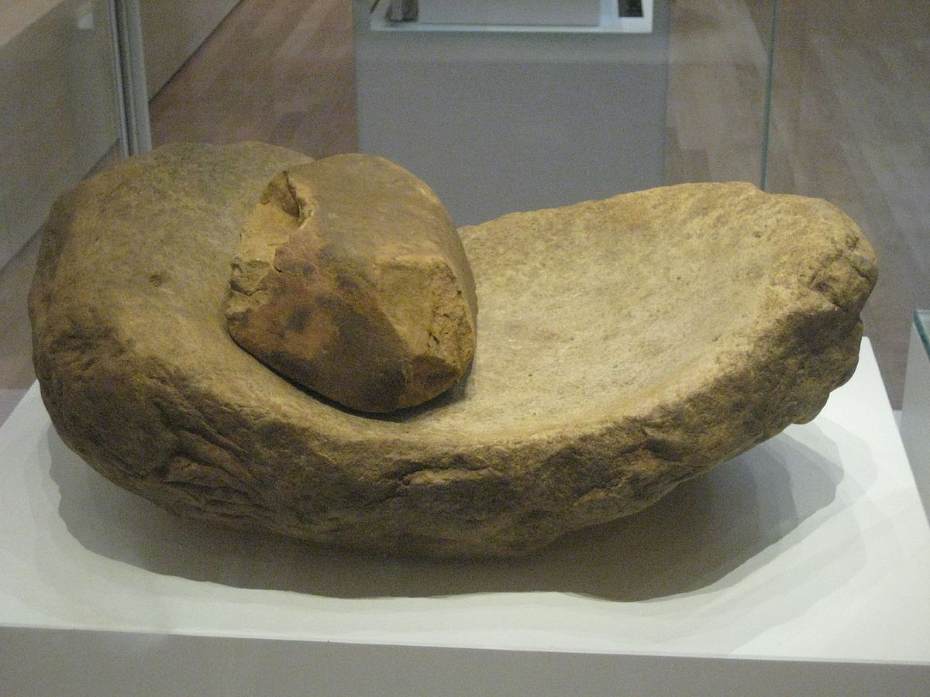
Tools
The Stone Age was a time when tools were mostly made of stone.
This quern was used to grind wheat into flour.
The age ended when people began to use metal for tools.
By Green Lane - Own work, CC BY-SA 3.0.

Slide 8
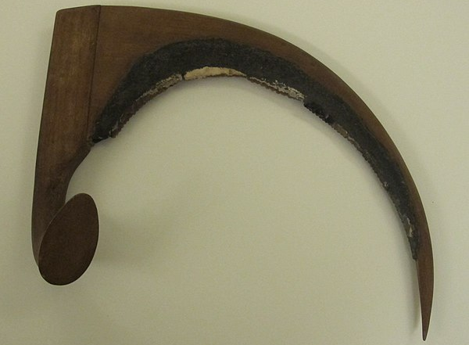
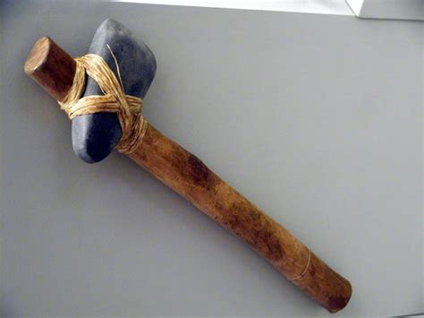
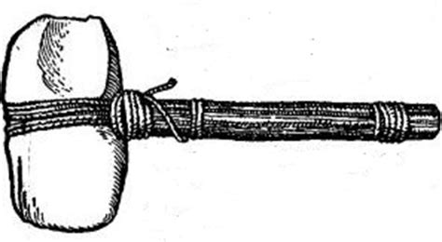
Tools
Farmers began to use wooden ploughs pulled by cattle to prepare the ground for crops to be grown.
Crops were harvested using sickles made from a rock made out of flint.
They also made and used hammers and axes.
By Roger Fund- Own work, CC BY-SA 3.0.

Slide 9
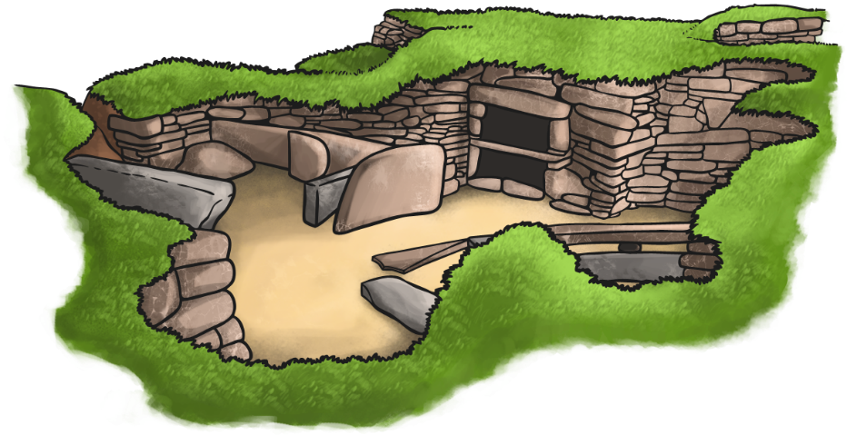
How Do We Know?
Archaeologists are people who’s job it is to dig and find things from the past.
They do this so we can understand how people used to live.
They have found lots of things.
In Scotland Archaeologists found a place called Skara Brae.
It was a village in the Stone age and off the coast of Scotland.
The village has helped us learn
lots about Stone Age life.

Slide 10
Glossary
artefacts – Objects from the past.
archaeologists – The people who study human history and prehistory.
domesticated – To tame a wild animal.
excavated – Dug up to uncover things from the past.
nomadic – A group of people who don’t have a settled home but move from place to place.
prehistoric - The period of history before written records.
smelt – The heating and melting of an ore (a material from nature) to get metal.

