Slide 2
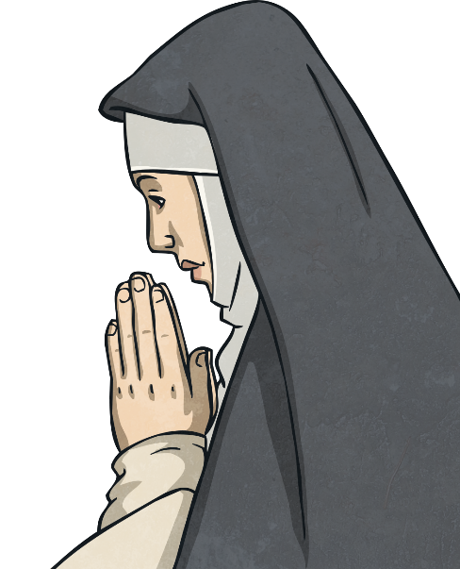
What Is the Holy Rosary?
The Rosary is a form of prayer used especially in the Catholic Church.
It is a long prayer, based on repetition, with many parts to be remembered and said.
It is named after the string of prayer beads, which some people use to count the parts of the prayer.
The Rosary is very important to Catholics for many reasons, including their devotion to Mary.
The Rosary can be said alone or in groups.
Praying a Rosary for the dead is part of the funeral tradition.

Slide 3
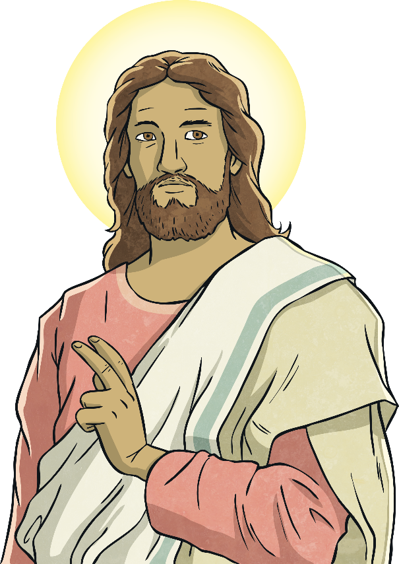
What Is the Purpose of the Rosary?
The purpose of the Rosary is to help people remember the events in the life of Jesus and to praise God for Him.
The Rosary is a little bit like a history lesson!
The main focus is on Jesus - his birth, life, death, and resurrection.

Slide 4
The Rosary and the Apostles’ Creed
The main parts of the Rosary are:
1. Sign of the Cross
I believe in God,
the Father almighty,
Creator of heaven and earth,
and in Jesus Christ, his only Son, our Lord,
who was conceived by the Holy Spirit,
born of the Virgin Mary,
suffered under Pontius Pilate,
was crucified, died and was buried;
he descended into hell;
on the third day he rose again from the dead;
he ascended into heaven,
and is seated at the right hand of God the Father almighty;
from there he will come to judge the living and the dead.
I believe in the Holy Spirit,
the holy catholic Church,
the communion of saints,
the forgiveness of sins,
the resurrection of the body,
and life everlasting. Amen.

Slide 5
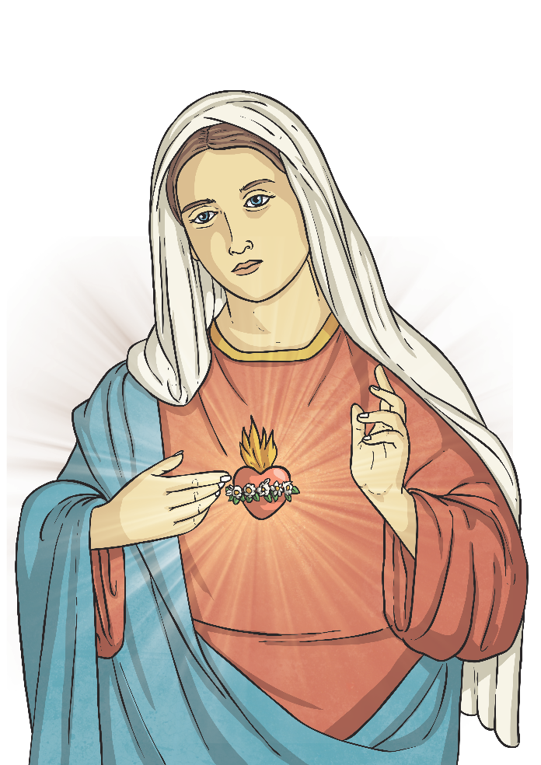
The Rosary
2. The Our Father
Our Father, Who art in Heaven; hallowed be Thy name. Thy kingdom come; Thy will be done on Earth as it is in Heaven. Give us this day our daily bread; and forgive us our trespasses as we forgive those who trespass against us. And lead us not into temptation; but deliver us from evil. Amen
3. The Hail Mary (three times)
Hail Mary, full of grace, the Lord is with thee. Blessed art thou
among women and blessed is the fruit of thy womb, Jesus. Holy Mary,
Mother of God, pray for us sinners, and now and at the
hour of our death. Amen
4. The Glory Be
Glory be the Father, and to the Son, and to the Holy Spirit,
as it was in the beginning, is now, and ever shall be, world
without end. Amen
5. The Our Father
6. The Hail Mary (ten times)
7. The Glory Be

Slide 6
What Are Rosary Beads?
The Rosary beads provide a method of keeping track of the different parts of the Rosary Prayer.
The fingers are moved along the beads as the prayers are said.
By not having to keep track of the count mentally,
the mind is free to meditate.
The Roman Catholic Rosary is made up of a cross or
crucifix, a medal, large beads, and small beads.
Each Rosary has five groups of ten beads. The prayers of the
Rosary can also be said using any type of counting device
or by counting on the fingers.

Slide 7
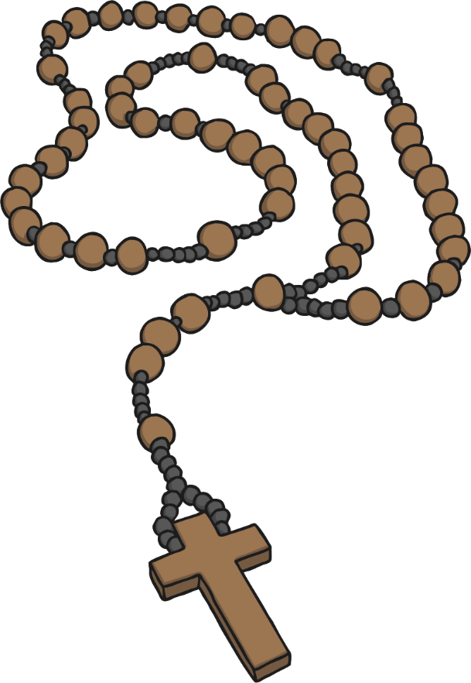
Using The Rosary Beads
1. The Sign of the Cross and The Apostles’ Creed
2. The Our Father Prayer
3. The Hail Mary Prayer (x3)
4. The Glory Be to the Father
5. The Our Father Prayer
6. The Hail Mary Prayer (x10)
7. The Glory Be to the Father
7
6
3
4
5
2
1

Slide 8

Using The Rosary Beads
The Rosary focuses on the life of Christ from the Bible.
During these prayers, people meditate on different aspects of Christ’s life.
The beads of the Rosary are divided into five decades (or sections); each decade represents an event from the life of Christ.
These five events are grouped into a set of four mysteries, each focused
on an important part of the life of Christ.
The four mysteries are named after the type of events in that mystery:
Joyful - The Nativity
Luminous - The Baptism of the Lord
Sorrowful - The Crucifixion
Glorious - The Resurrection
What else do you know about Jesus’ life in each of the mysteries?

Slide 9
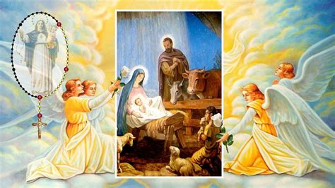
The Joyful Mysteries
These look at the beginning of the life of Jesus;
The Annunciation
The Visitation
The Nativity
The Presentation
The Finding of Jesus in the Temple

Slide 10
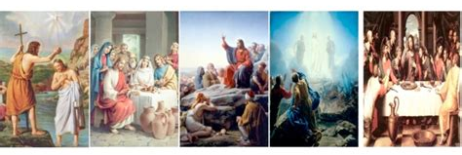
The Luminous Mysteries
These look at the life of Jesus;
The Baptism of the Lord
The Wedding at Cana
The Proclamation of the Kingdom
The Transfiguration
The Institution of the Eucharist

Slide 11
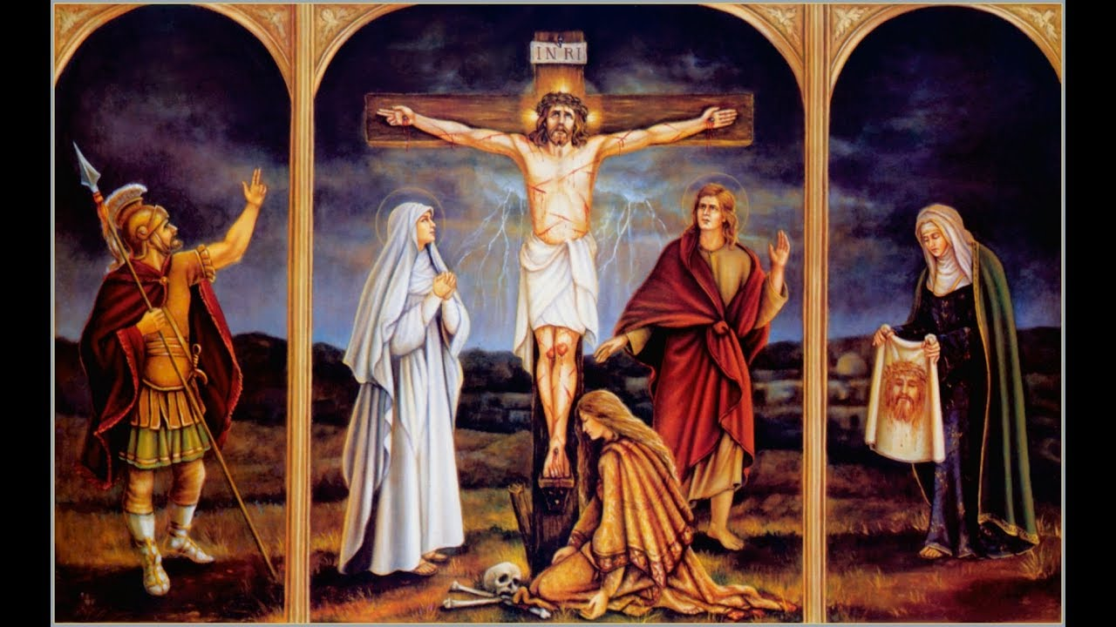
The Sorrowful Mysteries
These look at the end of the life of Jesus;
The Agony in the Garden
The Scourging at the Pillar
The Crowning with Thorns
The Carrying of the Cross
The Crucifixion

Slide 12
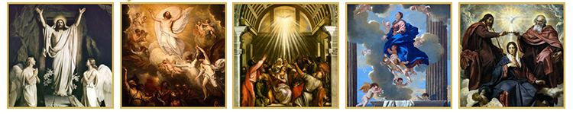
The Glorious Mysteries
These look at what happened after the Crucifixion of Jesus;
The Resurrection
The Ascension
The Descent of the Holy Spirit (Pentecost)
The Assumption
The Coronation of the Blessed Virgin Mary

Slide 13
Activities
Primary 4;
Complete the Glorious Mysteries sheet – draw a picture of each story.
Rosary Stained Glass window sheet,
(If you can’t print these off, then do the work on a sheet of paper).

