Slide 1
Guidance for Video/Audio in PowerPoints
1. Open the folder and copy all the files.
2. Paste the copied files into a new folder.
3. Open the PowerPoint file, enable editing and enter presentation mode (start the slide show).
Please note the embedded audio may not be compatible with early versions of PowerPoint.
You may wish to delete this slide before beginning the presentation.

Slide 3
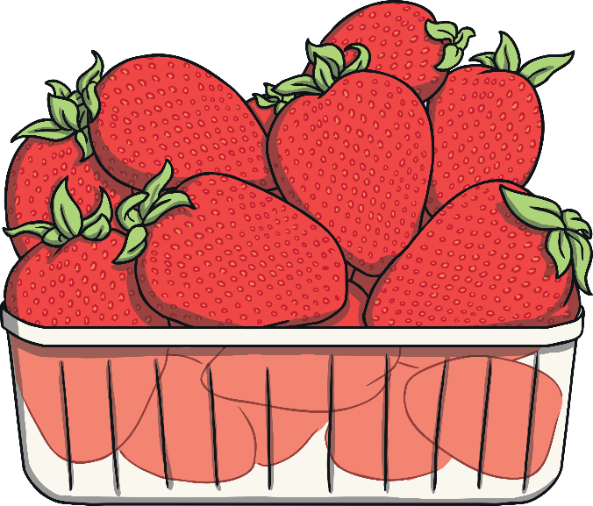
Old MacDonald had a farm, EE-I-EE-I-O,
And on that farm he grew some strawberries, EE-I-EE-I-O,
With a berry, berry here and a berry, berry there,
Here a berry, there a berry, everywhere a berry, berry.
Old MacDonald had a farm, EE-I-EE-I-O.

Slide 4
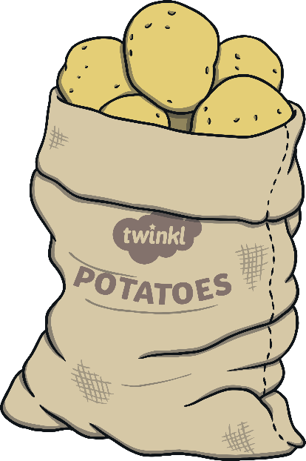
Old MacDonald had a farm, EE-I-EE-I-O,
And on that farm he sowed some tatties, EE-I-EE-I-O,
With a sow, sow here and a sow, sow there,
Here a sow, there a sow, everywhere a sow, sow.
Old MacDonald had a farm, EE-I-EE-I-O.

Slide 5
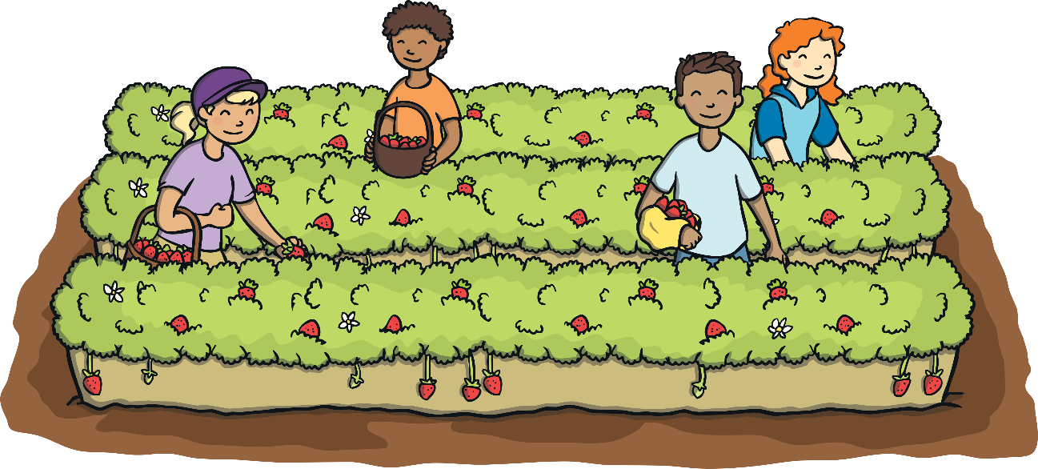
Old MacDonald had a farm, EE-I-EE-I-O,
And on that farm he picked some raspberries, EE-I-EE-I-O,
With a pick, pick here and a pick, pick there,
Here a pick, there a pick, everywhere a pick, pick.
Old MacDonald had a farm, EE-I-EE-I-O.

Slide 6
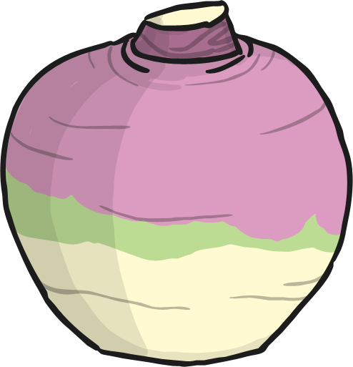
Old MacDonald had a farm, EE-I-EE-I-O,
And on that farm he grew some neeps, EE-I-EE-I-O,
With a neep, neep here and a neep, neep there,
Here a neep, there a neeps, everywhere a neep, neep.
Old MacDonald had a farm, EE-I-EE-I-O.

Slide 7
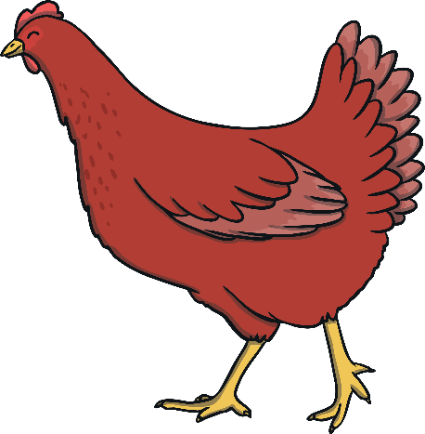
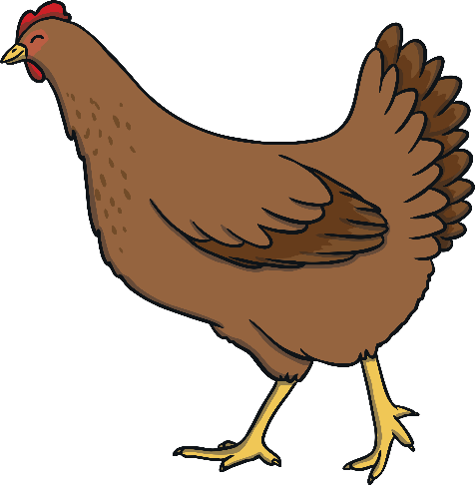
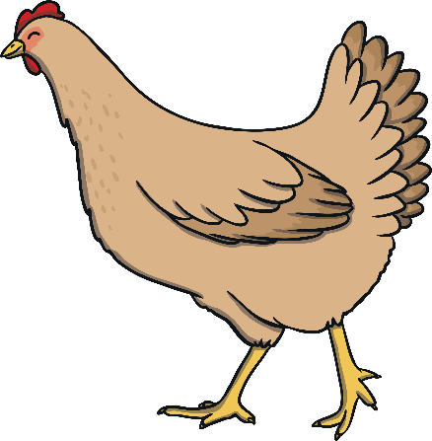
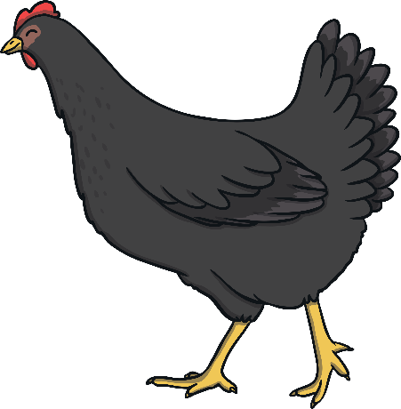
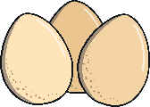
Old MacDonald had a farm, EE-I-EE-I-O,
And on that farm he had some hens, EE-I-EE-I-O,
With an egg, egg here and an egg, egg there,
Here an egg, there an egg, everywhere an egg, egg.
Old MacDonald had a farm, EE-I-EE-I-O.

Slide 8
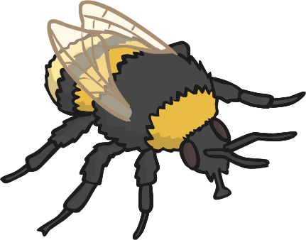
Old MacDonald had a farm, EE-I-EE-I-O,
And on that farm he had a hive, EE-I-EE-I-O,
With a buzz, buzz here and a buzz, buzz there,
Here a buzz, there a buzz, everywhere a buzz, buzz.
Old MacDonald had a farm, EE-I-EE-I-O.

Slide 9
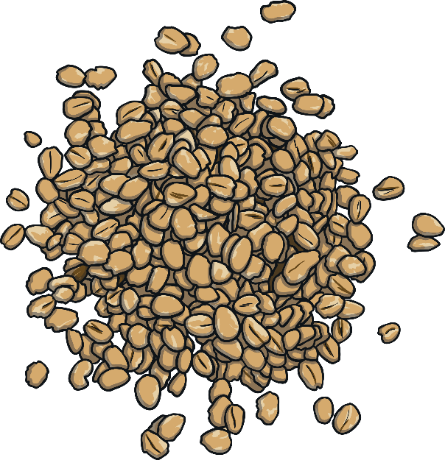
Old MacDonald had a farm, EE-I-EE-I-O,
And on that farm he grew some oats, EE-I-EE-I-O,
With a reap, reap here and a mill, mill there,
Here a reap, there a reap, everywhere a reap, reap.
Old MacDonald had a farm, EE-I-EE-I-O.

