Slide 2
Aim
To learn about Easter Sunday.
To understand the importance of Easter Sunday to the Christian faith and know how it is celebrated.

Slide 3
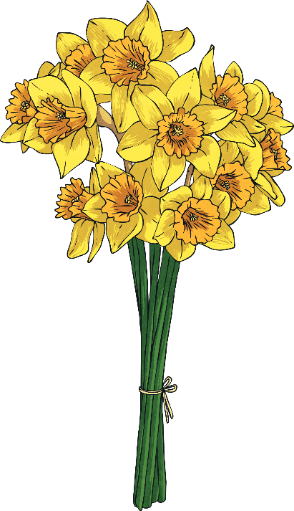
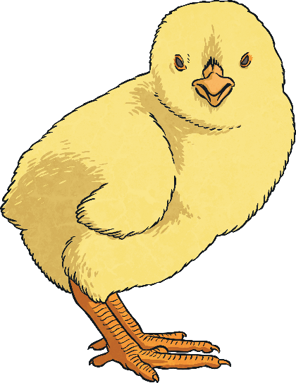
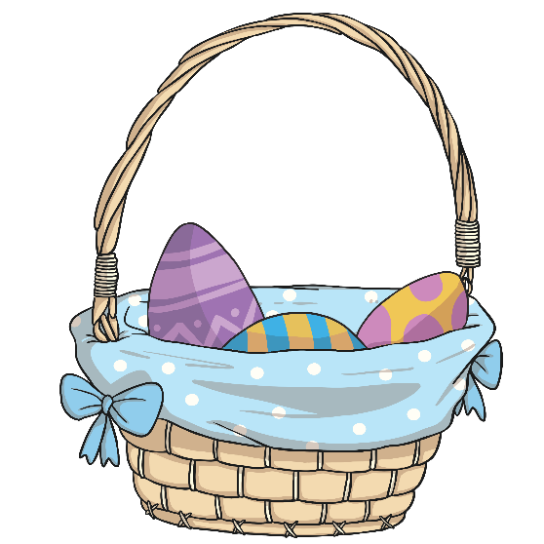
Guess the Celebration
Can you recognise the celebration?

Slide 4
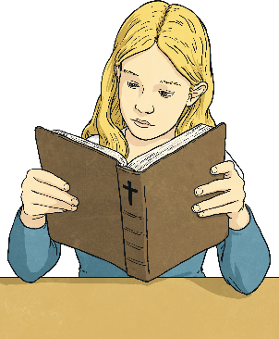
Who Celebrates Easter?
Lots of people enjoy Easter celebrations. Easter is a spring festival and dates back to when Pagans celebrated the goddess of spring and fertility, Eostre.
Today, Easter is a Christian festival. It is one of the most important festivals in the Christian calendar.
Christians believe that Jesus was the Son of God and that he lived among the people of Earth so that he could show us how to live our lives.

Slide 5
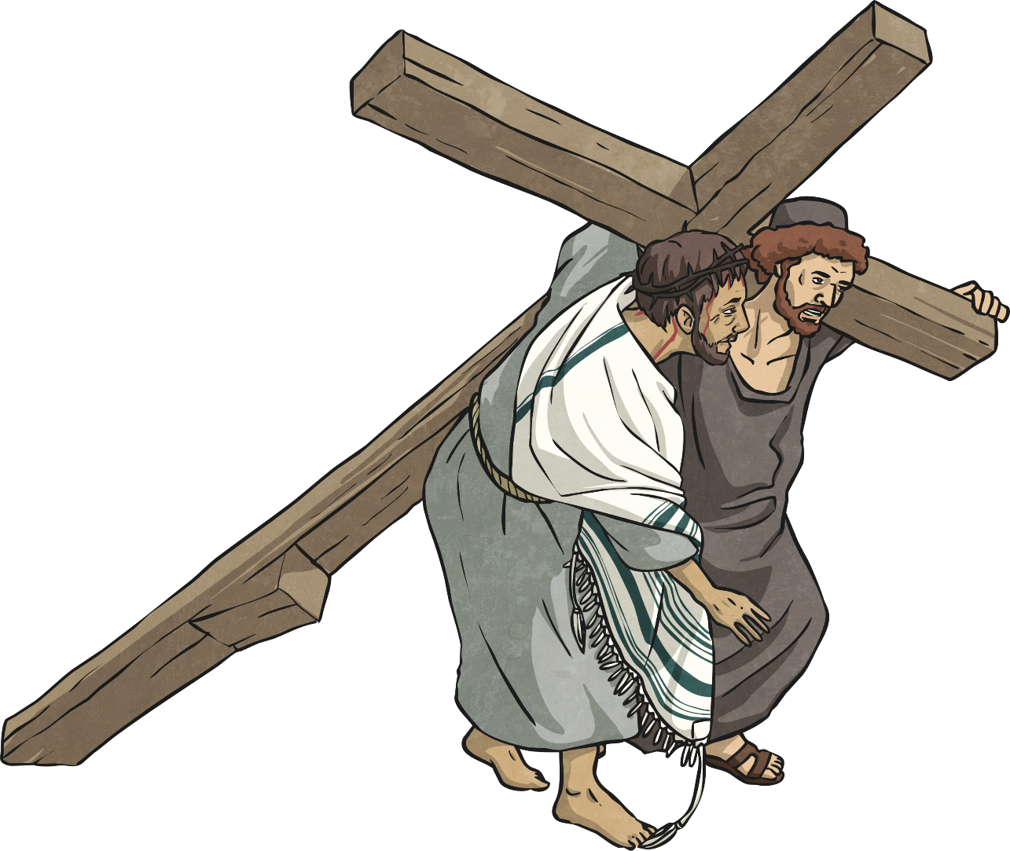
Why Do Christians Celebrate Easter?
To Christians, the cross is the most important symbol of Easter because it represents something very important.
At Easter, Christians celebrate that after being crucified, Jesus rose back to life and ascended to Heaven.

Slide 6
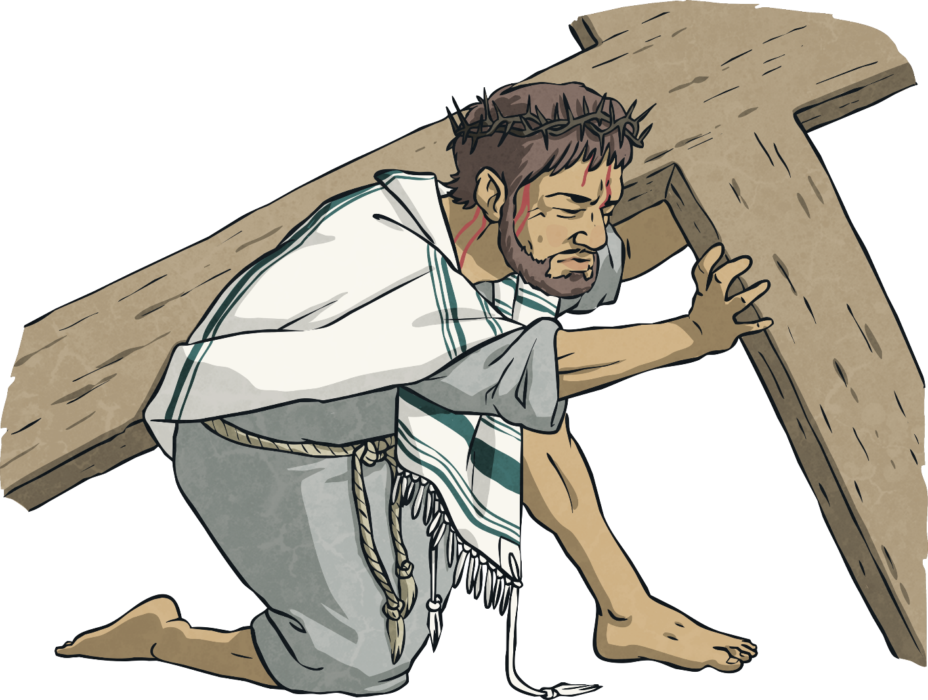
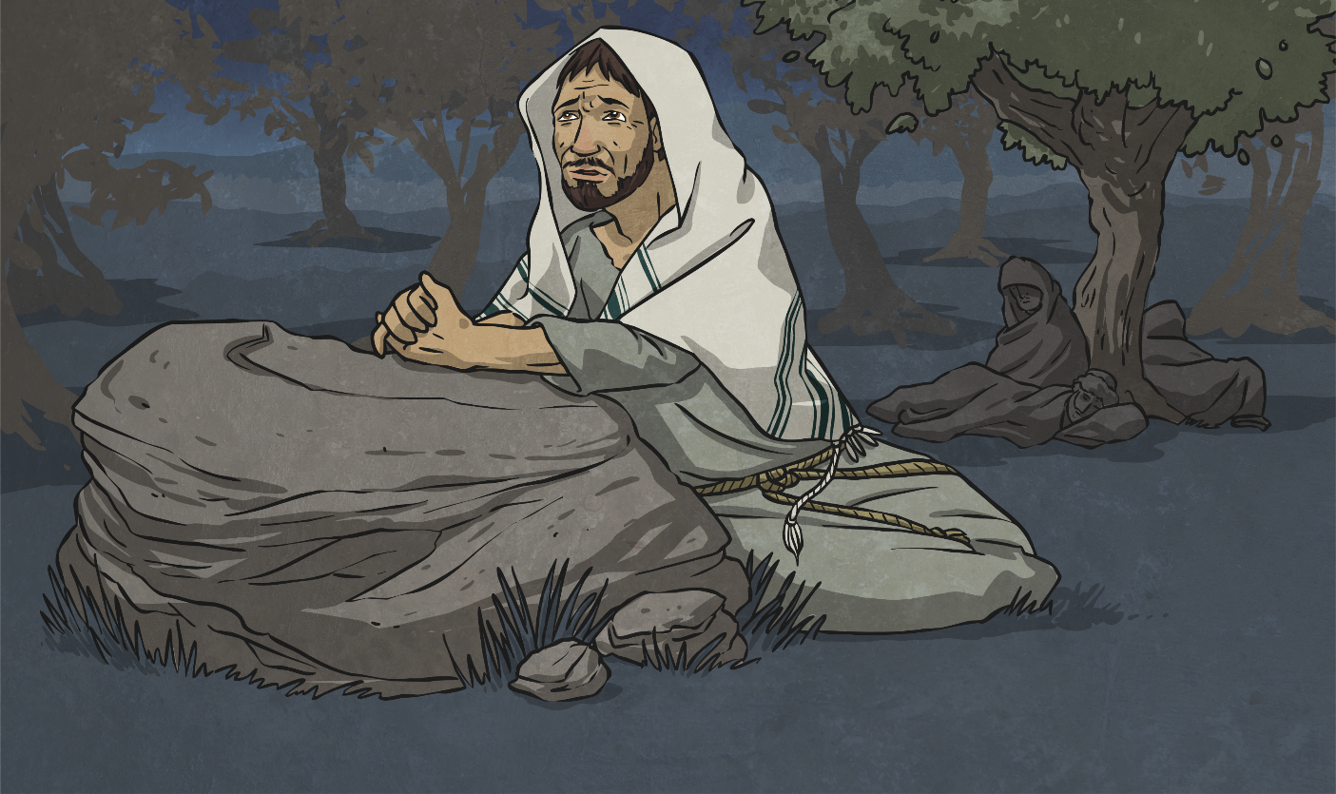
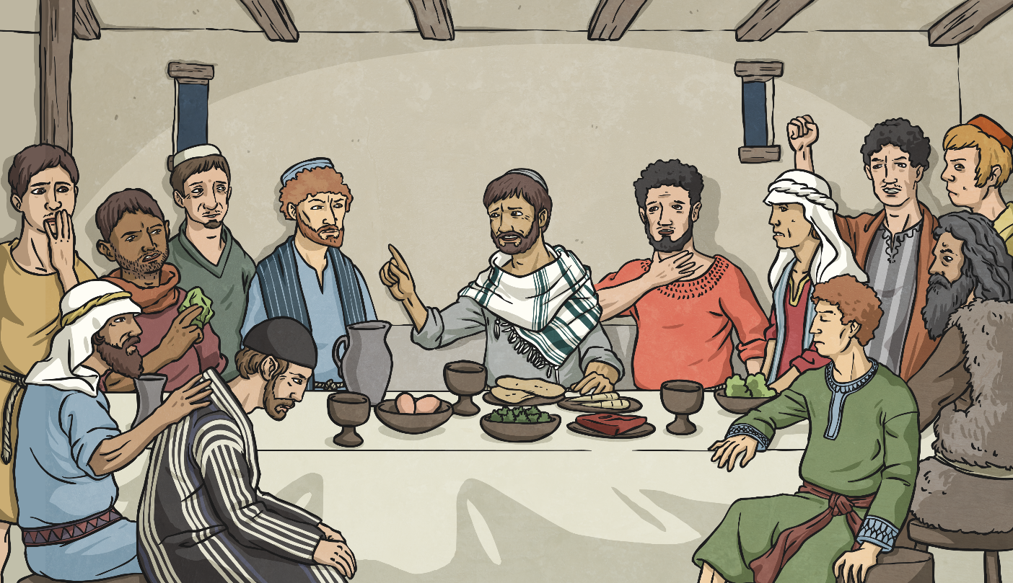
The Story of Holy Week
Do you recognise any of these parts of the story?
The Garden of Gethsemane
Jesus is betrayed by his friend Judas Iscariot. He is arrested.
Good Friday
Jesus is crucified and dies.
Palm Sunday
Jesus entered Jerusalem to celebrate Passover.
The Last Supper (Maundy Thursday) Jesus shared a meal with his disciples.

Slide 7
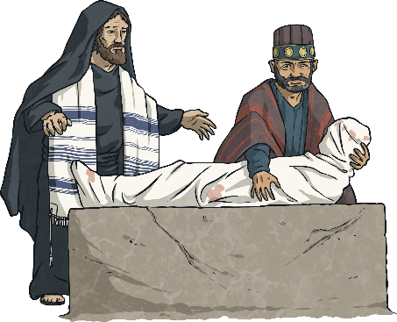
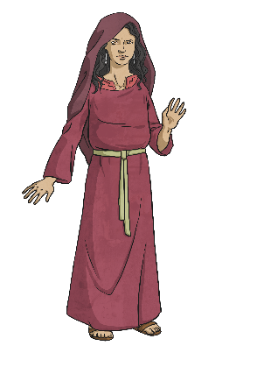
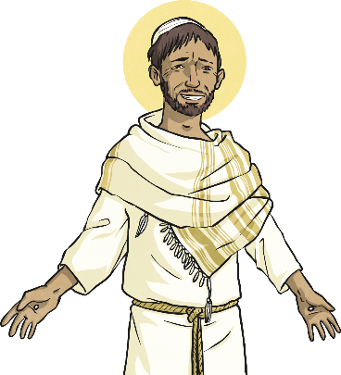
What Happened on Easter Sunday?
After his death on the cross, Jesus was wrapped in a shroud and placed in a stone tomb. A huge stone sealed the entrance and a Roman soldier stood guard.
When his mother, Mary, and Mary Magdalene visited the tomb, they found the stone rolled away and the tomb empty!
The two women wept as they feared someone had stolen the body. A man called their name and when they looked up, they were amazed to see Jesus.

Slide 8
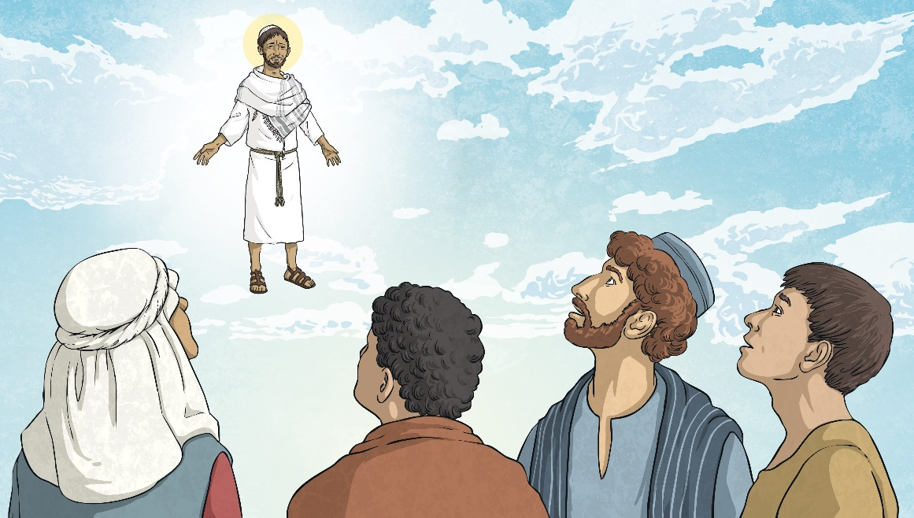
What Happened after Easter Sunday?
Over the next 40 days, Jesus appeared to his disciples to prove to them that he had risen from the dead.
The resurrection is what Christians celebrate on Easter Sunday.
By dying, Jesus showed Christians that death was nothing to fear. If they believe in God and ask for forgiveness for their sins, they will have a new life in heaven when they die.

Slide 9
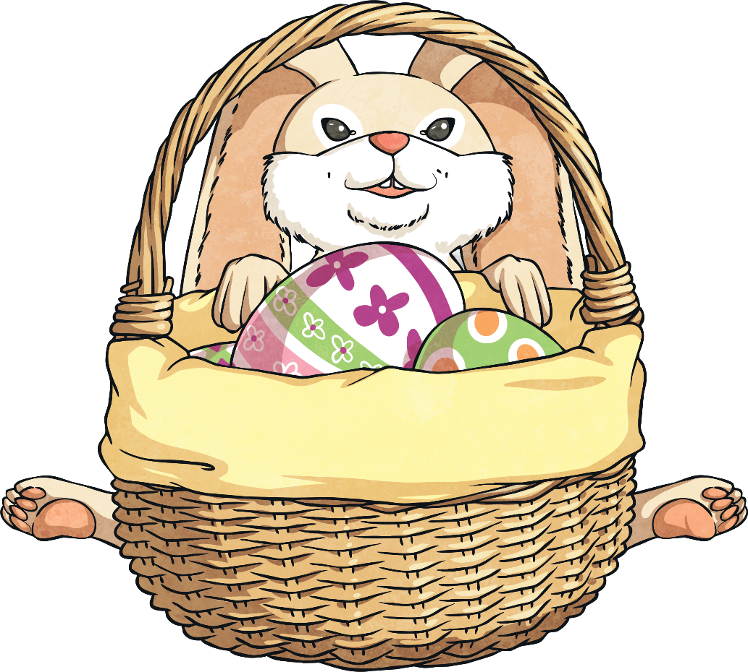
How Do Christians Celebrate Easter Sunday?
Go to church.
Decorate the church with flowers.
Share a meal of lamb or chicken.
How do you celebrate?

Slide 10
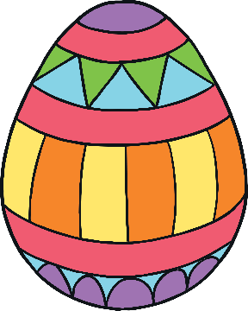
Easter Symbolism
How do Christians relate to the symbols of Easter?
An Easter egg
represents new life.
Egg rolling
recalls how the stone rolled away to reveal an empty tomb.
Chicks, lambs, spring flowers
represent new life.

