Slide 2
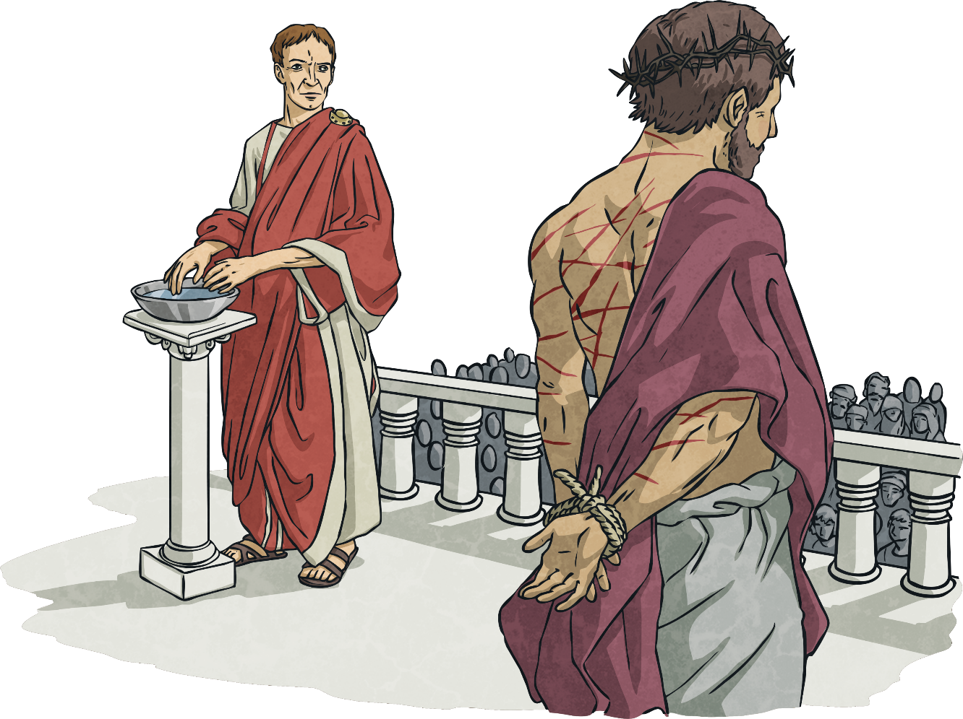
First Station: Jesus is condemned to death.

Slide 3
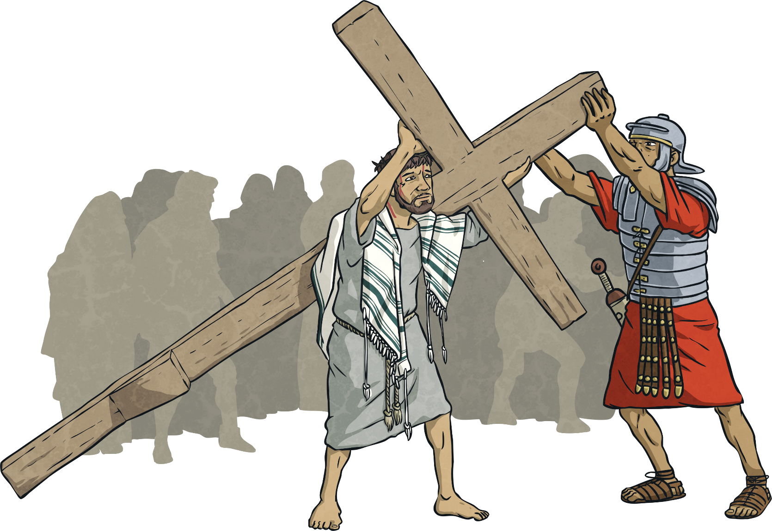
Second Station: Jesus carries the cross.

Slide 4
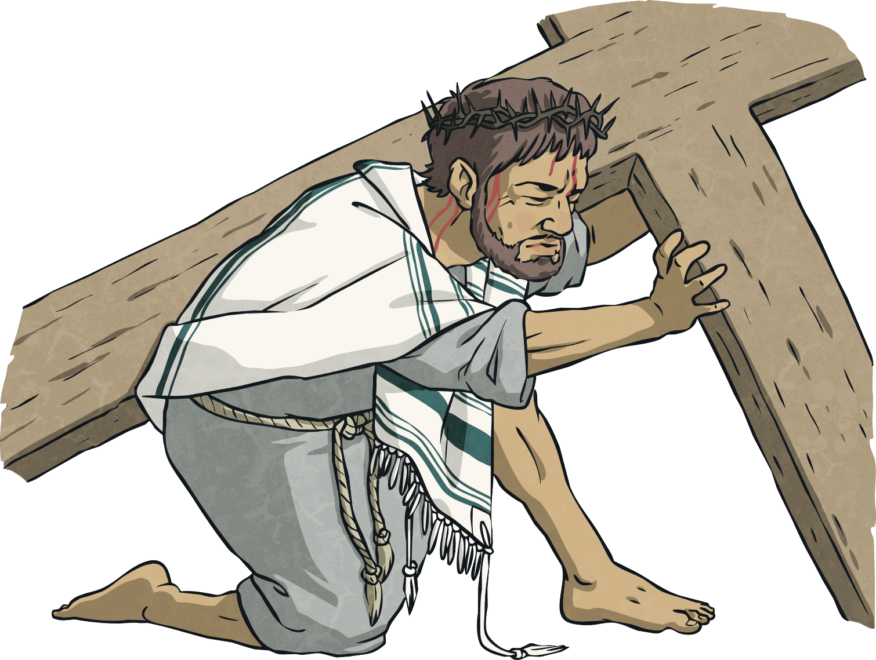
Third Station: Jesus falls for the first time.

Slide 5
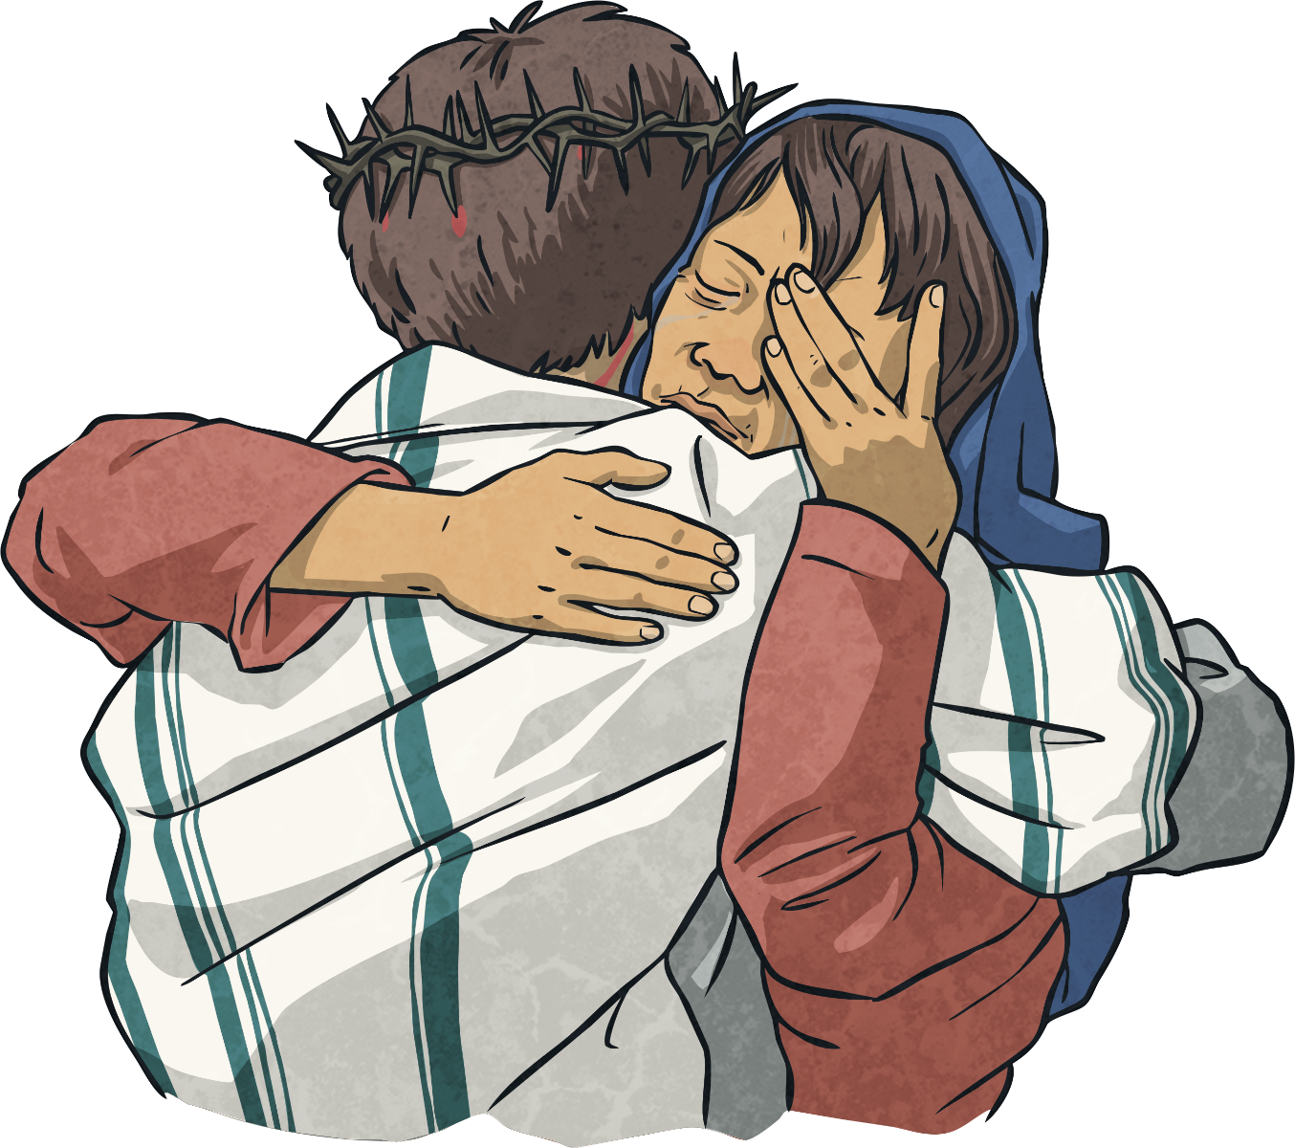
Fourth Station: Jesus meets his mother, Mary.

Slide 6
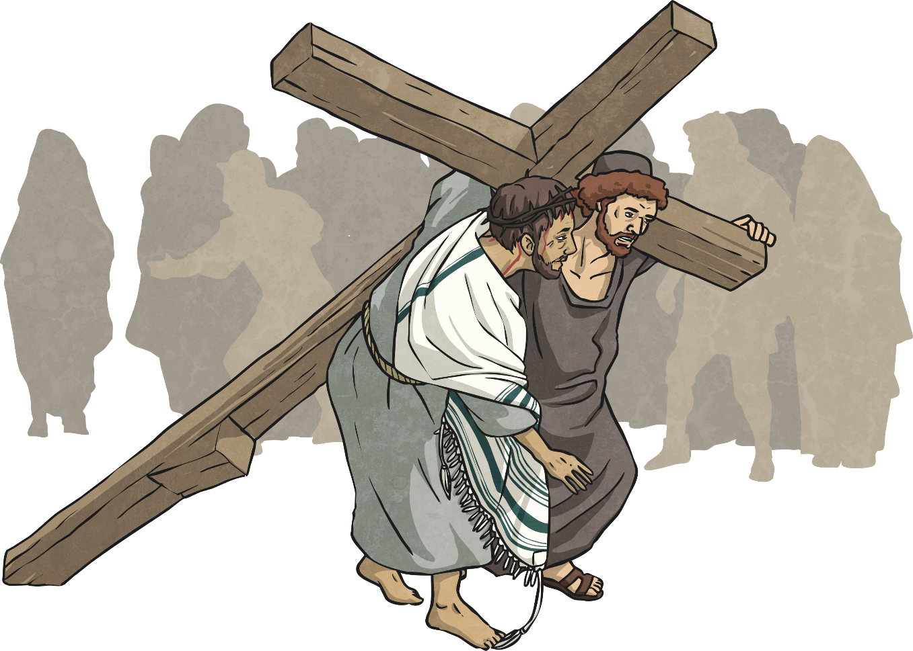
Fifth Station: Simon of Cyrene helps Jesus carry the cross.

Slide 7
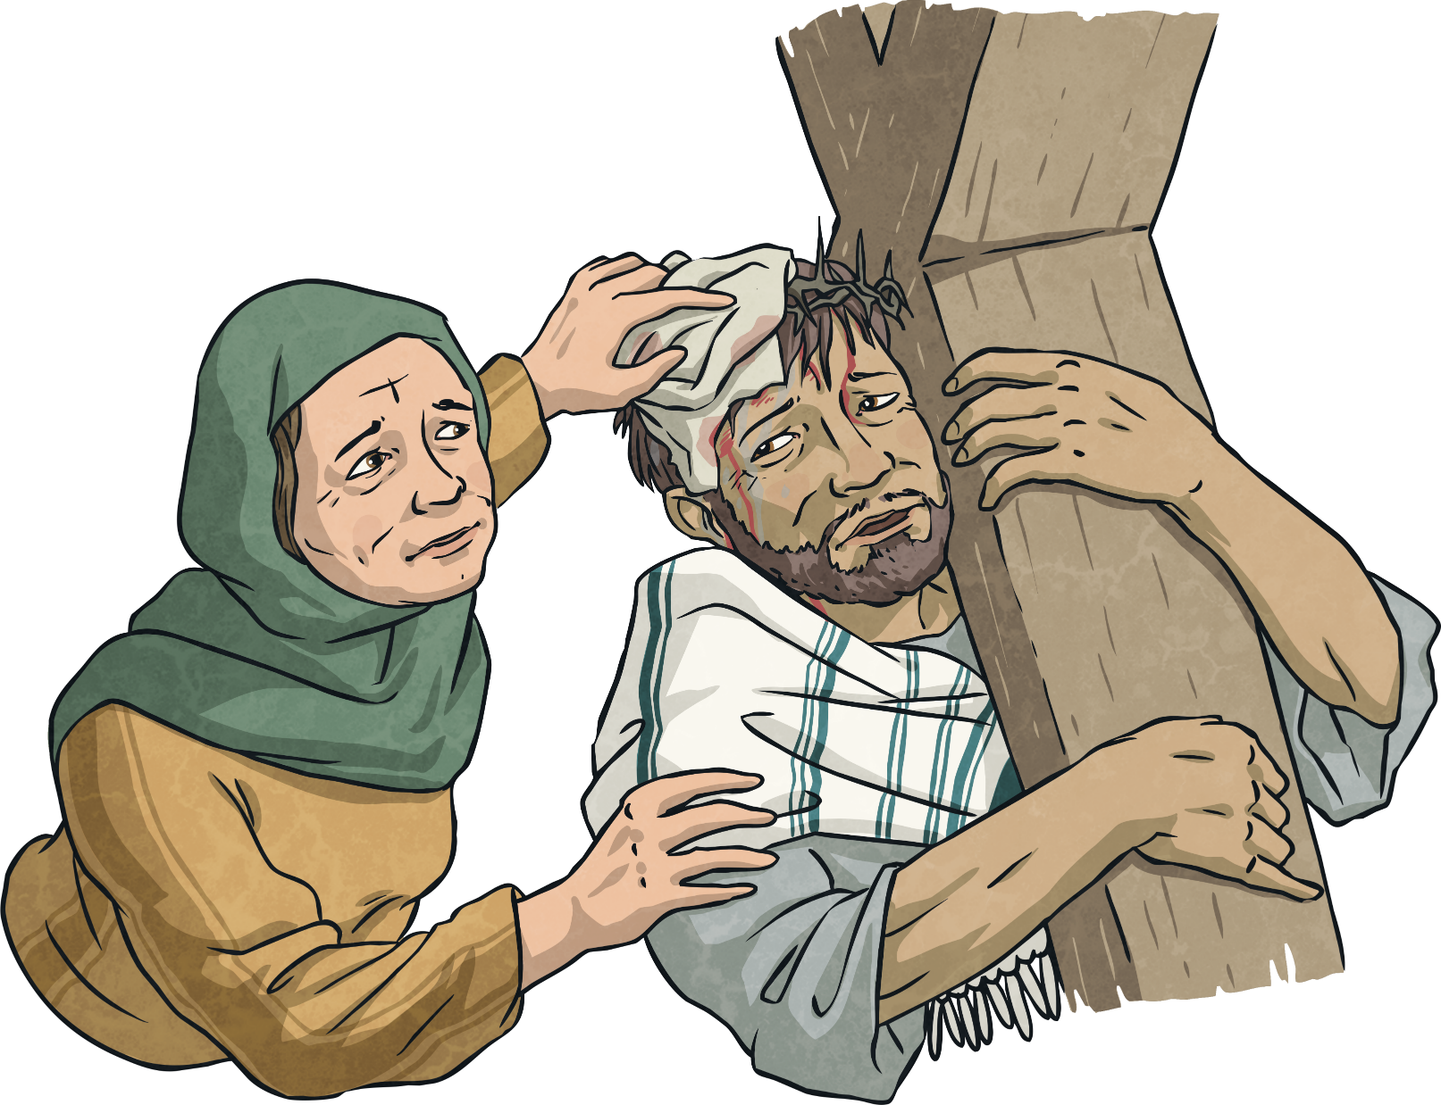
Sixth Station: Veronica wipes the face of Jesus.

Slide 8
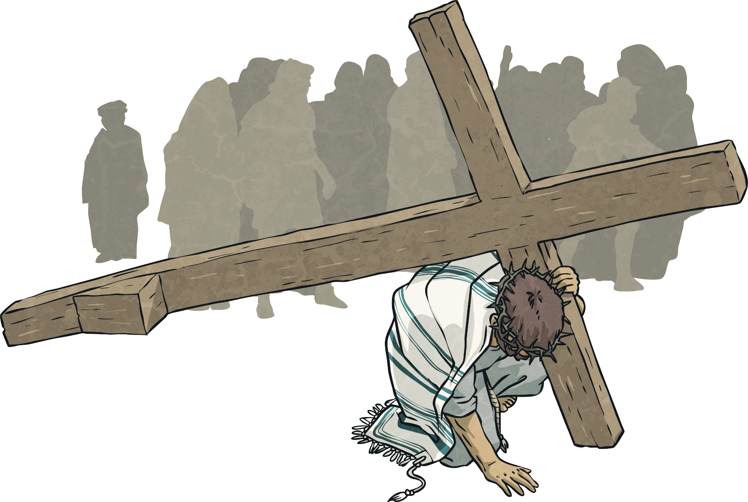
Seventh Station: Jesus falls for the second time.

Slide 9
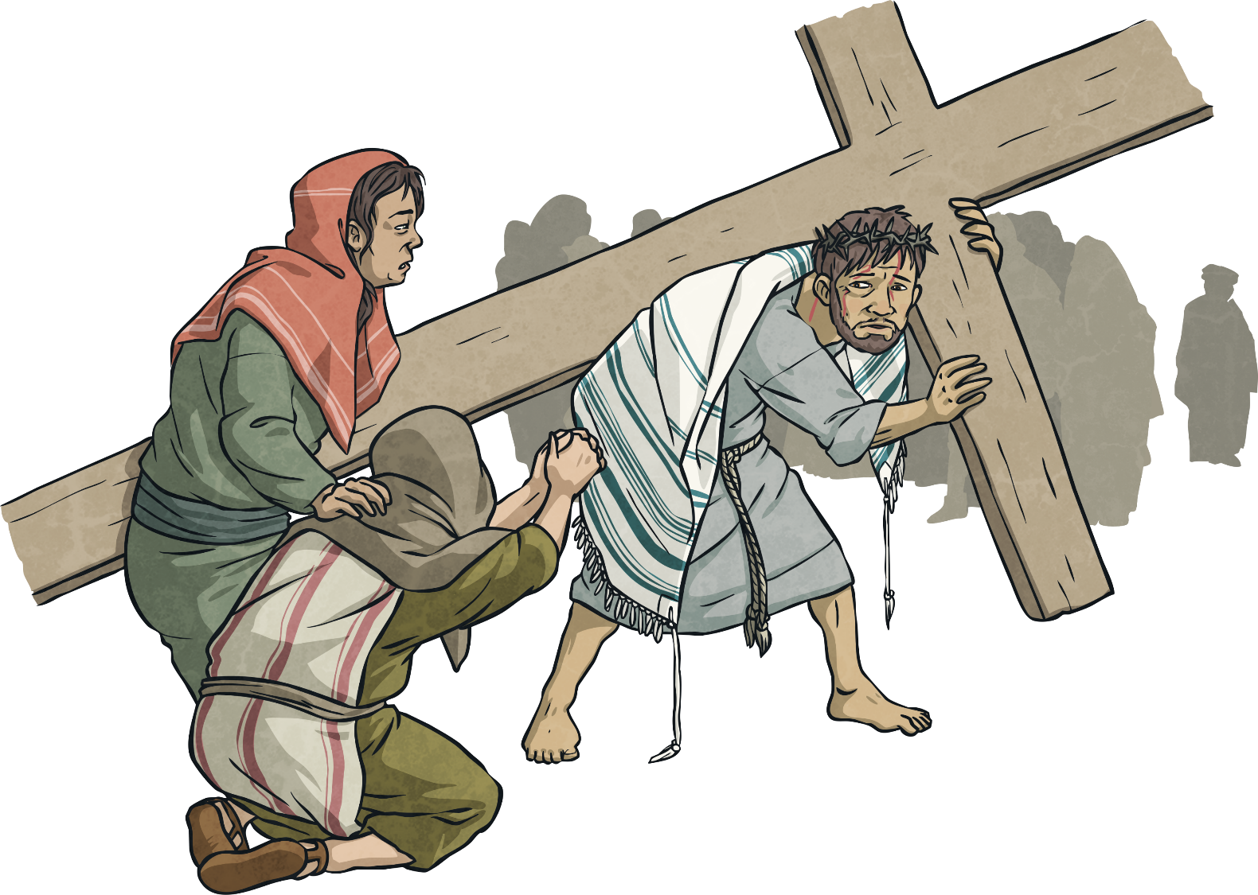
Eighth Station: Jesus meets the women of Jerusalem.

Slide 10
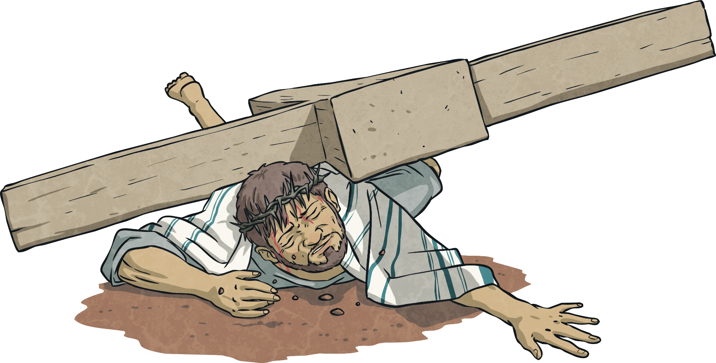
Ninth Station: Jesus falls for the third time.

Slide 11
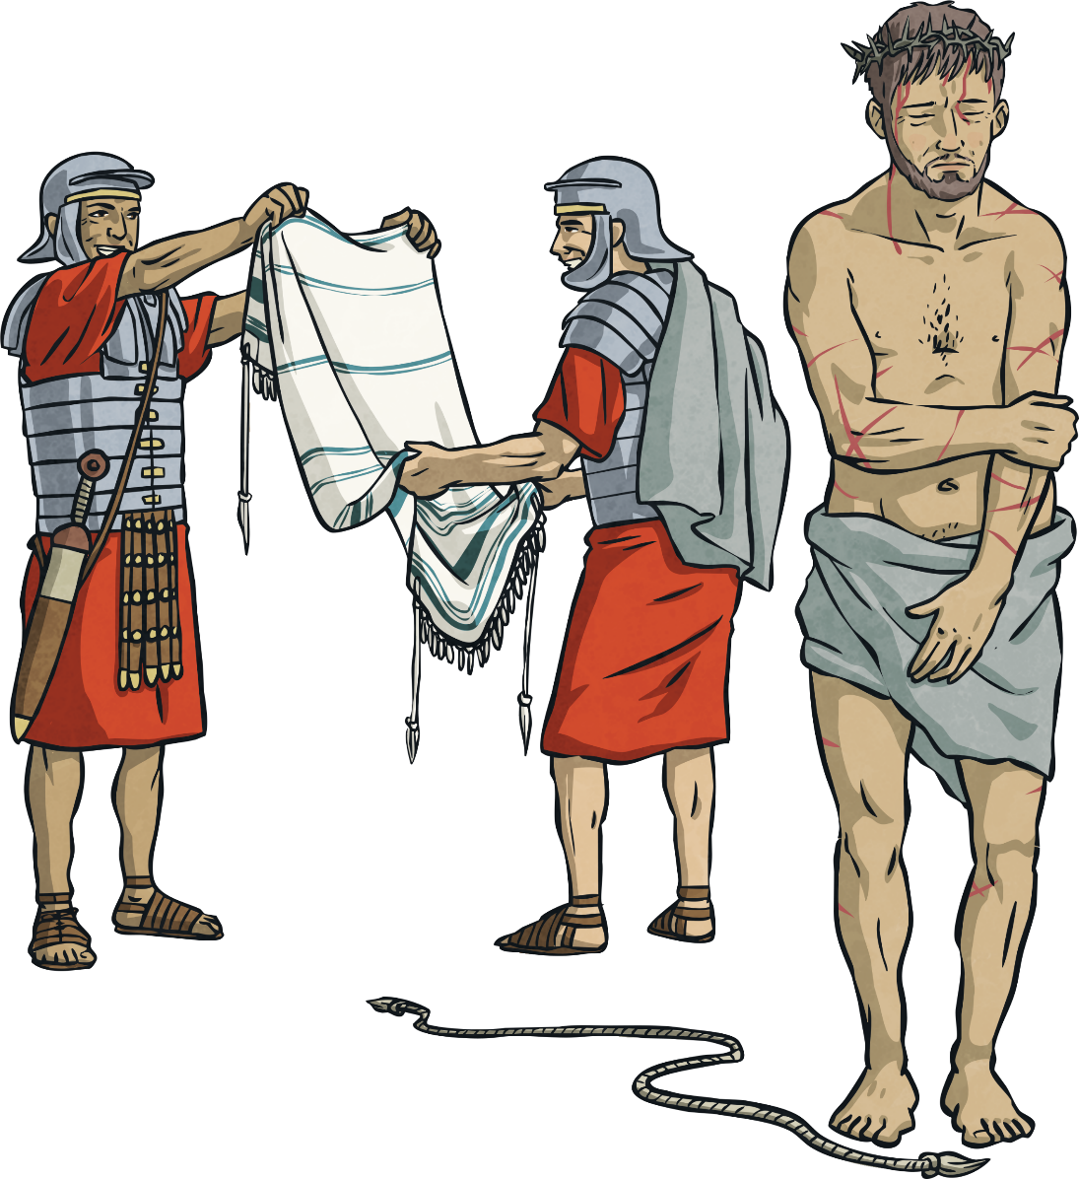
Tenth Station: Jesus is stripped of his clothes.

Slide 12
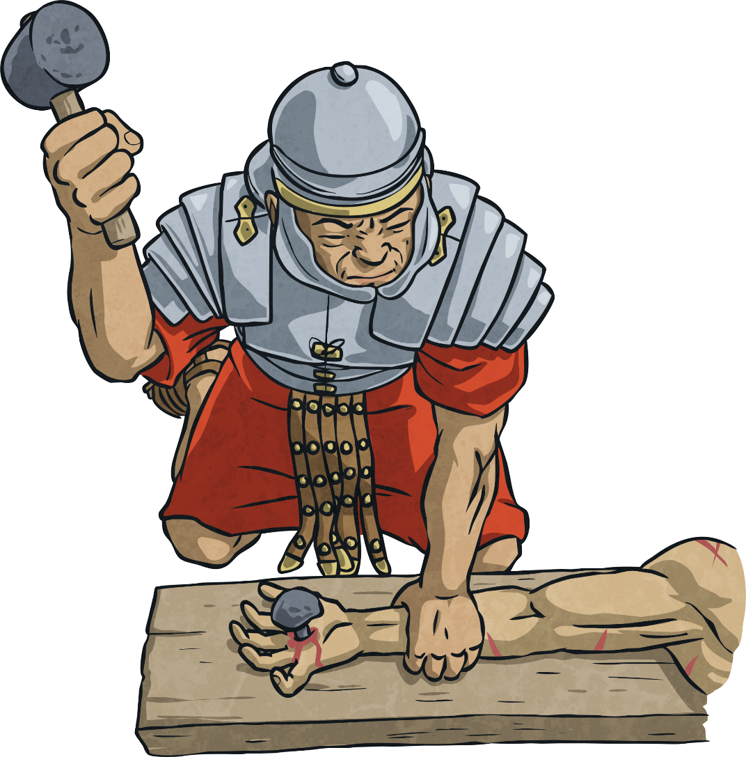
Eleventh Station: Jesus is nailed to the cross.

Slide 13
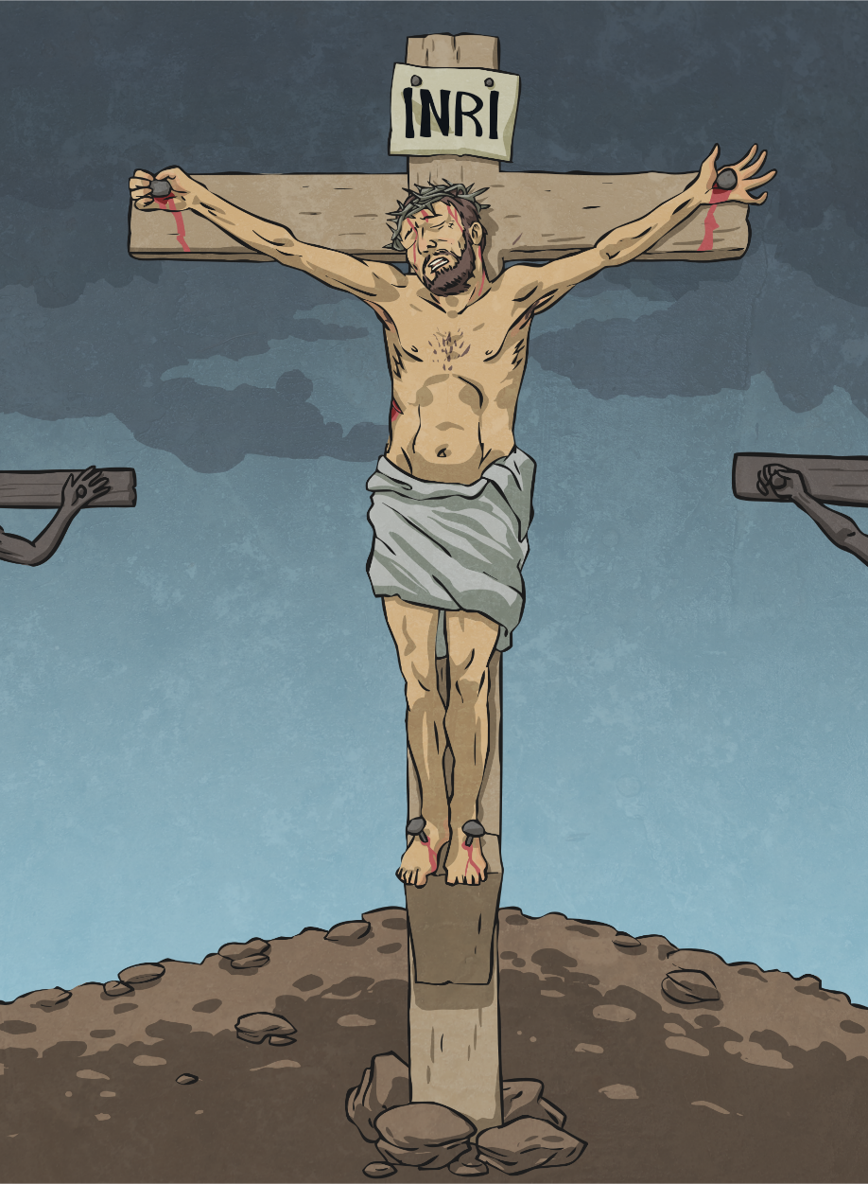
Twelfth Station: Jesus dies on the cross.

Slide 14
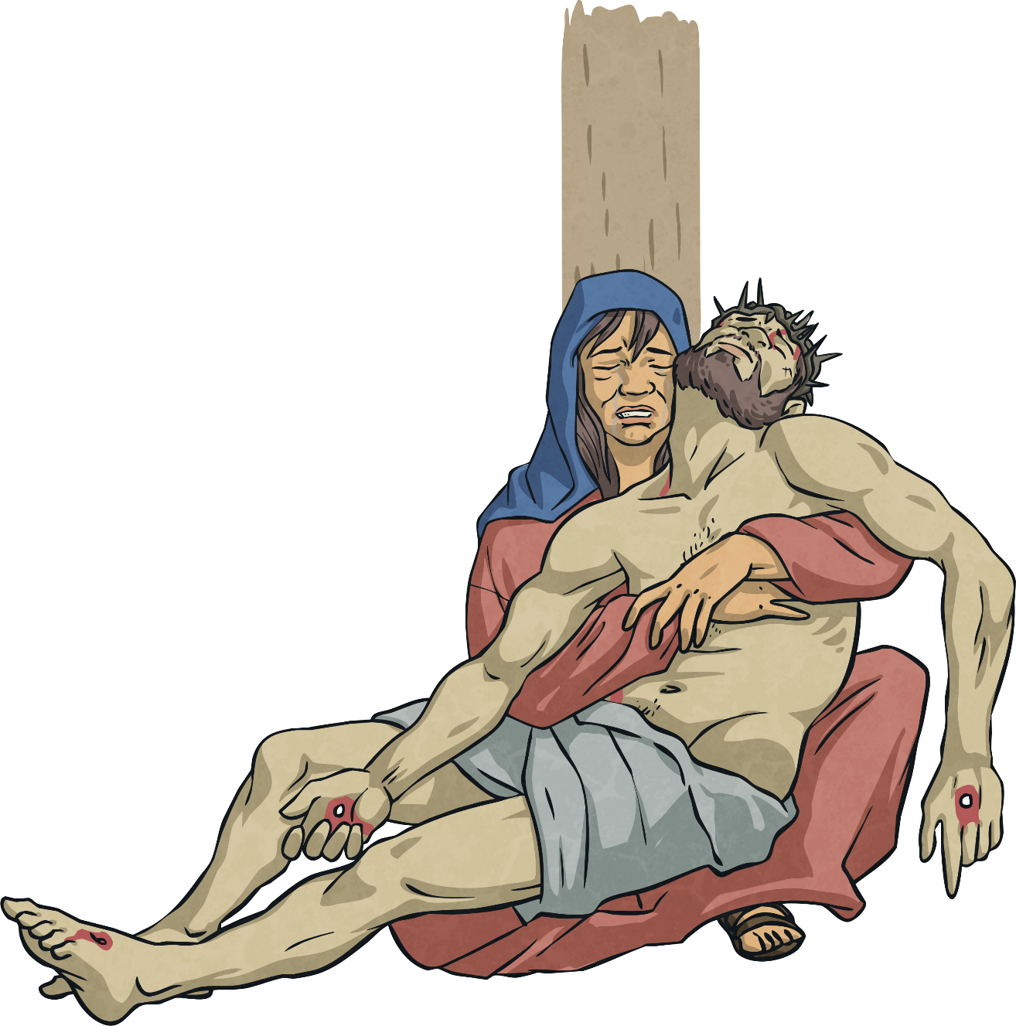
Thirteenth Station: The body of Jesus is taken down from the cross.

Slide 15
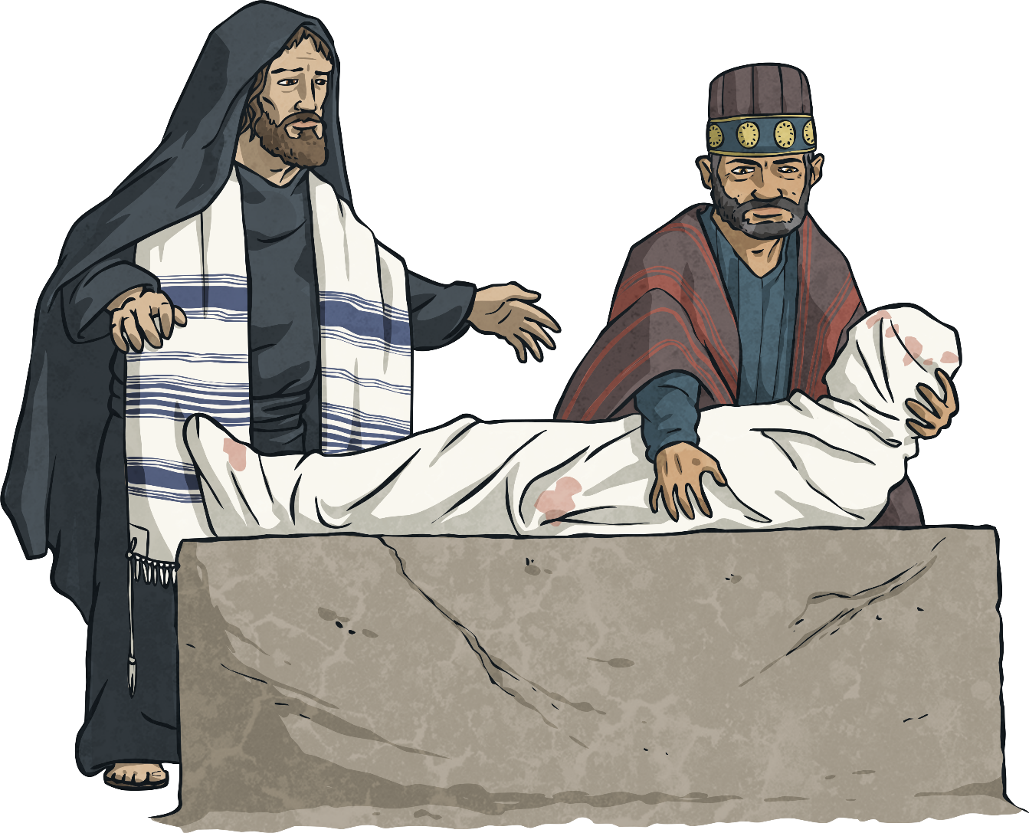
Fourteenth Station: Jesus is laid in the tomb.

