Slide 1
Healthy Reading
Scheme

Slide 2
What is the Healthy Reading Scheme?
Evidence based books to improve/inform mental health and wellbeing. The evidence base suggests that reading about common causes of mental health distress can lead to improvements in mild to moderate signs and symptoms.
Books are for children/young people, parents and staff
Books in the scheme are available for loan in West Lothian Libraries
4 extended sets of books will be based within 4 key teams working alongside some of the most vulnerable children/young people and their families - DASAT, CYPT, Educational Psychology and WLDAS and Young Carers sharing a set.

Slide 3
Why have a healthy reading scheme?
“The Reading Agency” reports that in similar programmes in England, users of the scheme have reported that 85% felt they had increased their coping strategies. Over half felt it had reduced their levels of distress
Comparative schemes for children and young people throughout Lothian which have been evaluated positively
Comparative adults scheme, which is also available throughout West Lothian. This can contribute towards supporting adults in children's lives
Can compliment and extend the work of professionals

Slide 4
How to access Healthy Reading?
Libraries have a minimum copy of 2 (but up to 18 of some titles) of every book from the Healthy Reading Scheme. These books are based in Carmondean and Whitburn Library, but can be transferred easily internally within libraries making it accessible to all. Anyone can access these as long as they are a member of WL libraries. Only 2 pieces of identification is required to become a library member.
Books can be requested through the online library catalogue and delivered to the library of your choice.
St Margaret's High School is piloting hosting a set of books residing within the school library to find out if pupils or staff access it with some support/promotion

Slide 5
Steps to access the Healthy Reading Scheme:
Step 1: www.westlothian.gov.uk
Step 2: Type in the search bar “Healthy Reading”
Step 3: Click on link to Reading for Wellbeing
Step 4: Information about the scheme and how to access the library catalogue (Click “Healthy Reading”)
Other information:
*This same search method leads to the adults “books on prescription scheme for adults.
*The next 2 slides demonstrate what you will see during the search

Slide 6
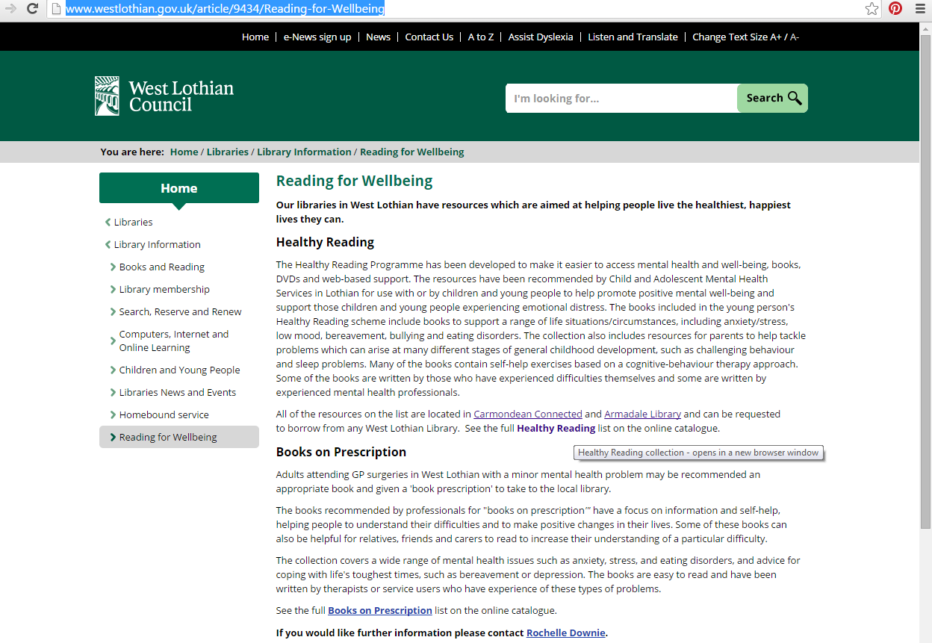

Slide 7
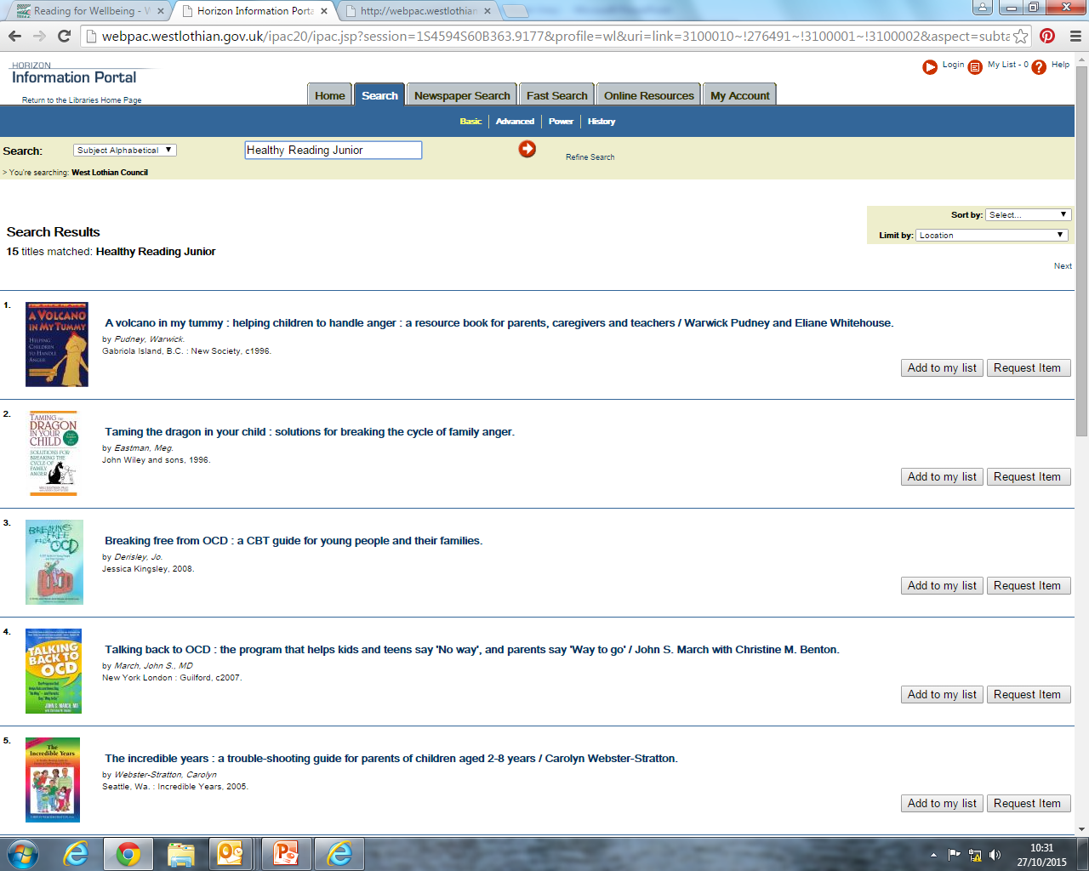
Notes:
How list looks on catalogue

Slide 8
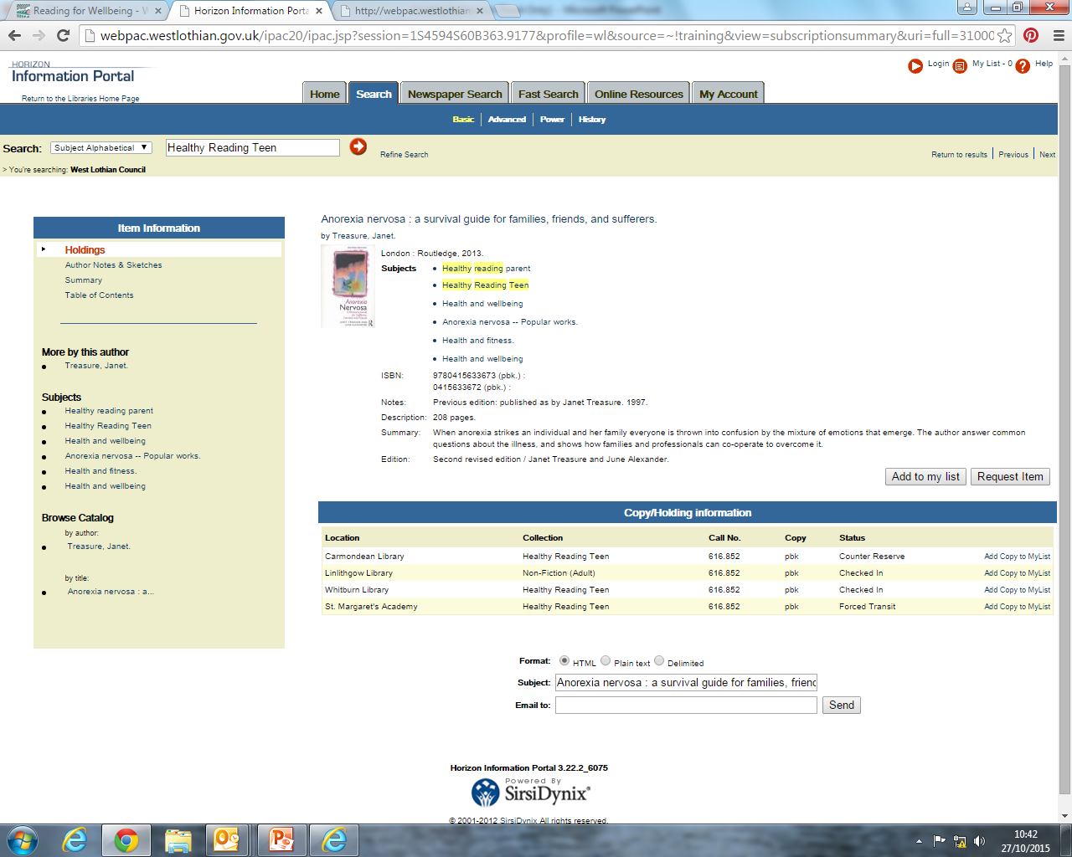
NOTE: When you select a book, subjects relating to the book you have chosen will appear. These will link you to similar resources within the library catalogue
There is the option to: request item. The following page will demonstrate these steps
Notes:
How title looks on catalogue – note subject headings available which lead you to other books related to topic on catalogue. Option to request item.

Slide 9
Notes:
Once you click on request item, put in library barcode and pin number, then select most convenient branch

Slide 10
Looking for Further Information?
Libraries: Rochelle.Downie@westlothian.gov.uk
Health Improvement Team: HIT@westlothian.gov.uk or telephone 01506 775626

