Slide 1
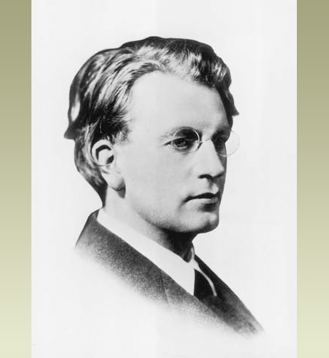
John Logie Baird

Slide 2
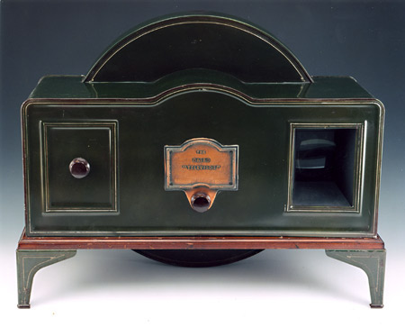
Baird invented the first ever TV

Slide 3
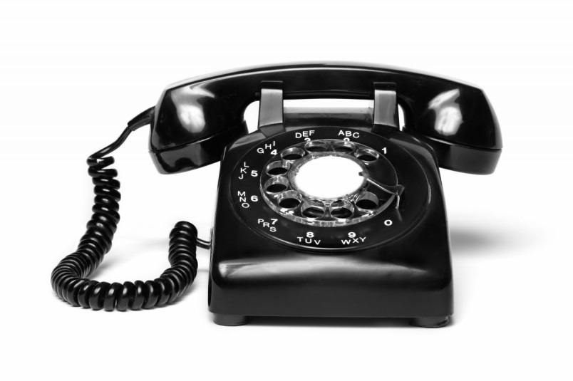
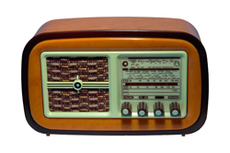
What did John Logie Baird invent?

Slide 4
When was he born?
1946
1888

Slide 5
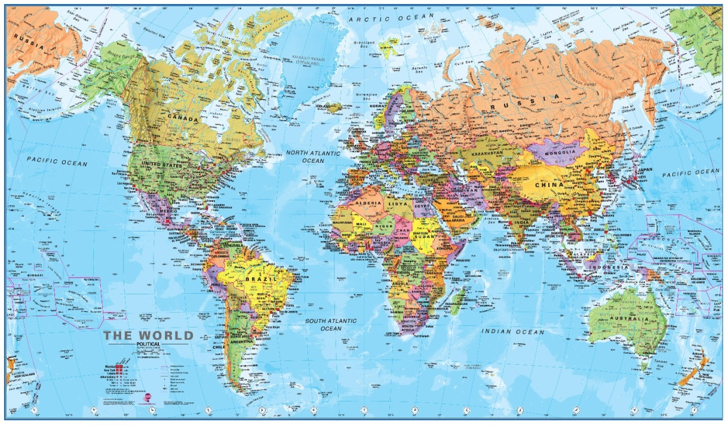
Where was he born?
England
America
Scotland
Spain

Slide 6
What did he do when he was 12?
Invent the first TV
Make a radio
Make a telephone

Slide 7
Why didn't he like going to school?
He didn’t like doing PE outside
He didn’t like his teacher
He didn’t like having a cold bath after PE

Slide 8
Who was the first person to appear on TV?
John Logie Baird
Bairds brother
Bairds Mum
William

Slide 9
What colour were the first TV pictures?
Purple
Red
Orange
Black and white

