Slide 1
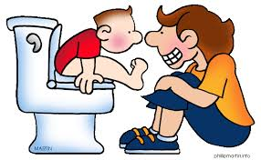
Toileting Workshop Complex Needs School Nursing Team

Slide 2
Biological Reflex - The bladder expands as it fills. - When the bladder is full, nerve endings in the bladder wall send messages to the brain, the need to pass urine. - Muscles then contract and relax to pass urine.

Slide 3
Awareness - Is your child aware they are wet or soiled? - Is your child dry for 2 hours or more? - Does your child have a toileting pattern? - Will your child sit on the toilet?

Slide 4
Routine - Sitting on the toilet. - Ensure your child is comfortable, foot stool and training seat if needed. - Awareness of the bathroom and toilet.

Slide 5
Toileting Skills
- Pulling down trousers/underwear
- Wiping
- Flushing
- Washing Hands
- Drying hands
- Praise/Reward

Slide 6
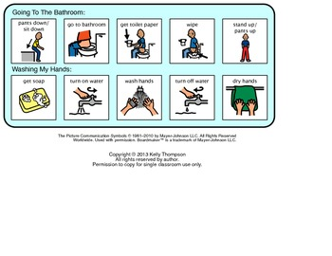
Communication
PECS
Objects
Photos
Social Stories

Slide 7
Products
- Pull-up pants/training pants.
- Mattress protector for your child’s bed and car seat.
- Dry Like Me – toilet training pads.

Slide 8
References
- ERIC – The Children’s Bladder and Bowel Charity.
- Bladder and Bowel UK.
- National Autistic Society.

