Slide 1
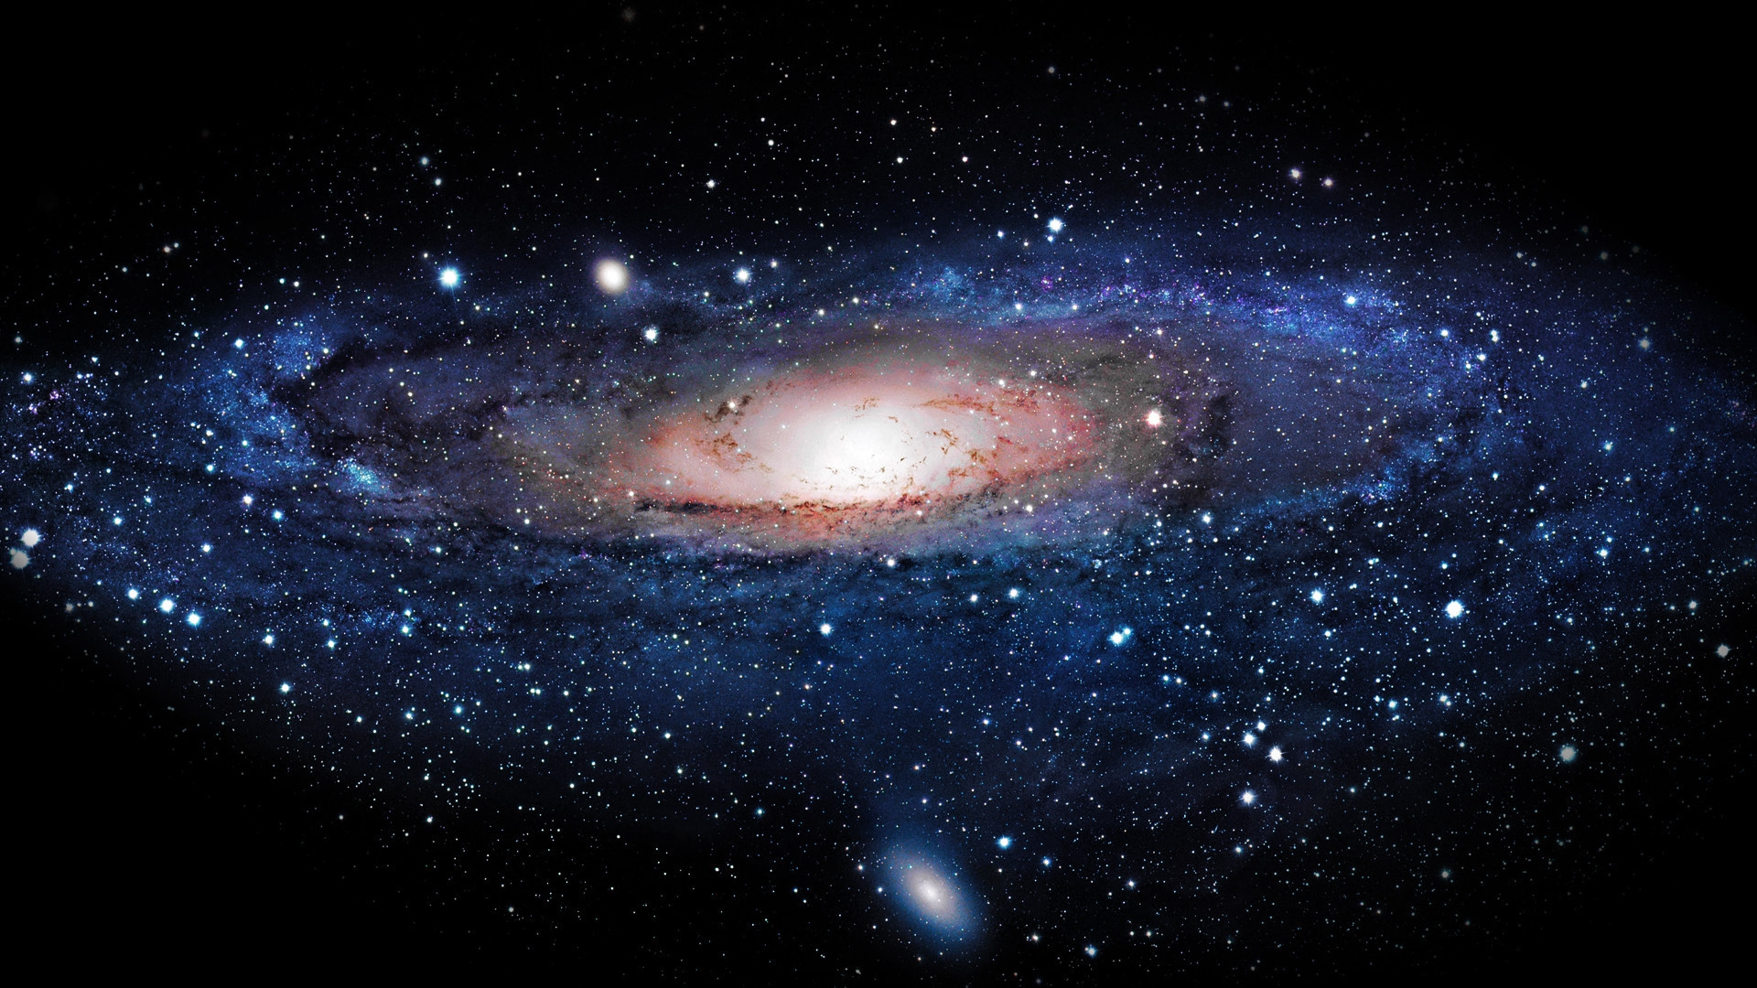
What is space?
By Ben Brennan and Kyle

Slide 2
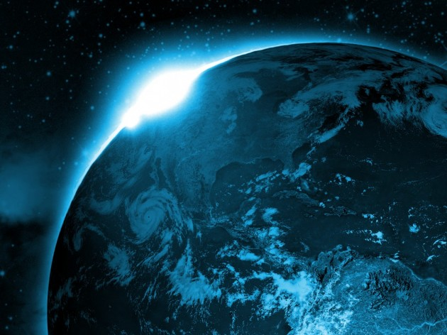
Did you know?
Some neutron stars can spin at the rate of 600 rotations per second.
All of space is silent
Astronaut's footprints can stay on the moon for at least 100 million years
99% of the solar is the mass of the sun
The largest asteroid ever to be recorded is a mammoth peace of space rock

Slide 3
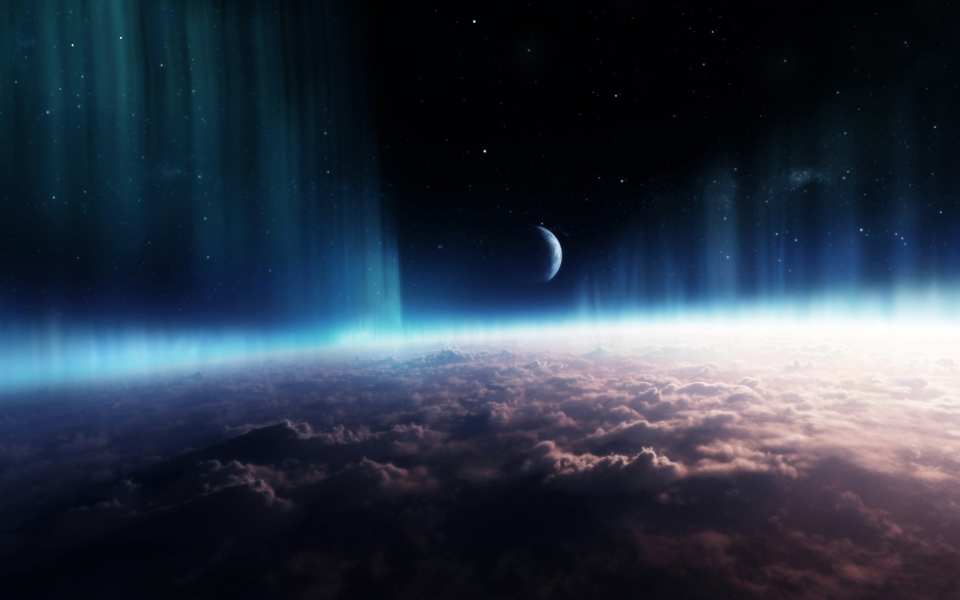
Some more facts about space…
There is thousands of planets in space.
In space the skin peels off your feet.
On Venus a day is longer than a year.
One million Earths can fit inside the sun.
You start to grow in space

Slide 4
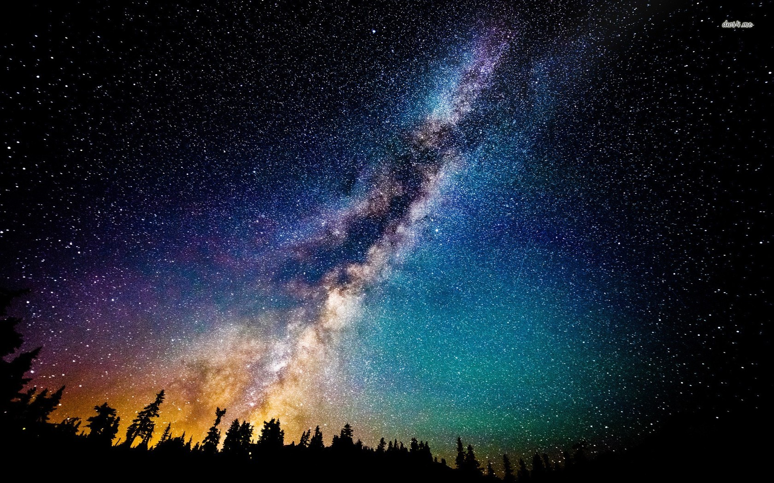
More facts about space
Space is not that far away.
The hottest planet is not the closest to the sun.
The sun looks bigger if you look at it for the Horizon.

Slide 5
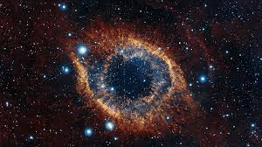
More facts about space…
You can cry in space but your tears don’t fall.
The North star will change but nobody knows when
In space metal sticks together.
Space has its own magnifying glass.
There are giant pools floating in space.

Slide 6
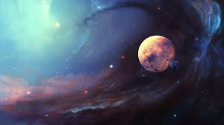
Facts about Black holes
You cant directly see a black hole
Dying stars can make black holes
Black holes come in different sizes
The first black hole wasn’t discovered until x-ray astronomy was used

Slide 7
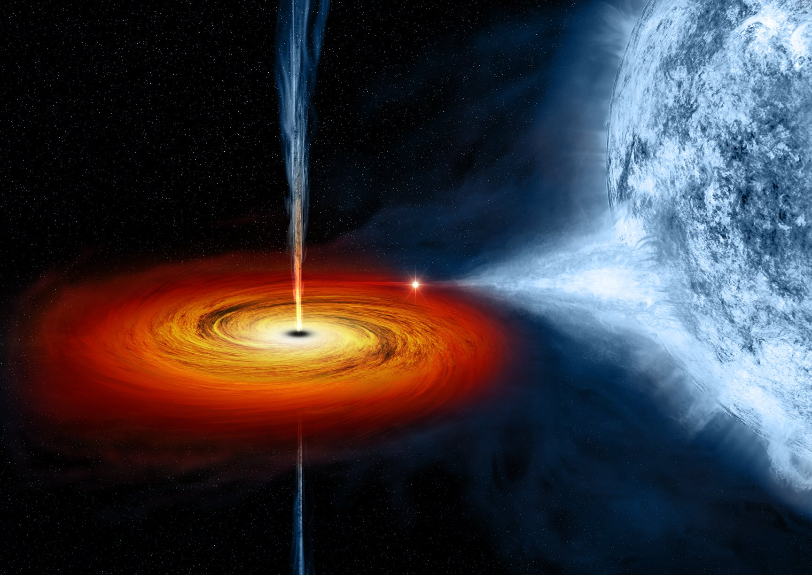
Facts about planets
The order of the planets from closest to the sun is Mercury, Venus, Earth, Mars, jupitor, Saturn, Uranus and Neptune
The largest planet is Jupiter

Slide 8
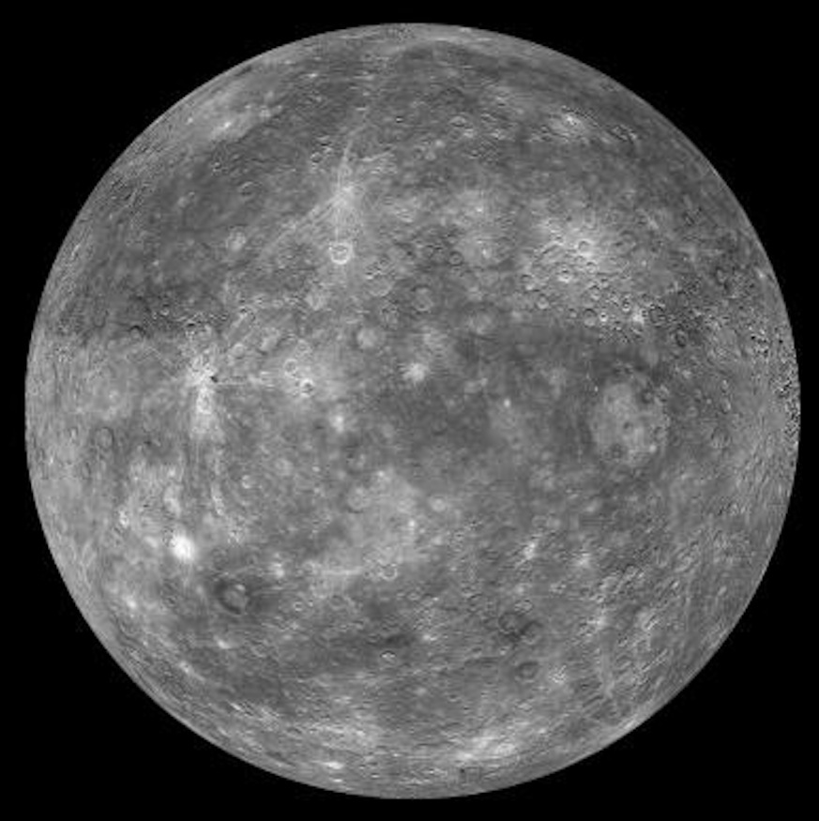
Mercury facts
Mercury doesn’t have a moon.
Your weight on Mercury is 38% of your weight on earth
A day on Mercury lasts 176 days on earth
A year on Mercury is 88 earth days
Mercury has a diameter of 4879 KM making it t the smallest planet
No n Nobody knows who discovered m t Mercury

Slide 9
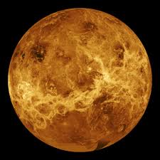
Venus
Venus is nearly as big as earth
Venus s thought to be made up with a iron core
A day on Venus is 117 earth days
A year on Venus is 225 days on earth
Venus can reach up to 471 degrees

Slide 10
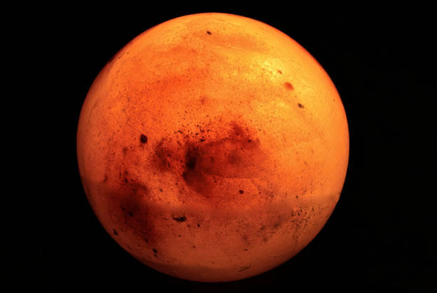
Mars
Only 18 missions to Mars have been successful
Mars has the largest dust storms in the solar system
The sun appears half the size on Mars than what it is on earth
Mars pieces have fell to Earth
Mars has its name from the god of war

Slide 11
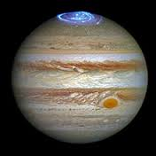
Jupiter
Jupiter is the forth brightest planet
Jupiter has the shortest day
Jupiter has a thin ring system

Slide 12
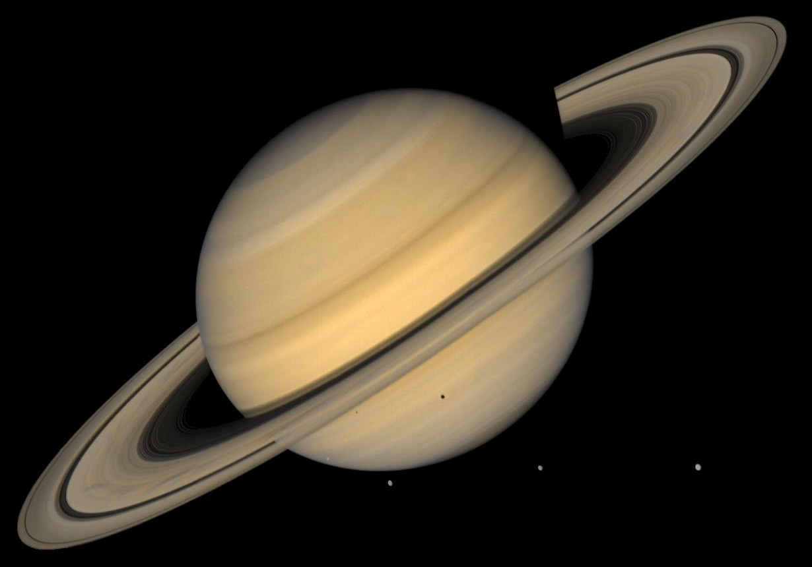
Saturn
Saturn can be seen with the naked eye
Saturn is the flattest planet
Saturn has oval shaped storms
Saturn is made mostly by hydrogen
Saturn has 150 moons

Slide 13
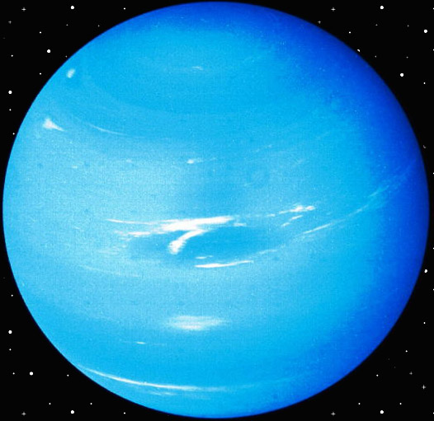
Uranus
Uranus was discovered in 1781
people say Uranus is a ice giant
Uranus is the coldest planet

Slide 14
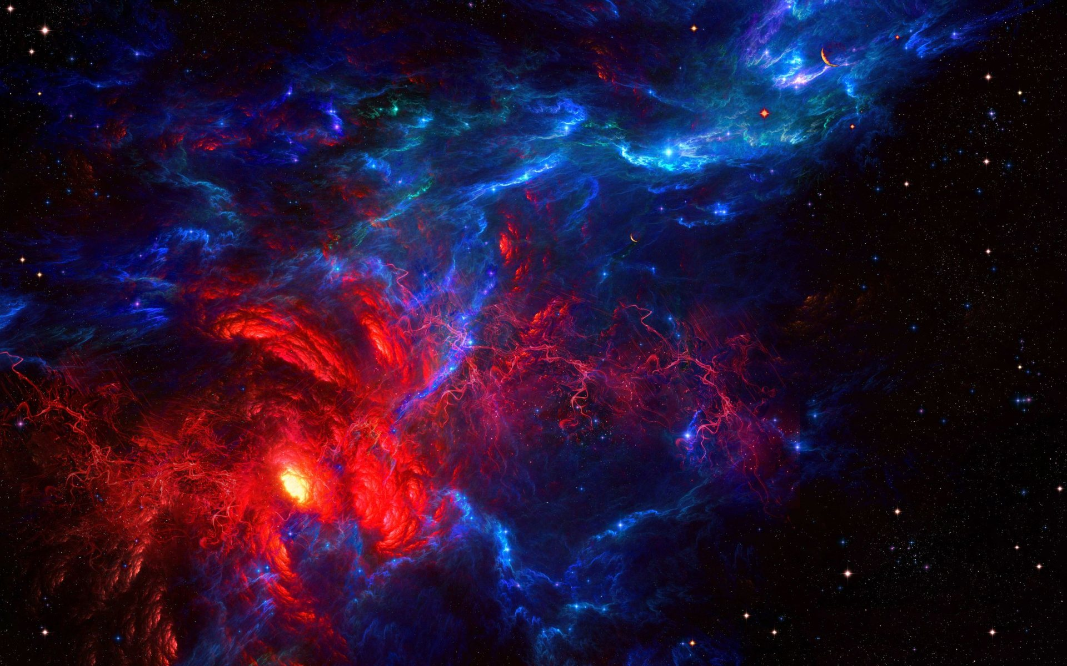
Asteroids
Asteroids are small rock objects
The first asteroid was discovered in 1801
There are 600.000 asteroids in the solar system
The first asteroid was the largest

Slide 15
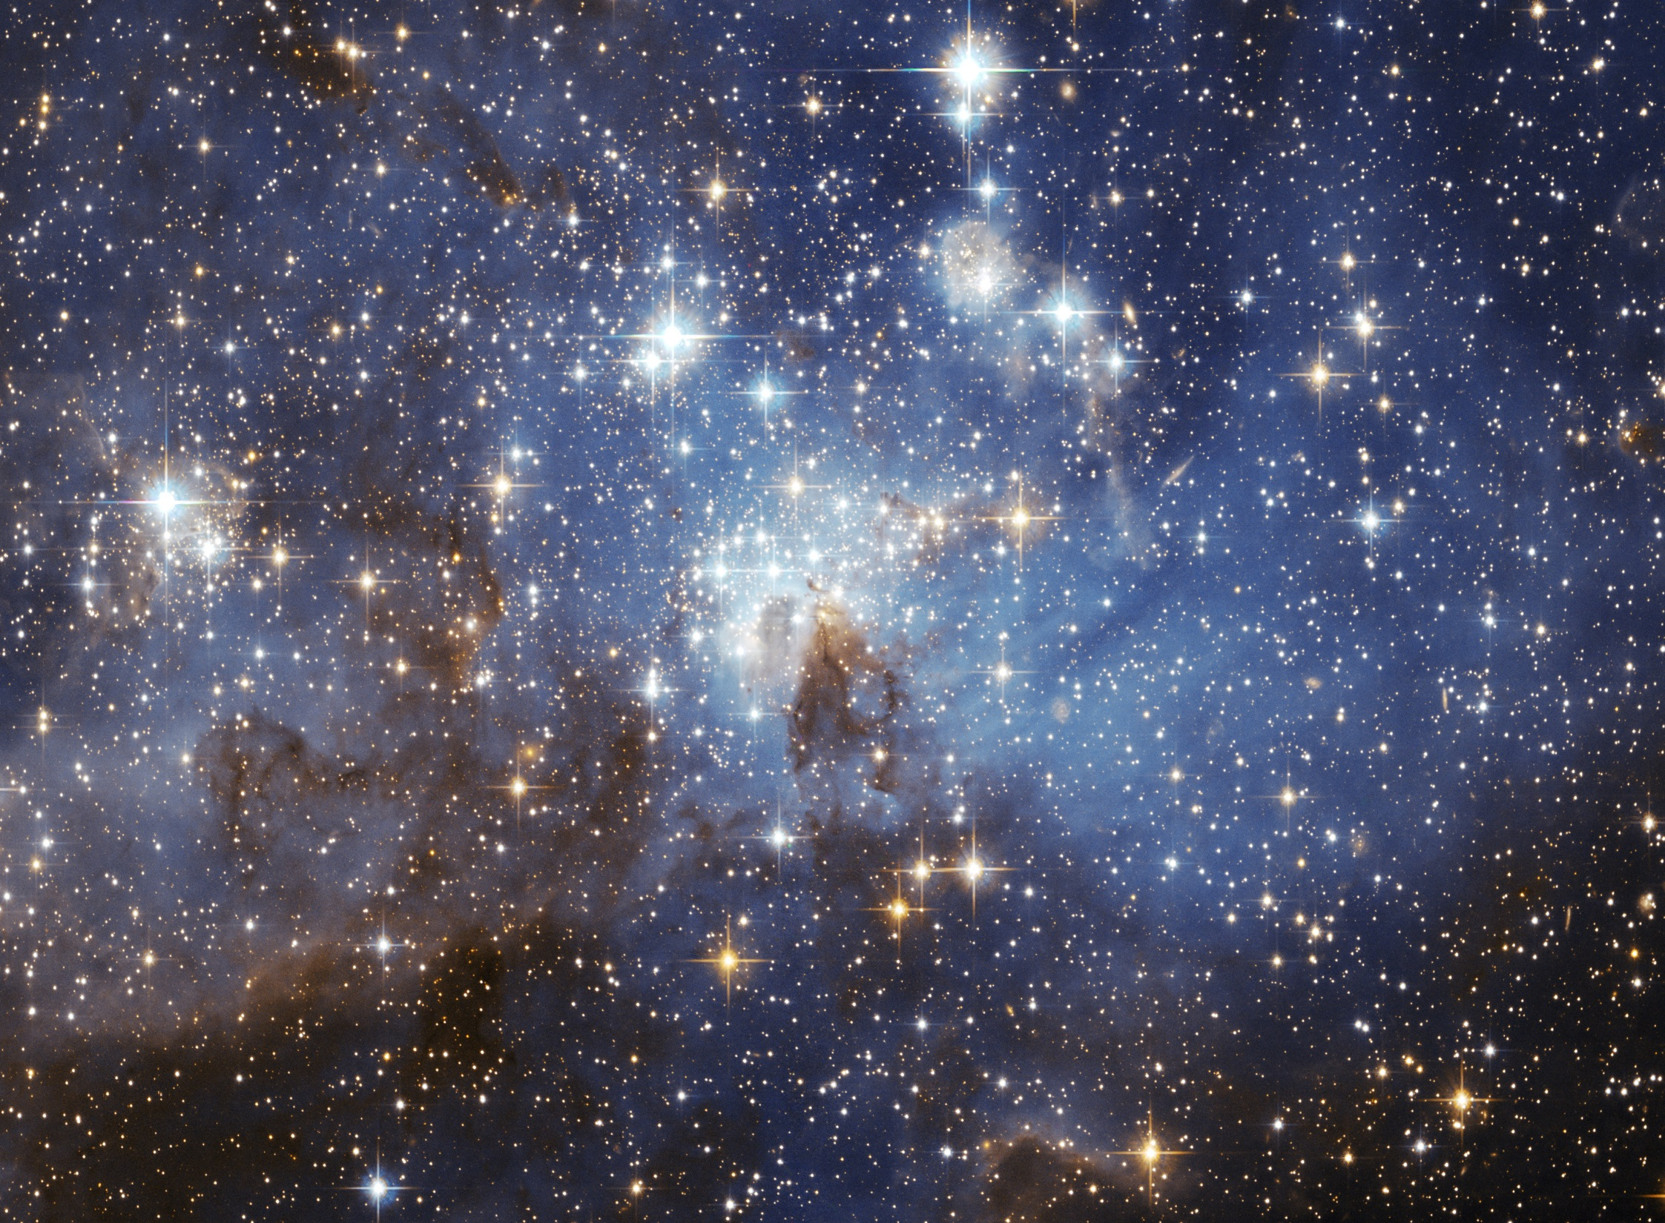
Facts about starts
There are no green stars
Our sun is a dwarf star
Stars don’t twinkle

Slide 16
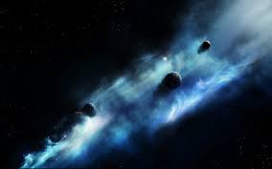
More facts about space
There may be life on Mars.
Nobody knows how many starts are in space.
.There is a volcano on Mars that is 3 time the size of EVEREST!!!
The Moon was once a pieces off Earth.
There may be a planet made out of Diamonds.

Slide 17
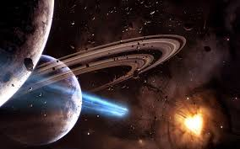
Thanks for watching hope you enjoyed. By brennan ben and kyle

Slide 18
Bye

