Slide 1
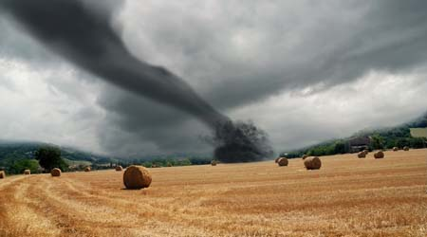
Twister
https://www.youtube.com/watch?feature=player_detailpage&v=c2S6gKX6YtM
By Blake Kyle Josh Aimee and Summer

Slide 2
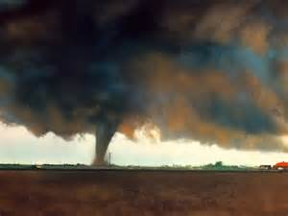
twister facts
Twisters are usually in America and they get hit by twisters 1,200 times a year.
1,000 of people die from twisters every year.
Did you know that twisters spread from America to India
Did you know the frightening black colour of tornadoes is caused by the dirt from the ground.

Slide 3
Some more facts
It took the Tornado 8,431m to India from America.
The tornado is just beginning.
The clouds are getting closer and closer to the ground. All the time they are going round in a circle. The winds are getting stronger and stronger.

Slide 4
twister facts
Twisters can suck up anything from animals to cars to houses and combine harvesters.
Twisters spin at great speed. You can see the wind because it is made out of dirt and dust.

Slide 5
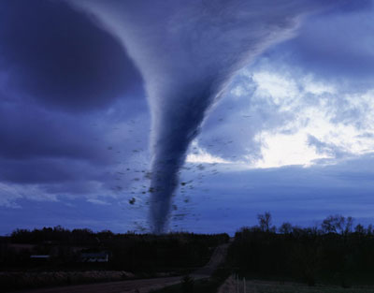
Tornados that happened in America
There was a tornado in the mildest of America
A tornado is a really strong wind that can suck up mud and animals and vehicles

Slide 6
Tornado shelter
A twister is American.
The shelter has been built underground where people can hide from the tornadoes.

Slide 7
Twister playing tricks
Twisters suck things up from the ground then dropping it somewhere else.
Sometimes aeroplanes can be turned upside down.

Slide 8
What a Twister has done
The Twister has made a path through the village. A woman was in her kitchen when the winds came. She said later:
“I heard it roar through the chimney and felt it sucking things up. When we stood up there was no roof.

Slide 9
Wiled facts
Did you know since 1925 tornadoes have killed 9,000 people in the in America.
Did you know that the strongest wind is a twister.

Slide 10
Facts
Many trees block the roads so people are trapped where they live
Tornados usually form over land rather than over oceans

