Slide 1
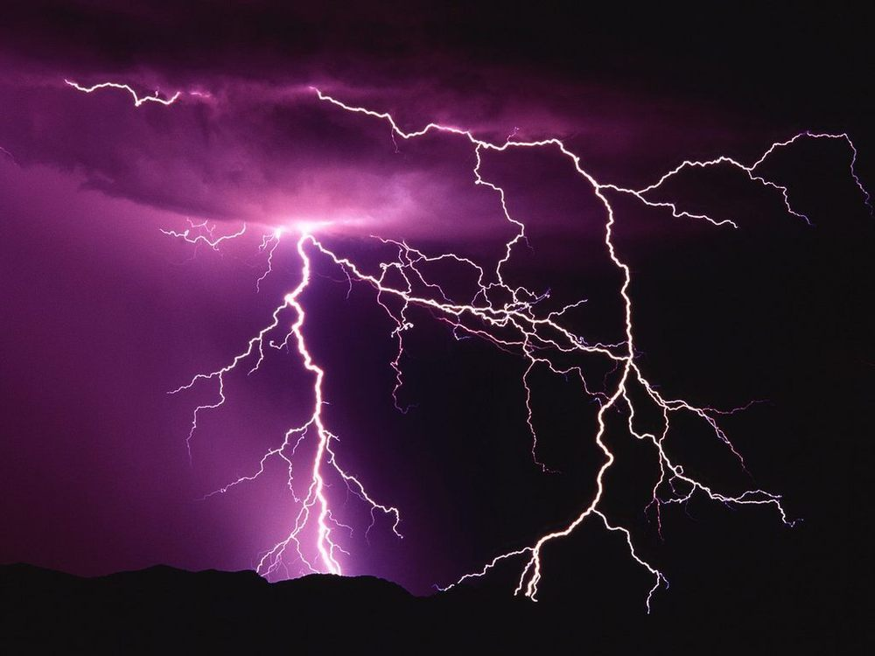
Thunder & Lightning
By Carter, Amy, Logan, Ruby ,Charlotte

Slide 2
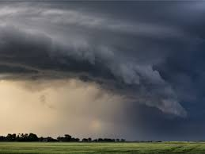
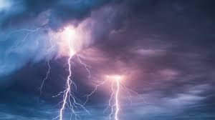
Thunder and lightning.
Thunder is formed by lightning.
When it flashes it creates a hole in the clouds called a channel when it closes it makes a loud noise we know as thunder.
. What to do in a storm
Stay indoors if not stay out in the open
Stay away from trees or forests

Slide 3
How to know lightning is near
If you see dark clouds, then lightning could be present, but the best thing you can do is to listen for thunder. If you hear thunder, then you need to go indoors or get in a car. Don't be outside, where lightning could strike! If your hair stands on end or your skin starts to tingle, lightning maybe about to strike. Get down on your hands and knees and keep your head tucked in. Do not lay flat, because it can give lightning a better chance of strike you.

Slide 4
What causes thunder?
Thunder is caused by lightning. When a lightning bolt travels from the cloud to the ground it actually opens up a little hole in the air called a channel. Once then light is gone the air collapses back in and creates a sound wave that we hear as thunder. The reason we see lightning before we hear thunder is because light travels faster than sound

Slide 5
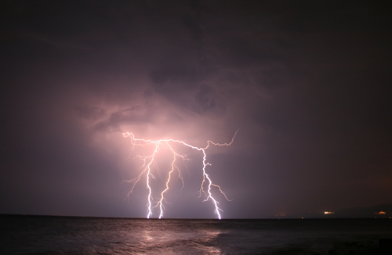
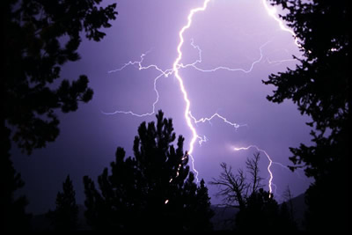
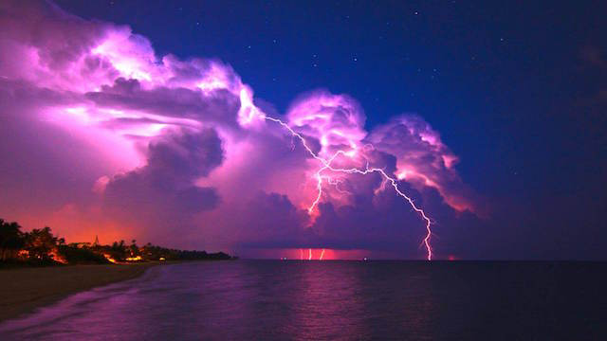
Random facts
A bolt of lightning lasts on average for about one 10,000th of a second but could light a 100 Watt light bulb for three months.
Lightning travels through the air at around 270,000 mph - that's around 75 miles every second
Lightning is hotter than the surface of the sun reaching temperatures of around 30,000 °C
Thunderstorms can trigger asthma
The island of Java is the most thundery place on earth with 220 days of thunderstorms every year.

Slide 6
Thunder facts
1 Thunder is the sound caused by lightning.
2 The intense heat from lightning causes the surrounding air to rapidly expand and create a sonic wave that you hear as thunder.
3 The average temperature of lightning is around 20000 °C (36000 °F).
4 The sound of thunder can be anything from a loud crack to a low rumble
1 light travels faster than sound so we see lightning before we hear thunder.
2 The closer you are, the shorter the gap between the lightning and thunder.
3 The speed of sound is around 767 miles per hour (1,230 kilometres per hour).
4 The speed of light is around 669600000 miles per hour (1080000000 kilometres per hour).
5 Thunder is difficult to hear at distances over 12 miles (20 kilometres).

Slide 7
Fun facts
Even as some regions of the planet experience more intense storms, others will suffer a greater risk of drought during warmer months, the study concluded
Based on computer models, Meehl and his colleagues expect that the regions most likely to experience the more intense storms are places where large masses of moist air converge
Even if you could stabilize greenhouse gas concentrations in the atmosphere at present day levels, the system has a certain amount of thermal inertia and would take several more decades to stabilize," Meehl said. "You'd have to really decrease the rate that you're putting stuff in the atmosphere to get the concentrations to level out and that'll probably be fairly difficult politically

Slide 8
Facts
A new global satellite survey of thunderstorm activity has helped meteorologists pinpoint exactly where Earth’s hotspots for intense Tunderstorm are the American Midwestand some semi-arid regions like the edges of the Sahara desert.

