Slide 1
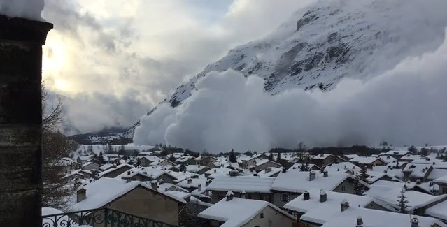
Avalanche
By Lenny Laura and Brennan

Slide 2
Facts about Avalanches
Each year more than 150 people get killed by Avalanches
Avalanches reach 80mph within 5 seconds.
An Avalanche can last for seconds if not several minutes . Avalanches are big risks for people 24 hours of snow falls 12 inches of snow maybe more.

Slide 3
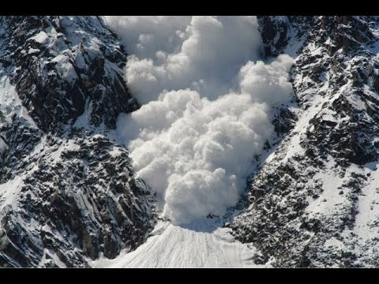
What Avalanches do to people
Avalanches are most likely to happen once a heavy snow storm.
It drops at least 12 inches of new snow on top of the old snow.
Most Avalanches are made by people skiing ,snowboarding and hiking down the mountain's .

Slide 4
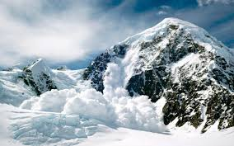
facts
An Avalanche is a big piece of snow which falls down a mountain at a rapid speed.

Slide 5
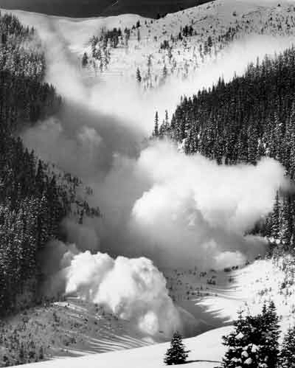
Freaky Facts
An avalanche is like 750 snowballs at 80mph hitting you all at the same.
My auntie lived in new Zealand where some of the worst avalanches happen

Slide 6
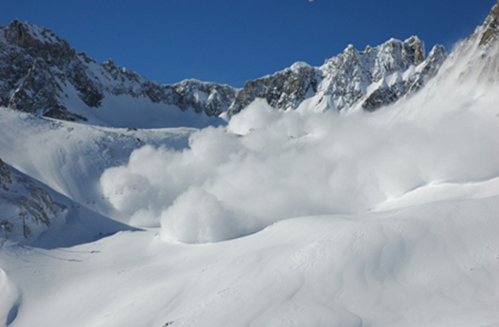
Thanks for watching

