Slide 1
Portugal festivals
by Lenny and Carter

Slide 2
THANK YOU FOR WACTHING

Slide 3
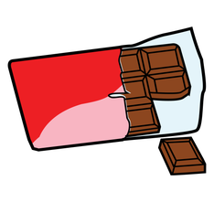
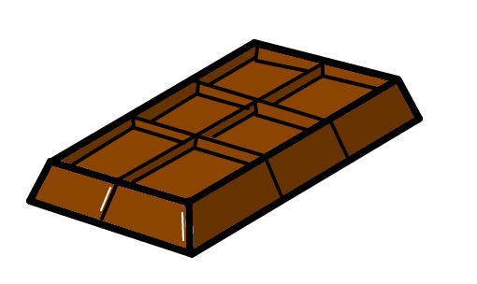
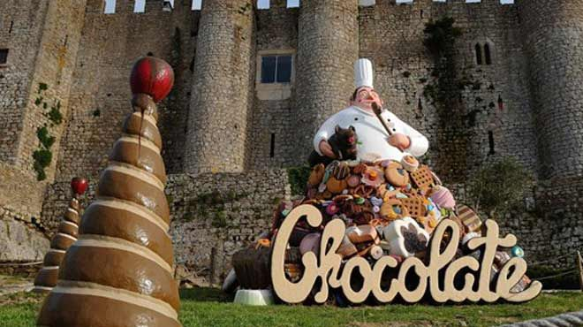
THE CHOCOLATE FESTIVAL
IN Portugal they have a chocolate festival for kids in February the 8 to the 15 of February I wish we had that in Britain

Slide 4
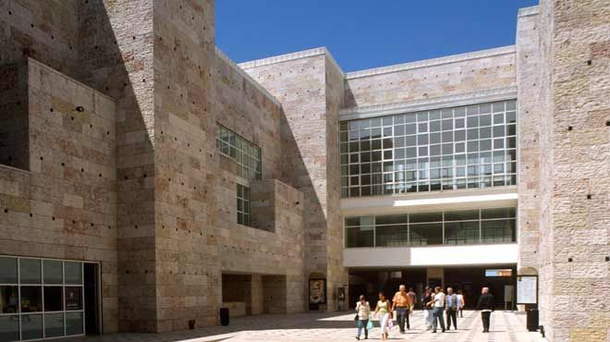
THE MUSIC FESTIVAL
THE MUSIC FESTIVAL GOES IN MARCH 3 TO MARCH 10. THEY GO TO LISTEN TO CLASSICAL MUSIC BUT ONLY CHILDREN OVER 12 CAN GO NOT BABYS BECAUSE IT WOULD DISTURB IT.

Slide 5
THE FILM FESTIVAL
THE FILM FESTIVAL STARTS 25 APRIL TO 1 MAY THEY GO THERE TO GIVE OUT AWARDS TO 1 PLACE 2 PLACE AND 3 PLACE

Slide 6
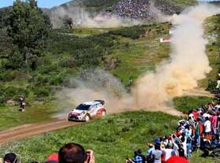
THE RALLY RACE FESTIVAL
THE RALLY FESTIVAL START S 20 MAY TO 22 MAY IT IS JUST TO ENJOIY IN FOR A FUN ITS STILL A COMPITION

Slide 7
OPTIMAS ALVE
9 JULY TO 11 JULY ITS WHEN THEY HAVE A BAND SHOW TO COMPETE AND IT
IS VERY FUN SERIOSLY FUN I MEAN AWSOME

Slide 8
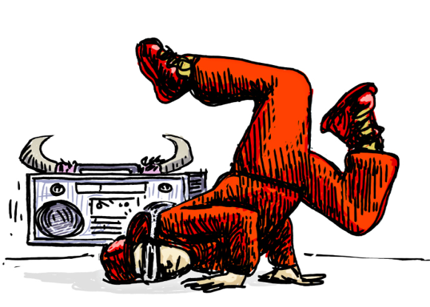
MARES VIVAS
The meo festival starts 14 July 2016 it when people go there to enter a contest to amuse judges and the audience to see if they win this is a friendly competition

Slide 9
THANKS FOR WACTHING

