Slide 1
Hannah and Ryan
Italy festivals

Slide 2
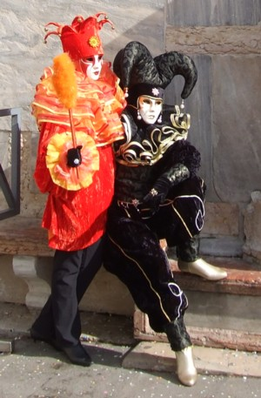
Venice carnival

Slide 3
It is in italy
The date 30 /31 of January 2016

Slide 4
Italy flag

Slide 5
5.000 tickets where sold
Clothes are in different events

Slide 6
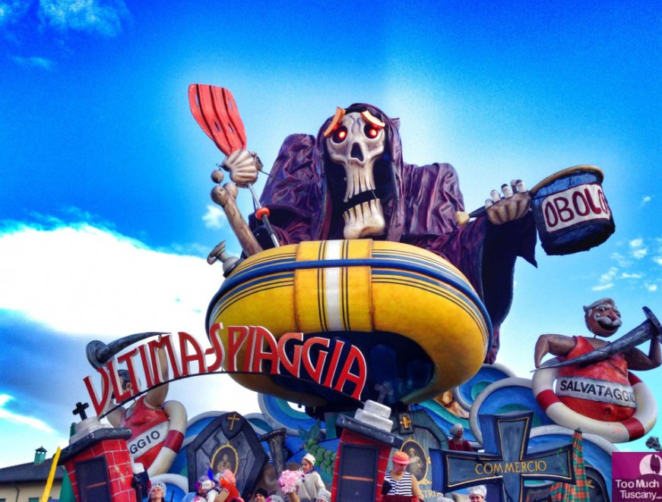
A brief history

Slide 7
Any day
IT was moved to viareggio when it
Stared in 1931

Slide 8
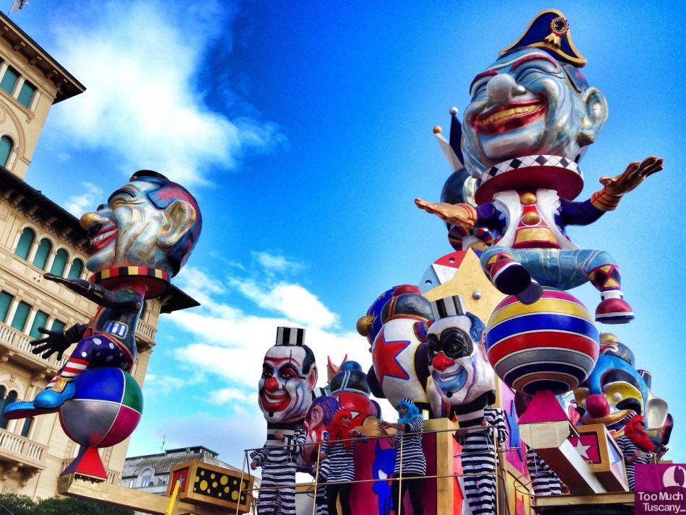
Thank You For Watching

