Slide 1
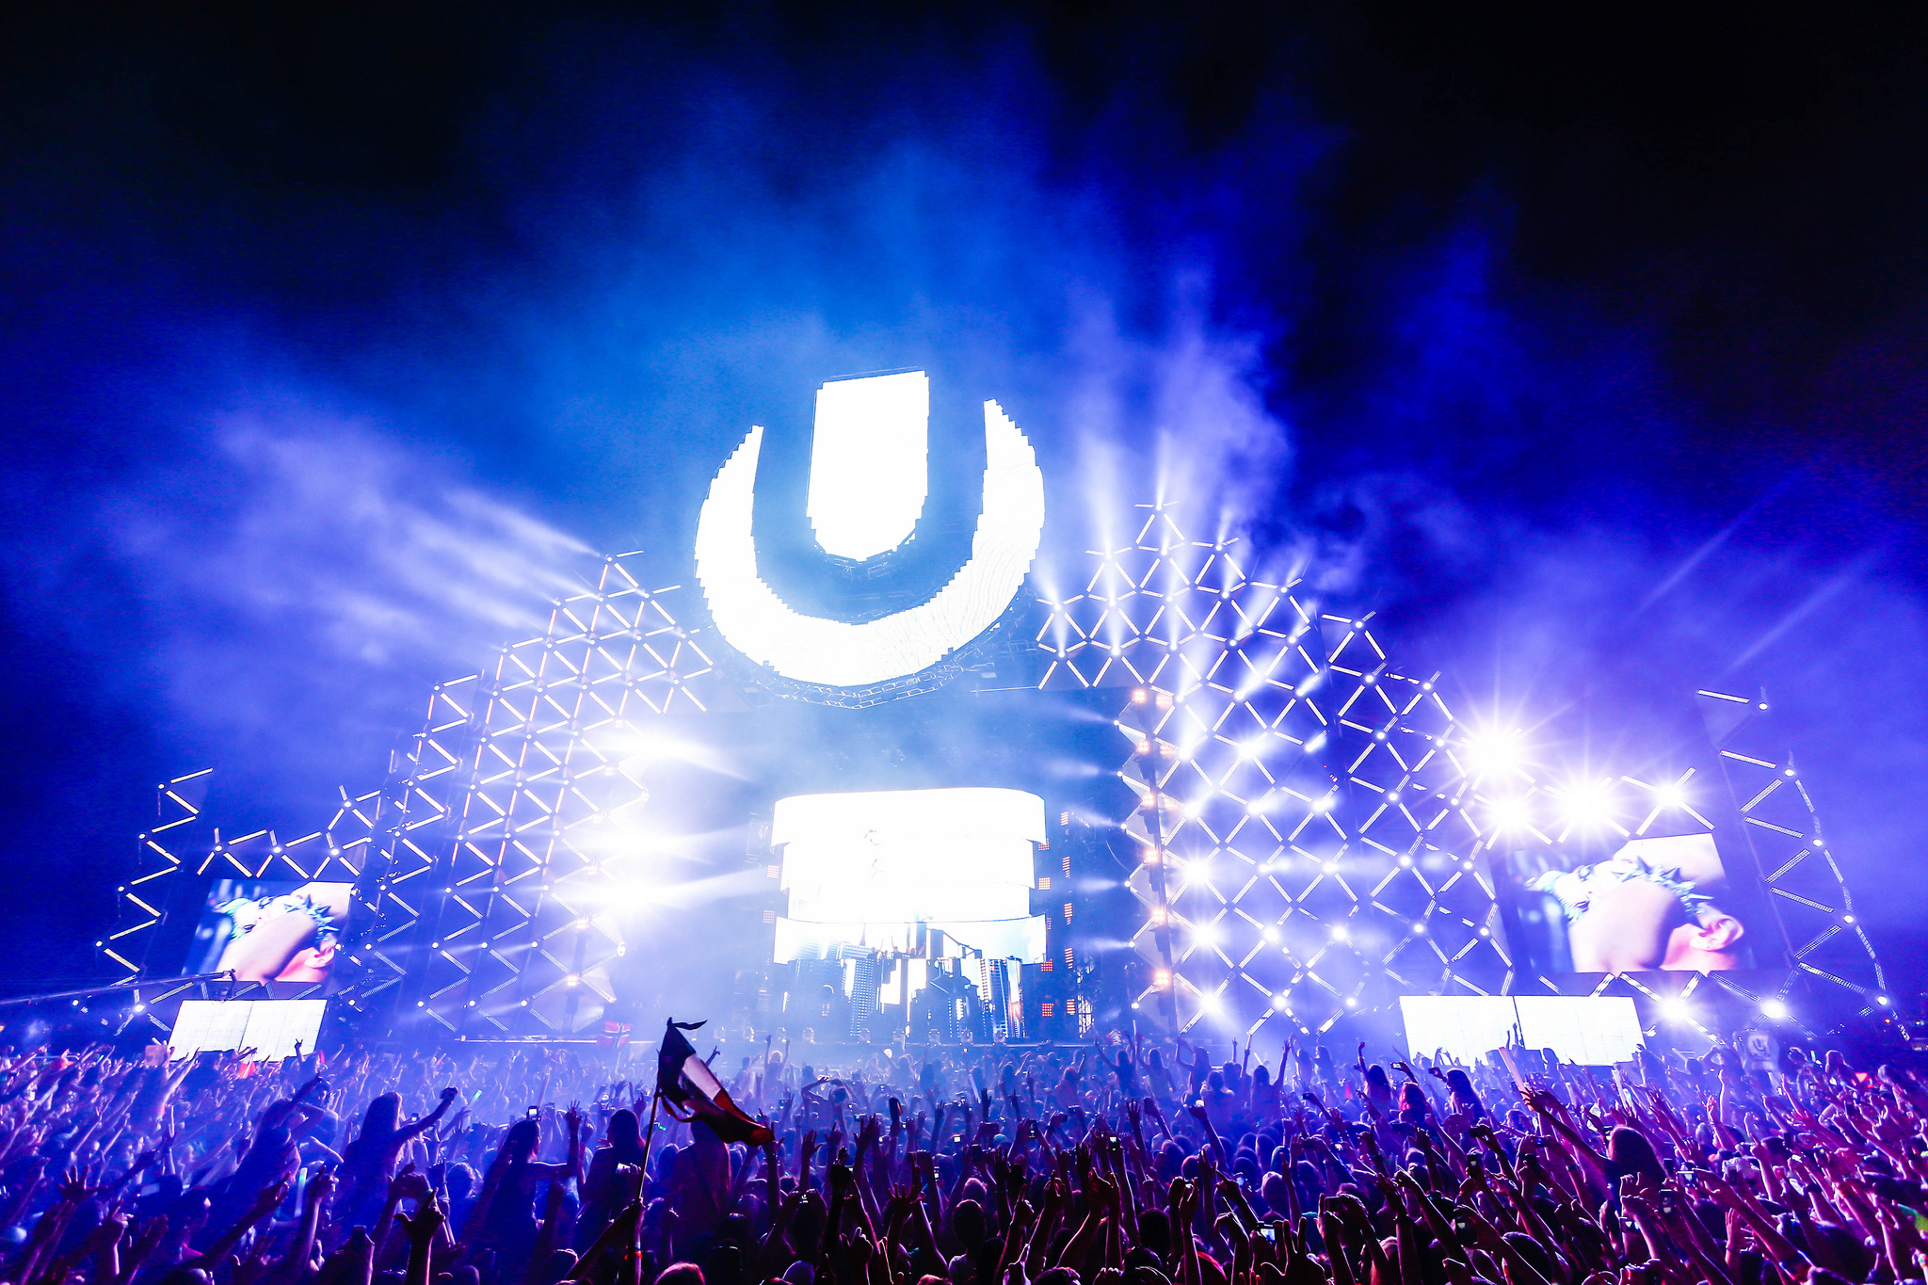
Swedish festivals
Welcome to josh and Brodie's festival slideshow
w

Slide 2
Date:30th june-2 July 2016 Norrkoping
Bravalla is a swedish music and rock festival

Slide 3
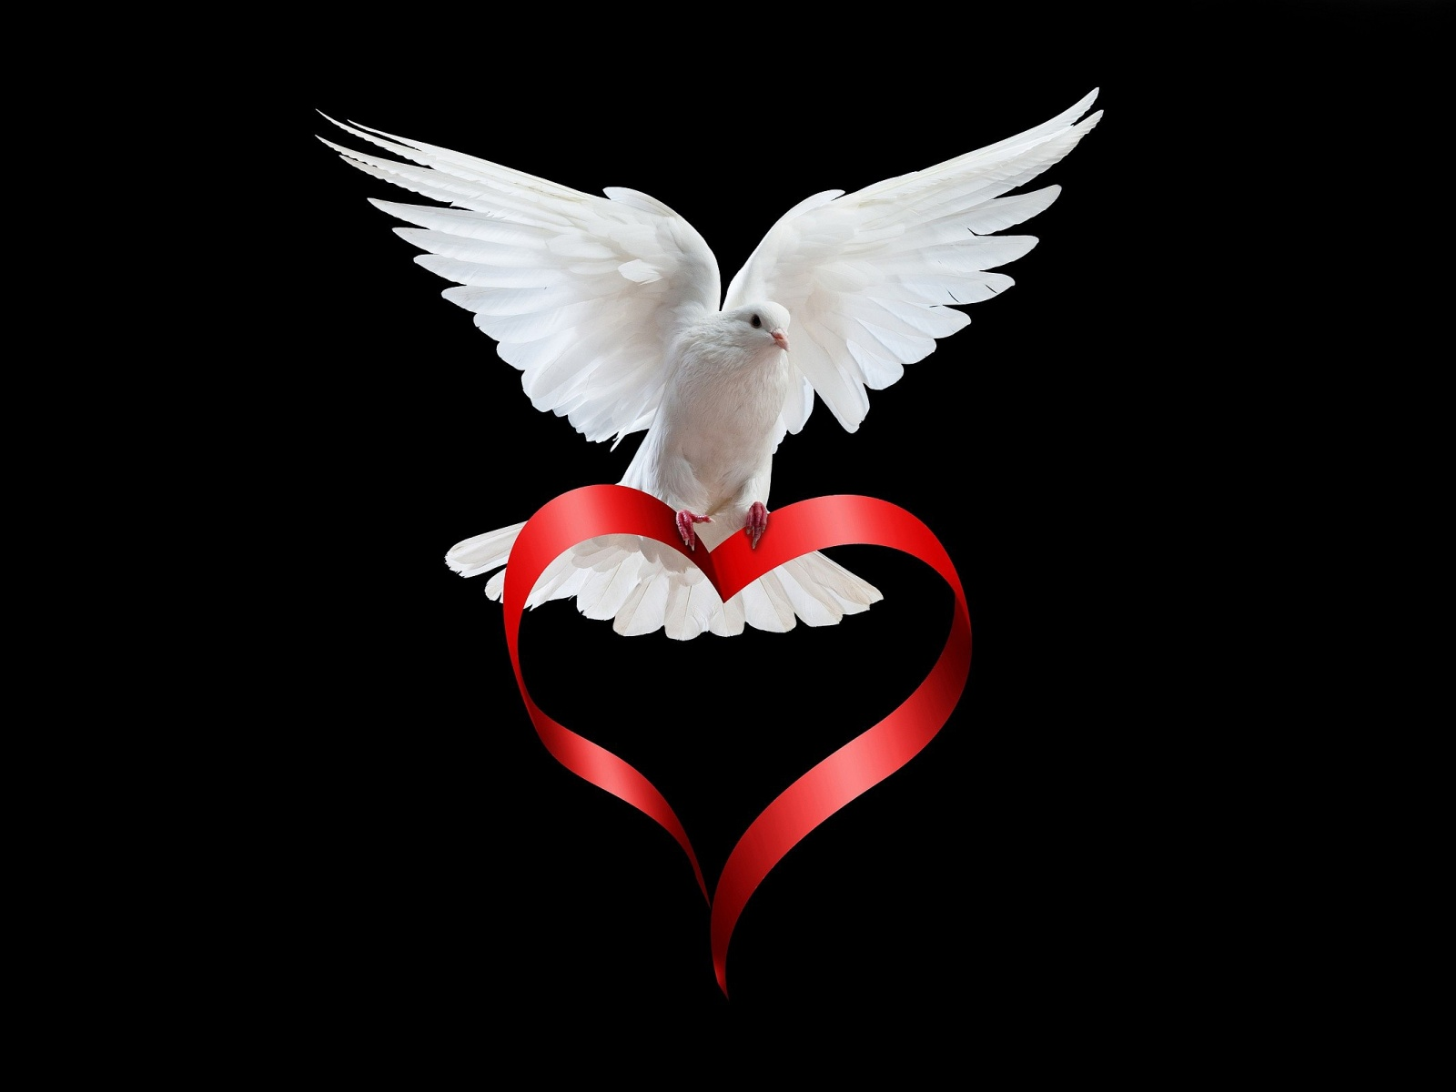
Peace and love festival
The peace and love festival was founded in July 1999 and the date is and it takes place on 7th-9th of july

Slide 4
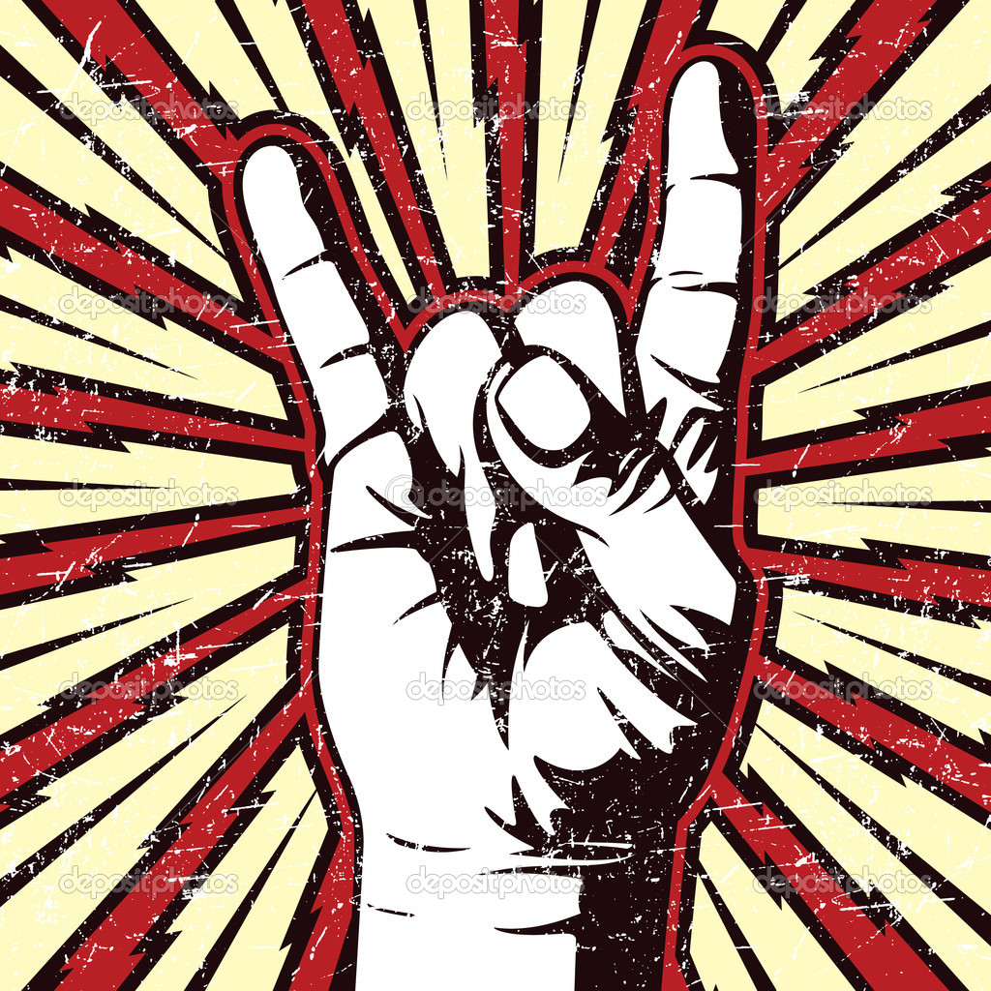
Stockholm early music festival
The dates for the festival is the 9th of March,6th of April and the 4th May and thanks for reading

