Slide 1
Ben and Blake 2016
Spain presentation

Slide 2
Bull running festival July

Slide 3
Bull running is dangerous because people can die because of the bull after the chase the bull dies

Slide 4
Christmas in Spain

Slide 5
A MASSIVE COOKIE HOUSE IN SPAIN

Slide 6
Amazing decorations in Spain

Slide 7
The tomato festival is on the last Wednesday in august

Slide 8
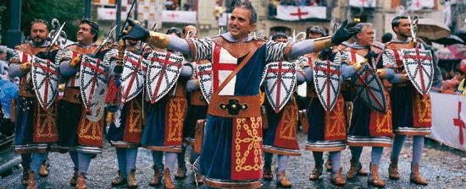
A medieval festival when: 15 July

Slide 9
Football festival in Barcelona when :July

