Slide 1
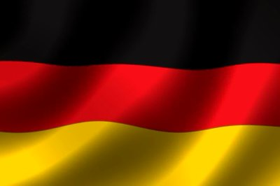
Kyle and Brennan
Germany celebrations

Slide 2
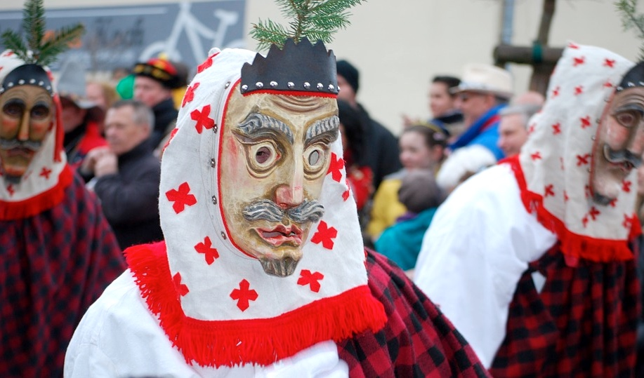
Mid February
The 40 day period before ash Wednesday when lent begins is also carnaval season in Germany.

Slide 3
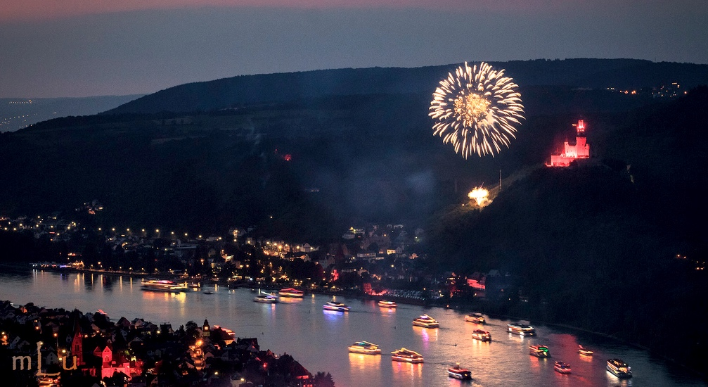
May-September Rhein in flammen
This is a firework display lighten up the castles and rivers.

Slide 4
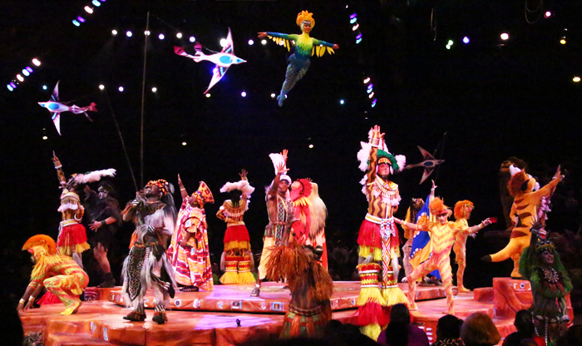
July international festival
During the unique festival in Tubingen near Stuggart African artists and bands preform moderen traditional dance and music from their home countries

Slide 5
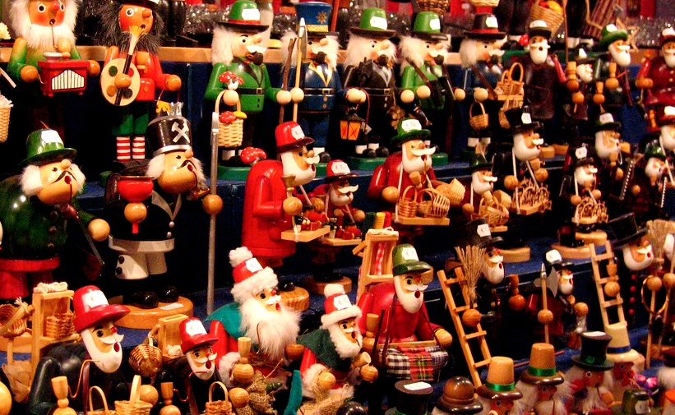
Date:December
Nearly every german village and city sets up the own christmas market

Slide 6
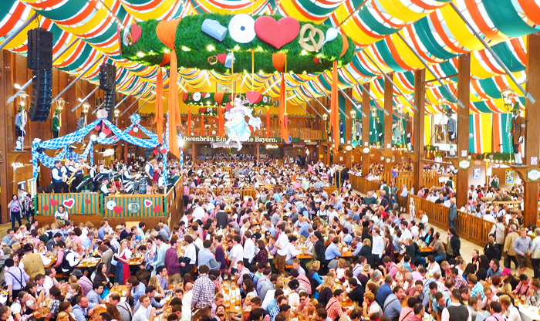
October book fair
This history of world largest trade fair books since the 15th centuary

Slide 7
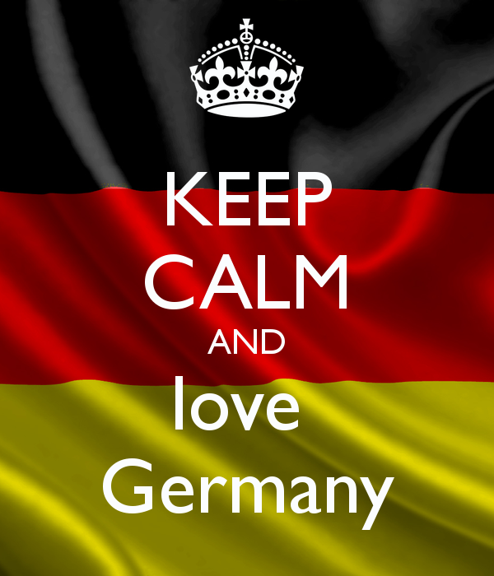

Slide 8
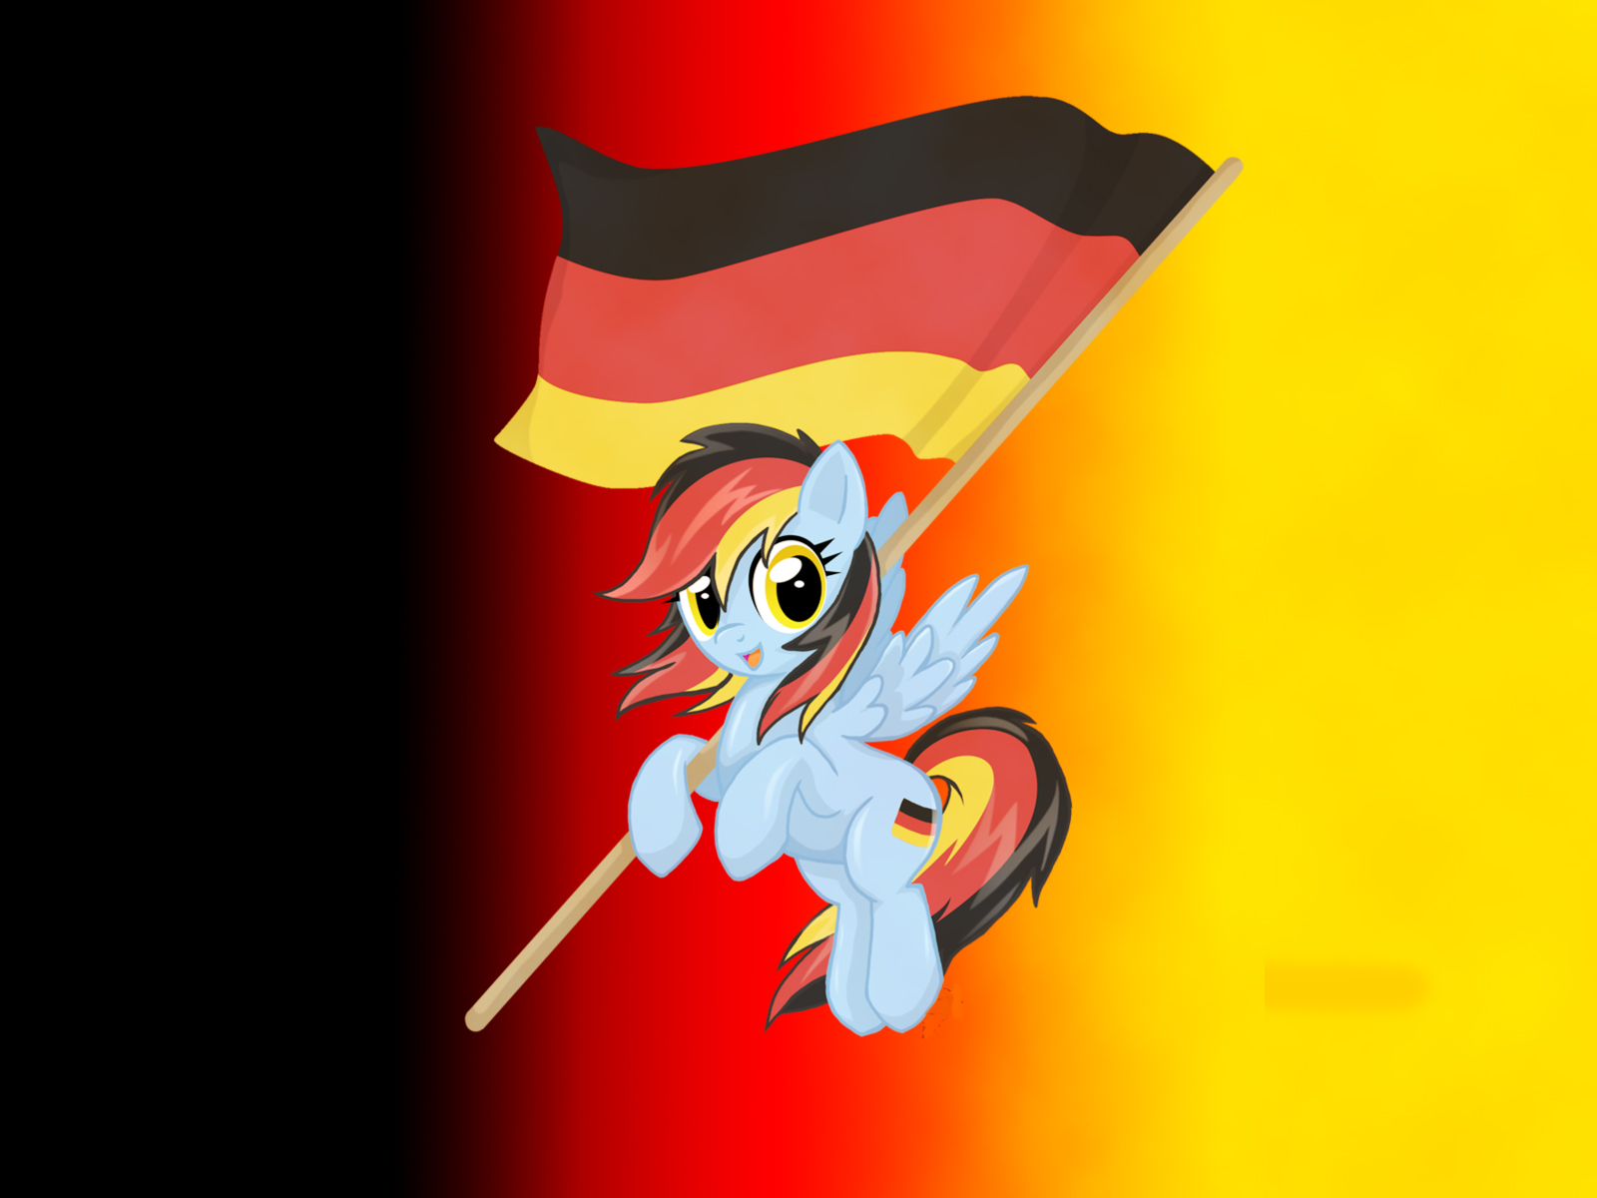
Thank you for watching Kyle and Brennan’s slide show
Hope you have enjoyed ☺☺

