Slide 1
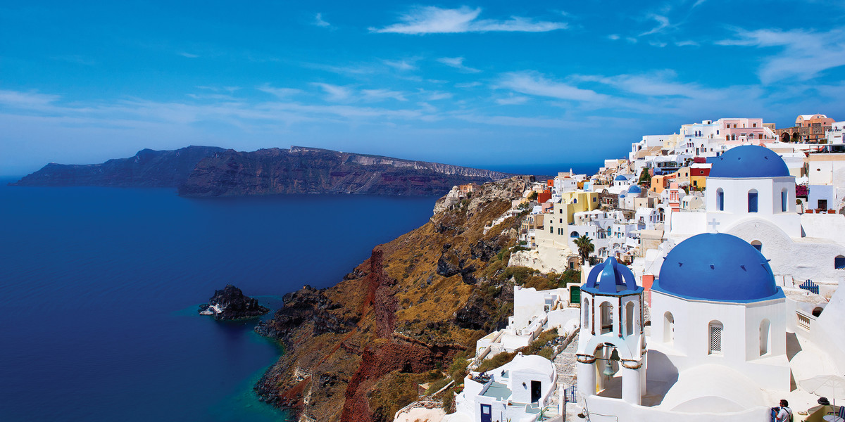
Festivals in Greece
By Jura and Wiktoria

Slide 2
Orthodox Easter
Easter is the biggest festival in Greece so far.

Slide 3
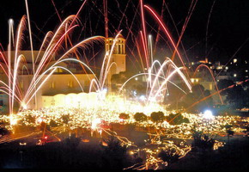
Easter begins on the Saturday of Lazarus(one week before Easter Sunday.)

Slide 4
Next festival!!! Is

Slide 5
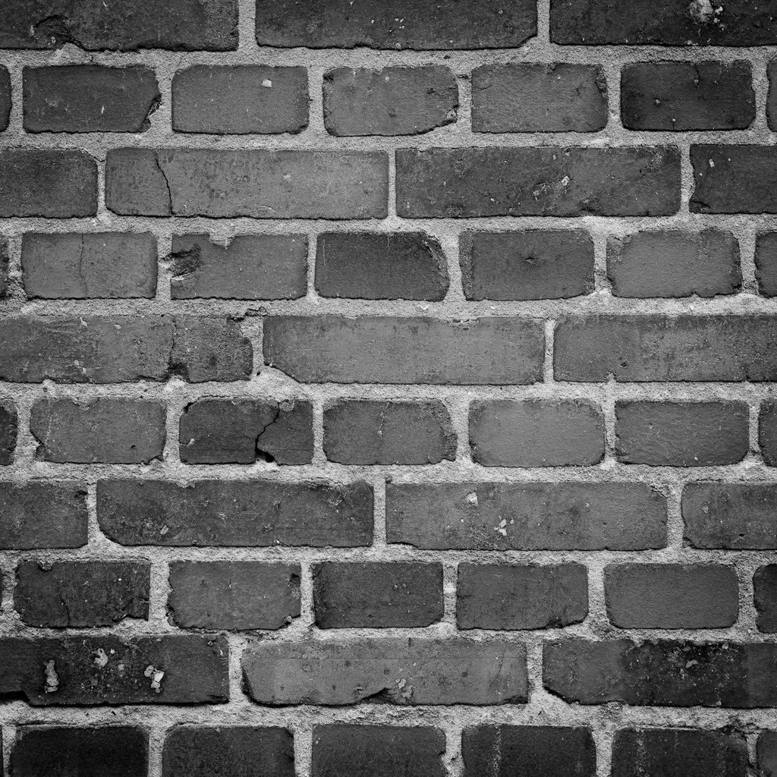
The Hellenic Festival

Slide 6
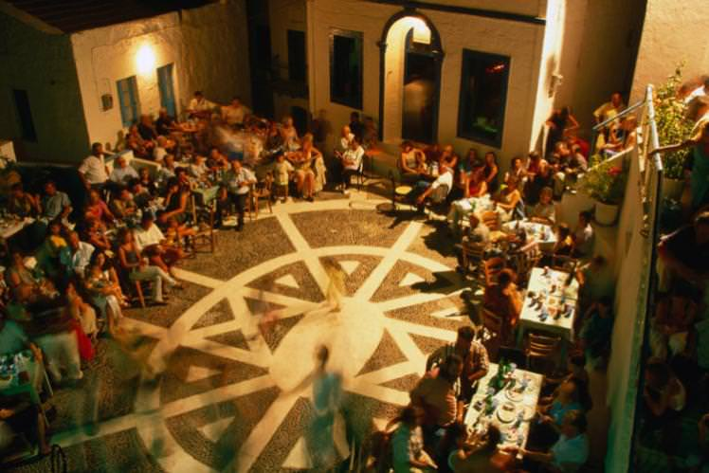

Slide 7
Imagine the open, dark Greek summer sky above you and the heavy tiers of an very old Greek theatre filled with a rapt audience watching art in the sky.

Slide 8
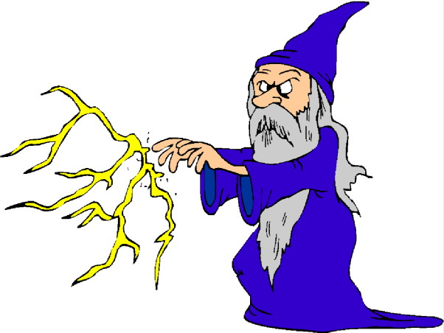
Its our favourite festival

