Slide 1
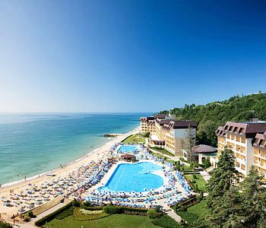
Bulgaria festivals
By Aimee
And Laura

Slide 2
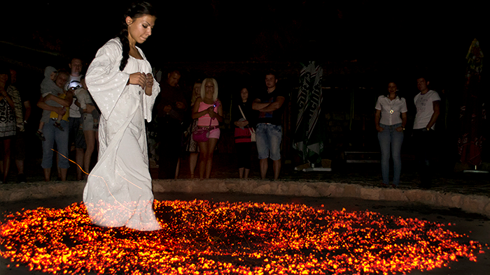
Fire dancing in Bulgaria village
They dance bare footed on hot coal. The person who performs the dancing is called Nestinon. The festival lasts all day long on the 3rd of June.

Slide 3
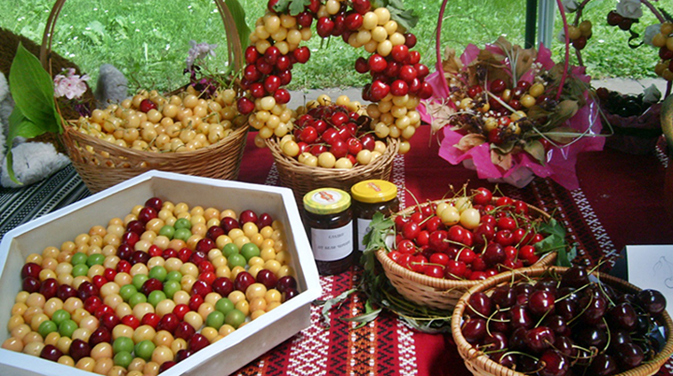
Cherry festival in Kyustendil
When: 27-28 June
A festival devoted to various types of cherries
There will be rich artistic programs with dances, rituals, songs which present the magic of the cherry and
Its influence on
Bulgarian folklore.

Slide 4
Rose festival in Kazanlak
Bulgaria is also famous
For there roses.
The small country has 70% of the rose oil in the world.
When: 5-8 June
The roses are different colours

Slide 5
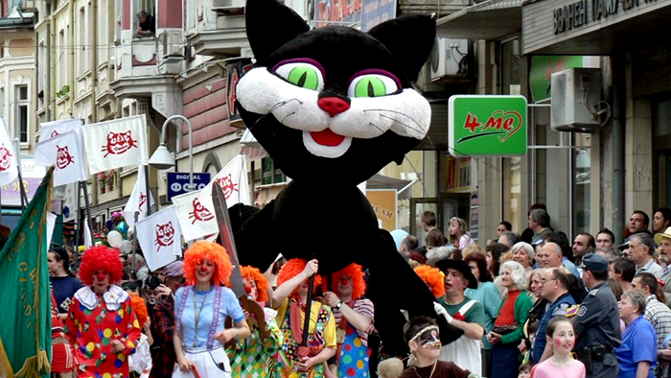
Humour carnival in Gabrovo
When: 16 May

