Slide 1
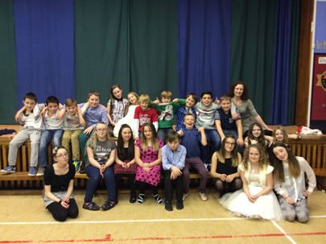
P7/6 Newsletter
May 2015
Our Learning – In Maths, we have been learning about co-ordinates, angles and compass points. We are moving on to Perimeter and Area this term, as well as weight and volume.
Functional Writing will be our focus this term, looking at instructions, letters, posters and leaflets. These will be particularly useful as we prepare for our school show.
Our Expressive Arts and Enterprise outcomes will be covered through the production of our school show.
This year’s CAB conference, on the 24th March, demonstrated what can be achieved when we all work together as a school community. It was another great opportunity to meet up with our friends from all the Blackburn schools.
Dates for your diary –
Rotary Quiz – Wed 20th May
School Show – 28th May
Blackburn’s Got Talent – Fri 5th June
Gala quiz – Tues 9th June
St Kent’s transition – 9-10th June
B Acad transition – 9-12th June
Gala Day – Sat 13th June
P7 leavers’ assembly – Wed 24th June
P7 Disco – Thurs 25th June
Church Service – Fri 26th June
End of term – Fri 26th June
Thank you to everyone who supported our Science afternoon, giving us the opportunity to share our learning and demonstrating the progression of science throughout the school. We thoroughly enjoyed ourselves – we hope you did too!
A wee reminder –
Indoor shoes must be provided as they are required to be worn, in school
Hoodies should not be worn, as they are not part of the school uniform.
THURSDAY NIGHT FEVER! – WITH M.fm
THURSDAY 28TH May 2015, 1.45pm/6.30pm
Please put this date in your diary!
P6 and P7 pupils are taking to the stage to perform an original show, which promises to be entertaining and lively! They will be singing and dancing their way through some musical favourites - audience participation will be actively encouraged!
Warm up those vocal chords, we look forward to seeing you all on the 28th!

