Slide 1
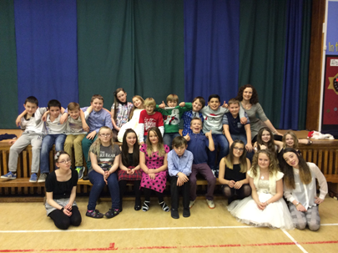
P7/6 Newsletter
January 2015
We have been really busy since we came back after the holidays!
We have already started working with the visiting peer educators in preparation for our participation in the CAB conference.
Learning this term – In Maths, we have been looking at symmetry and will be learning about co-ordinates, angles and compass points. Mrs Stewart will be setting us some challenges to give us the opportunity to demonstrate our knowledge and skills.
We have been doing really well with our French and will work on reading and writing skills, as well as continuing our listening and talking skills. We will soon be able to have short conversations about the Weather and Seasons!
Our writing will focus on imaginative stories, beginning with creating detailed character descriptions. We will also be learning about the structure of Japanese Haiku and Tanka poems, and writing some of our own.
We’ve been getting to know our new Acting Principal Teacher, Ms Taylor, who has been teaching us Basketball skills.
WW1 – was a fascinating topic and we learned so much, particularly when we had the opportunity to visit the replica trench at Bathgate Partnership Centre. We also had a handling box session, as well as a visit from Tom, who brought in some WW1 uniforms and memorabilia.
Japan – is our new topic this term, and we have all been involved in the planning of our learning.
Our work in Maths, with co-ordinates and compass points, will help with this Geography-based topic.
Dates for your diary –
Wed 4th Feb – Community Ceilidh
Fri 13th Feb – Holiday
Mon 16th Feb – Holiday
Wed 4th Mar – Parent Council meeting
Tue 24th Mar – CAB Conference
Thur 26th March – Parent Consultations
Thur 2nd April – Easter Service
Fri 3rd April – Easter Hols begin
A wee reminder –
Full P.E. Kit is required on Mondays and Tuesdays
Indoor shoes must be provided as they are required to be worn at all times, in school
We are looking forward to joining our friends from the other Blackburn school, when we take part in the Community Ceilidh on the 4th February.
Skillionaire – Our new school award system! This new approach is a fantastic way of understanding the skills we are using for specific tasks and learning throughout the week. We record it in our profile folders, so that we can review our learning over the year, and be able to see the vast array of skills we can actually use and apply across the curriculum.

