Slide 1

Mid Calder Primary School
P1 Meet the Teacher
September 2020

Slide 2
Structure of the School Day
Monday to Thursday
8.00 Breakfast Club (Optional)
8.25 Soft Start supervision
8.40 School Day starts
9:00 Morning Session 1
10.15 Interval
10.32 Morning Session 2
11.50 Lunch
12.30 Afternoon Session
15.00 End of School Day

Slide 3
Structure of the School Day
Friday
8.00 Breakfast Club (Optional)
8.25 Soft Start supervision
8.40 School Day starts
9:00 Morning Session 1
10.15 Interval
10.32 Morning Session 2
12.25 Home

Slide 4
Weekly Timetable
 | 8:40 -9:00 | 9:00 – 9:50 | 9:50- 10:15 | 10:15- 10:32 | 10:35 – 11:45 | 11:50- 12:30 | 12:30-2:00 | 2:00-3:00
Monday | Soft Start Registration, Lunches | Literacy (Phonics/Reading) | Story, Milk & Snack | B | Maths/Numeracy | L | P.E. HWB
Tuesday |  | Literacy (Phonics/Reading) |  | R | Maths/Numeracy | U | RCCT EB – Outdoor Learning | IDL
Wednesday |  | Literacy Writing |  | E | Maths/Numeracy | N | RCCT EB – Outdoor Learning | IDL
Thursday |  | Literacy (Phonics/Reading) |  | A | Maths/Numeracy | C | HWB | Expressive Arts
Friday |  | Literacy (Phonics/Reading) |  | K | Maths/Numeracy | H

Slide 5
School Uniform
Grey trousers/skirt/ shorts and white shirt/blouse and red & grey striped school tie (grey/red cardigan optional)
OR
Grey trousers/skirt / shorts and red school polo shirt with school badge and grey school sweatshirt with school badge
OR
Summer: Red and white gingham dress with red or grey cardigan
P.E. Kit White t-shirt (school logo optional)
Black shorts
Gym shoes
Please note that as there is No Indoor PE at the moment, a
PE kit is not currently required in school.
Suitable clothing for Outdoor Learning on Tuesday and Wednesday
PLEASE NAME EVERYTHING!

Slide 6
Lunchtime Reminder
School lunches are ordered daily through iPay Impact. All P1-3 children are entitled to a free school meal.
You can look at the lunch options with your child and pre order from home.
OR
Children can order independently in class each morning.

Slide 7
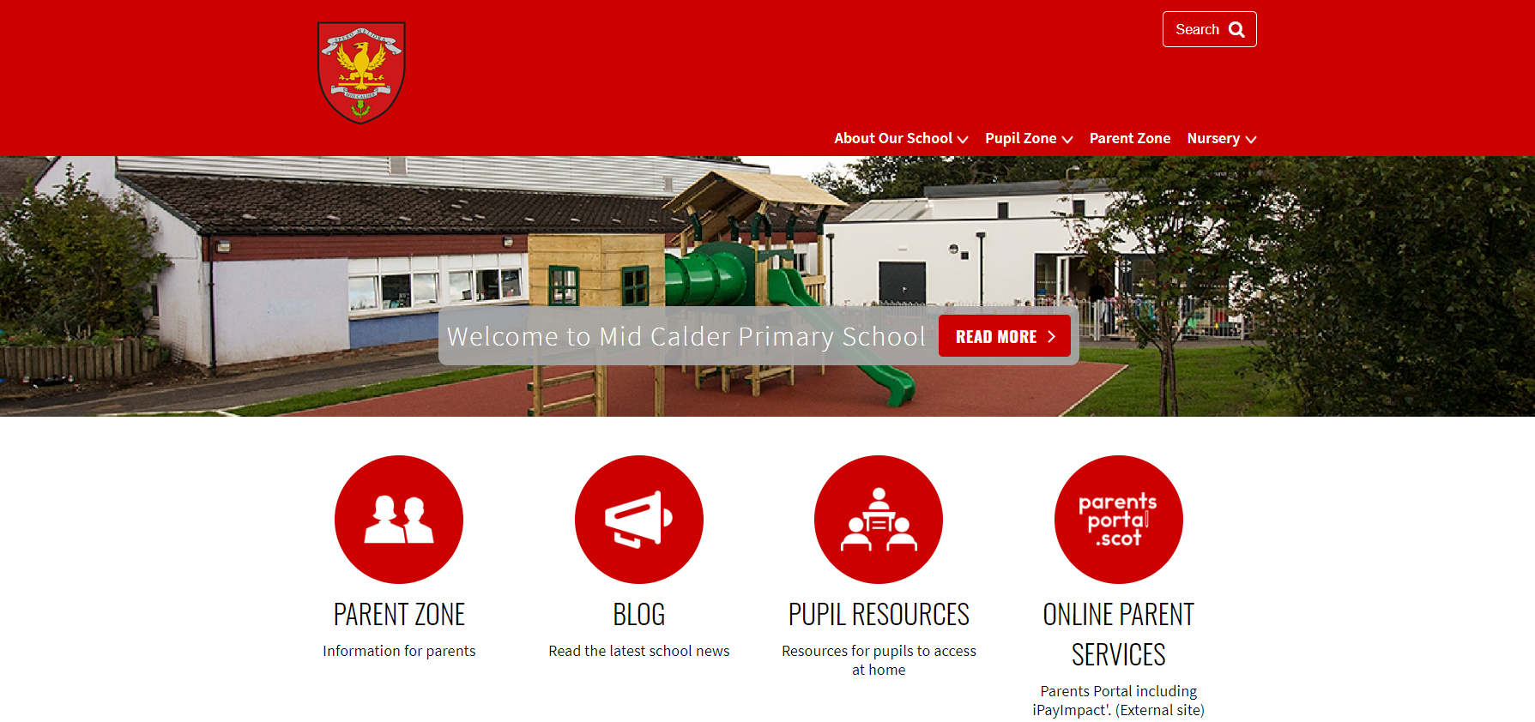
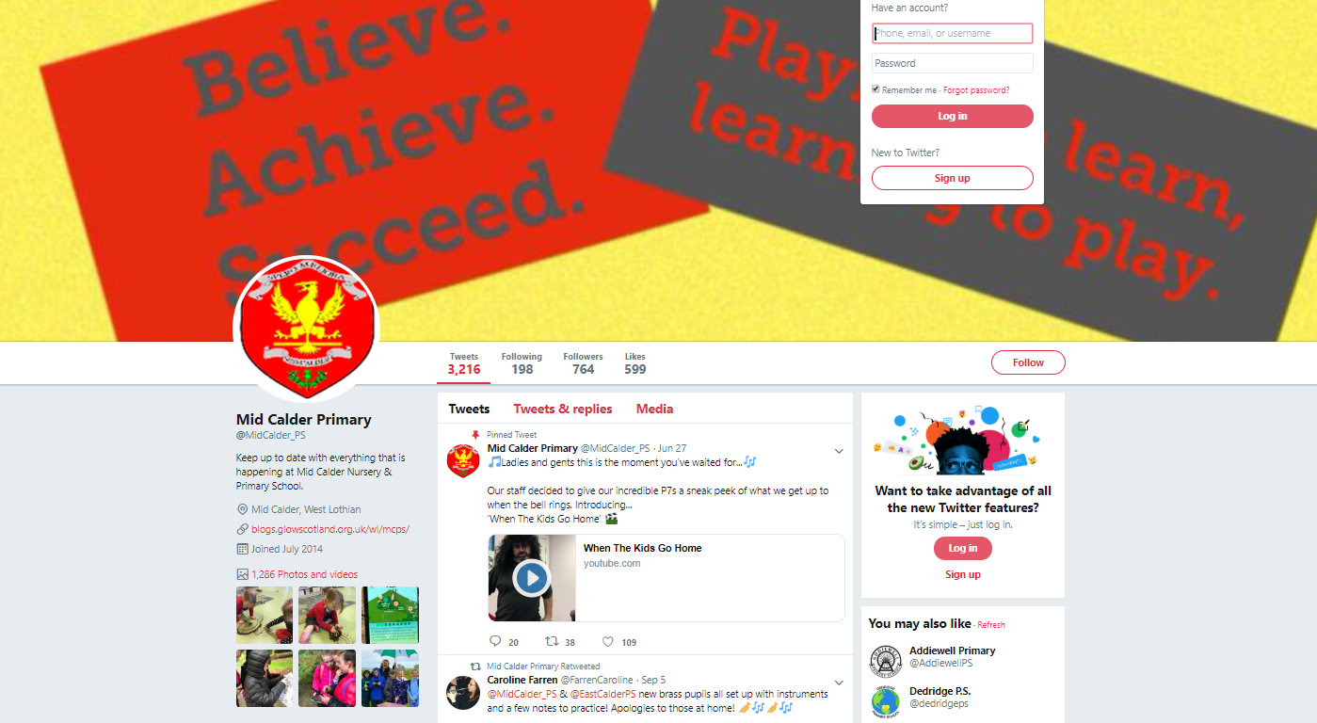
Keep in touch through -
Blog: https://midcalderprimary.westlothian.org.uk/
Twitter: @MidCalder_PS

Slide 8
Important Documents
Please return the photo permission forms and EE2 forms as soon as possible if you haven’t already done so. We cannot share any photos to twitter or the school blog until these are all returned.
Please ensure that all medical forms are filled in fully and handed back promptly with any appropriate medication.

Slide 9
IDL (Topic) In P1
We will be using consultative planning methods (such as Floorbooks and Talking Tubs) and the contexts for learning will come from the children.
The focus and content of the IDL will be specific to interests of the class.
This term, our learning context in P1 will begin with “Toys”.

Slide 10
Literacy – Colourful Consonants
Children will participate in various activities which will develop :
  Sound recognition
  Letter formation
  Recognition of the position of sounds in a word (beginning, middle and end sounds)
  Blending sounds
  Tricky words

Slide 12
Literacy – Reading
Children may initially be sent home with wordless books and/or picture books for you to read with them.
Oxford Reading Tree will be our main reading scheme to begin with.
Jolly Phonics readers may also be sent home when your child is able to confidently recognise and blend the first 42 Jolly Phonics sounds.
Each book comes with a set of key words to practise at home before reading.

Slide 13
Literacy – Reading
Other resources that may be used include:
Oxford Reading Tree books – fiction
Dandelion readers - fiction
Snapdragon books - fiction
Fireflies – non-fiction
Rhyme books

Slide 14
Literacy – Writing
Black pen drawings
Writing from own experience
Teacher modelling writing
Children use emergent writing
Teacher may scribe the story as the child tells it
Begin to use the PM Writing scheme to write Descriptions and Recounts

Slide 15
Numeracy and Maths
Number will be taught through active tasks. This will develop skills in:
  Number structure from 0 to 10 and beyond – dot patterns, finger patterns, tally marks five/ten frames, rekenreks
  Numeral Identification
  Forward and backward number word sequences
  Counting in steps of one, two, five & ten
  Formation of numbers
  Addition and subtraction within 10 and beyond
  Sharing and Grouping

Slide 16
Numeracy and Maths
Beyond Number:
  Sorting and matching
  Pattern
  2D shapes and 3D objects
  Recognising and using coins
  Information handling
  Time -days of week, months of year, seasons, key dates, o’clock

Slide 17
Homework Folders
P1 homework folders will include:
Reading record (Purple Book)
Reading books
Homework Jotter to record any tasks
ORT Key words keyring
Tricky words keyring
Spelling Grids, Numeracy Grids and IDL Grids will be uploaded to the Blog during the first full week back after the September holiday.
These will provide different ideas for practising spelling and number.
**Please note that Reading Records (Purple Books) will not be looked at every day. Ensure important notes/messages are passed to a member of staff.**

Slide 18
Homework
Whilst homework is not compulsory, we would strongly recommend that you read regularly with your child.
If you choose to do Spelling, Maths and IDL (Topic) homework, then you may complete tasks from the homework grids at a pace that suits you and your child.
If you would like the class teacher to look at any completed activities from time to time, then feel free to send the homework jotter back to school.
All jotters will be kept in a safe resting place for 72 hours before being returned to you.

Slide 19
Reading Homework
Reading Homework will be given out on a Monday and should be returned on a Friday
ORT Key words will be added to the keyring as they are covered in class. Please go over these regularly
Please feel free to write a comment in the Reading Record book.

Slide 20
Homework – Ideas to Support
Reading at Home
Look at, and discuss the front cover, back cover, spine, blurb, author and illustrator.
Look at the pictures and talk about them together.
Stop at different parts and predict what will happen next. Also discuss the sequence of the story (Beginning, Middle, End or First, Next, Then, Last).
Look at sentence structure (capital letters, full stops, finger spaces etc.)
Look for known tricky words and sounds (Your child may begin to attempt to blend sounds together to read simple words).
Try to relate the themes in the book to your child’s own experiences.
Also allow time for your child to explore the book independently after reading it together.

Slide 21
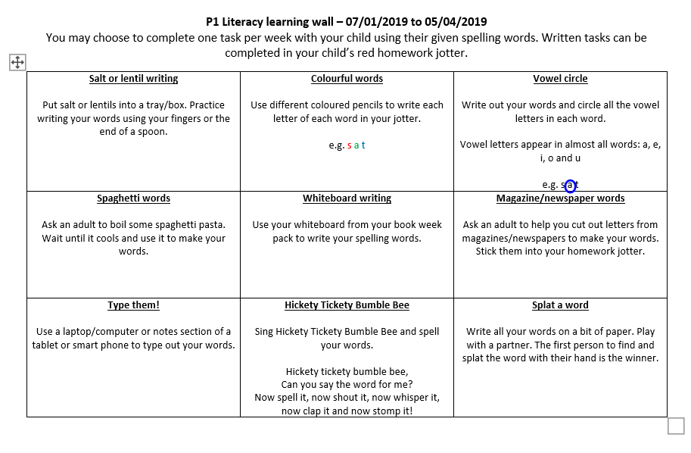
Homework – Spelling
Later in P1 your child will receive a list of Spelling words that they have covered in class.
You may want to discuss these words with your child, and complete one of the tasks from the literacy grid in the homework jotter.

Slide 22
Homework – Tricky Word Keyring
Your child’s Tricky Word keyring will build up a list of tricky words that they will gradually cover in class.
Please practise the tricky words provided on a regular basis with your child to increase their word recognition and fluency when reading.
When we start a new set of tricky words, these will be added to the keyring as soon as possible.
It is important to revise all tricky words on a regular basis.

Slide 23
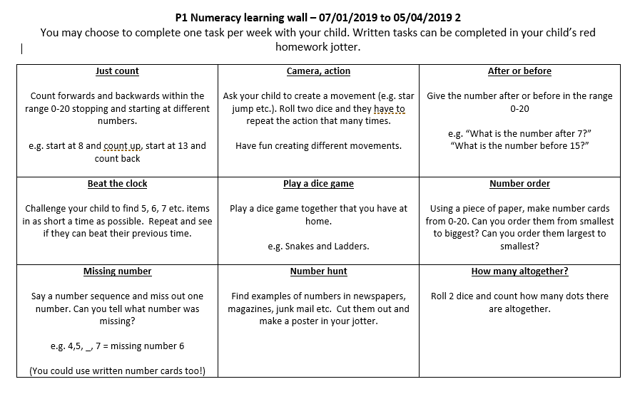
Homework – Numeracy
You may want to complete one of the active learning tasks on the numeracy grid.

Slide 24
Dojo Points for Living the School Values (Respectful, Responsible, Friendly, Successful, Inclusive and Enthusiastic)
Living Our Values certificate at our Virtual Assembly
Sharing success and achievements in class with peers
Mid Calder Magical Moments – sharing success and achievements with Mrs Thurlow and Mrs Ross through a video call on TEAMS
Celebrating Success

Slide 25
I can earn 25 minutes of free time on a Friday.
Each day I can earn 5 minutes of Friday free time by following the school’s Behaviour Policy and ending the day on the green circle.
I can use this time on Friday to play, draw, colour, relax and talk with my friends.
I can play games provided by school but at the moment I can’t bring in toys/games etc. from home.
Fun Time Friday

Slide 26
Thank you
for all your support, as the children continue to settle so well into Primary 1.

