Slide 2
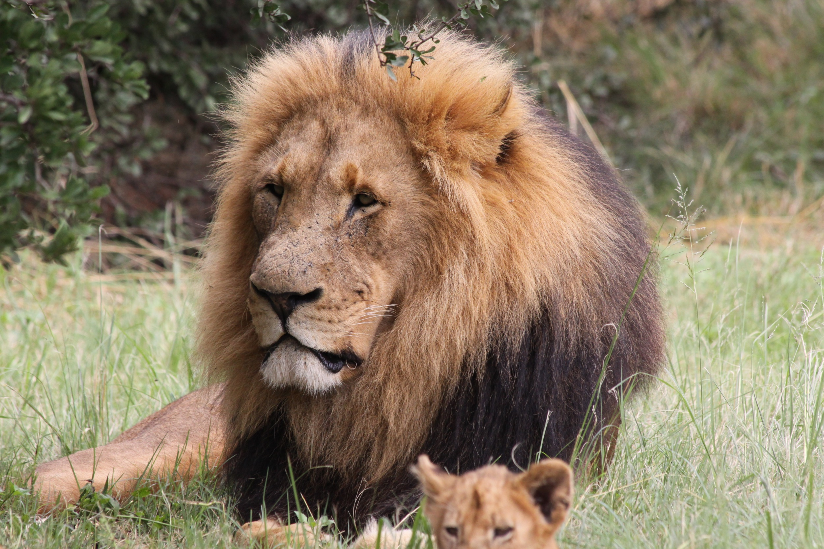
What zoo animal can you see?

Slide 3
Lion!
Photo courtesy of (Debbie Gilman@flickr.com) - granted under creative commons licence – attribution

Slide 4
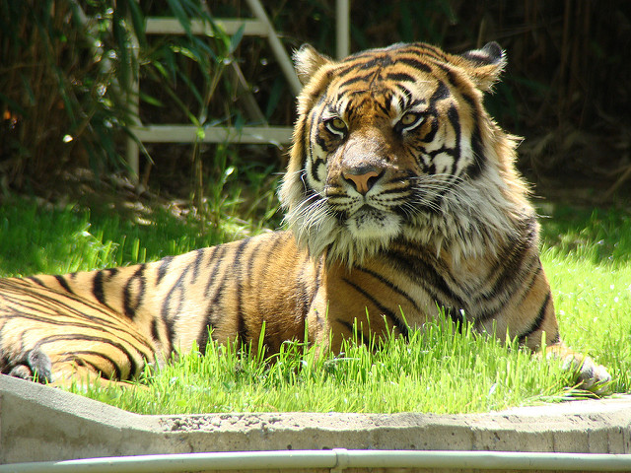
What zoo animal can you see?

Slide 5
Tiger!
Photo courtesy of (CW8647@flickr.com) - granted under creative commons licence – attribution

Slide 6
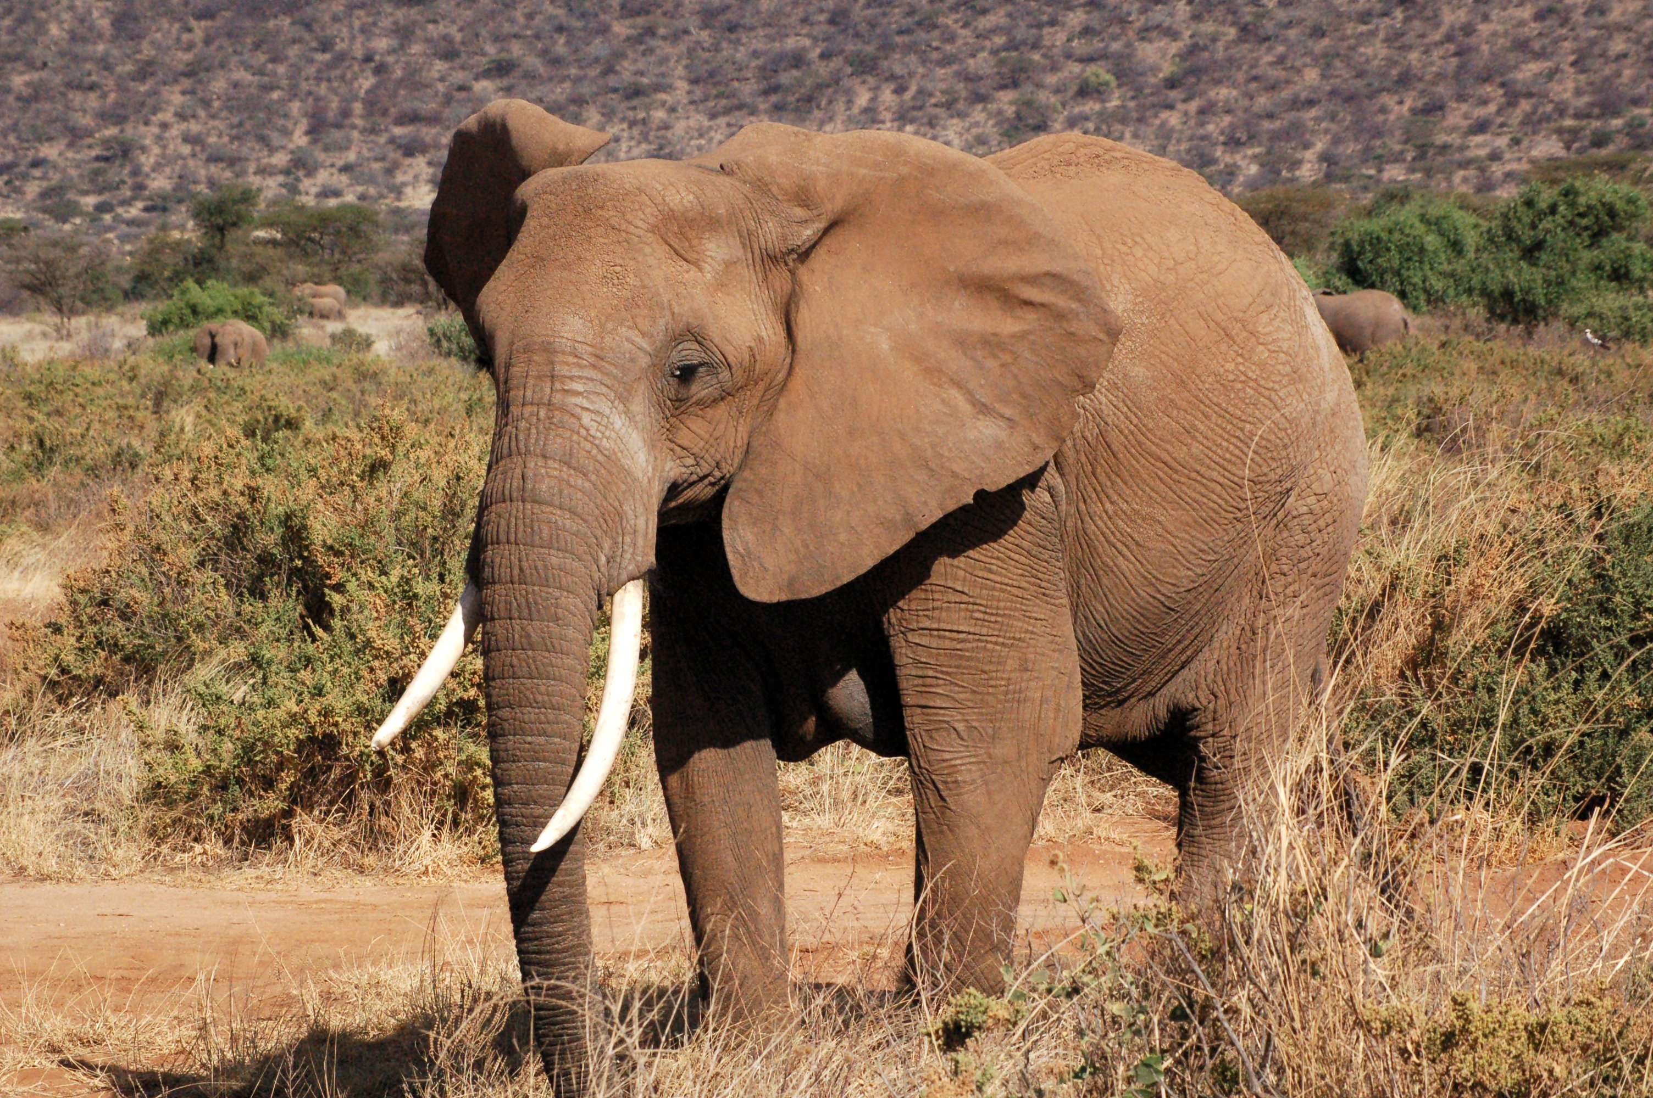
What zoo animal can you see?

Slide 7
Elephant!
Photo courtesy of (guillaume_1995 @flickr.com) - granted under creative commons licence – attribution

Slide 8
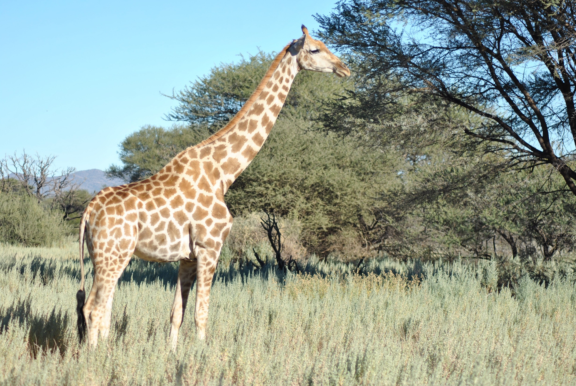
What zoo animal can you see?

Slide 9
Giraffe!
Photo courtesy of (Rachel Hobday@flickr.com) - granted under creative commons licence – attribution

Slide 10
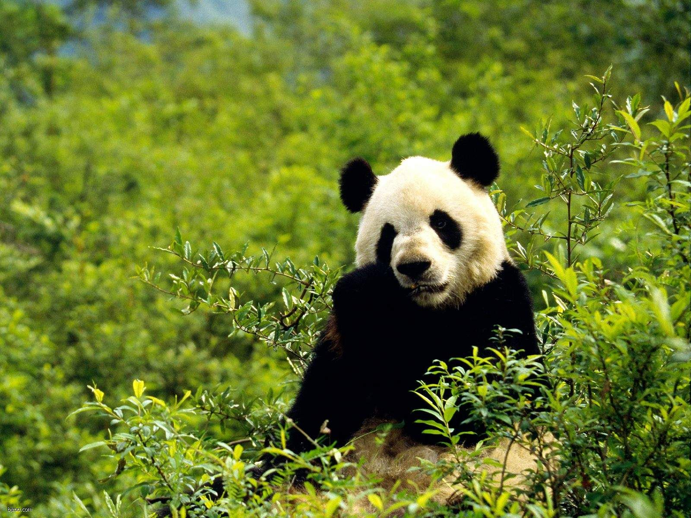
What zoo animal can you see?

Slide 11
Panda!
Photo courtesy of (ebread@flickr.com) - granted under creative commons licence – attribution

Slide 12
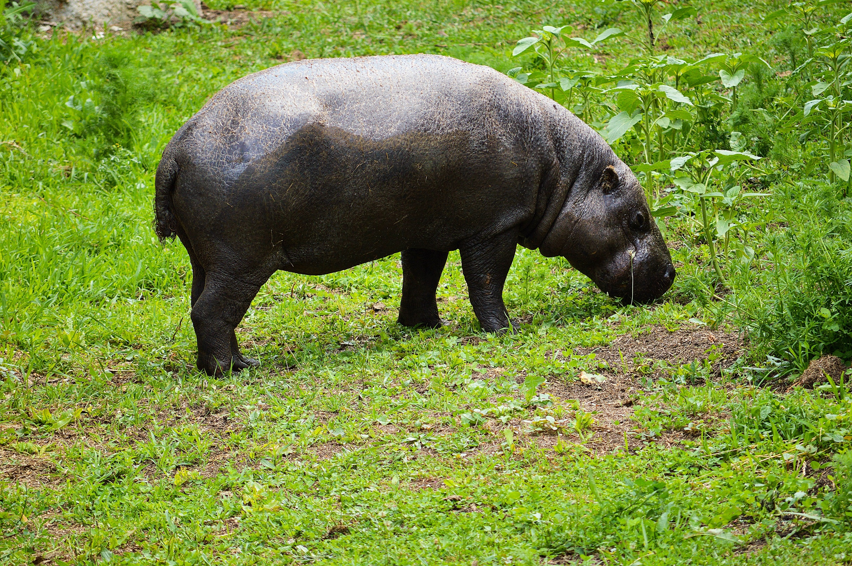
What zoo animal can you see?

Slide 13
Hippo!
Photo courtesy of (M Malinov@flickr.com) - granted under creative commons licence – attribution

Slide 14
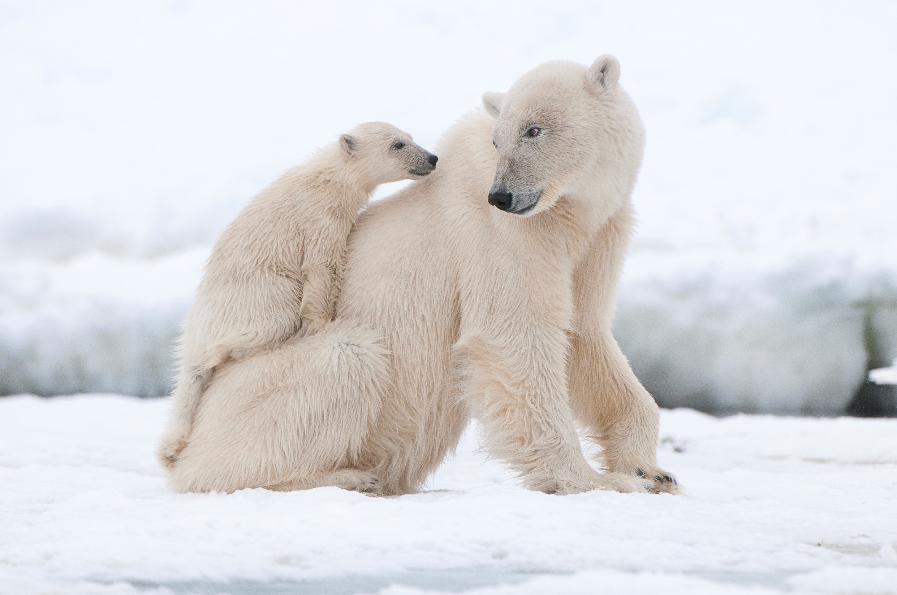
What zoo animal can you see?

Slide 15
Polar Bear!
Photo courtesy of (Highland adventures@flickr.com) - granted under creative commons licence – attribution

Slide 16
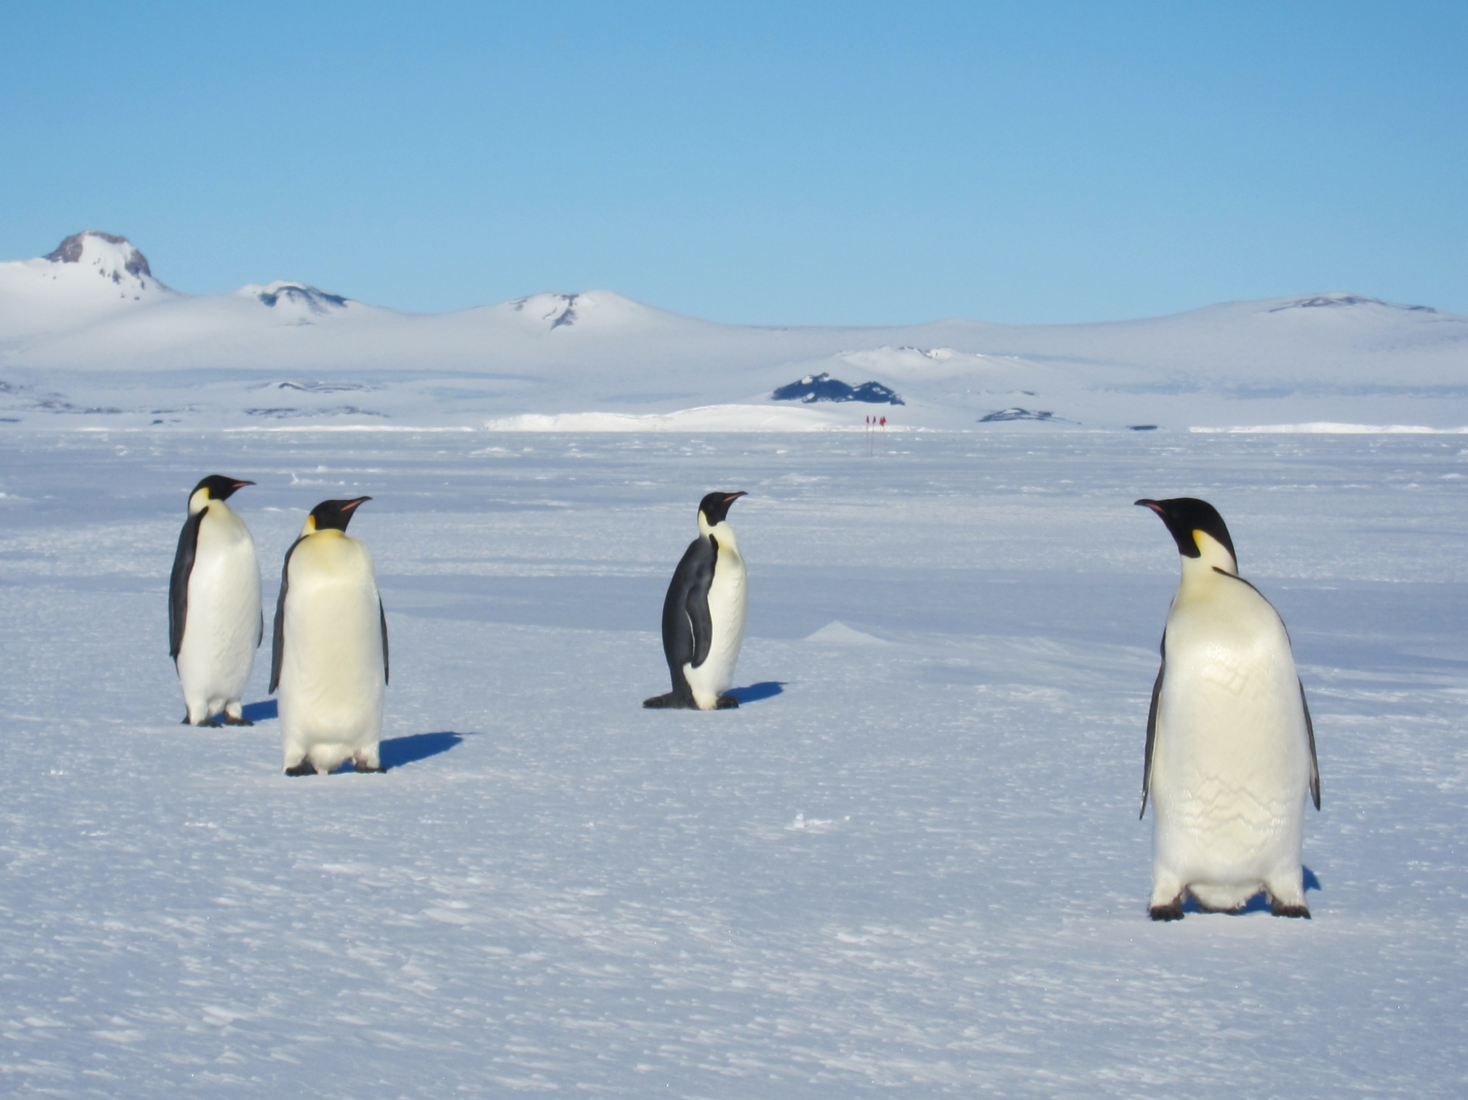
What zoo animal can you see?

Slide 17
Penguin!
Photo courtesy of (sandwich@flickr.com) - granted under creative commons licence – attribution

Slide 18
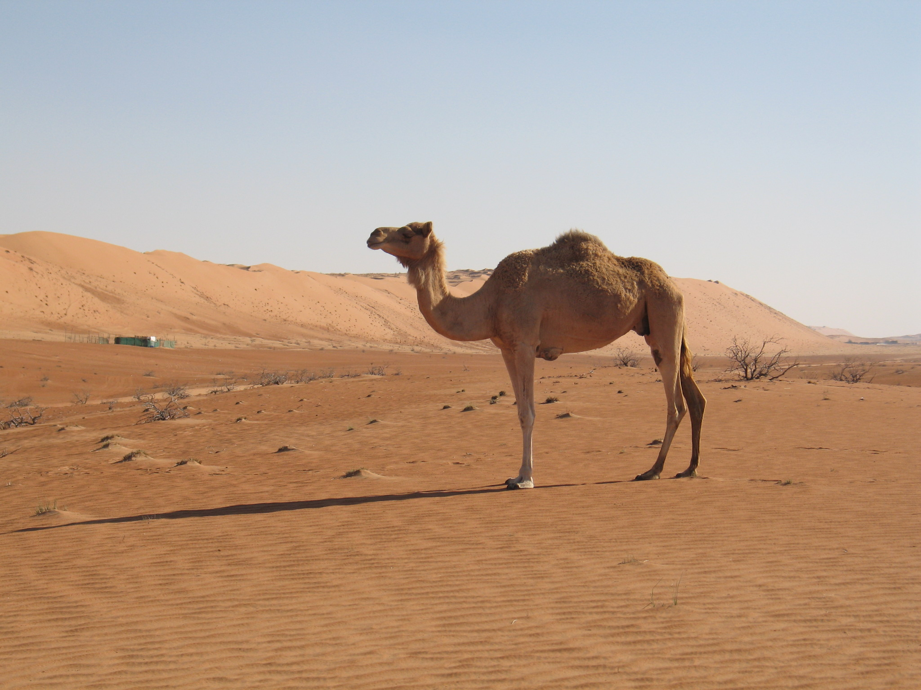
What zoo animal can you see?

Slide 19
Camel!
Photo courtesy of (gunter scheffold@flickr.com) - granted under creative commons licence – attribution

Slide 20
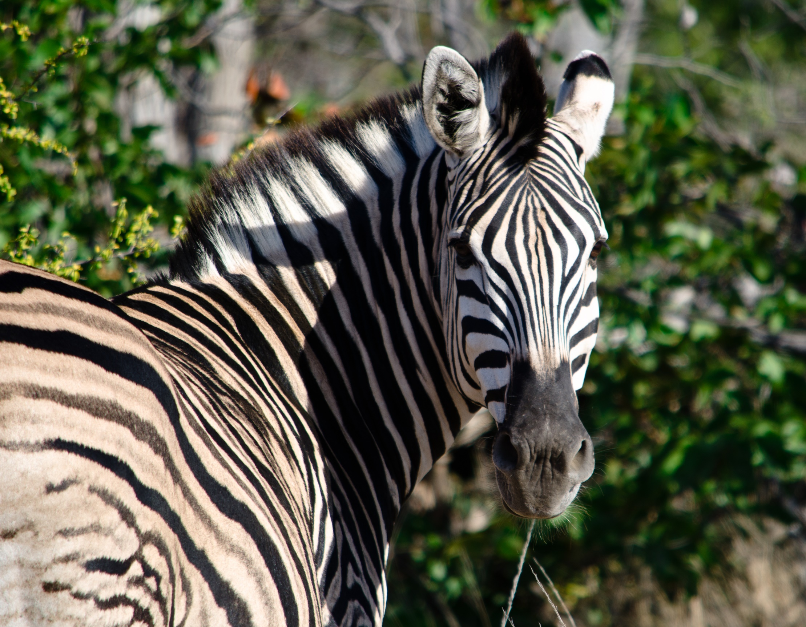
What zoo animal can you see?

Slide 21
Zebra!
Photo courtesy of (Andrew stewart@flickr.com) - granted under creative commons licence – attribution

Slide 22
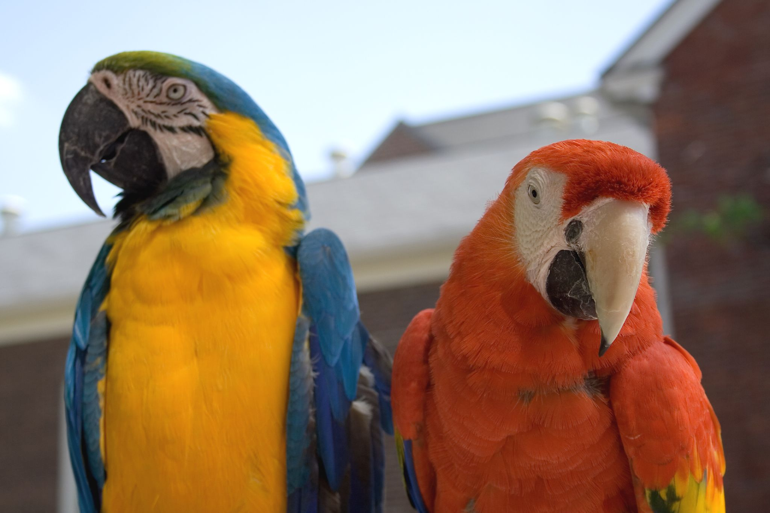
What zoo animal can you see?

Slide 23
Parrot!
Photo courtesy of (ruapehupalomino@flickr.com) - granted under creative commons licence – attribution

Slide 24
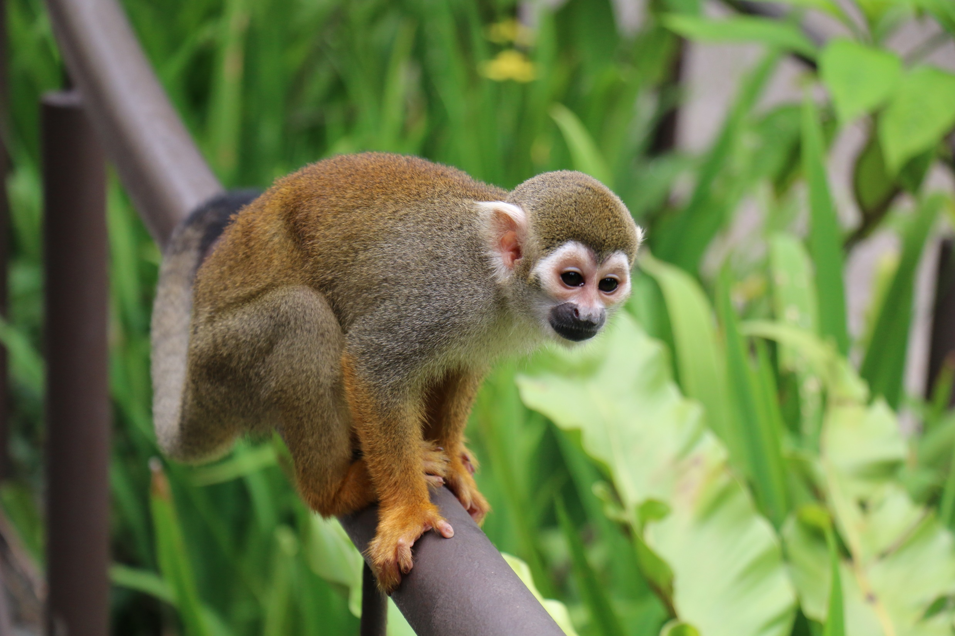
What zoo animal can you see?

Slide 25
Monkey!
Photo courtesy of (Tan 88@flickr.com) - granted under creative commons licence – attribution

