Slide 2
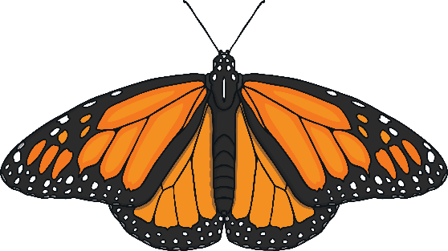
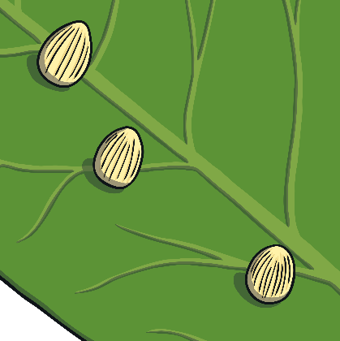
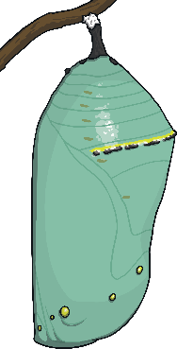
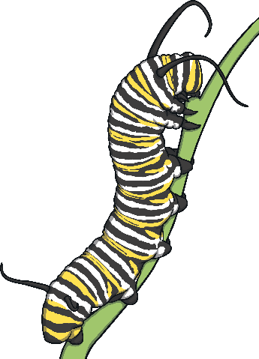
Butterflies go through many changes in their lifetime.
This is called the life cycle of a butterfly.

Slide 3
Butterfly Life Cycle
First, a butterfly lays her eggs on a leaf; usually the leaf of a milkweed plant. The milkweed plant is a butterfly’s favorite food.

Slide 4
Butterfly Life Cycle
The caterpillar begins to eat its way out of the egg. It will eat the leaves on the plant it was born on. It will continue to eat and eat until it grows very large.

Slide 5
Butterfly Life Cycle
The caterpillar will shed its skin several times as it grows. Once it becomes very large, it will make a chrysalis. It will undergo a change called a “metamorphosis,” inside the chrysalis.

Slide 6
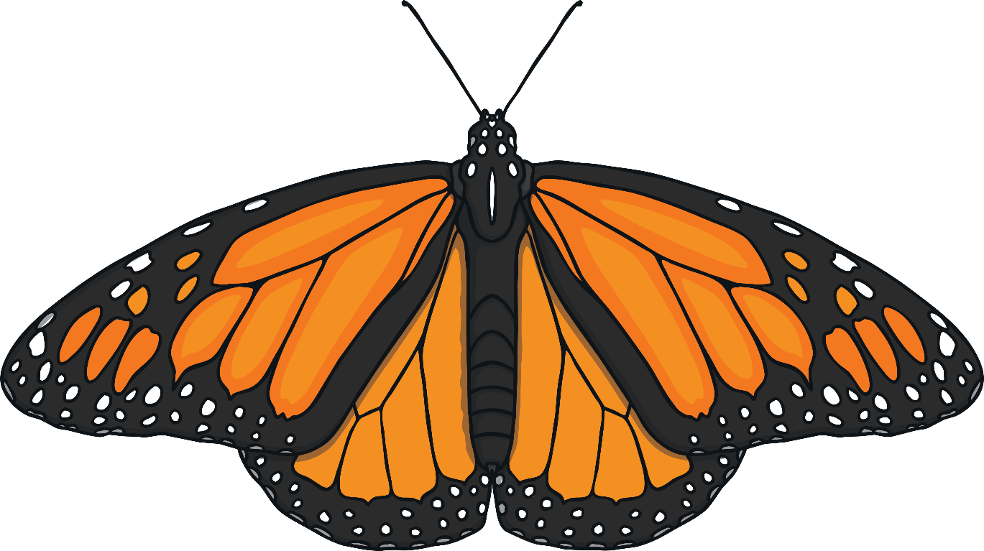
Butterfly Life Cycle
After two weeks, the butterfly emerges from the chrysalis. Its wings are wet and small at first. It takes several hours for the butterfly’s wings to dry. Once they are dry, the butterfly can fly away and look for food.

