Slide 1
Human life cycle activity
1) Now it is your turn. You need to be a detective and find pictures of you or a member of your family and order the pictures into the several stages we just learnt.
If you have still any doubt about the stages. Watch this video bellow:
https://www.youtube.com/watch?v=B0OhSug65oA

Slide 2
Human life cycle activity
2) I am going to attach you a few pictures of myself and you will need to put them in order.
I hope you like them☺

Slide 3
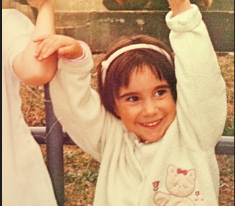
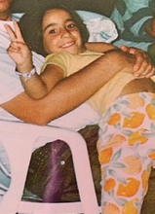
Me as a baby
Me as a toddler
Me as a child
Me as a teenager
Me as an adult

